Slide 1

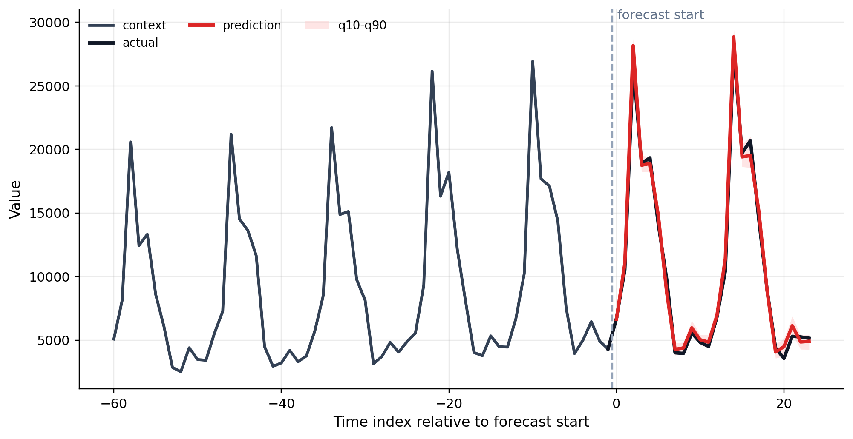
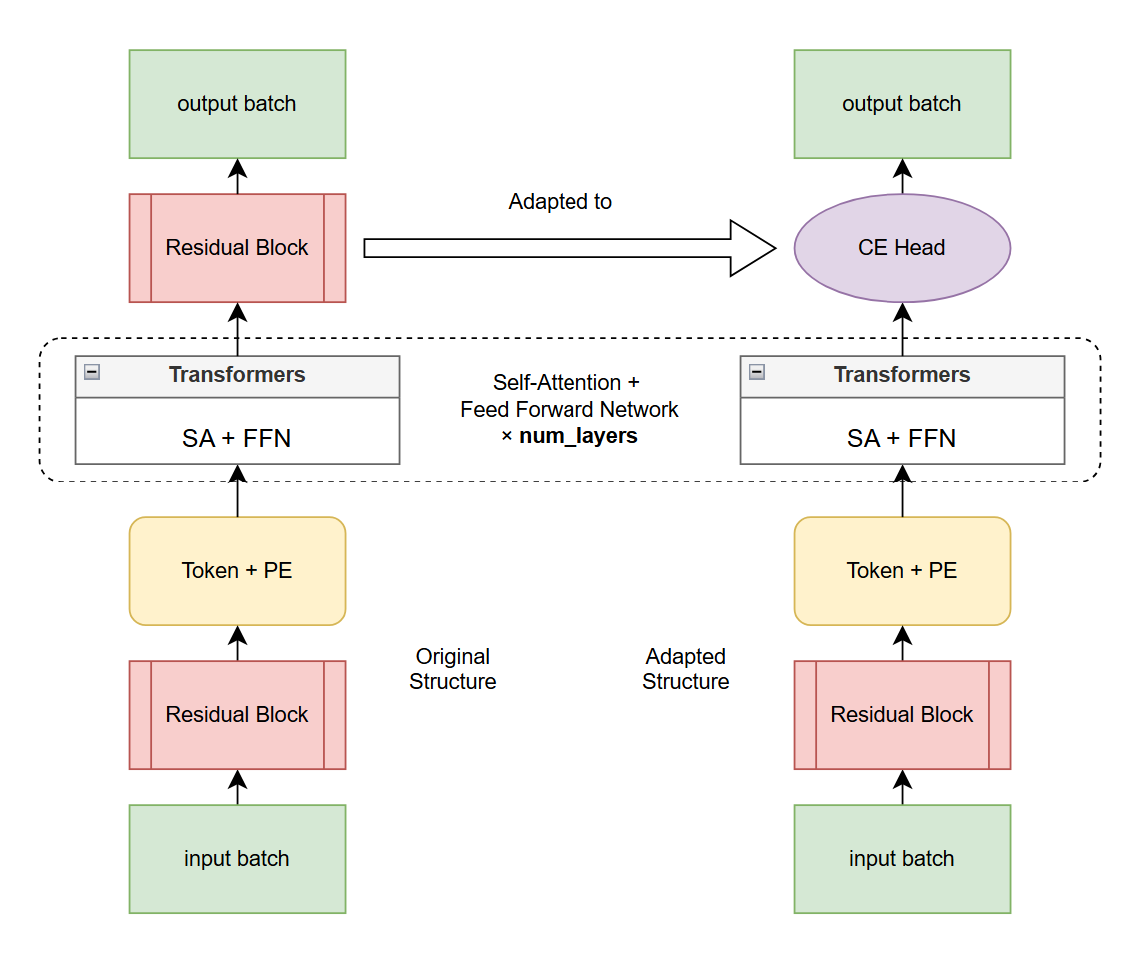
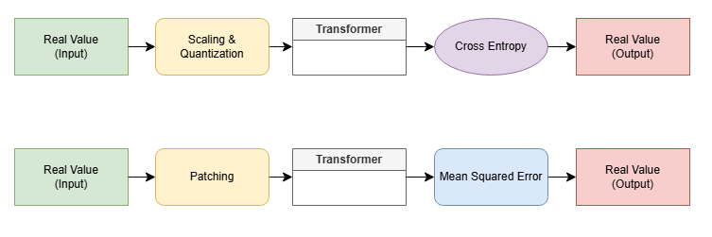
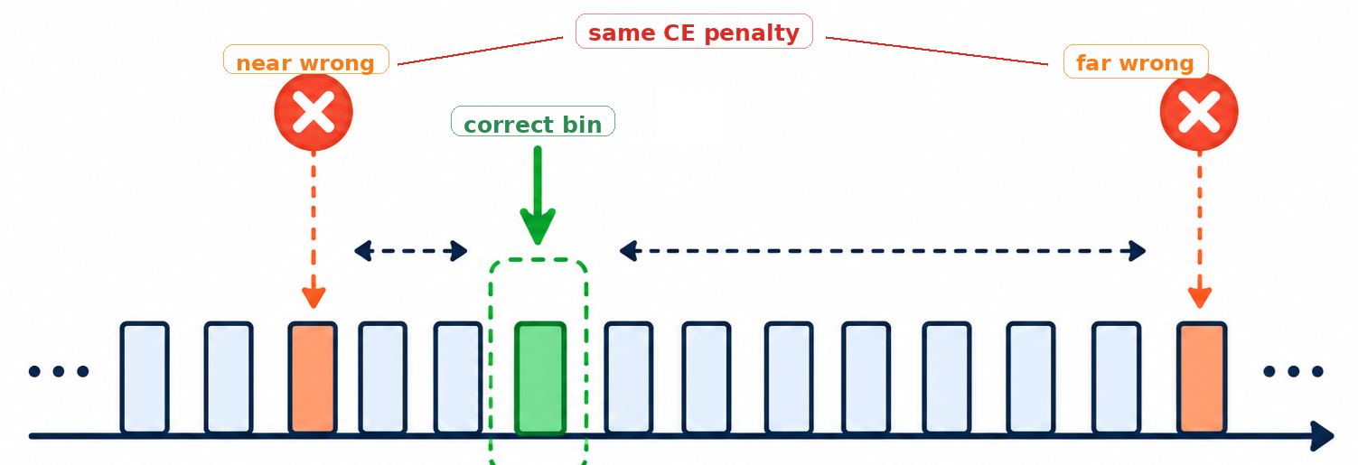
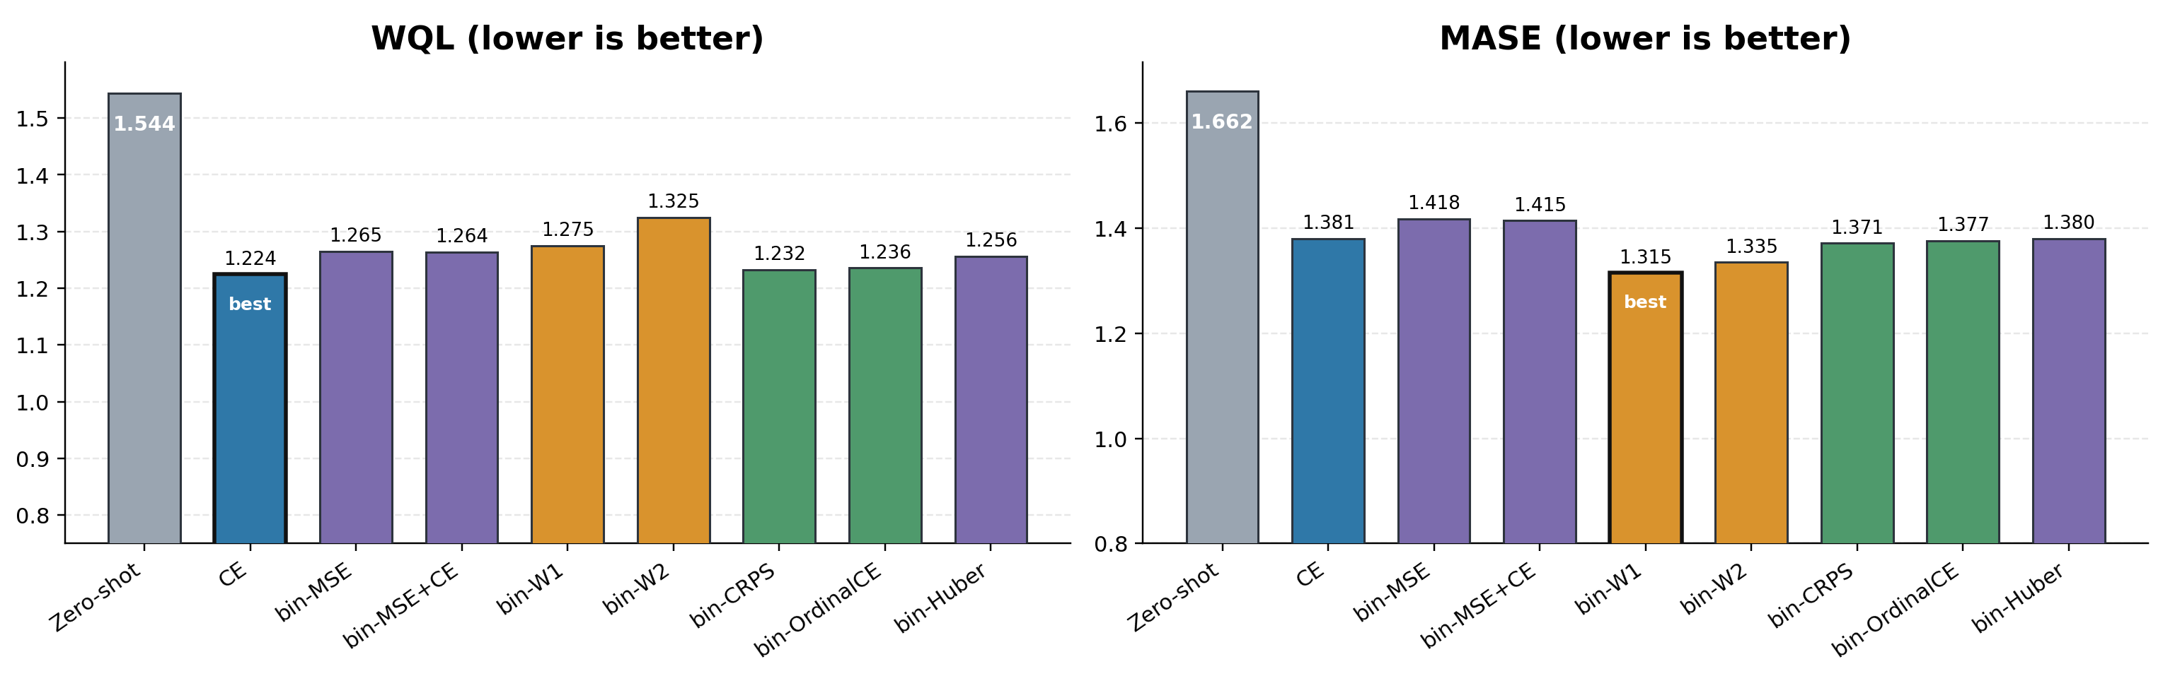
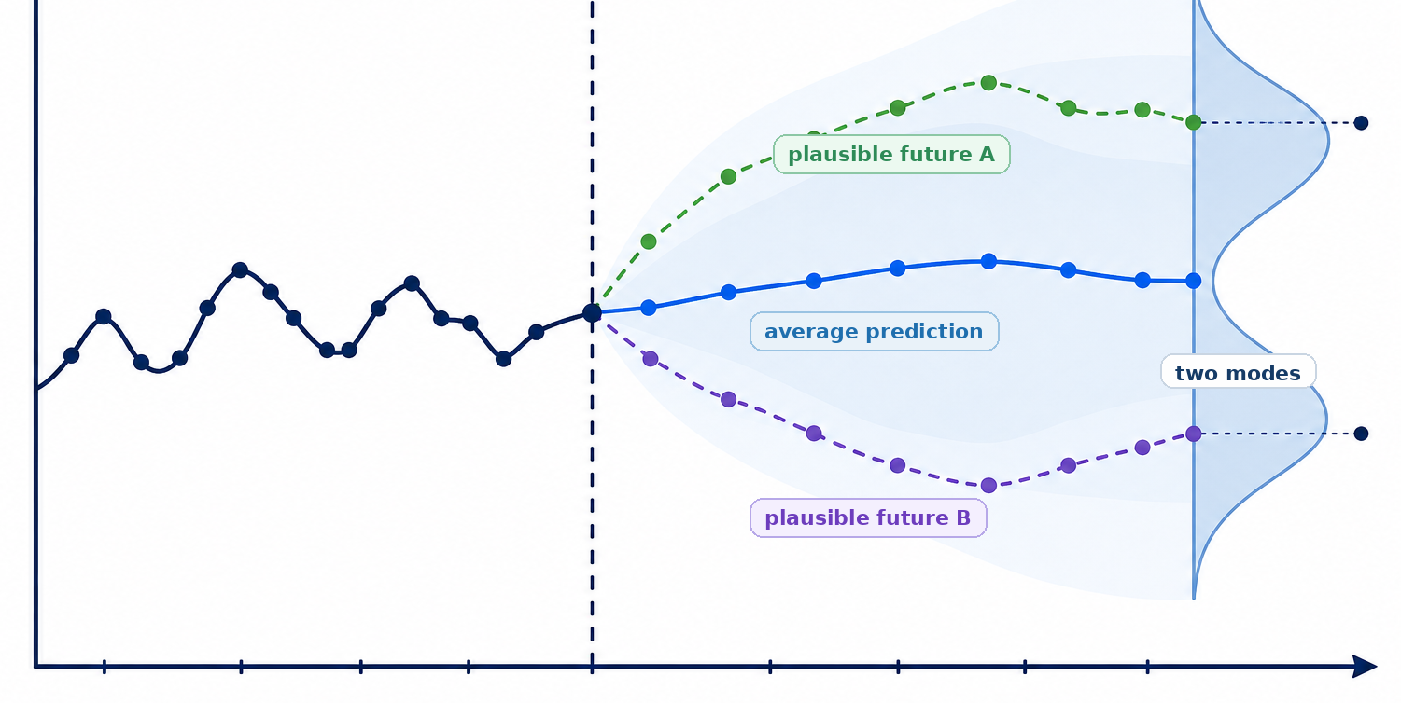
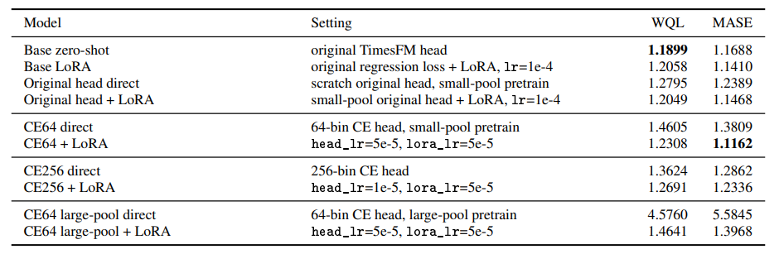
Bridging the Gap Between Numerical and Categorical Objectives in Time-Series Foundation Models: Loss- and Head-Level Adaptation
Yewei Huang (istina@sjtu.edu.cn)
Shanghai Jiao Tong University
Background
Our Approach
Time Series Forecasting
Route A: Loss-Level Adaptation for Chronos
Keep the Chronos-T5 architecture, tokenizer, and backbone fixed, and apply LoRA fine-tuning while changing only the training objective.
Route B: Head-Level Adaptation for TimesFM
Route B adapts TimesFM at the output-head level. We keep the TimesFM backbone fixed and pretrain a new CE-style discretized prediction head, then apply downstream LoRA fine-tuning for the forecasting task.
LLM-based Forecasting: Chronos & TimesFM
Chronos, with CE error:
TimesFM, with MSE error:
Terminologies
Forecast Horizon:
The future time steps the model needs to predict.
Context Window:
The past observations given to the model as input.
Discretization / Bins:
Continuous time-series values are mapped into discrete token bins. This is central to Chronos.
Cross-Entropy Loss, CE:
A classification loss over bins. It treats prediction as choosing the correct discrete class.
Numerical Loss, MSE / MAE / Huber:
Regression-style losses that penalize numerical distance between prediction and target.
Experiments
Setup
Dataset: Evaluate: Monash tourism_monthly, 24-step forecasting. Pretrain CE head: M-series datasets, weather, electricity, traffic, web traffic, rideshare, vehicle trips, KDD Cup 2018, COVID deaths, NN5, and FRED-MD.
Challenges
Metrics: We report WQL (weighted quantile loss) and MASE (mean absolute scaled error); lower is better.
Classification ignores distance: in plain CE, nearby and far-away wrong bins are both wrong classes.
Baselines: For route A, the baseline is standard CE + LoRA fine-tuning setup; For route B, the baseline is the original zero-shot model and the original regression-head LoRA setting.
Results
Left to right: Zero-shot, CE, bin-MSE, bin-MSE+CE, bin-W1, bin-W2, bin-CRPS, bin-OrdinalCE, bin-Huber
Regression is conservative: numerical losses favor average-looking forecasts.
ACM Class
https://acm.sjtu.edu.cn

