Slide 1

Connecting the Past with the Present…
Overcoming Bad Data Management with ETL

Slide 2
Problem- Previous management did not create a central warehouse of well data

Slide 3
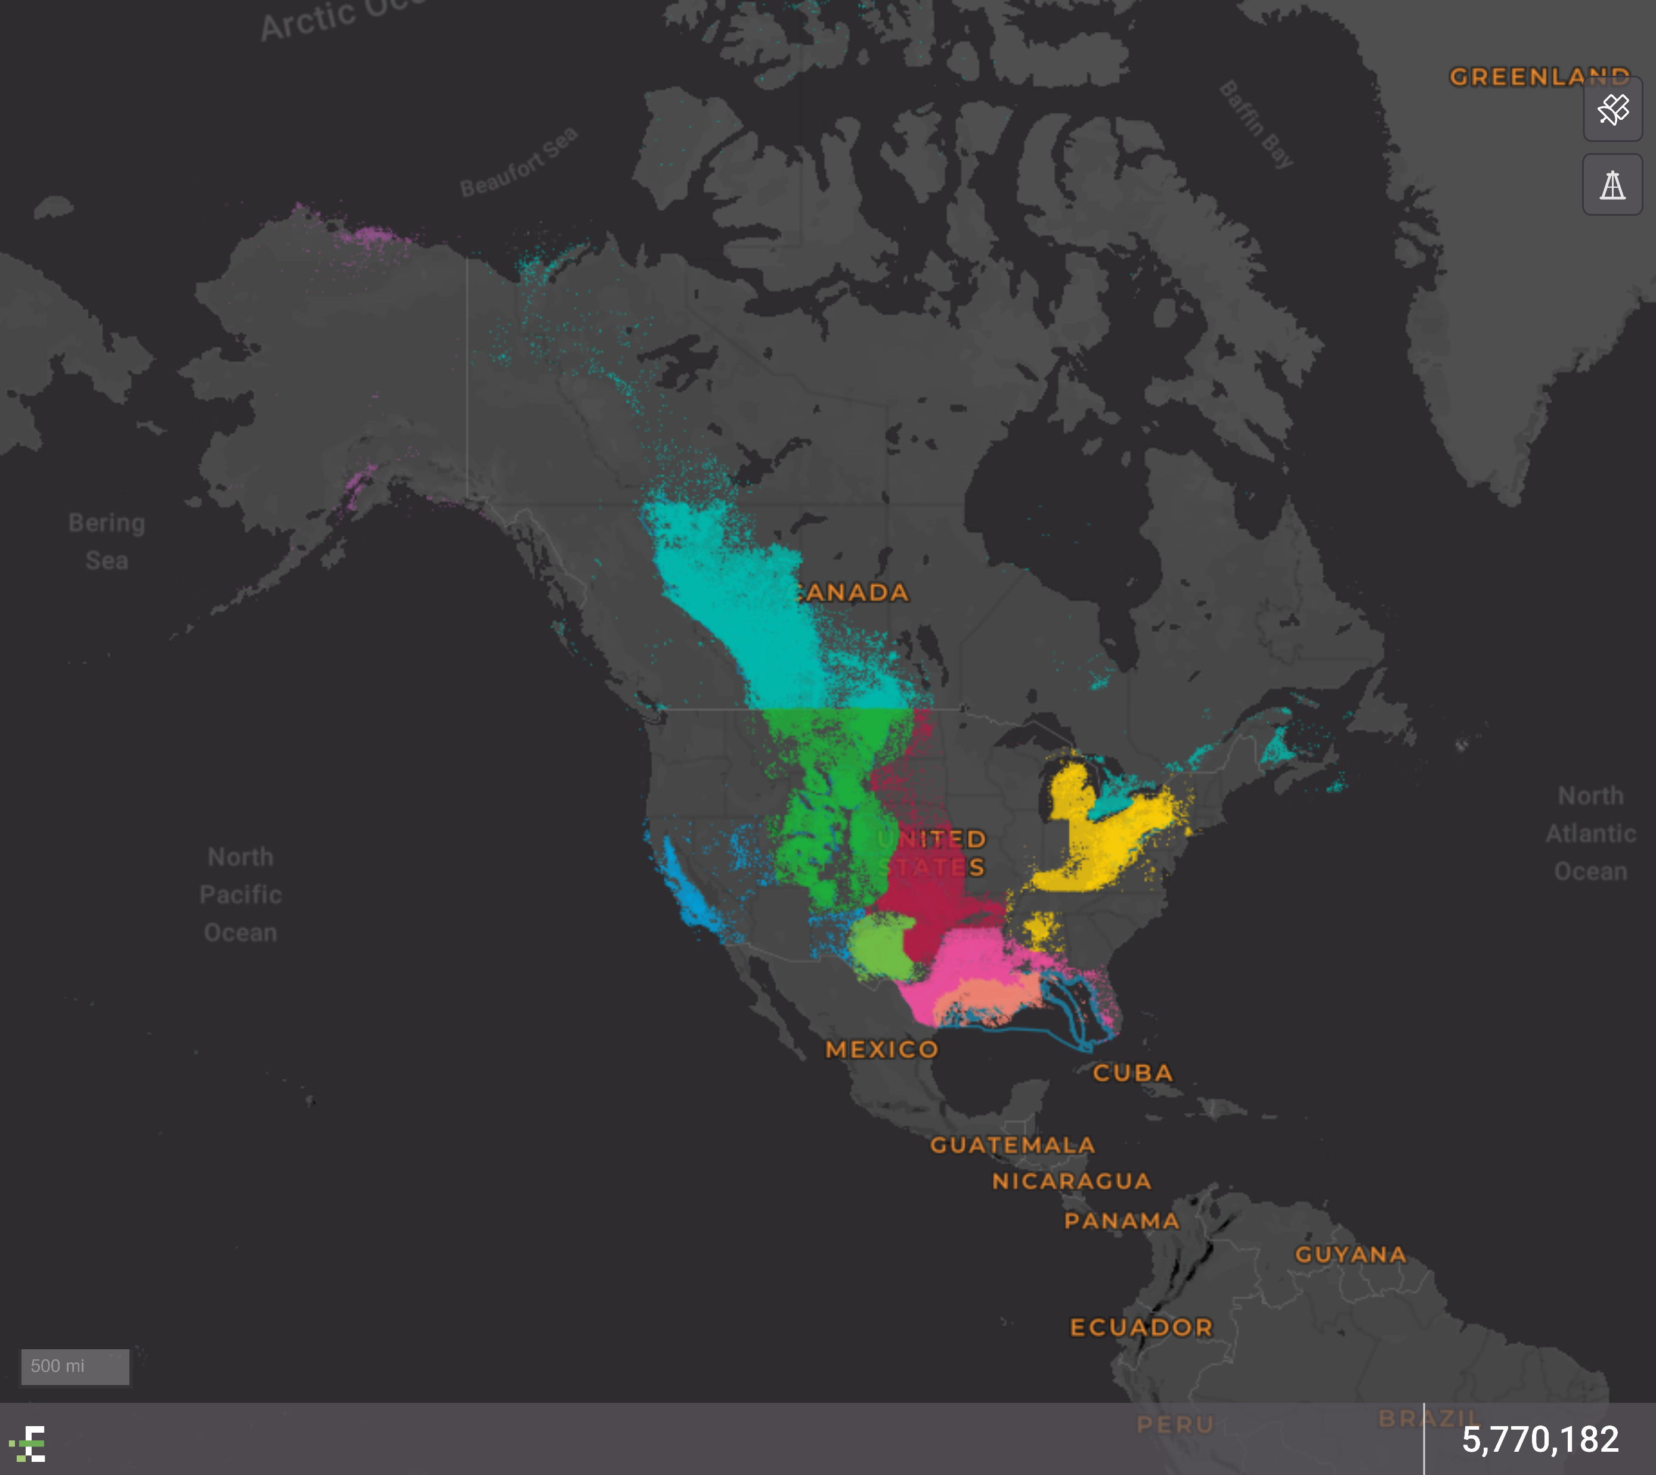
When we want historical data we have to go to a third party site such as Enverus to get it. A map of their data coverage of the US is below. They have over 5.7MM wells in their database. But they do not provide daily production, data we need to run our business, only monthly.

Slide 4
Solution…let’s use ETL to combine the company’s daily production data with historical well data from Enverus in a MongoDB database. With all of the data in one place we can then work on the best option to visualize and access it.

Slide 5
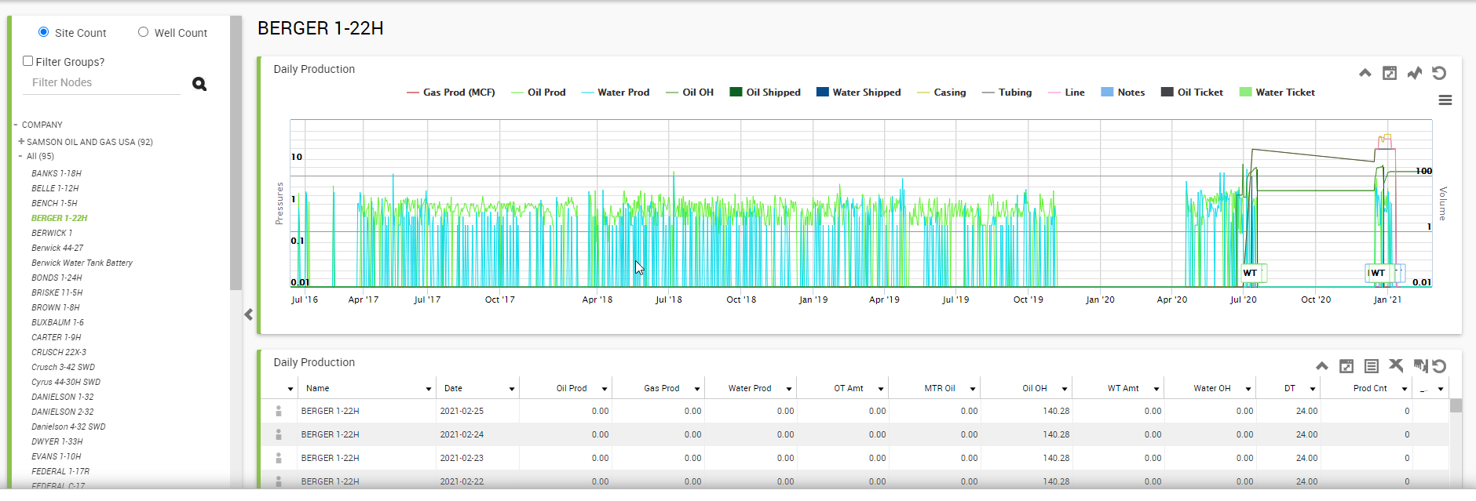
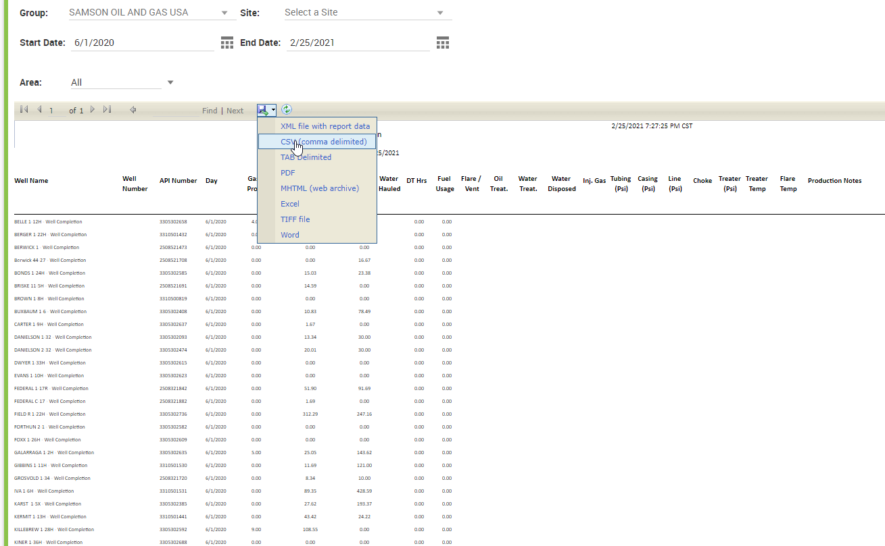
High Resolution Daily Production Data from Field Insights
Download Historical Production for all Wells from June 2020 to Today into a .csv

Slide 6
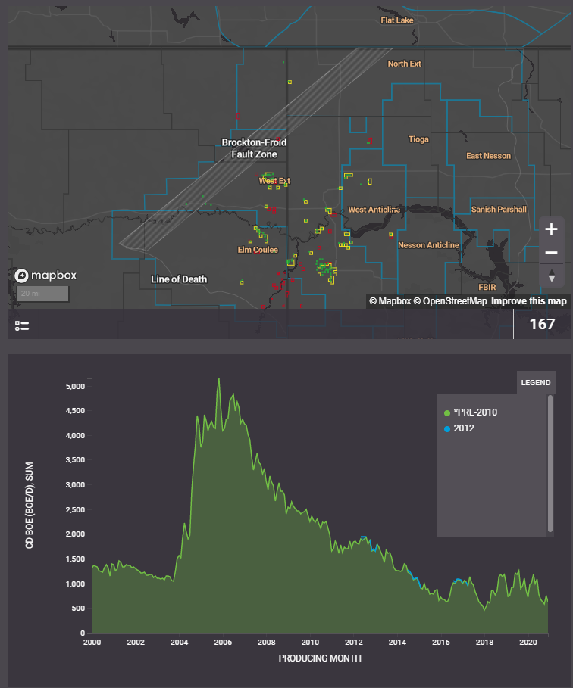
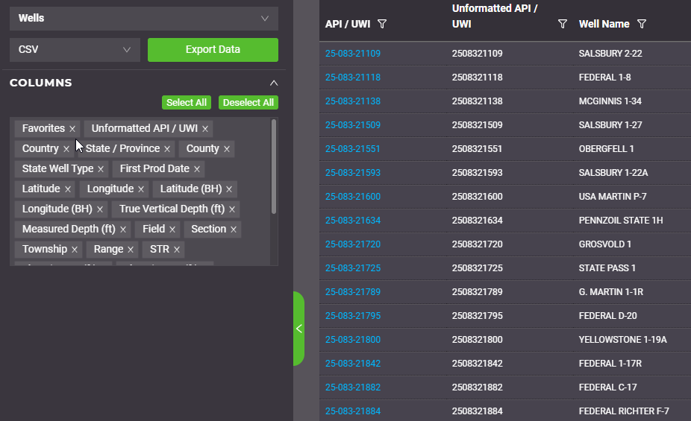
Download historical well data from Enverus for all operated wells into a .csv
Only monthly data from this source

Slide 7
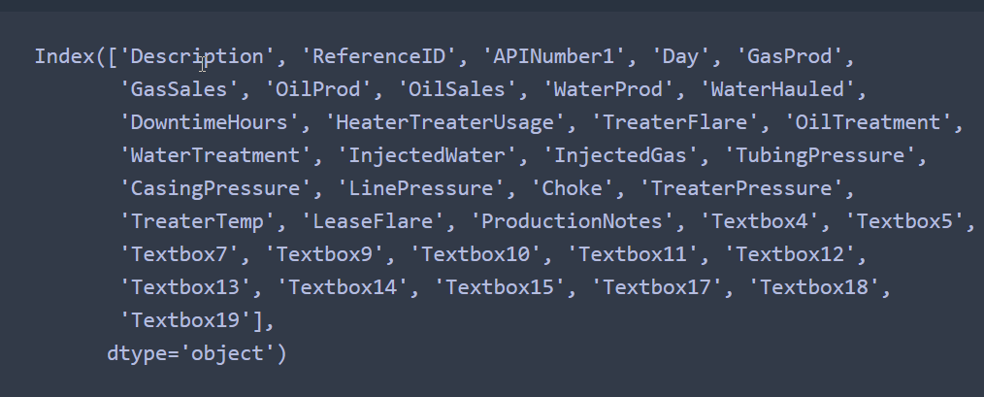
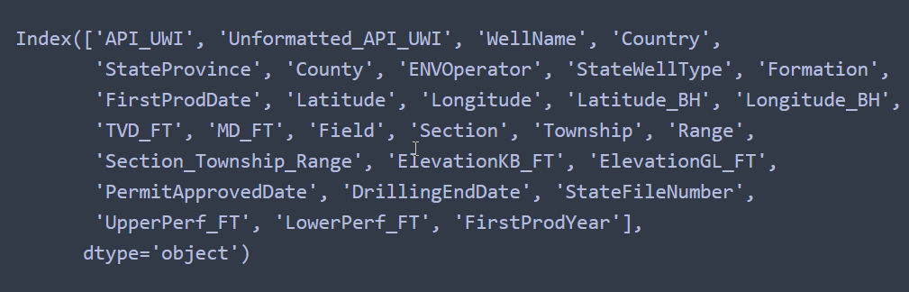
Now that we have the data, we need to Transform the data
First, we inspect the data sets to determine the common ID
Then we replace both dataframes column headers with the same name

Slide 8
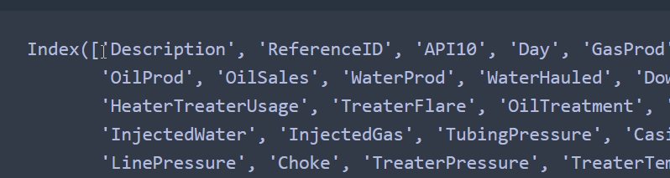
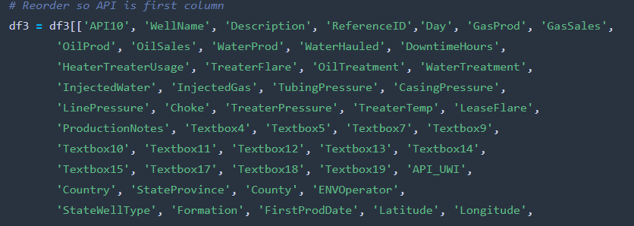
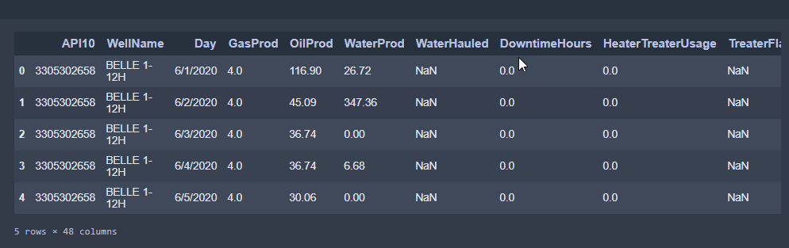
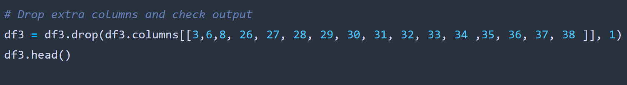
We Continue Transforming the Data by Re-Ordering and Deleting Columns
Move the API10 column (which contains the key/UWI) to the first column and the WellName to the second column
Then we replace both dataframes column headers with the same name

Slide 9
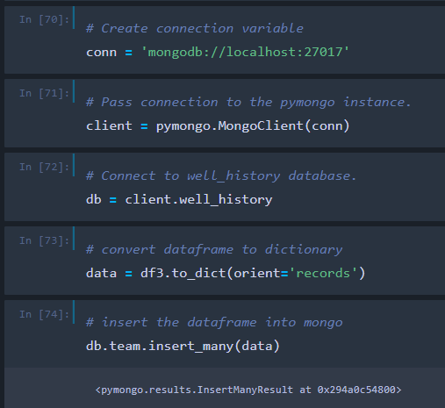
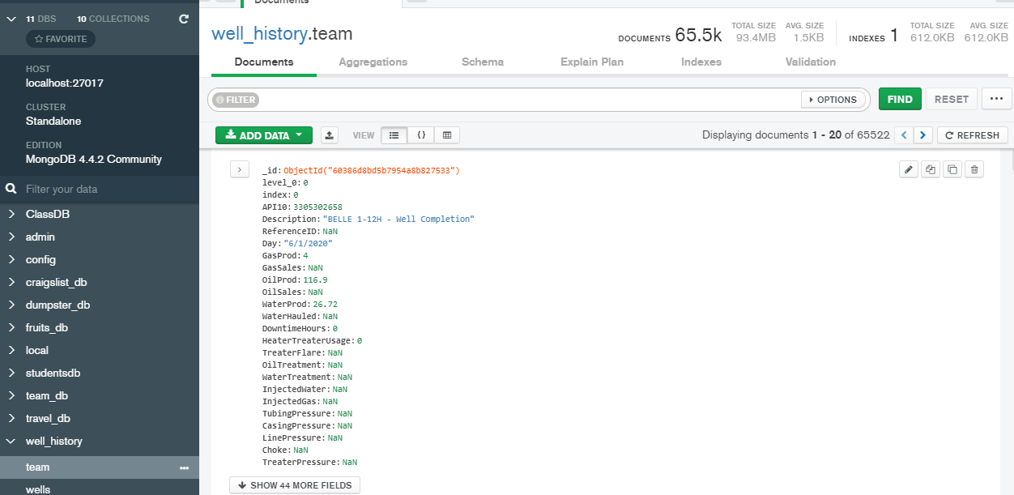
With a Clean Dataframe We are Ready to Load it into MongoDB
Connect to MongoDB, convert the data to a dictionary and insert the data into MongoDB
We now have a MongoDB with daily production data and historical well information that we can build off of.

