Slide 1
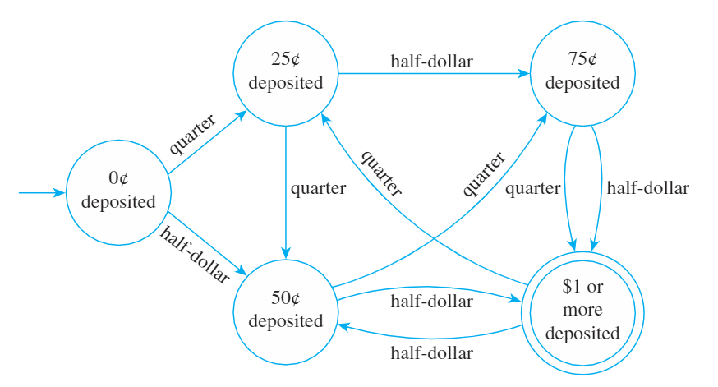
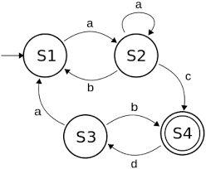
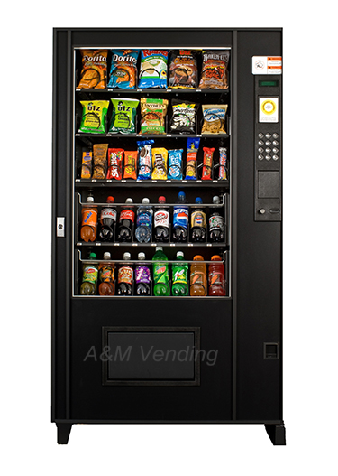
Poster for Finite State Automata
Tyler Nichols
CST-215
12/12/2018
https://www.useloom.com/share/0193c1b3a2e745e393ad58481ba09396
Finite State Automaton
To begin, we must fully understand what exactly a Finite State Automaton. At its base level, it is a mathematical model of computation. As stated by Wikipedia, “It is an abstract machine that can be in exactly one of a finite number of states at any given time.” These automatons are very useful as they perform a predetermined sequence of actions based on certain inputs very quickly and efficiently. They take input symbols and whichever set of input symbols lead to an accepting state is said to be its accepted Language, which can then be defined by a Regular Expression.
Language
If regular expressions are the grammar of FSA’s, then languages are the sentences that flow out of them. It is best to understand languages in action. In Figure 1, we see 4 states, 3 non-accepting states in S1, S2, and S3. S4 is our only accepting state. So, only languages that end in the accepting state, and are constrained by the regular expression rules, can be allowed. So, our regular expression for Figure 1 can be represented as Q = {a, b, c, d} or the string of input a, b, c, and d are all present within the system Q. Therefore, any combination of system Q that leads to the final state of S4 follows both the constraints of the regular expression and the constraints of the definition of Finite State Automaton. I.E. abaaacdaac. This string loops around multiple states but ends in the final state of S4
Figure 3. Vending Machine Finite State Automaton
Regular Expression in Use
As it can be plainly seen, Finite State Automatons are highly useful in the specific and limited usage they are tasked in accomplishing. In the case of the Vending Machine in Figure 3, the Language of the Finite State Automaton, or Q, is a quarter and half-dollar, or Q = {0.25, 0.50} . The final state, or position in the FSA that allows the user to receive a beverage or snack is $1 or more deposited, or the double circle.
Figure 2. Vending Machine
Examples of a FSA
There are many common examples of FSA’s in the real world that use very basic expressions to achieve the outcome desired. In the case of Figure 2, a vending machine takes an input in the form of currency. This would be the Language defined for this FSA. The regular expressions would then be any combinations of the Language set that would produce an outcome. For example, a bag of chips requires $1.25. Placing 5 quarters, or 25 nickels, or 125 pennies would achieve this desired result, or any combinations of quarters, nickels, and so on.
Figure 1. Example of a Finite State Automaton
Regular Expression
A regular expression can be defined as follows. If A and B are regular expressions in Q, then A * B (concatenation), A | B (alternation), A* (infinite) are all regular expressions. A regular expression is best viewed as the rules or grammar that we constrain on an FSA to run smoothly and properly. If we look at each FSA carefully, we can see both regular expressions and languages at work. We will look at Figure 1 in the language section.
References
Regular Expressions, Regular Grammar and Regular Languages. (2018, September 07). Retrieved from https://www.geeksforgeeks.org/regular-expressions-regular-grammar-and-regular-languages/
Finite-state machine. (2018, November 18). Retrieved from https://en.wikipedia.org/wiki/Finite-state_machine
Epp, S. S. (2011). Discrete Mathematics with Applications (4th ed.). Boston, MA: Richard Stratton.

