Slide 1
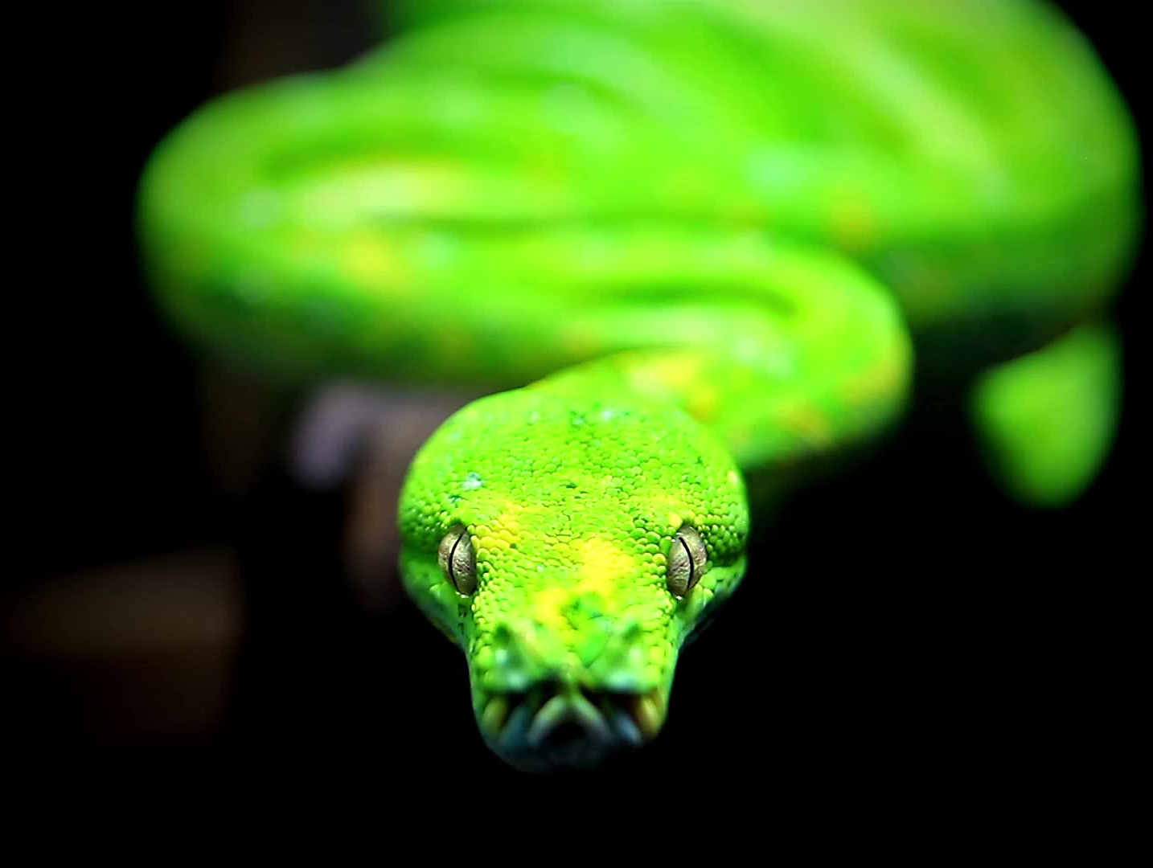
Zero to Python
Chapter 1: The First Bit
Slither Smoothly from Beginner to Pro

Slide 2
Python
One of the most popular and beginner-friendly programming languages in the world.
It's used in everything from web development
Data science
AI
Automation
Game development

Slide 3
Running Code
An online Python editor (like Replit, Trinket, or Google Colab)
A local IDE (like VSCode or PyCharm)
The terminal using `python filename.py

Slide 4
Your First Program
Let's write your first line of Python code:
print("Hello, World!")
When you run it, you'll see:
Hello, World!
This simple line uses the built-in `print()` function to display text.

Slide 5
Try It Yourself
Change the message or print something else:
print("Hello, Python!")
print(42)
print("My name is Ada")

Slide 6
What Just Happened?
You ran real Python code.
You used a function: print()
You printed a string: text surrounded by quotes
You're officially a Python programmer now!

Slide 7
Quick Recap
Catch your breath
Stand and stretch
Avoid a blood clot
Questions?

Slide 8
Data Types
A classification that determines the kind of data a variable can hold and what operations can be performed on it

Slide 9
Purpose
Data types help the computer understand and manage different kinds of information

Slide 10


Importance
Using the correct data type ensures that operations are performed correctly and efficiently, preventing errors and ensuring data integrity

Slide 11
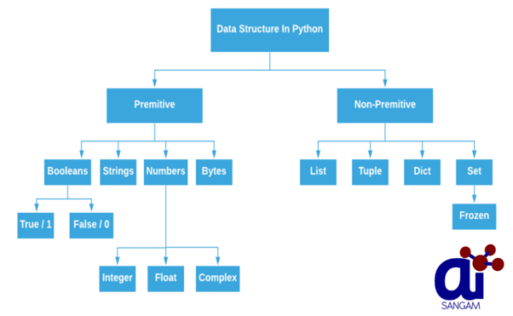
Primitive vs. Non-primitive
Some languages distinguish between primitive (basic) data types like integers and floats, and non-primitive data types (built from primitives) like arrays or objects

Slide 12

Questions

Slide 13
Data Types
Let's break them down

Slide 14
Int: What is it?
Represents whole numbers (positive, negative, or zero).
Use Case:
Used to count things like age, quantity, or score.
Example:
age = 25
items = 4
print(age * items)

Slide 15
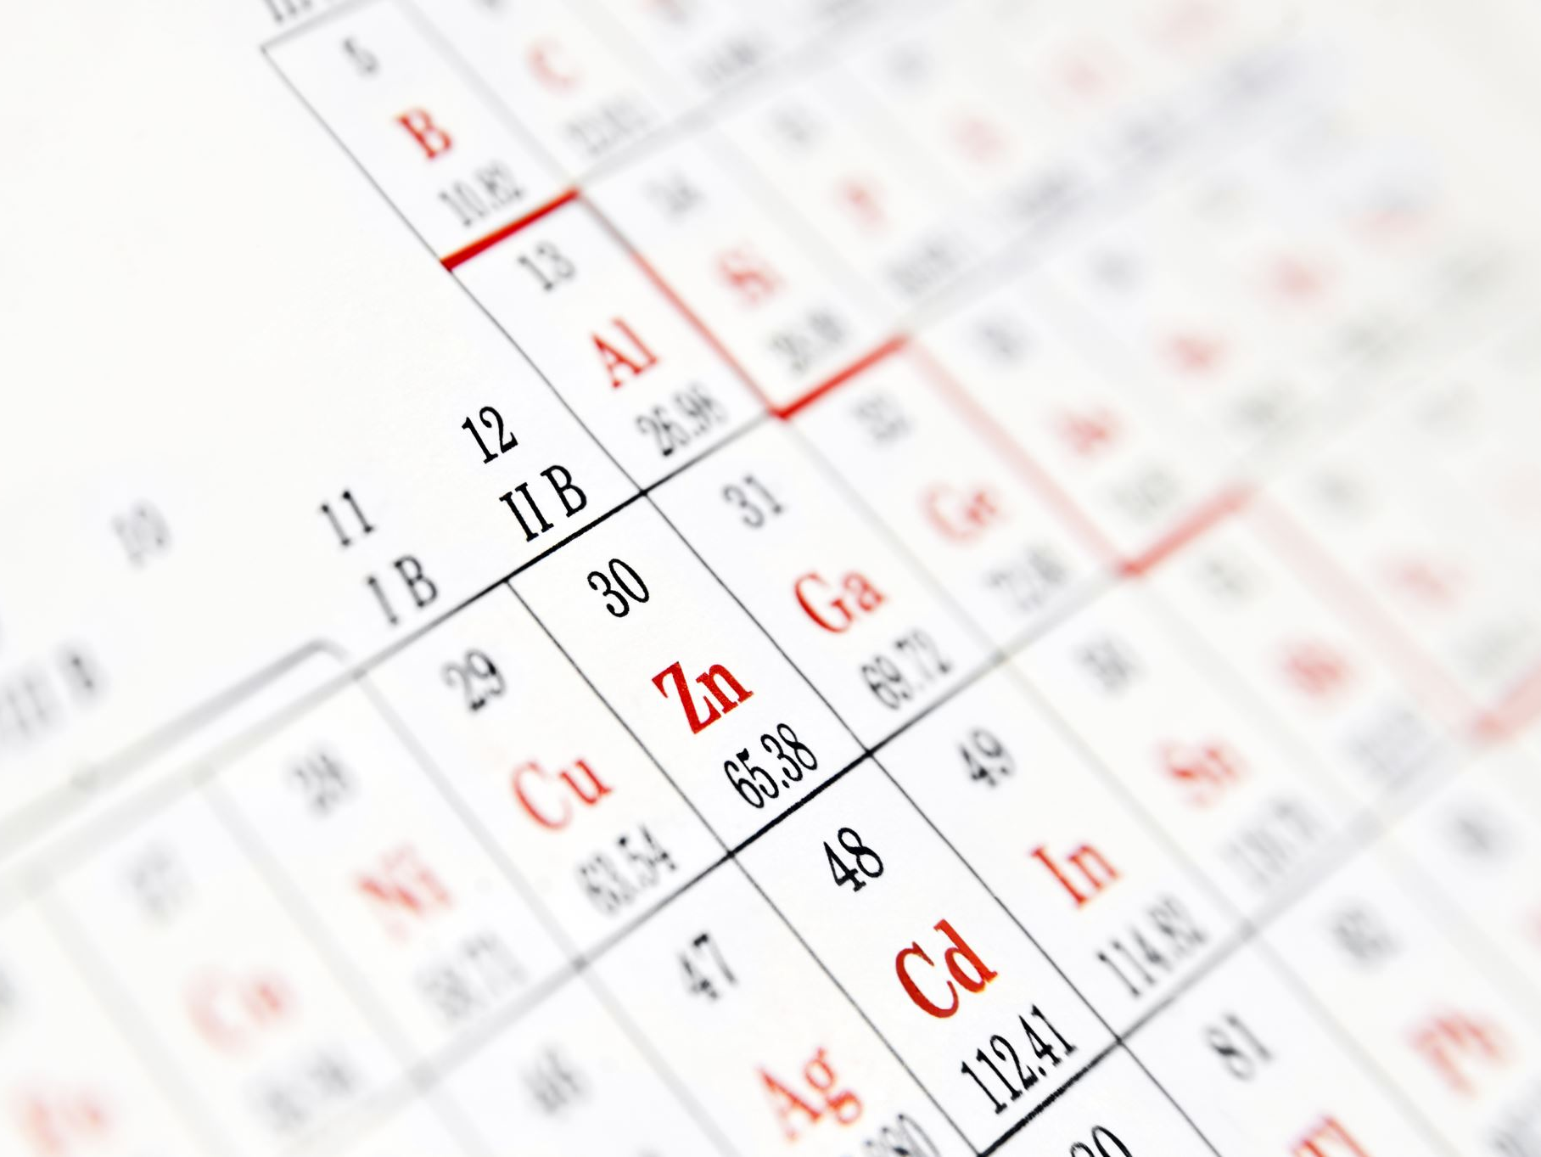
float
What is it?
Represents decimal numbers for precise values.
Use Case:
Used for prices, measurements, and scientific calculations.
Example:
price = 19.99
quantity = 3
total = price * quantity
print(total)

Slide 16
complex
What is it?
Holds numbers with real and imaginary parts.
Use Case:
Used in electrical engineering, physics, or complex math.
Example:
z = 3 + 4j
print(z.real)
print(z.imag)

Slide 17
str
What is it?
A string of characters enclosed in quotes.
Use Case:
Used for names, messages, input, and all text-related data.
Example:
name = "Alice"
print("Hello, " + name)

Slide 18
bool
What is it?
Holds one of two values: True or False.
Use Case:
Used in logic for conditionals like 'is active' or 'is valid'.
Example:
is_logged_in = True
if is_logged_in:
print("Welcome back!")

Slide 19
list
What is it?
An ordered, changeable collection of items.
Use Case:
Used for things like to-do lists, shopping carts, and results.
Example:
fruits = ["apple", "banana"]
fruits.append("cherry")
print(fruits)

Slide 20
tuple
What is it?
An ordered, unchangeable collection.
Use Case:
Used for fixed data like coordinates or configuration pairs.
Example:
location = (40.7128, -74.0060)
print(location[0])

Slide 21
range
What is it?
Represents a sequence of numbers, often in loops.
Use Case:
Used for generating indices or repeating code a set number of times.
Example:
for i in range(5):
print(i)

Slide 22
dict
What is it?
Stores data as key-value pairs.
Use Case:
Used for user profiles, configurations, or labeled data.
Example:
user = {"name": "Alice", "age": 30}
print(user["name"])

Slide 23
set
What is it?
Unordered collection of unique elements.
Use Case:
Used to remove duplicates or quickly check membership.
Example:
emails = {"a@example.com", "b@example.com"}
print(len(emails))

Slide 24
frozenset
What is it?
Immutable version of a set.
Use Case:
Used when a constant, unchangeable set of unique items is needed.
Example:
constants = frozenset([3.14, 2.718])

Slide 25
bytes
What is it?
Immutable sequence of raw binary data.
Use Case:
Used in file storage, network transmission, or media data.
Example:
data = bytes(5)
print(data)

Slide 26
bytearray
What is it?
Mutable version of bytes.
Use Case:
Used when binary data needs to be altered before use.
Example:
data = bytearray(5)
data[0] = 255
print(data)

Slide 27
memoryview
What is it?
Allows efficient access to parts of byte objects.
Use Case:
Used in performance-critical applications dealing with large buffers.
Example:
b = bytearray(b"hello")
mv = memoryview(b)
print(mv[0])

Slide 28





Questions

