Slide 1
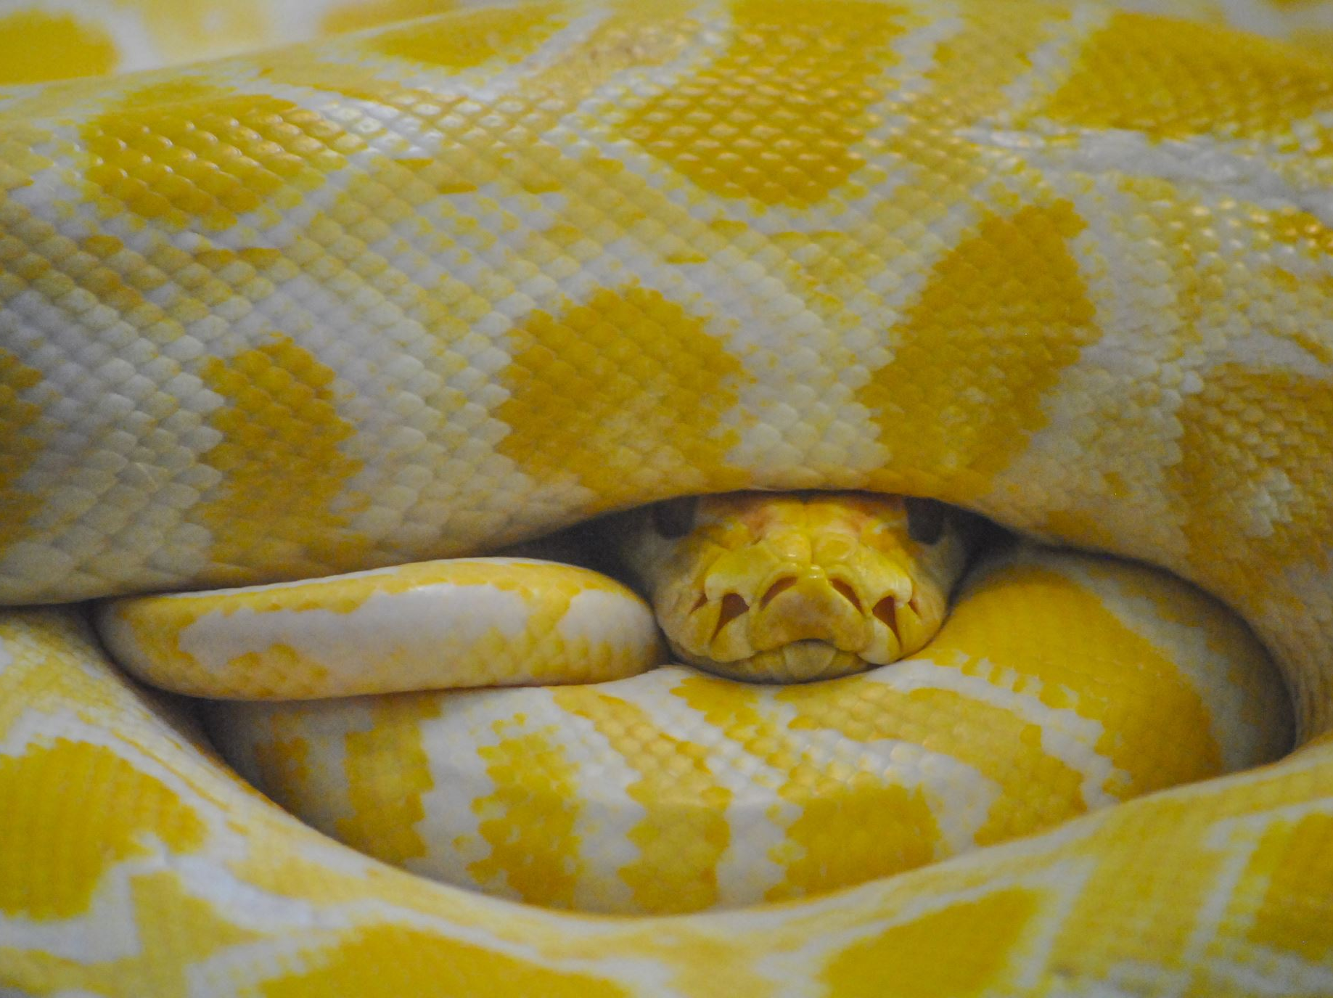
Zero to Python
Chapter 2: Strings & Text Handling
Section 1: What is a String?

Slide 2



What is a String?
What is it?
A string is a sequence of characters enclosed in quotes. It can include letters, numbers, spaces, and symbols.
Use Case:
Used to store text like names, messages, or input.
Example:
text = "Hello, world!"
print(text)

Slide 3
Single & Double Quotes
What is it?
Strings can be defined with either single (' ') or double (" ") quotes in Python.
Use Case:
Useful for avoiding escape characters depending on the text.
Example:
msg1 = 'Hello'
msg2 = "Welcome!"
print(msg1, msg2)

Slide 4
Triple Quotes
What is it?
Triple quotes (''' or """) allow for multi-line strings.
Use Case:
Used for writing multi-line messages or documentation strings (docstrings).
Example:
bio = '''This is line one.
This is line two.'''
print(bio)

Slide 5

Zero to Python
Chapter 2: Strings & Text Handling
Slither Smoothly from Beginner to Pro

Slide 6
Normal Strings
What is it?
Standard text values in Python, enclosed in single or double quotes.
Use Case:
Used to store and display text data such as names, messages, and content.
Example:
message = "Hello, Python!"
print(message)

Slide 7
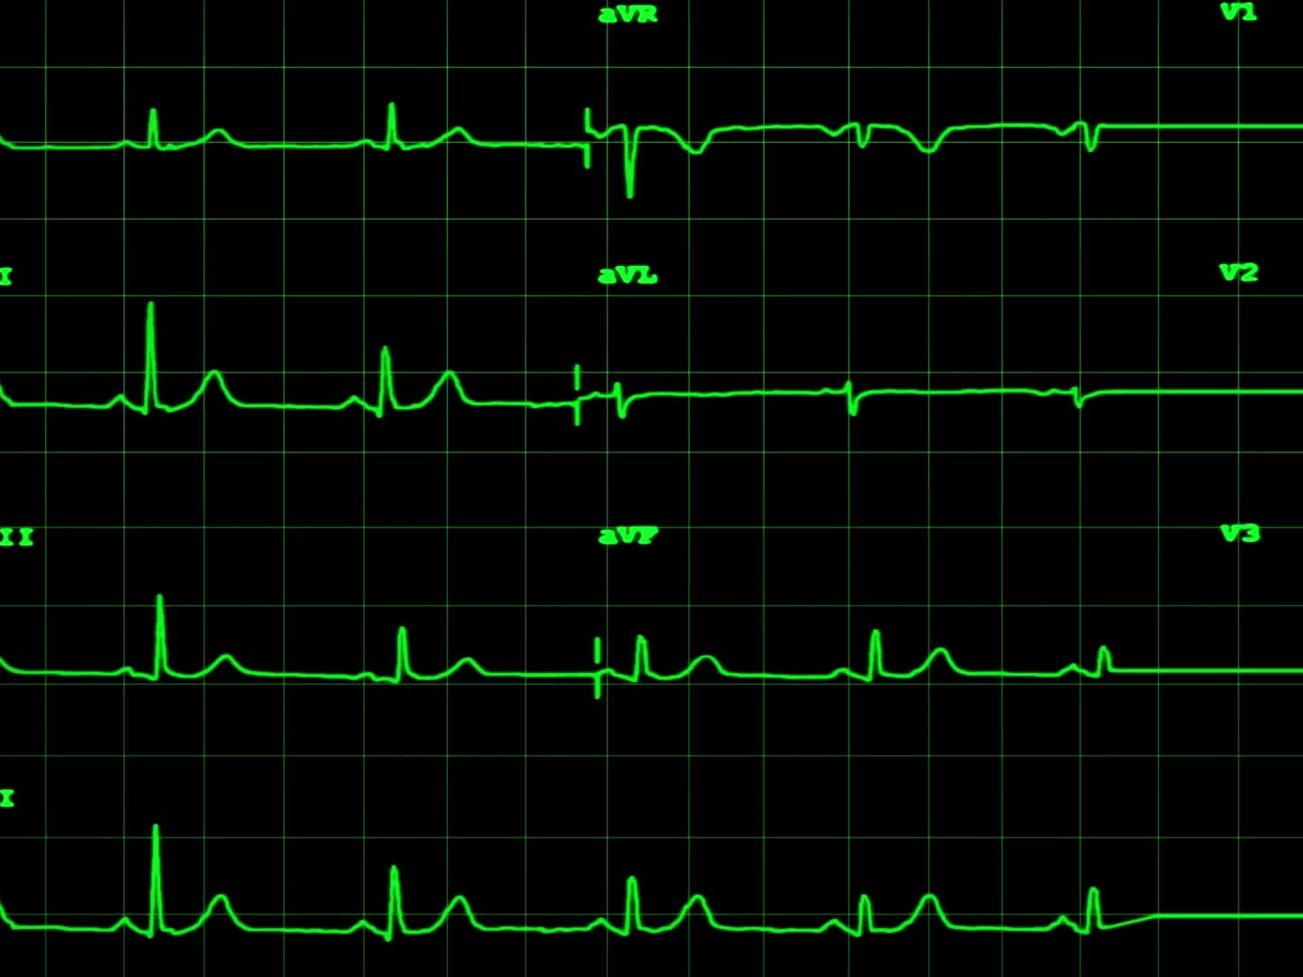
Raw Strings
What is it?
Prefixing a string with 'r' treats backslashes as literal characters.
Use Case:
Useful for regular expressions, file paths, or Windows-style paths.
Example:
path = r"C:\Users\Name\Documents"
print(path)

Slide 8
Byte Strings
What is it?
Prefixing with 'b' creates a byte object instead of a standard string.
Use Case:
Used for binary data like files, network streams, or encoding tasks.
Example:
data = b"hello"
print(data)

Slide 9
Unicode Strings
What is it?
All strings in Python 3 are Unicode by default (no prefix needed).
Use Case:
Unicode supports characters from many global languages and symbols.
Example:
greeting = "こんにちは"
print(greeting)

Slide 10

Zero to Python
Chapter 2: Strings & Text Handling
Section 3: String Operations

Slide 11
String Concatenation (+)
What is it?
Combines two or more strings into one.
Use Case:
Used to dynamically build messages or join inputs.
Example:
first = "Hello"
second = "World"
print(first + " " + second)

Slide 12
String Repetition (*)
What is it?
Repeats a string multiple times.
Use Case:
Used for formatting, animation effects, or playful repetition.
Example:
dash = "-" * 10
print(dash)

Slide 13
Membership (in)
What is it?
Checks if a substring exists within a string.
Use Case:
Used for validation or filtering.
Example:
# "@" in email # Checks if email contains @
email = "user@example.com"
if "@" in email:
print("This looks like an email address!")
⚠️ In a dictionary, in only checks for keys, not values.

Slide 14

Length (len)
What is it?
Returns the number of characters in a string.
Use Case:
Used to check input size, content length, etc.
Example:
msg = "Hello"
print(len(msg))

Slide 15
Indexing
What is it?
Accesses characters by position (zero-based index).
Use Case:
Used to get specific characters from a string.
Example:
word = "Python"
print(word[0]) # 'P'

Slide 16
Slicing
What is it?
Extracts a part of the string using start:stop notation.
Use Case:
Used to cut out sections of strings.
Example:
text = "Hello, World!"
print(text[0:5]) # 'Hello'

Slide 17

Zero to Python
Chapter 2: Strings & Text Handling
Section 4: String Methods

Slide 18
.lower()
What is it?
Converts all characters in a string to lowercase.
Use Case:
Useful for standardizing text input or comparisons.
Example:
name = "ALICE"
print(name.lower()) # 'alice'

Slide 19
.upper()
What is it?
Converts all characters in a string to uppercase.
Use Case:
Used to emphasize or normalize text.
Example:
msg = "hello"
print(msg.upper()) # 'HELLO'

Slide 20
.strip()
What is it?
Removes whitespace from the beginning and end of a string.
Use Case:
Useful when cleaning user input or raw data.
Example:
user_input = " yes "
print(user_input.strip()) # 'yes'

Slide 21
.replace()
What is it?
Replaces parts of the string with new text.
Use Case:
Used to correct or modify content dynamically.
Example:
text = "I like Java"
print(text.replace("Java", "Python"))

Slide 22
.split()
What is it?
Splits a string into a list based on a delimiter.
Use Case:
Used to process CSVs, user input, or log files.
Example:
line = "apple,banana,cherry"
print(line.split(","))

Slide 23
.join()
What is it?
Joins a list of strings into one string with a delimiter.
Use Case:
Used when outputting lists as readable strings.
Example:
words = ["Hi", "there"]
print(" ".join(words))

Slide 24
.find()
What is it?
Finds the index of the first occurrence of a substring.
Use Case:
Used in search tools or filtering logic.
Example:
email = "user@example.com"
print(email.find("@"))

Slide 25
Zero to Python
Chapter 2: Strings & Text Handling
Section 5: f-Strings

Slide 26
What is an f-string?
What is it?
An f-string is a formatted string literal. It starts with 'f' and allows variables and expressions inside curly braces.
Use Case:
Used for embedding variables directly into strings in a readable way.
Example:
name = "Alice"
print(f"Hello, {name}!")

Slide 27
Expressions in f-strings
What is it?
You can include calculations and function calls inside the curly braces.
Use Case:
Makes dynamic formatting simple and compact.
Example:
a = 5
b = 3
print(f"Sum is {a + b}")

Slide 28
Comparing with .format()
What is it?
f-strings are a newer and cleaner alternative to the older .format() method.
Use Case:
Reduces syntax clutter and improves readability.
Example:
# Old way
print("Hello, {}".format(name))
# New way
print(f"Hello, {name}")

Slide 29

Zero to Python
Chapter 2: Strings & Text Handling
Section 6: Multiline Strings & Docstrings

Slide 30
Multiline Strings
What is it?
Triple-quoted strings (''' or """) span multiple lines.
Use Case:
Used for long text blocks like emails, messages, or embedded documents.
Example:
quote = '''To be,
or not to be,
that is the question.'''
print(quote)

Slide 31
What is a Docstring?
What is it?
A docstring is a special multiline string used to document a function, class, or module.
Use Case:
Used to describe what the code does and how to use it.
Example:
def greet(name):
'''This function greets the user.'''
print(f"Hello, {name}!")

Slide 32
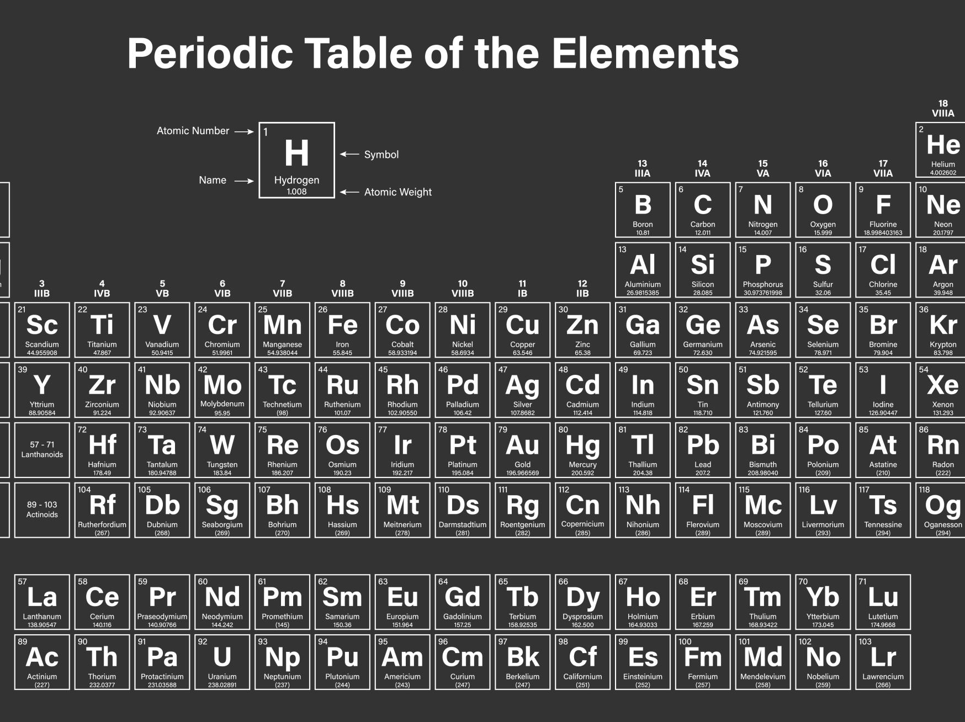
Zero to Python
Chapter 2: Strings & Text Handling
Section 7: Real-World Use Cases

Slide 33
Logging and Debugging
What is it?
Strings are often used to record messages or errors.
Use Case:
Used in every app to track behavior or issues.
Example:
log = "User login failed for user_id: 42"
print(log)

Slide 34
User Input and Validation
What is it?
String input is collected, validated, and transformed.
Use Case:
Used in forms, CLIs, or user interfaces.
Example:
name = input("Enter your name: ")
if name:
print(f"Hello, {name}!")

Slide 35
Formatted Output
What is it?
F-strings or string formatting build readable messages.
Use Case:
Used in reports, receipts, UI messages, etc.
Example:
total = 29.99
print(f"Your total is ${total:.2f}")

Slide 36
Text File Processing
What is it?
Strings are used to read, write, and analyze files.
Use Case:
Used in automation, configuration, and scripting.
Example:
with open("data.txt") as f:
lines = f.read().splitlines()
print(lines)

