Slide 1

Flow Control in Python
Chapter 3 - Section 3.1: Making Decisions Like a Chef

Slide 2


What Is Flow Control?
Flow control determines the order in which instructions are executed.
Analogy: writing a recipe
— you follow steps, make decisions, and repeat instructions when needed.

Slide 3

Cooking Analogy: Making a Sandwich
sandwich()
- If you have bread, proceed.
- If you have cheese and ham, add both.
- If no ham, just use cheese.
- If you run out of ingredients — stop!
This is flow control: making decisions and repeating steps based on conditions.

Slide 4
Why Flow Control Matters
Without flow control:
- Code runs from top to bottom, no flexibility.
With flow control:
- Programs can make decisions, repeat steps, or skip parts.

Slide 5

Types of Flow Control
1. Conditionals: if, elif, else — make decisions
2. Loops: while,
for — repeat steps
3. Break Tools:
break, continue, pass

Slide 6

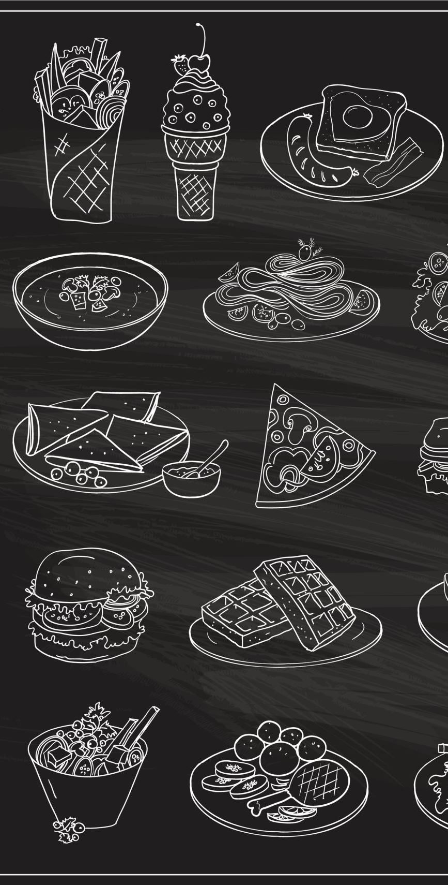
Real-World Use Cases
- Menus: like a fast food ordering system
- Input prompts: e.g., 'Enter password again'
- Conditional logic: apply discounts if total > $50

Slide 7

What’s Next
- Learn Boolean logic and comparisons
- Write your first smart if block
- Build a real decision-making program

Slide 8

Boolean Values and Expressions
Booleans are either True or False.
Used to test conditions and control flow.
Examples:
- 5 > 3 → True
- 2 == 4 → False

Slide 9
Comparison Operators
== Equal to
!= Not equal to
> Greater than
< Less than
>= Greater or equal
<= Less or equal

Slide 10
Type Conversion to Boolean
bool(0) → False
bool(1) → True
bool('') → False
bool('Hello') → True
***Truthy & falsy appendix***

Slide 11
Logical Operators
Used to combine conditions:
- and: both must be true
- or: at least one must be true
- not: reverses the result

Slide 12
Boolean Logic: AND vs OR (Truth Table)
A | B | A and B | A or B
True | True | True | True
True | False | False | True
False | False | False | False

Slide 13
NOT and Short-Circuiting
Expression | Result
not True | False
not False | True
False and print('Skipped') | False (print skipped)
True or print('Skipped') | True (print skipped)

Slide 14

Short-Circuit Evaluation
Python stops evaluating as soon as the result is known.
Example:
True or print('This won’t run')

Slide 15

The if Statement
Basic form:
if condition:
do something
Only runs the block if the condition is True.

Slide 16
if, elif, else Chains
Multiple branches:
if condition:
...
elif condition:
...
else:
...

Slide 17
Nested Conditionals
You can place one if inside another.
Use carefully — too much nesting reduces readability.

Slide 18
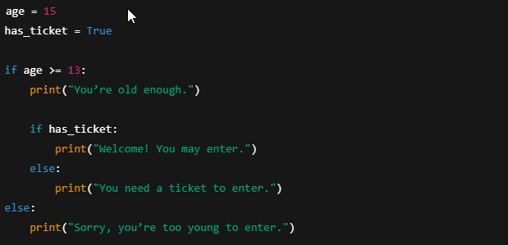
Nested IF example

Slide 19

The while Loop
Repeats as long as the condition is True.
Example:
while input != 'exit':
ask again

Slide 20

The for Loop
Loops over a sequence:
for item in sequence:
do something
Common with range():
for i in range(5):

Slide 21
Why 'for letter in "hello"' Works
"hello" is a string, but Python treats it like a sequence:
['h', 'e', 'l', 'l', 'o']
The for loop pulls one character at a time:
for letter in "hello":
print(letter)

Slide 22
Step-by-Step Execution of the Loop
Loop 1 → letter = 'h' → prints h
Loop 2 → letter = 'e' → prints e
Loop 3 → letter = 'l' → prints l
Loop 4 → letter = 'l' → prints l
Loop 5 → letter = 'o' → prints o
Final output:
h e l l o

Slide 23
break, continue, pass
- break: exits the loop early
- continue: skips the rest of this loop iteration
- pass: does nothing (placeholder)

Slide 24

Combining Loops and Conditionals
Real logic happens when you mix loops and decisions.
Example: input validation
while not valid:
if input meets condition: valid = True

Slide 25

Review & Quiz
- What are the 3 types of flow control?
- What’s the difference between = and ==?
Quick Check:
if 3 > 2 and 1 < 4 → ?

Slide 26
Practice Lab: Flow Control
Try it out:
- Build a number guessing game
- Menu selector (1, 2, 3, exit)
- Password attempt limiter

