Slide 1

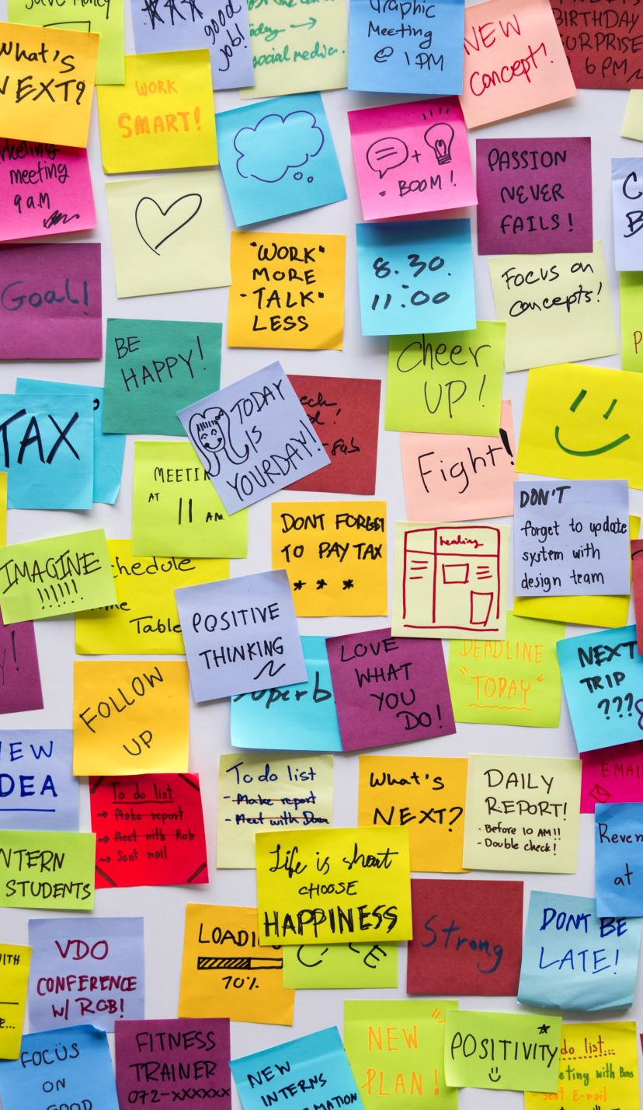
6.1 - What Is a Dictionary?
Dictionaries store data in key-value pairs.
Think of it like a real dictionary: a word (key) maps to a definition (value).
Python syntax: { 'name': 'Alice', 'age': 25 }

Slide 2
6.2 - Creating and Accessing
Use curly braces or dict():
person = { 'name': 'Bob', 'age': 30 }
Access with keys: person['name'] → Bob
Use .get('key') for safe access

Slide 3
6.3 - Add, Update, and Delete
Add: dict['new_key'] = value
Update: dict['key'] = new_value
Delete: del dict['key']
Check existence with 'key' in dict

Slide 4
6.4 - Looping Through Dictionaries
Loop through keys: for key in dict:
Loop through values: for val in dict.values():
Loop through items: for k, v in dict.items():

Slide 5

6.5 - Dictionary Methods
.keys() → returns all keys
.values() → returns all values
.items() → returns key-value pairs
.get(key, default) → avoids crash if key not found

Slide 6
6.6 - Nested Dictionaries
You can store dictionaries inside other dictionaries:
students = { 'Alice': {'age': 22, 'major': 'CS'} }
Access: students['Alice']['major'] → CS

Slide 7
6.7 - Real-World Use: JSON
JSON (JavaScript Object Notation) looks like a Python dictionary.
Used for APIs, configs, data transfer.
You can load JSON into a Python dict using json.loads()

Slide 8
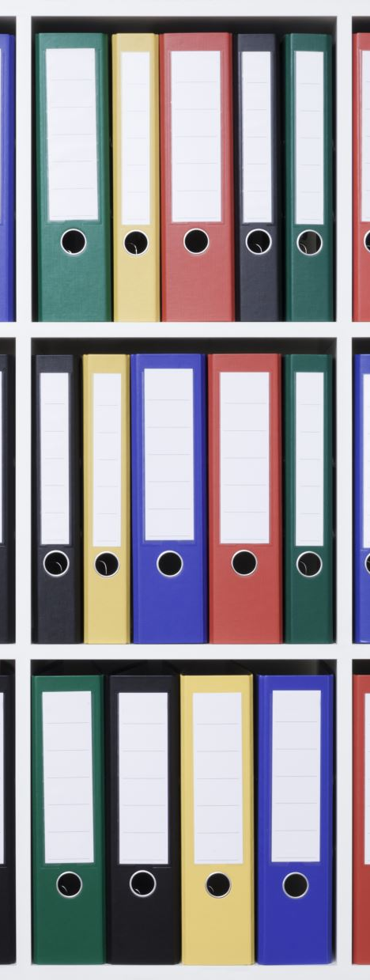
6.8 - Project Lab: Contact Book System
Build a contact manager that uses a dictionary to store names and numbers.
- Add new contact
- Update existing contact
- View all contacts
- Delete a contact

Slide 9

6.9 - Review and Challenge
✅ What happens when you access a missing key?
✅ How do you loop through both key and value?
Challenge: Create a student gradebook using a nested dictionary.
Let users enter names and grades, then view the average.

