Slide 1
Mastering Lambda Functions
Tiny Code, Big Power
Learn how lightweight functions drive fast coding and modern cloud apps.

Slide 2
What is a Lambda?
- Anonymous (no-name) function
- Single line: lambda arguments: expression
- Example:
lambda x: x + 1

Slide 3
Why Use Lambdas?
- Short and temporary
- Save lines of code
- Use with map(), filter(), sorted() and events

Slide 4

Cloud Perspective on Lambdas
- AWS Lambda: Serverless compute
- Event-driven: trigger → function auto-runs
- Same philosophy: small, quick, efficient

Slide 5
Cheat Sheet - Discount Multipliers
- 10% off = x 0.9
- 25% off = x 0.75
- 50% off = x 0.5
Formula:
Multiplier = 1 - (Discount% / 100)

Slide 6
Demo: Applying a Discount with Lambda
prices = [10, 20, 30]
# Apply 10% discount
discounted = list(map(lambda p: p * 0.9, prices))
print(discounted)
# Output:
[9.0, 18.0, 27.0]

Slide 7
What map() Really Does
map(function, iterable)
Applies a function to every item in a list.
Example:
- prices = [10, 20, 30]
- Apply discount function to each price
- Returns a new list of discounted prices

Slide 8
🧑‍💻 Code_A_Long: Let's Code Together!
Step-by-Step:
1. Type:
prices = [10, 20, 30]
2. Type:
discounted = list(map(lambda p: p * 0.9, prices))
3. Type:
print(discounted)
✅ Should output: [9.0, 18.0, 27.0]
🎤 Chant: 'Define less, do more!'

Slide 9
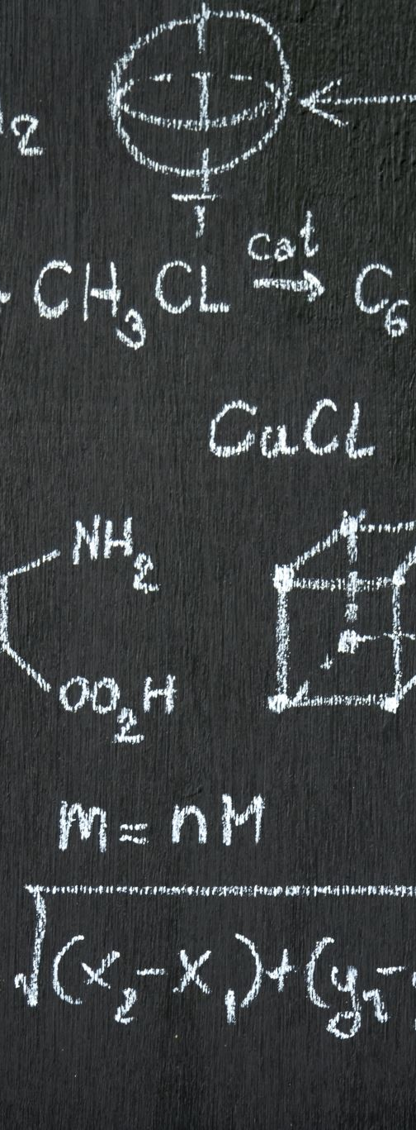
Simple Lambda Examples
- Square a number:
square = lambda x: x * x
- Add two numbers:
add = lambda a, b: a + b

Slide 10
More Complex Lambdas
- Sort words by length:
words.sort(key=lambda word: len(word))
- Filter even numbers:
evens = list(filter(lambda x: x % 2 == 0, nums))

Slide 11
Summary: Lambdas vs Classes
- Lambdas = tiny, fast tools
- Classes = full system models
Use lambdas inside classes for small tasks, not to replace full object designs.

Slide 12
Conclusion
- Lambdas save time
- Great for quick transformations
- Pave the way for serverless thinking
- Think: Tools inside Buildings!

