Slide 1
Authorship analysis
Roberto Deresu
Facultatea de Matematica si Informatica

Slide 2
Dataset
The Federalist Papers Dataset
PAN12 - Text Authorship Attribution Dataset

Slide 3
Features
Ranking distance representation of each document, with function words: Mosteller and Wallace or nltk english
N-grams representation of each document. N-grams range: 3-4, frequency threshold: 100

Slide 4
String-kernels
Linear kernel
Intersection kernel
Binary kernel

Slide 5
Training and classification
SVM with one vs. rest classifier

Slide 6
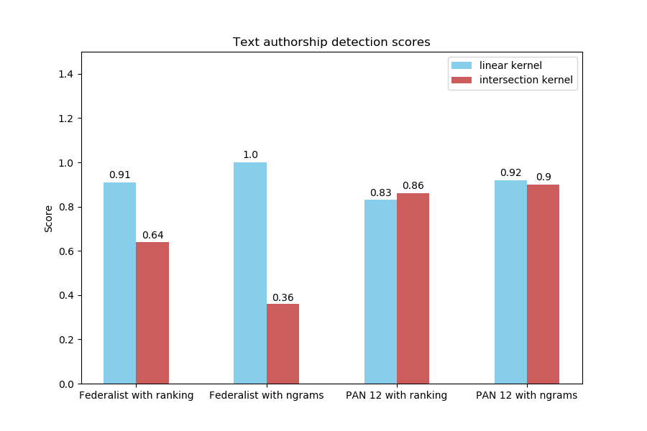
Results

Slide 7
THANK YOU!

