Slide 1
Language modeling and Transformers basics

Slide 2


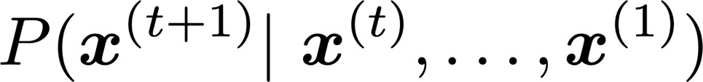


1. Language Modeling
Language Modeling is the task of predicting what word comes next
books
the students opened their
laptops
exams
minds
More formally: given a sequence of words
compute the probability distribution of the next word
,
:
where can be any word in the vocabulary
A system that does this is called a Language Model

Slide 3

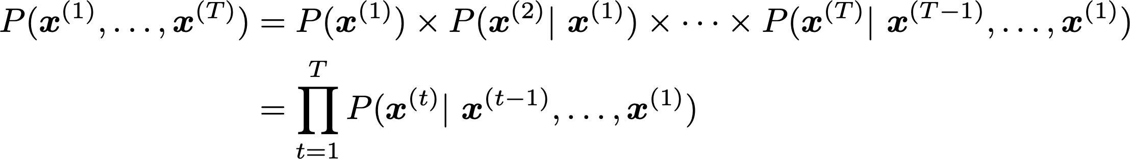
Language Modeling
You can also think of a Language Model as a system that assigns a probability to a piece of text
For example, if we have some text , then the
probability of this text (according to the Language Model) is:
This is what our LM provides

Slide 4



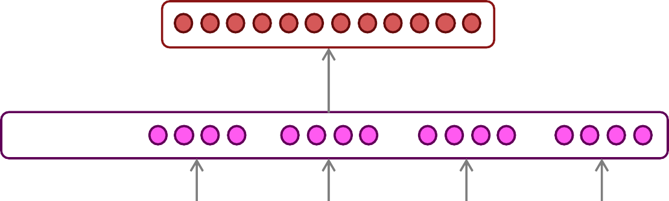



2. How to build a neural language model?
Recall the Language Modeling task:
  Input: sequence of words
  Output: prob. dist. of the next word
How about a window-based neural model?
  E.g., Named Entity Recognition:
LOCATION
museums
in
Paris
are amazing
4

Slide 5













A fixed-window neural Language Model
books
laptops
output distribution
a
zoo
hidden layer
concatenated word embeddings
words / one-hot vectors
the students
opened
their

Slide 6





A fixed-window neural Language Model
Approximately: Y. Bengio, et al. (2000/2003): A Neural Probabilistic Language Model
books
laptops
Remaining problems:
Fixed window is too small
Enlarging window enlarges 𝑊
Window can never be large enough!
𝑥⁽¹⁾ and 𝑥⁽²⁾ are multiplied by completely different weights in 𝑊. No symmetry in how the inputs are
a
zoo
processed.
We need a neural architecture that can process any length input
the students
opened
their

Slide 7
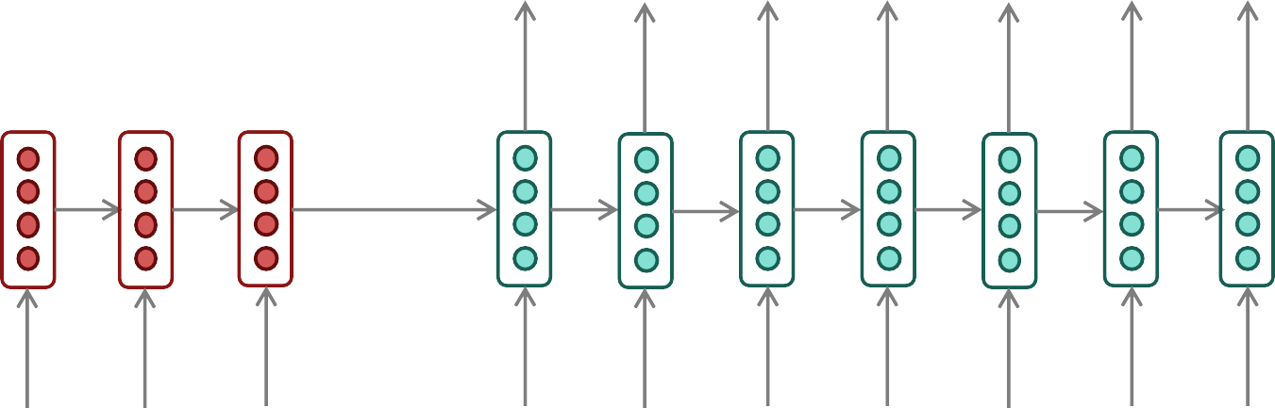
The bottleneck problem in RNNs
Encoding of the source sentence.
Target sentence (output)
All source meaning forced into one fixed-size representation.
he
hit
me with
a
pie <END>
Encoder RNN
Decoder RNN
il
a
m’ entarté
<START> he
hit
me with
a
pie
Source sentence (input)
Problems with this architecture?
Information Loss: early sequence context degrades heavily
Rigid capacity: cannot scale naturally for longer sentences
Modern architectures bypass this vector entirely

Slide 8

3. Attention
Attention provides a solution to the bottleneck problem.
Core idea: on each step of the decoder, use direct connection to the encoder to focus
on a particular part of the source sequence
First, we will show via diagram (no equations), then we will show with equations

Slide 9
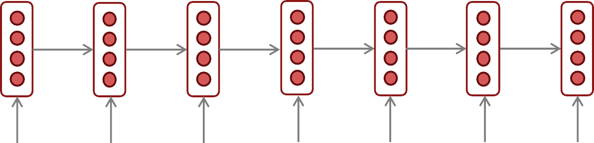
The starting point: mean-pooling for RNNs
positive
How to compute sentence encoding?
Usually better: Take element-wise max or mean of all hidden states
Sentence encoding
overall I enjoyed the movie a lot
Starting point: a very basic way of ‘passing information from the encoder’ is to average

Slide 10
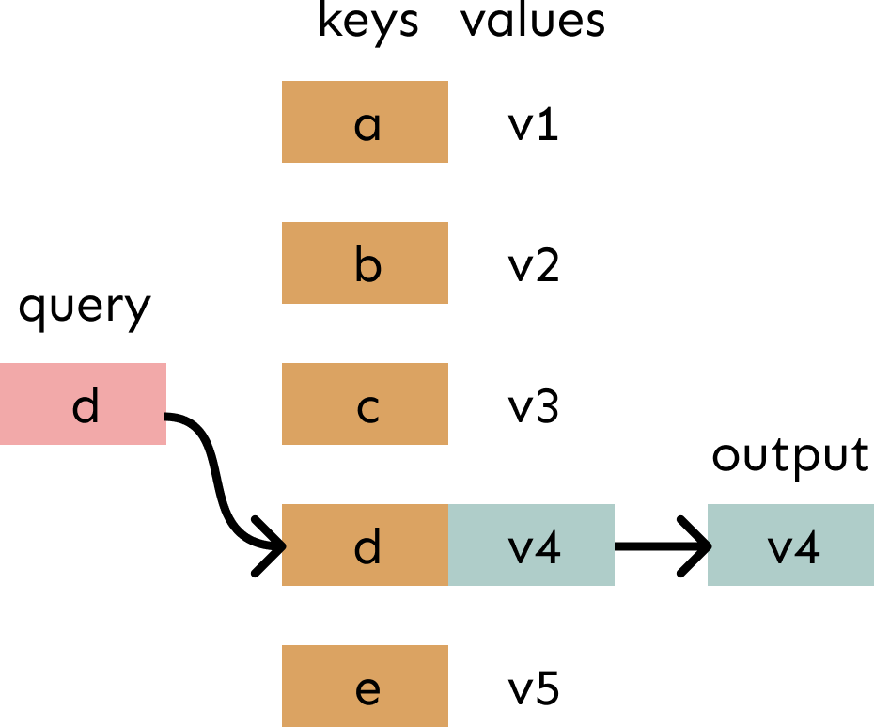
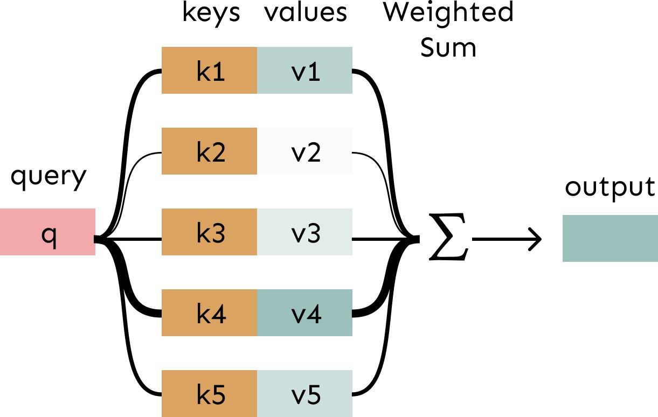
Attention is weighted averaging, which lets you do lookups!
Attention is just a weighted average – this is very powerful if the weights are learned!
In attention, the query matches all keys softly, to a weight between 0 and 1. The keys’ values are multiplied by the weights and summed.
In a lookup table, we have a table of keys that map to values. The query matches one of the keys, returning its value.

Slide 11
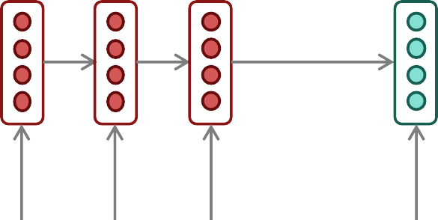
Sequence-to-sequence with attention
Core idea: on each step of the decoder, use direct connection to the encoder to focus on a particular part of the source sequence
dot product
Attention
scores
Decoder RNN
Encoder
RNN
il
a
m’ entarté
<START>
Source sentence (input)

Slide 12
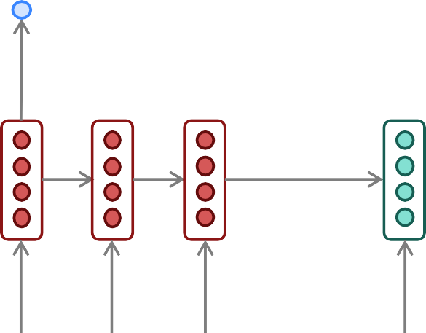
Sequence-to-sequence with attention
dot product
Attention
scores
Decoder RNN
Encoder
RNN
il
a
m’ entarté
<START>
Source sentence (input)

Slide 13
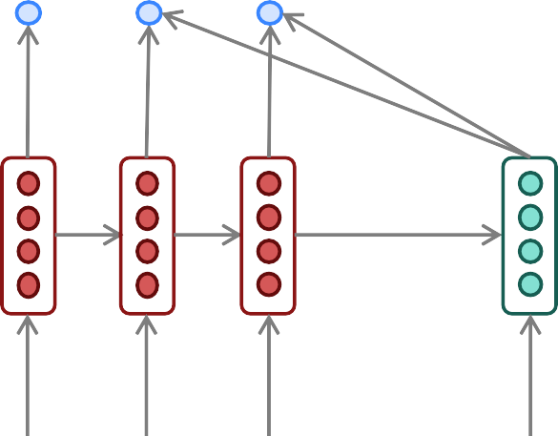
Sequence-to-sequence with attention
On this decoder timestep, we’re mostly focusing on the first encoder hidden state (”he”)
Attention
distribution
Take softmax to turn the scores into a probability distribution
Attention
scores
Decoder RNN
Encoder
RNN
il
a
m’ entarté
<START>
Source sentence (input)

Slide 14
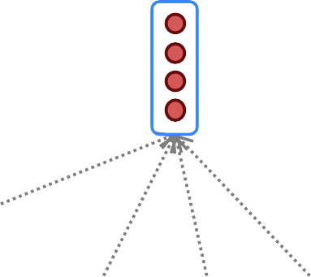
Sequence-to-sequence with attention
Attention
output
Use the attention distribution to take a
weighted sum of the encoder hidden states.
The attention output mostly contains information from the hidden states that received high attention.
Attention
distribution
Attention
scores
Decoder RNN
Encoder
RNN
il
a
m’ entarté
<START>
Source sentence (input)

Slide 15

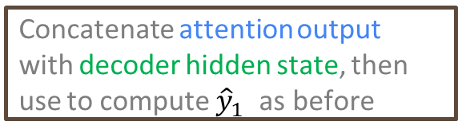
Sequence-to-sequence with attention
Attention
output
he
Concatenate attention output with decoder hidden state, then use to compute ${\hat{y}}_{1}$ as before
Attention
distribution
$${\hat{y}}_{1}$$
Attention
scores
Decoder RNN
Encoder
RNN
il
a
m’ entarté
<START>
Source sentence (input)

Slide 16
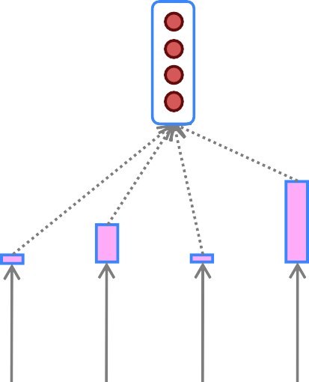
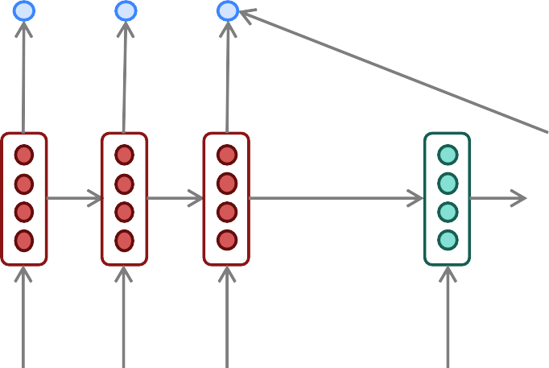

Sequence-to-sequence with attention
Attention
output
hit
Attention
distribution
$${\hat{y}}_{2}$$
Attention
scores
Decoder RNN
Encoder
RNN
Sometimes we take the attention output from the previous step, and also feed it into the decoder (along with the usual decoder input).
il
a
m’ entarté
<START> he
Source sentence (input)

Slide 17
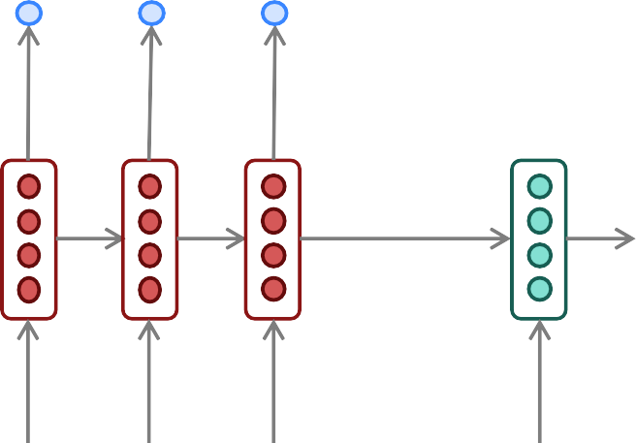
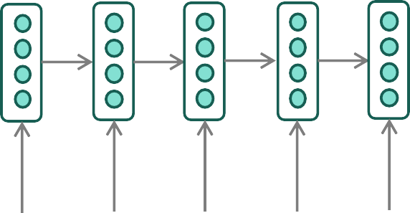

Sequence-to-sequence with attention
Attention
output
pie
Attention
distribution
$${\hat{y}}_{6}$$
Attention
scores
Decoder RNN
Encoder
RNN
il
a
m’ entarté
<START> he
hit
me with
a
Source sentence (input)

Slide 18
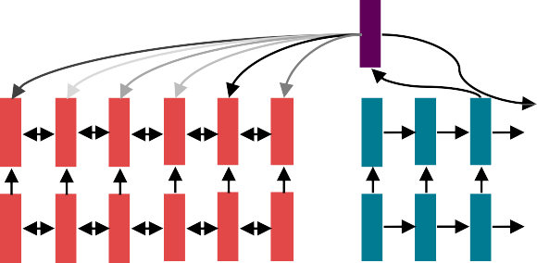


4. Do we even need recurrence at all?
Abstractly: Attention is a way to pass information from a sequence (𝑥) to a neural network input. (ℎ_{𝑡})
  This is also exactly what RNNs are used for – to pass information!
  Can we just get rid of the RNN entirely? Maybe attention is just a better way to pass
information!
Lots of trial
and error
2014-2017ish
Recurrence
2021
??????

Slide 19
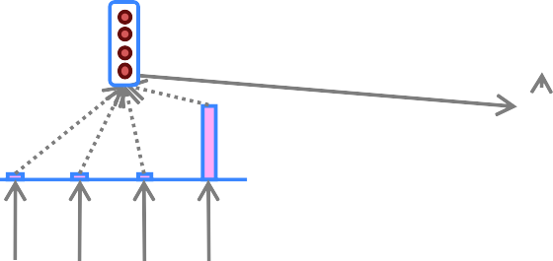
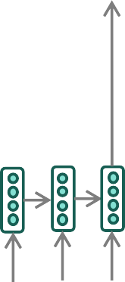
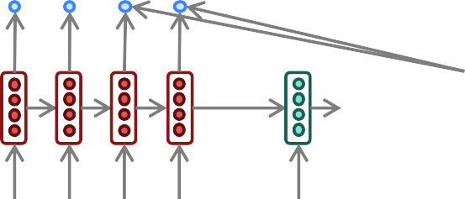
The building block we need: self attention
What we talked about – Cross attention: paying attention to the input x to generate 𝑦_{𝑡}
Attention output
wit
h
Attention
distribution
𝑦ො₄
Attention
scores
Encoder
RNN
il a
m’ entarté
<START>
he
hit me
Source sentence (input)
What we need – Self attention: to generate 𝑦_{𝑡}, we need to pay attention to 𝑦_{<𝑡}

Slide 20
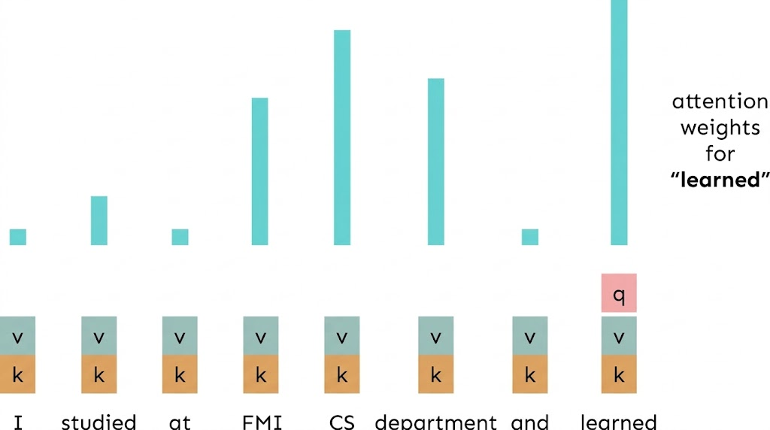
Self-Attention Hypothetical Example

Slide 21
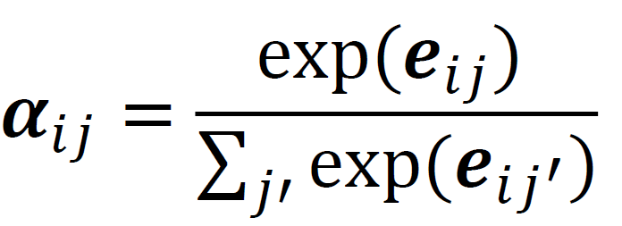
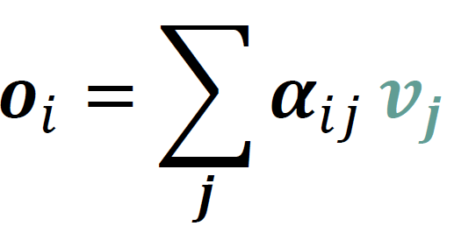
Self-Attention: keys, queries, values from the same sequence
Let 𝒘_{1:𝑛} be a sequence of words in vocabulary 𝑉, like Zuko made his uncle tea.
For each 𝒘_{𝑖} , let 𝒙_{𝑖} = 𝐸𝒘_{𝒊}, where 𝐸 ∈ ℝ^{𝑑×|𝑉|} is an embedding matrix.
1. Transform each word embedding with weight matrices Q, K, V , each in ℝ^{𝑑×𝑑}
𝒒_{𝑖} = 𝑄𝒙_{𝒊}
(queries)
𝒌_{𝑖} = 𝐾𝒙_{𝒊} (keys)
𝒗_{𝑖} = 𝑉𝒙_{𝒊}
(values)
2. Compute pairwise similarities between keys and queries; normalize with softmax
𝒆_{𝑖𝑗} = 𝒒⊤𝒌
𝒊 𝒋
3. Compute output for each word as weighted sum of values

Slide 22
Barriers and solutions for Self-Attention as a building block
Barriers
Doesn’t have an inherent
notion of order!
Solutions

Slide 23
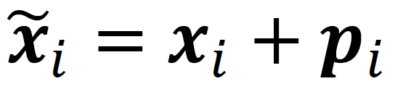
Fixing the first self-attention problem: sequence order
Since self-attention doesn’t build in order information, we need to encode the order of the
sentence in our keys, queries, and values.
Consider representing each sequence index as a vector
𝒑_{𝑖} ∈ ℝ^{𝑑}, for 𝑖 ∈ {1,2, … , 𝑛} are position vectors
Don’t worry about what the 𝑝_{𝑖} are made of yet!
Easy to incorporate this info into our self-attention block: just add the 𝒑_{𝑖} to our inputs!
Recall that 𝒙_{𝑖} is the embedding of the word at index 𝑖. The positioned embedding is:
In deep self-attention networks, we do this at the
first layer! You could concatenate them as well, but people mostly just add…

Slide 24

Position representation vectors through sinusoids
Sinusoidal position representations: concatenate sinusoidal functions of varying periods:
sin(𝑖/10000^{2∗1/𝑑}) cos(𝑖/10000^{2∗1/𝑑})
𝒑_{𝑖} =
𝑑
Dimension
sin(𝑖/10000^{2∗}2^{/𝑑})
𝑑
cos(𝑖/10000^{2∗}2^{/𝑑})
Index in the sequence
Pros:
  Periodicity indicates that maybe “absolute position” isn’t as important
  Maybe can extrapolate to longer sequences as periods restart!
Cons:
  Not learnable; also the extrapolation doesn’t really work!
24
Image: https://timodenk.com/blog/linear-relationships-in-the-transformers-positional-encoding/

Slide 25
Position representation vectors learned from scratch
Learned absolute position representations: Let all 𝑝_{𝑖} be learnable parameters! Learn a matrix 𝒑 ∈ ℝ^{𝑑×𝑛}, and let each 𝒑_{𝑖} be a column of that matrix!
Pros:
  Flexibility: each position gets to be learned to fit the data
Cons:
  Definitely can’t extrapolate to indices outside 1, … , 𝑛.
Most systems use this!
Sometimes people try more flexible representations of position:
  Relative linear position attention [Shaw et al., 2018]
  Dependency syntax-based position [Wang et al., 2019]

Slide 26
Barriers and solutions for Self-Attention as a building block
Barriers
Doesn’t have an inherent
notion of order!
Solutions
Add position representations to the inputs
No nonlinearities for deep learning! It’s all just weighted averages

Slide 27
Adding nonlinearities in self-attention
FF
FF
FF
self-attention
FF
Easy fix: add a feed-forward network
to post-process each output vector.
…
FF
FF
FF
self-attention
FF
…
𝑚_{𝑖} = 𝑀𝐿𝑃 output_{𝑖}
= 𝑊₂ ∗ ReLU 𝑊₁ output_{𝑖} + 𝑏₁
𝑤₂
chef
𝑤₃
who
𝑤_{𝑛}
food
+ 𝑏₂
𝑤₁
The
Intuition: the FF network processes the result of attention

Slide 28
Barriers and solutions for Self-Attention as a building block
Barriers
Doesn’t have an inherent
notion of order!
No nonlinearities for deep learning magic! It’s all just weighted averages
Need to ensure we don’t “look at the future” when predicting a sequence
  Like in machine translation
  Or language modeling
Solutions
Add position representations to the inputs
Easy fix: apply the same feedforward network to each self-attention output.

Slide 29
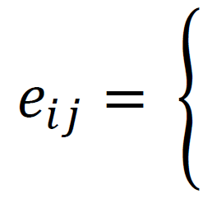
Masking the future in self-attention
We can look at these (not greyed out) words
To use self-attention in decoders, we need to ensure we can’t peek at the future.
 | −∞ −∞ −∞
 |  | −∞ −∞
 |  |  | −∞
[START]
At every timestep, we could change the set of keys and queries to include only past words. (Inefficient!)
To enable parallelization, we mask out attention to future words by setting attention
The
For encoding these words
chef
who
scores to −∞.
𝑞⊤𝑘_{𝑗}, 𝑗 ≤ 𝑖
𝑖
−∞, 𝑗 > 𝑖

Slide 30
Barriers and solutions for Self-Attention as a building block
Barriers
Doesn’t have an inherent
notion of order!
No nonlinearities for deep learning magic! It’s all just weighted averages
Need to ensure we don’t “look at the future” when predicting a sequence
  Like in machine translation
  Or language modeling
Solutions
Add position representations to the inputs
Easy fix: apply the same feedforward network to each self-attention output.
Mask out the future by artificially
setting attention weights!

Slide 31
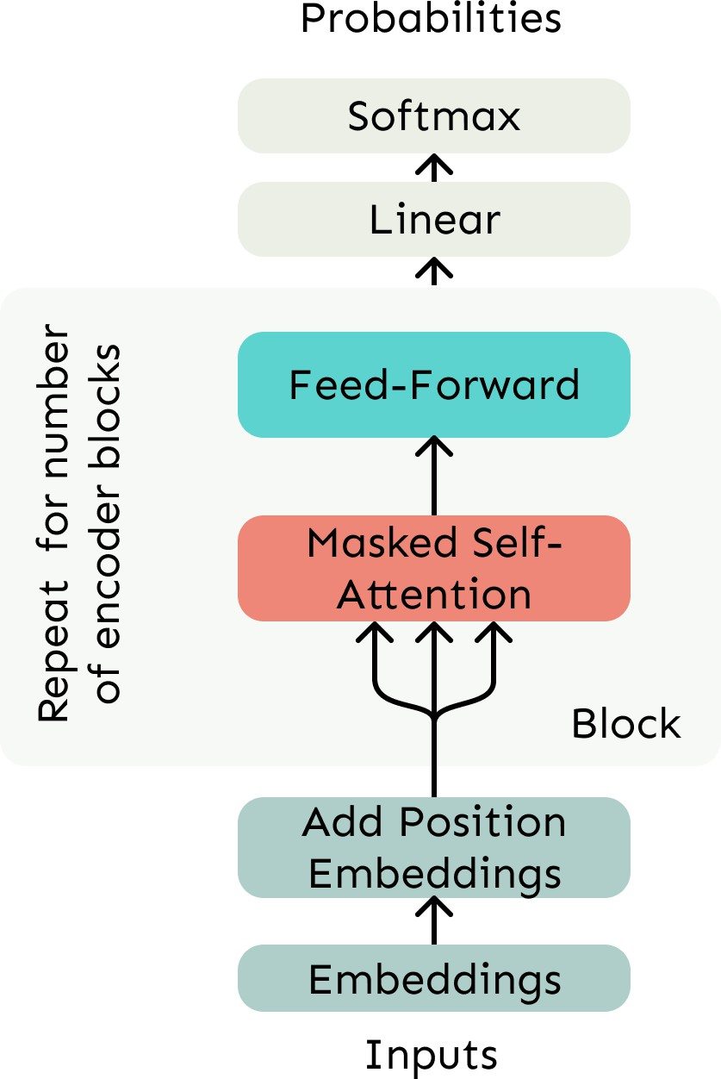
Necessities for a self-attention building block:
Transformer Decoder
Self-attention:
  the basis of the method.
Position representations:
  Specify the sequence order, since self-attention is an
unordered function of its inputs.
Nonlinearities:
  At the output of the self-attention block
  Frequently implemented as a simple feed-forward network.
Masking:
  In order to parallelize operations while not looking
at the future.
  Keeps information about the future from “leaking”
to the past.

Slide 32
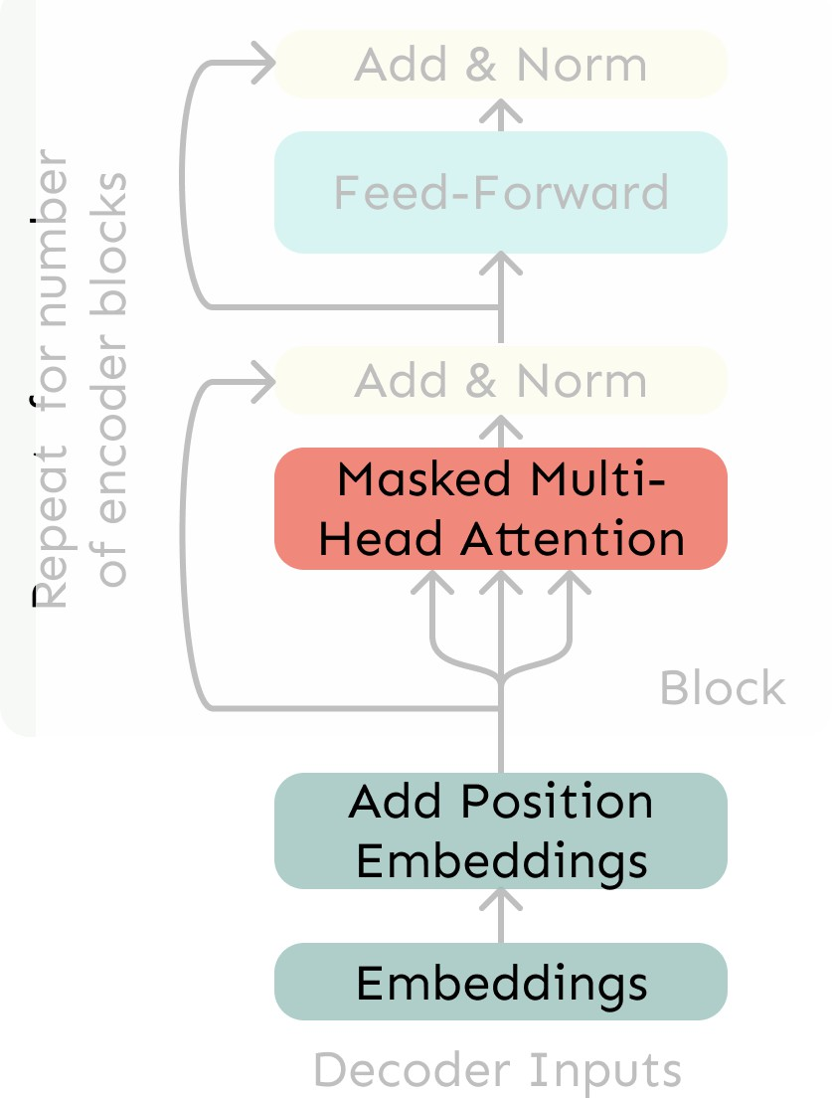
5. The Transformer Decoder
A Transformer decoder is how we’ll build systems like language models.
It’s a lot like our minimal self-attention architecture, but with a few more components.
The embeddings and position
embeddings are identical.
We’ll next replace our self-attention with multi-head self-attention.
Transformer Decoder

Slide 33
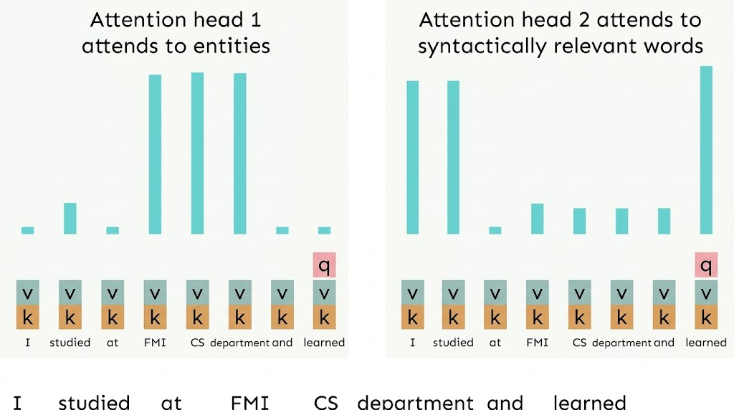
Hypothetical Example of Multi-Head Attention

Slide 34
Sequence-Stacked form of Attention
Let’s look at how key-query-value attention is computed, in matrices.
  Let 𝑋 = 𝑥₁; … ; 𝑥_{𝑛} ∈ ℝ^{𝑛×𝑑} be the concatenation of input vectors.
  First, note that 𝑋𝐾 ∈ ℝ^{𝑛×𝑑}, 𝑋𝑄 ∈ ℝ^{𝑛×𝑑}, 𝑋𝑉 ∈ ℝ^{𝑛×𝑑}.
⊤
The output is defined as output = softmax 𝑋𝑄 𝑋𝐾 𝑋𝑉 ∈ ℝ^{𝑛×𝑑}.
First, take the query-key dot products in one matrix
All pairs of attention scores!
= 𝑋𝑄𝐾⊤ 𝑋⊤
𝑋𝑄
multiplication: 𝑋𝑄 𝑋𝐾
⊤
_{𝐾}⊤ _{𝑋}⊤
∈ ℝ
𝑛×𝑛
Next, softmax, and compute the weighted average with another matrix multiplication.
softmax
𝑋𝑄𝐾⊤ 𝑋⊤
=
𝑋𝑉
output ∈ ℝ^{𝑛×𝑑}

Slide 35
Multi-headed attention
What if we want to look in multiple places in the sentence at once?
For word 𝑖, self-attention “looks” where 𝑥⊤𝑄⊤𝐾𝑥_{𝑗} is high, but maybe we want to
𝑖
focus on different 𝑗 for different reasons?
We’ll define multiple attention “heads” through multiple Q,K,V matrices
𝑑×^{𝑑}
Let, 𝑄_{ℓ}, 𝐾_{ℓ}, 𝑉_{ℓ} ∈ ℝ ^{ℎ}, where ℎ is the number of attention heads, and ℓ ranges from 1 to ℎ.
Each attention head performs attention independently:
output_{ℓ} = softmax 𝑋𝑄_{ℓ}𝐾⊤𝑋⊤ ∗ 𝑋𝑉_{ℓ}, where output_{ℓ} ∈ ℝ^{𝑛 × 𝑑/ℎ}
ℓ
Then the outputs of all the heads are combined!
  output = output₁, … , output_{ℎ} 𝑌, where 𝑌 ∈ ℝ^{𝑑×𝑑}
Each head gets to “look” at different things, and construct value vectors differently.

Slide 36
Multi-head self-attention is computationally efficient
Even though we compute ℎ many attention heads, it’s not really more costly.
  We compute 𝑋𝑄 ∈ ℝ^{𝑛×𝑑}, and then reshape to ℝ^{𝑛×ℎ×𝑑/ℎ}. (Likewise for 𝑋𝐾, 𝑋𝑉.)
  Then we transpose to ℝ^{ℎ×𝑛×𝑑/ℎ}; now the head axis is like a batch axis.
  Almost everything else is identical, and the matrices are the same sizes.
First, take the query-key dot products in one matrix
h=3 sets of all pairs of attention scores!
=
𝑋𝑄𝐾⊤ 𝑋⊤
𝑋𝑄
multiplication: 𝑋𝑄 𝑋𝐾
⊤
_{𝐾}⊤ _{𝑋}⊤
∈ ℝ
3×𝑛×𝑛
Next, softmax, and compute the weighted average with another matrix multiplication.
softmax
𝑋𝑄𝐾⊤ 𝑋⊤
X V
=
=
𝑃
mix
output ∈ ℝ^{𝑛×𝑑}
36

Slide 37
Scaled Dot Product [Vaswani et al., 2017]
“Scaled Dot Product” attention aids in training.
When dimensionality 𝑑 becomes large, dot products between vectors tend to
become large.
  Because of this, inputs to the softmax function can be large, making the
gradients small.
Instead of the self-attention function we’ve seen:
output_{ℓ} = softmax 𝑋𝑄_{ℓ}𝐾⊤𝑋⊤ ∗ 𝑋𝑉_{ℓ}
ℓ
We divide the attention scores by 𝑑/ℎ, to stop the scores from becoming large
just as a function of 𝑑/ℎ (The dimensionality divided by the number of heads.)
output_{ℓ} = softmax
𝑋𝑄_{ℓ}𝐾⊤𝑋⊤
∗ 𝑋𝑉_{ℓ}
ℓ
𝑑/ℎ

Slide 38

The Transformer Decoder
Now that we’ve replaced self-attention with multi-head self-attention, we’ll go through two optimization tricks that end up being :
  Residual Connections
  Layer Normalization
In most Transformer diagrams, these are often written
together as “Add & Norm”
Transformer Decoder

Slide 39
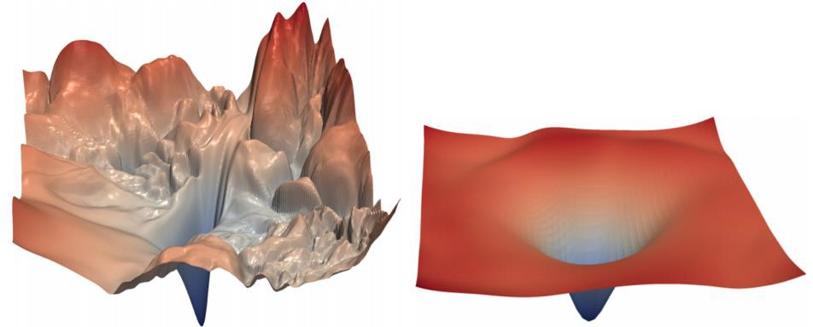
The Transformer Encoder: Residual connections [He et al., 2016]
Residual connections are a trick to help models train better.
  Instead of 𝑋^{(𝑖)} = Layer(𝑋 ^{𝑖−1} ) (where 𝑖 represents the layer)
_{𝑋}(𝑖−1) _{𝑋}(𝑖)
Layer
We let 𝑋^{(𝑖)} = 𝑋^{(𝑖−1)} + Layer(𝑋 ^{𝑖−1} ) (so we only have to learn “the residual”
from the previous layer)
_{𝑋}(𝑖−1) _{𝑋}(𝑖)
Layer
+
Gradient is great through the residual
connection; it’s 1!
Bias towards the identity function!
[no residuals] [residuals]
[Loss landscape visualization, Li et al., 2018, on a ResNet]
39

Slide 40
The Transformer Encoder: Layer normalization [Ba et al., 2016]
Layer normalization is a trick to help models train faster.
Idea: cut down on uninformative variation in hidden vector values by normalizing
to unit mean and standard deviation within each layer.
  LayerNorm’s success may be due to its normalizing gradients [Xu et al., 2019]
Let 𝑥 ∈ ℝ^{𝑑} be an individual (word) vector in the model.
Let 𝜇 = ¹ σ^{𝑑} 𝑥 ; this is the mean; 𝜇 ∈ ℝ.
𝑑
𝑗=1 𝑗
Let 𝜎 = ¹
Let 𝛾 ∈ ℝ^{𝑑} and 𝛽 ∈ ℝ^{𝑑} be learned “gain” and “bias” parameters. (Can omit!)
Then layer normalization computes:
𝑥 − 𝜇
_{σ}𝑑
2
𝑥_{𝑗} − 𝜇 ; this is the variance; 𝜎 ∈ ℝ.
𝑑
𝑗=1
output = ∗ 𝛾 + 𝛽
𝜎 + 𝜖
Normalize by scalar mean and variance
Modulate by learned elementwise gain and bias
40

Slide 41
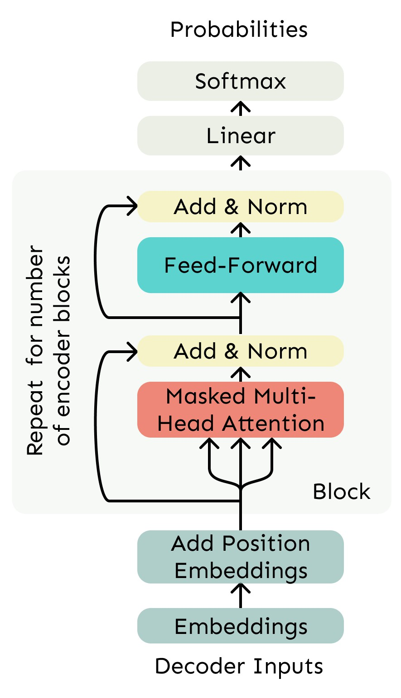
The Transformer Decoder
The Transformer Decoder is a stack
of Transformer Decoder Blocks.
Each Block consists of:
  Self-attention
  Add & Norm
  Feed-Forward
  Add & Norm
That’s it! We’ve gone through the
Transformer Decoder.
Transformer Decoder

Slide 42
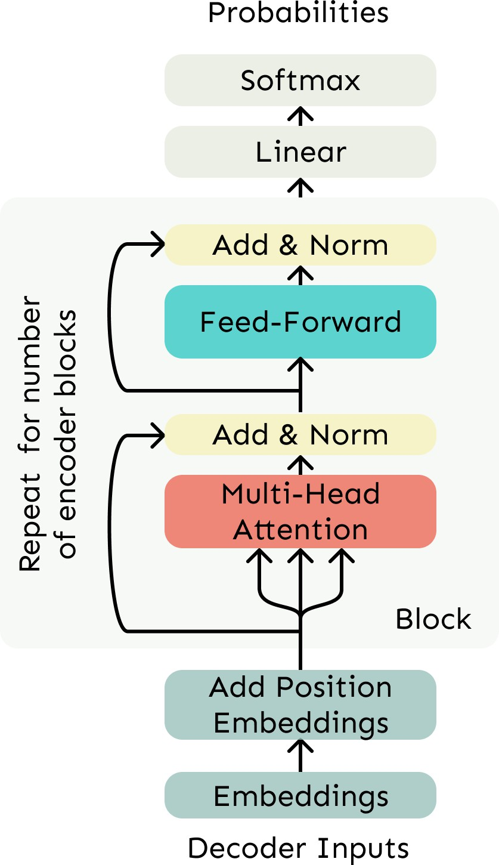

The Transformer Encoder
The Transformer Decoder constrains to unidirectional context, as for language models.
What if we want bidirectional context, like in a bidirectional RNN?
This is the Transformer Encoder. The only difference is that we remove the masking in the self-attention.
No Masking!
Transformer Decoder

Slide 43
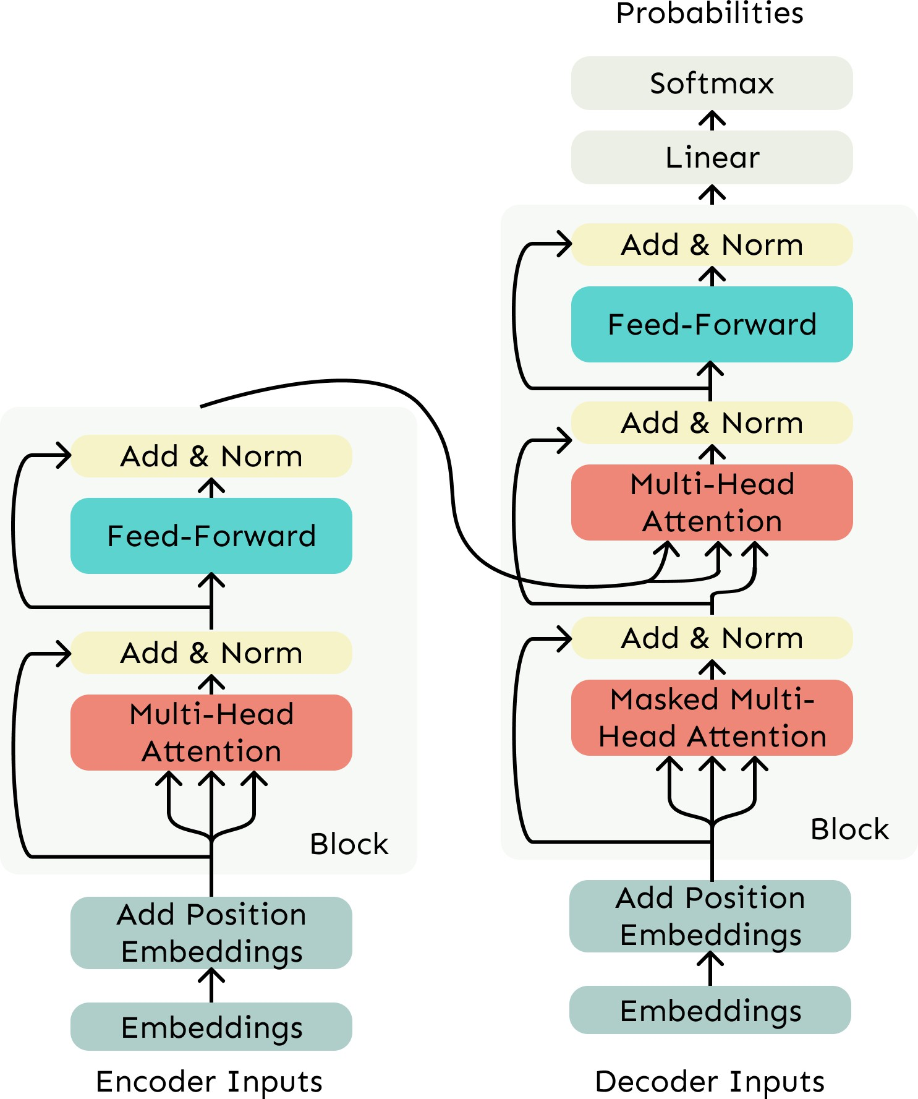
The Transformer Encoder-Decoder
In machine translation, we processed the source sentence with a bidirectional model and generated the target with a unidirectional model.
For this kind of seq2seq format, we often use a Transformer Encoder-Decoder.
We use a normal Transformer
Encoder.
Our Transformer Decoder is modified to perform cross-attention to the output of the Encoder.
43

Slide 44
Cross-attention (details)
We saw that self-attention is when keys, queries, and values come from the same source (shown in decoder)
Let ℎ₁, … , ℎ_{𝑛} be output vectors from the
Transformer encoder; 𝑥_{𝑖} ∈ ℝ^{𝑑}
ℎ₁, … , ℎ_{𝑛}
𝑧 , … , 𝑧
1
𝑛
Let 𝑧 , … , 𝑧 be input vectors from the
1 𝑛
Transformer decoder, 𝑧_{𝑖} ∈ ℝ^{𝑑}
Then keys and values are drawn from the
encoder (like a memory):
  𝑘_{𝑖} = 𝐾ℎ_{𝑖}, 𝑣_{𝑖} = 𝑉ℎ_{𝑖}.
And the queries are drawn from the
decoder, 𝑞_{𝑖} = 𝑄𝑧_{𝑖}.
44

Slide 45
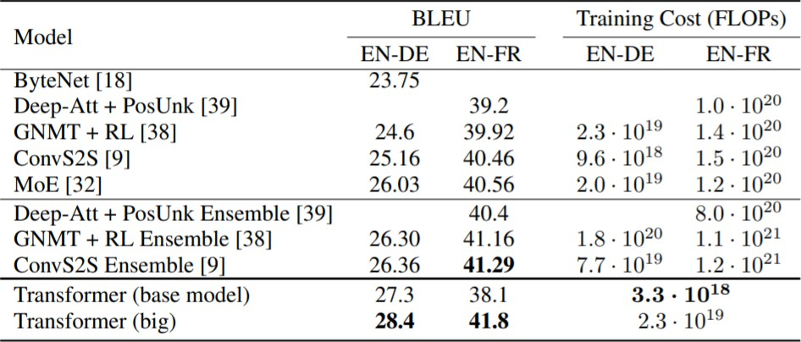
6. Great Results with Transformers
First, Machine Translation from the original Transformers paper!
Not just better Machine Also more efficient to
Translation BLEU scores train!
45 [Test sets: WMT 2014 English-German and English-French]
[Vaswani et al., 2017]

Slide 46
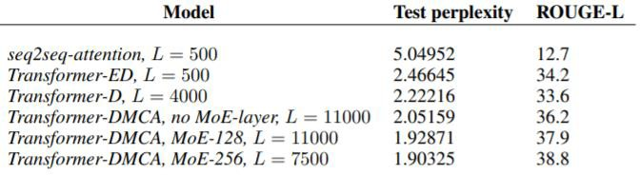
Great Results with Transformers
Next, document generation!
The old standard
Transformers all the way down.
[Liu et al., 2018]; WikiSum dataset
46

Slide 47
What would we like to fix about the Transformer?
Quadratic compute in self-attention (today):
  Computing all pairs of interactions means our computation grows
quadratically with the sequence length!
  What if the seq length 𝒏 ≥ 𝟓𝟎, 𝟎𝟎𝟎? E.g., to work on long documents
Position representations:
  Are simple absolute indices the best we can do to represent position?
  Relative linear position attention [Shaw et al., 2018]
  Dependency syntax-based position [Wang et al., 2019]

Slide 48
Do we even need to remove the quadratic cost of attention?
As Transformers grow larger, a larger and larger percent of compute is outside
the self-attention portion, despite the quadratic cost.
In practice, almost no large Transformer language models use anything but the
quadratic cost attention we’ve presented here.
  The cheaper methods tend not to work as well at scale.
So, is there no point in trying to design cheaper alternatives to self-attention?
Or would we unlock much better models with much longer contexts (>100k
tokens?) if we were to do it right?

Slide 49
Modern Transformer
design choices
49
Notes:
Section divider. The next 27 slides select core architectural mechanisms from the archived lecture 3 and former lecture 4.

Slide 50
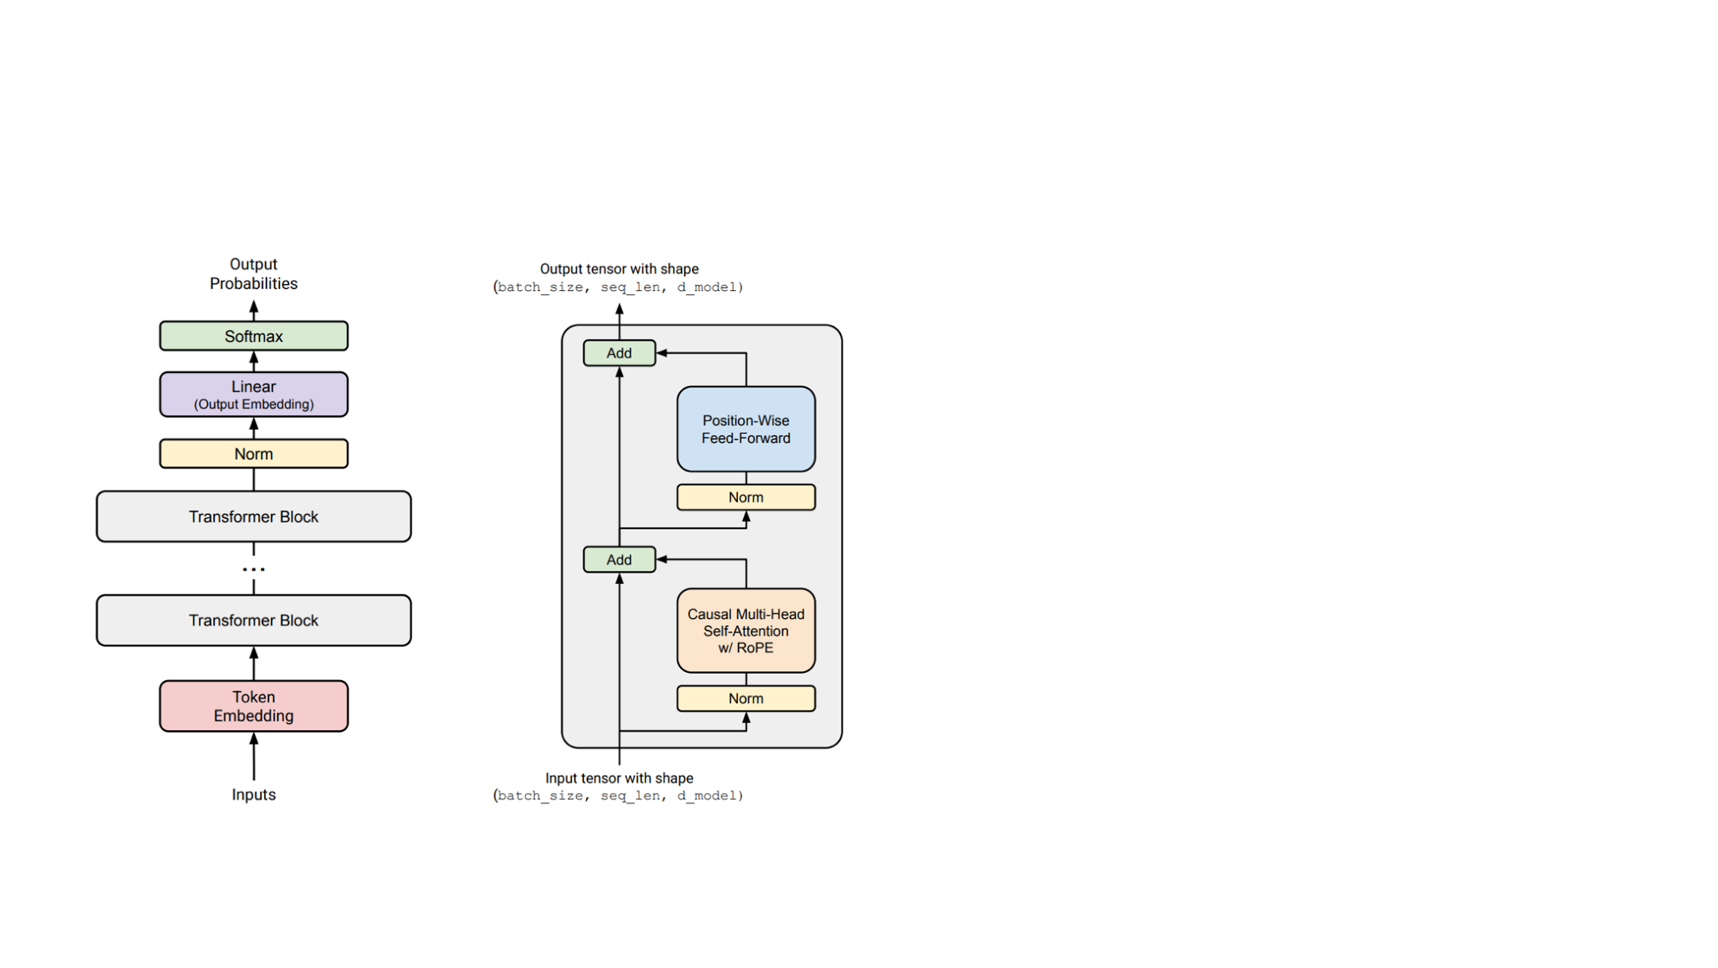
A modern Transformer block
Common choices
Pre-norm: normalize before attention and the feedforward layer.
RoPE: encode position in queries and keys.
SwiGLU: gate the feedforward activations.
Bias terms are often omitted in linear layers and normalization.
50
Notes:
Adapted from C:\Work\PPCLLM\additionals\lecture_03_lm_architecture_and_hyperparameters.pdf, PDF page 4. Original figures and mathematical artwork retained.

Slide 51
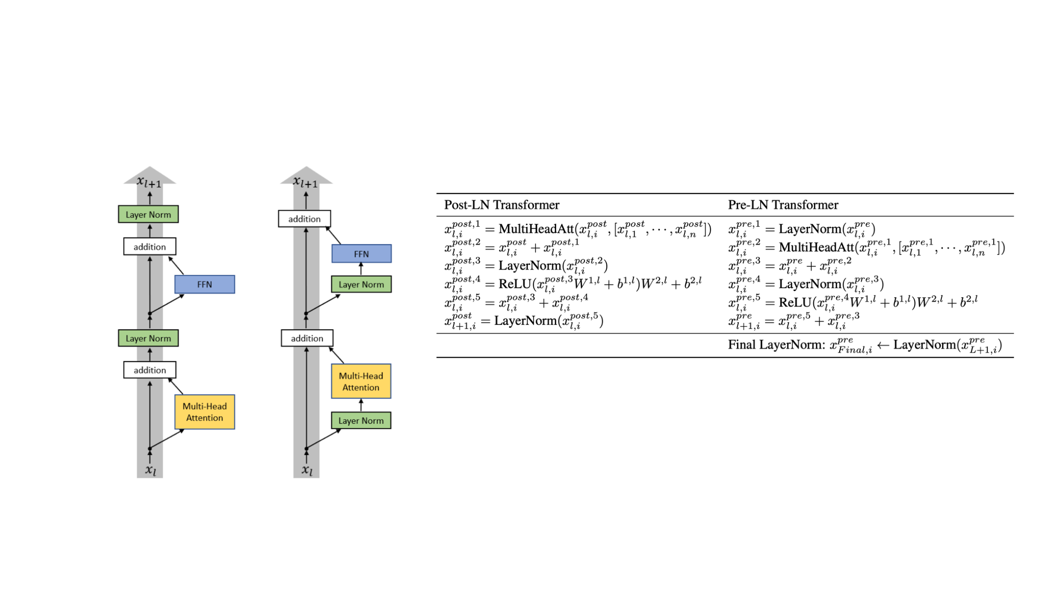
Pre-norm and the residual path
Normalize the input to each attention or feedforward sublayer.
Set up LayerNorm so that it doesn’t affect the
main residual signal path (on the left)
Figure from Xiong 2020
Pre-norm keeps a direct residual path through the block.
51
Notes:
Adapted from C:\Work\PPCLLM\additionals\lecture_03_lm_architecture_and_hyperparameters.pdf, PDF page 10. Original figures and mathematical artwork retained.

Slide 52
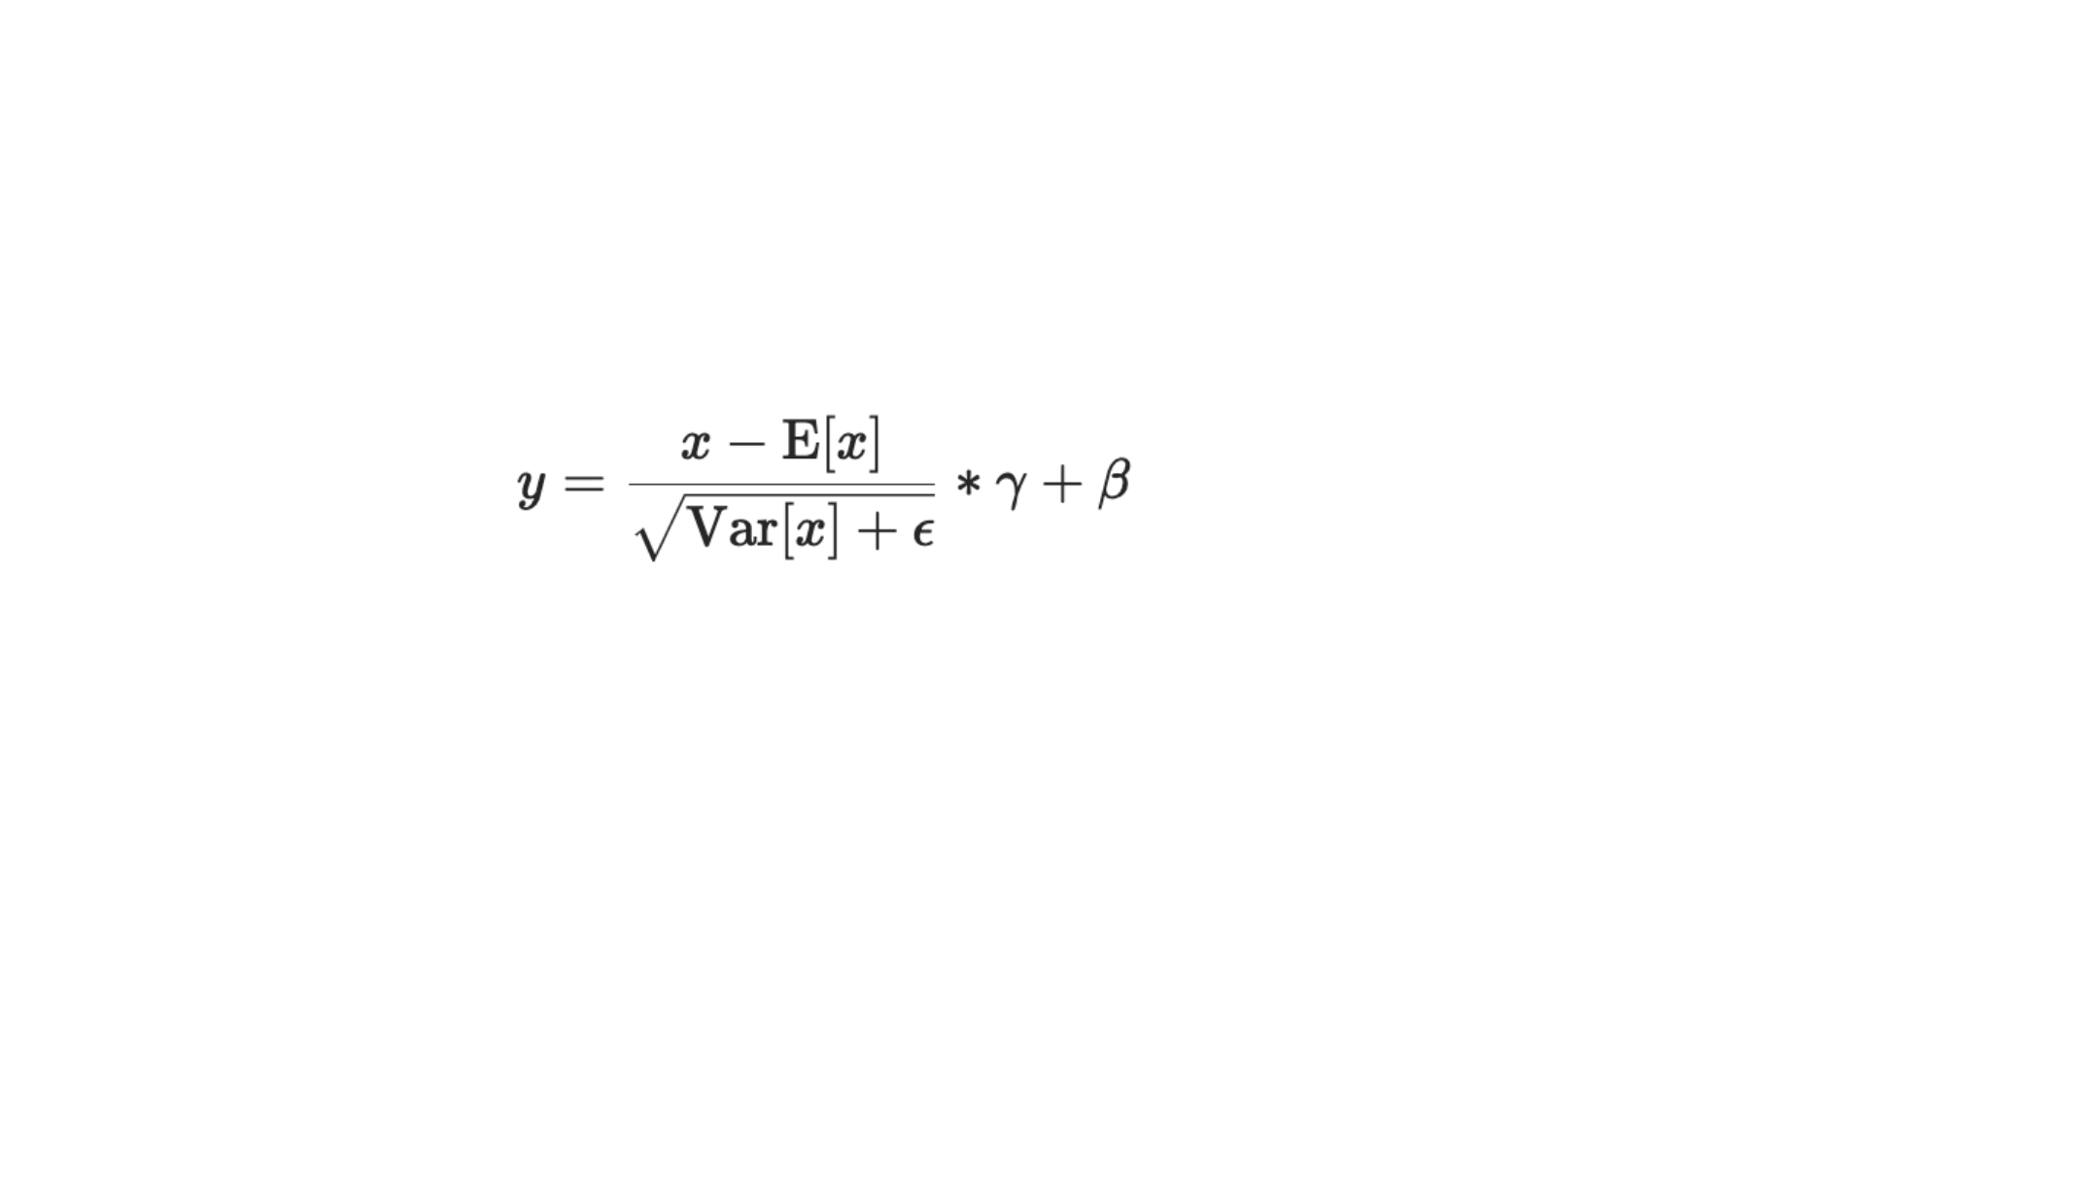
LayerNorm and RMSNorm
LayerNorm normalizes the mean and variance across the hidden dimensions.
LayerNorm
Center and rescale each token across its hidden dimensions.
RMSNorm rescales without subtracting the mean.
RMSNorm
Use the root mean square; commonly omit the additive bias.
rms(x) = √[(1/d) ∑ᵢ xᵢ² + ε]
yᵢ = γᵢ xᵢ / rms(x)
52
Notes:
Adapted from C:\Work\PPCLLM\additionals\lecture_03_lm_architecture_and_hyperparameters.pdf, PDF page 14. Original figures and mathematical artwork retained.
RMSNorm formula corrected to include the mean over d coordinates. Zhang and Sennrich (2019), https://arxiv.org/abs/1910.07467

Slide 53
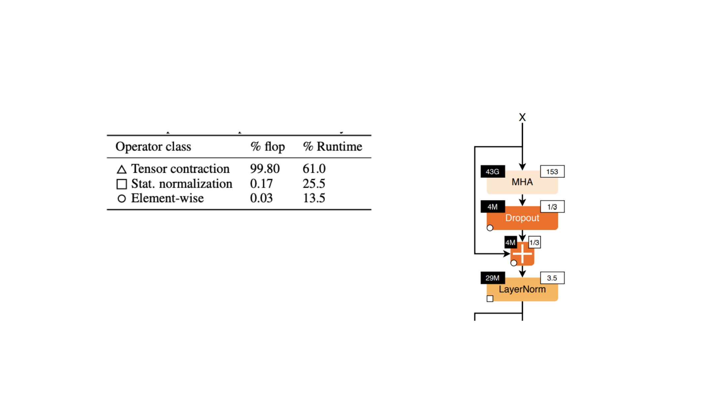
Normalization and data movement
Few FLOPs do not necessarily mean little runtime.
△ Tensor contraction
□ Normalization
○ Element-wise
RMSNorm can still matter due to
the importance of data movement
Left top (”43G”) is FLOPS
Right top (“153”) is the FLOP-to-memory ratio
53
[Ivanov et al 2023]
Notes:
Adapted from C:\Work\PPCLLM\additionals\lecture_03_lm_architecture_and_hyperparameters.pdf, PDF page 16. Original figures and mathematical artwork retained.

Slide 54
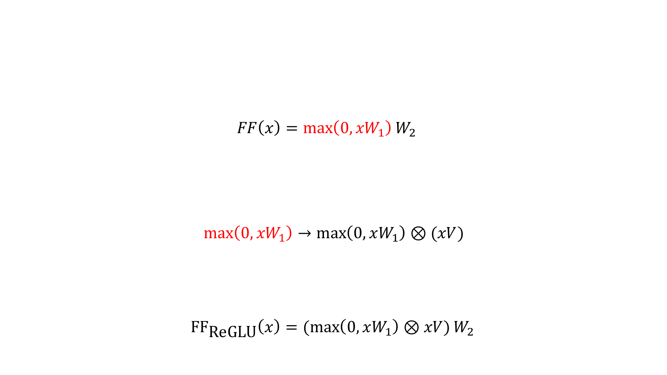
Gated feedforward layers
GLUs modify the ‘first part’ of a FF layer
Instead of a linear + ReLU, augment the above with an (entrywise) linear term
This gives the gated variant (ReGLU) – note that we have an extra parameter (V)
54
Notes:
Adapted from C:\Work\PPCLLM\additionals\lecture_03_lm_architecture_and_hyperparameters.pdf, PDF page 22. Original figures and mathematical artwork retained.

Slide 55
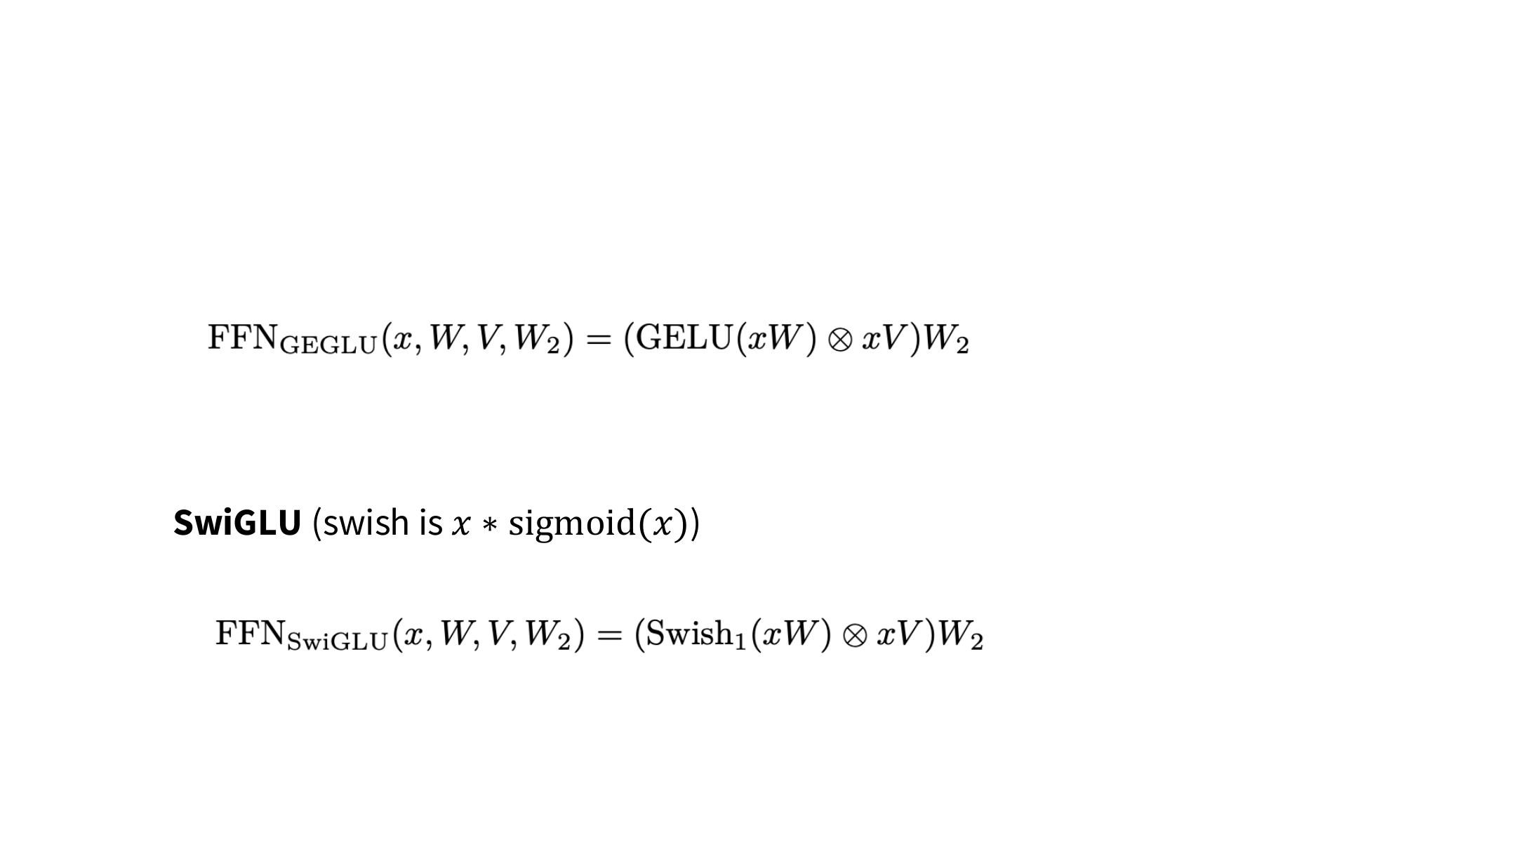
GeGLU and SwiGLU
GeGLU
The gate multiplies two projections element by element.
Three weight matrices instead of two.
To keep parameter count similar, use about 2/3 of the ungated FFN width.
55
Notes:
Adapted from C:\Work\PPCLLM\additionals\lecture_03_lm_architecture_and_hyperparameters.pdf, PDF page 23. Original figures and mathematical artwork retained.

Slide 56
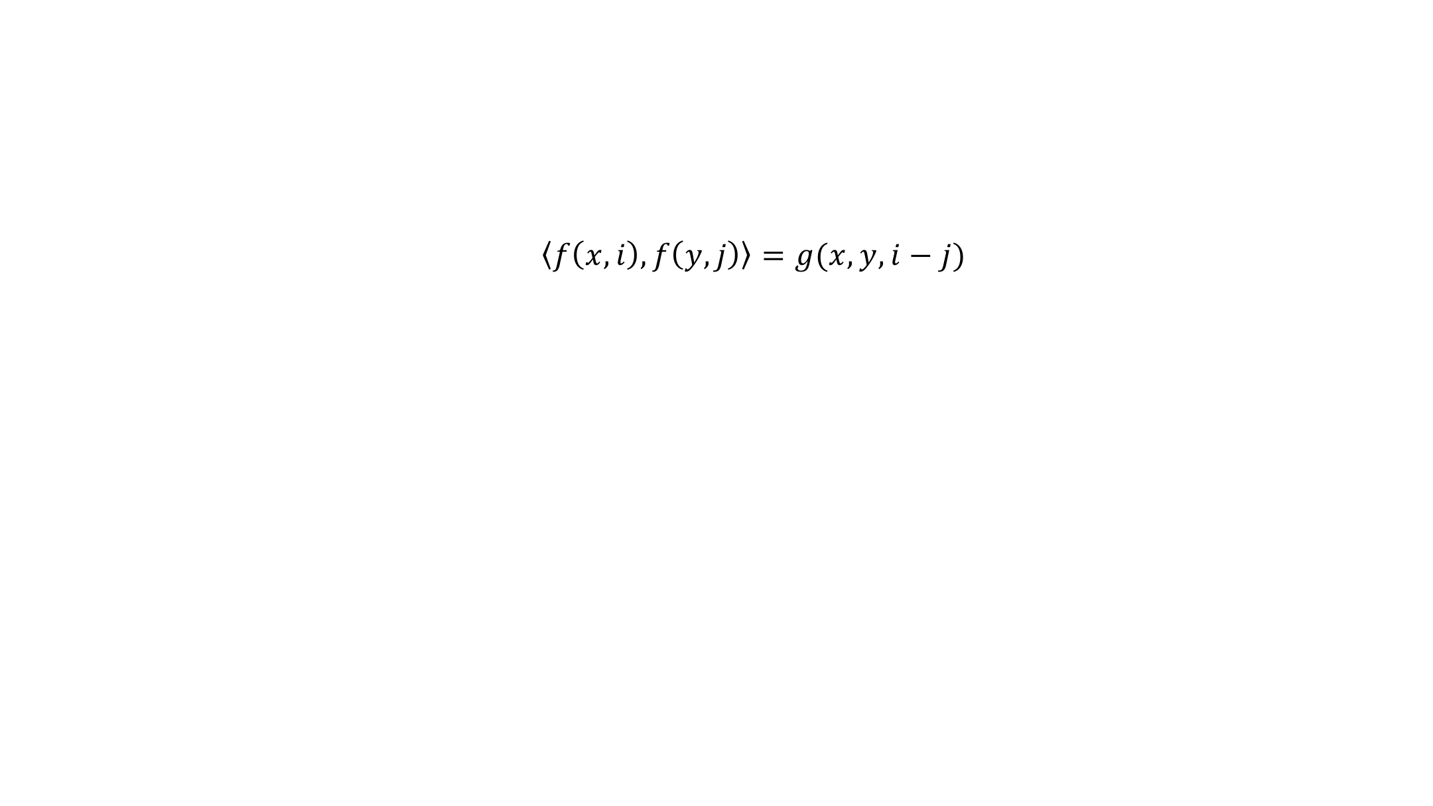
RoPE: relative position through rotation
The query–key inner product should depend on relative position i − j.
Keep the content vectors x and y, but make the positional dependence relative.
Adding position embeddings introduces content–position cross terms.
RoPE instead rotates queries and keys before computing their inner product.
56
Notes:
Adapted from C:\Work\PPCLLM\additionals\lecture_03_lm_architecture_and_hyperparameters.pdf, PDF page 31. Original figures and mathematical artwork retained.

Slide 57
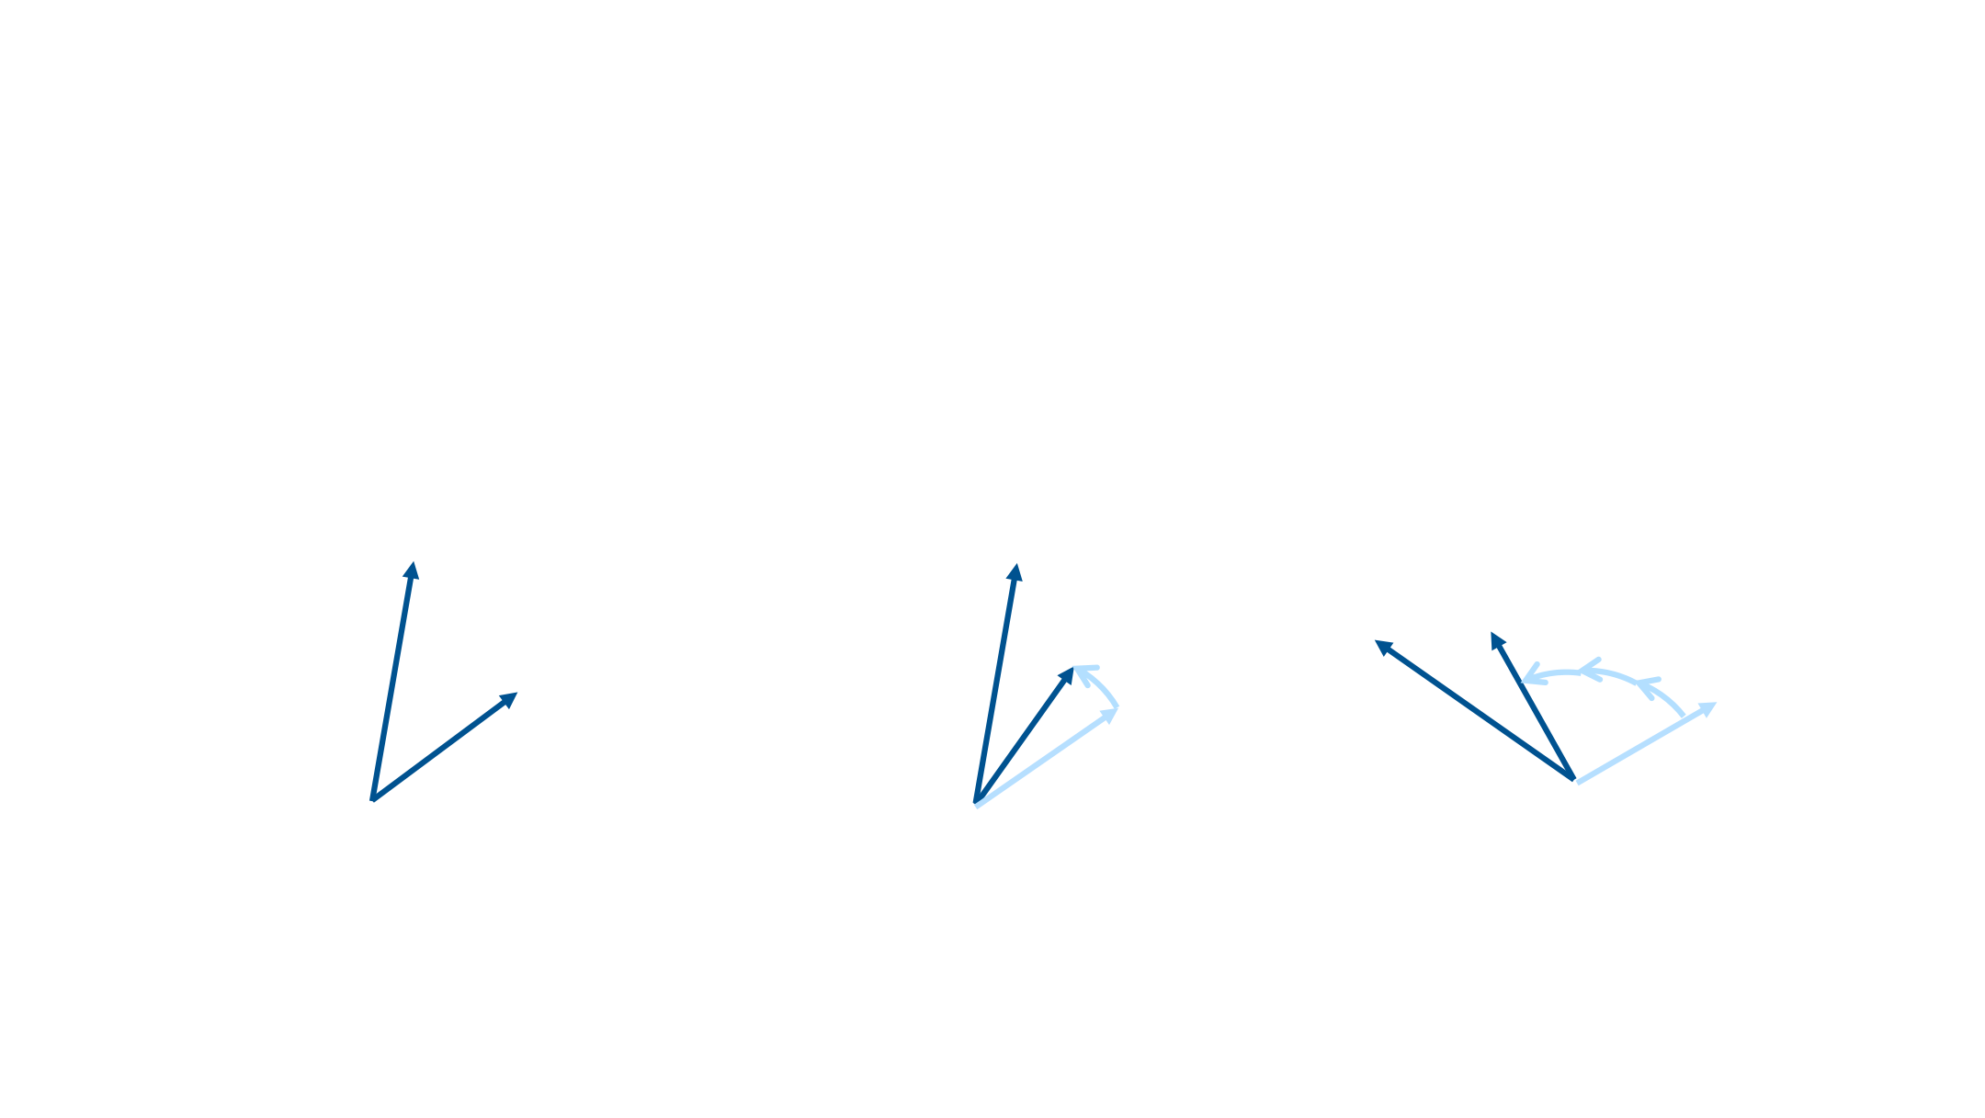
RoPE: rotation intuition
Rotate each vector by an angle determined by its position.
A common shift rotates both vectors equally; their inner product is unchanged.
we
we
know
know
know
we
Embedding
Embedding
Position independent
“we know that”
“of course we know”
embedding
Rotate we by ‘0 positions’
Rotate we by ‘2 positions’
57
know by ‘1 position’
Rotate know by ‘3 positions’
Notes:
Adapted from C:\Work\PPCLLM\additionals\lecture_03_lm_architecture_and_hyperparameters.pdf, PDF page 32. Original figures and mathematical artwork retained.

Slide 58
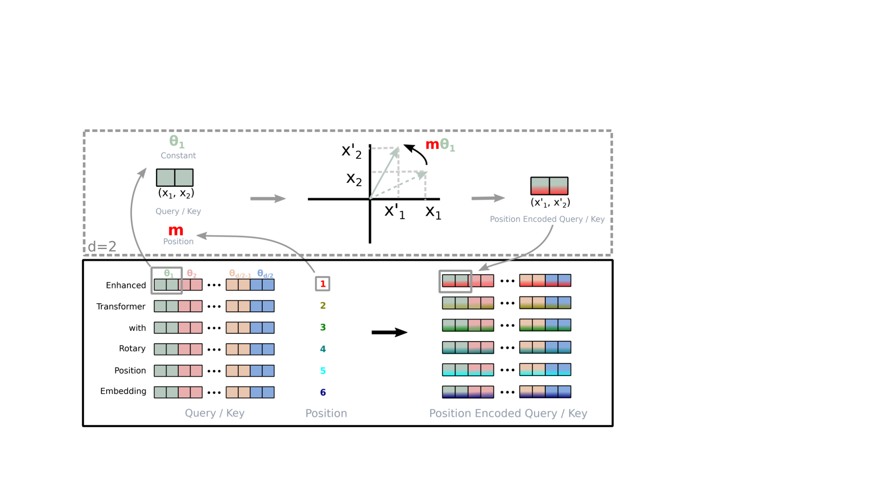
RoPE: rotate coordinate pairs
There are many rotations, which one do you pick?
Each coordinate pair has its own rotation frequency.
[Su et al 2021]
Just pair up the coordinates and rotate them in 2d (motivation: complex numbers)
58
Notes:
Adapted from C:\Work\PPCLLM\additionals\lecture_03_lm_architecture_and_hyperparameters.pdf, PDF page 33. Original figures and mathematical artwork retained.
Figure retained from Su et al. (2021). The omitted model-specific sidebar is not needed for the paired-coordinate mechanism.

Slide 59
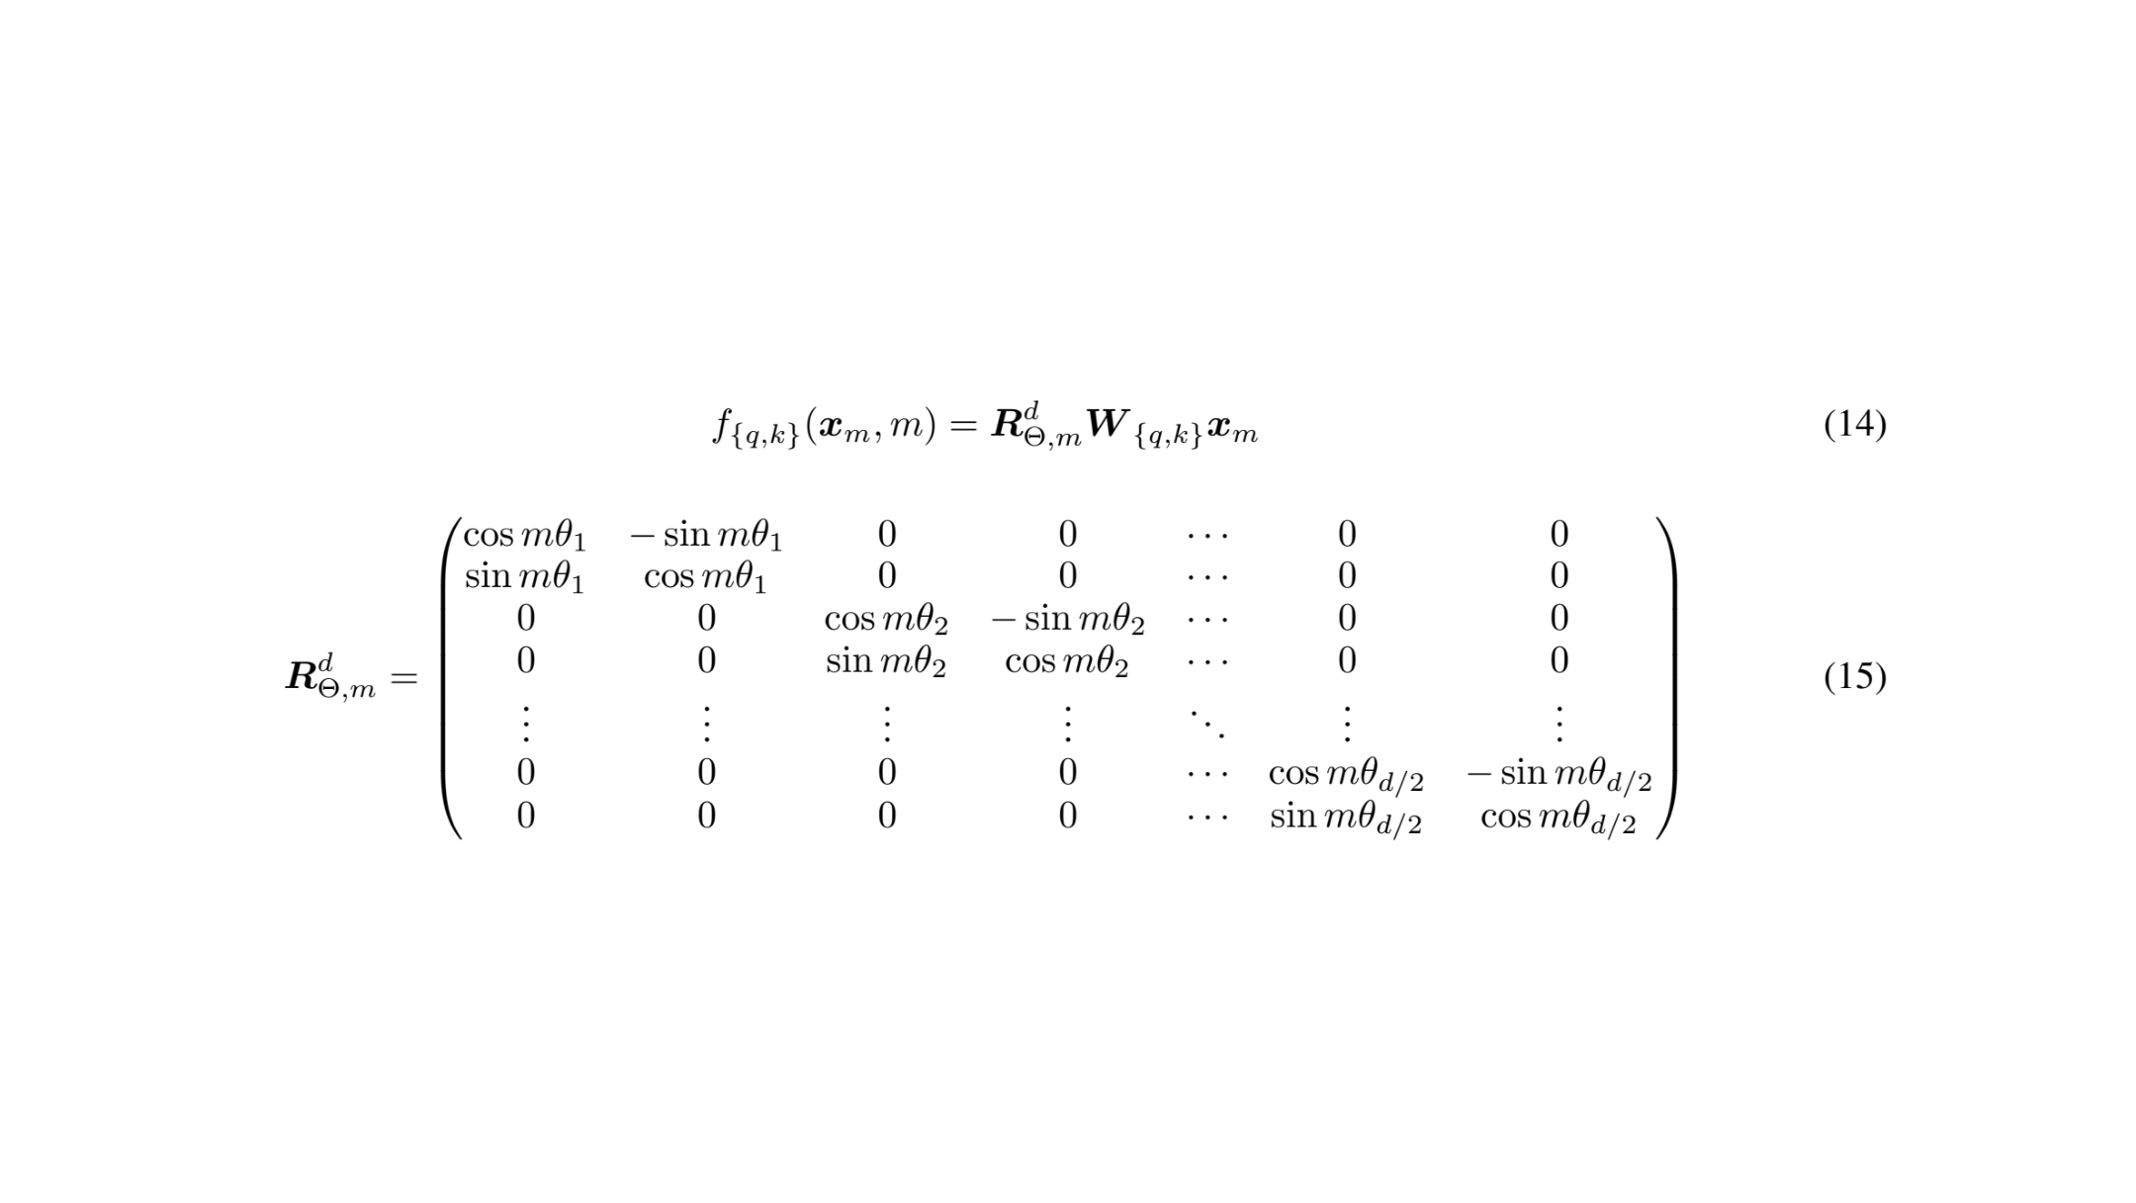
RoPE: the rotation matrix
Multiply with sines and cosines
m is the token position; θᵢ is the rotation frequency for coordinate pair i.
59
Notes:
Adapted from C:\Work\PPCLLM\additionals\lecture_03_lm_architecture_and_hyperparameters.pdf, PDF page 34. Original figures and mathematical artwork retained.

Slide 60
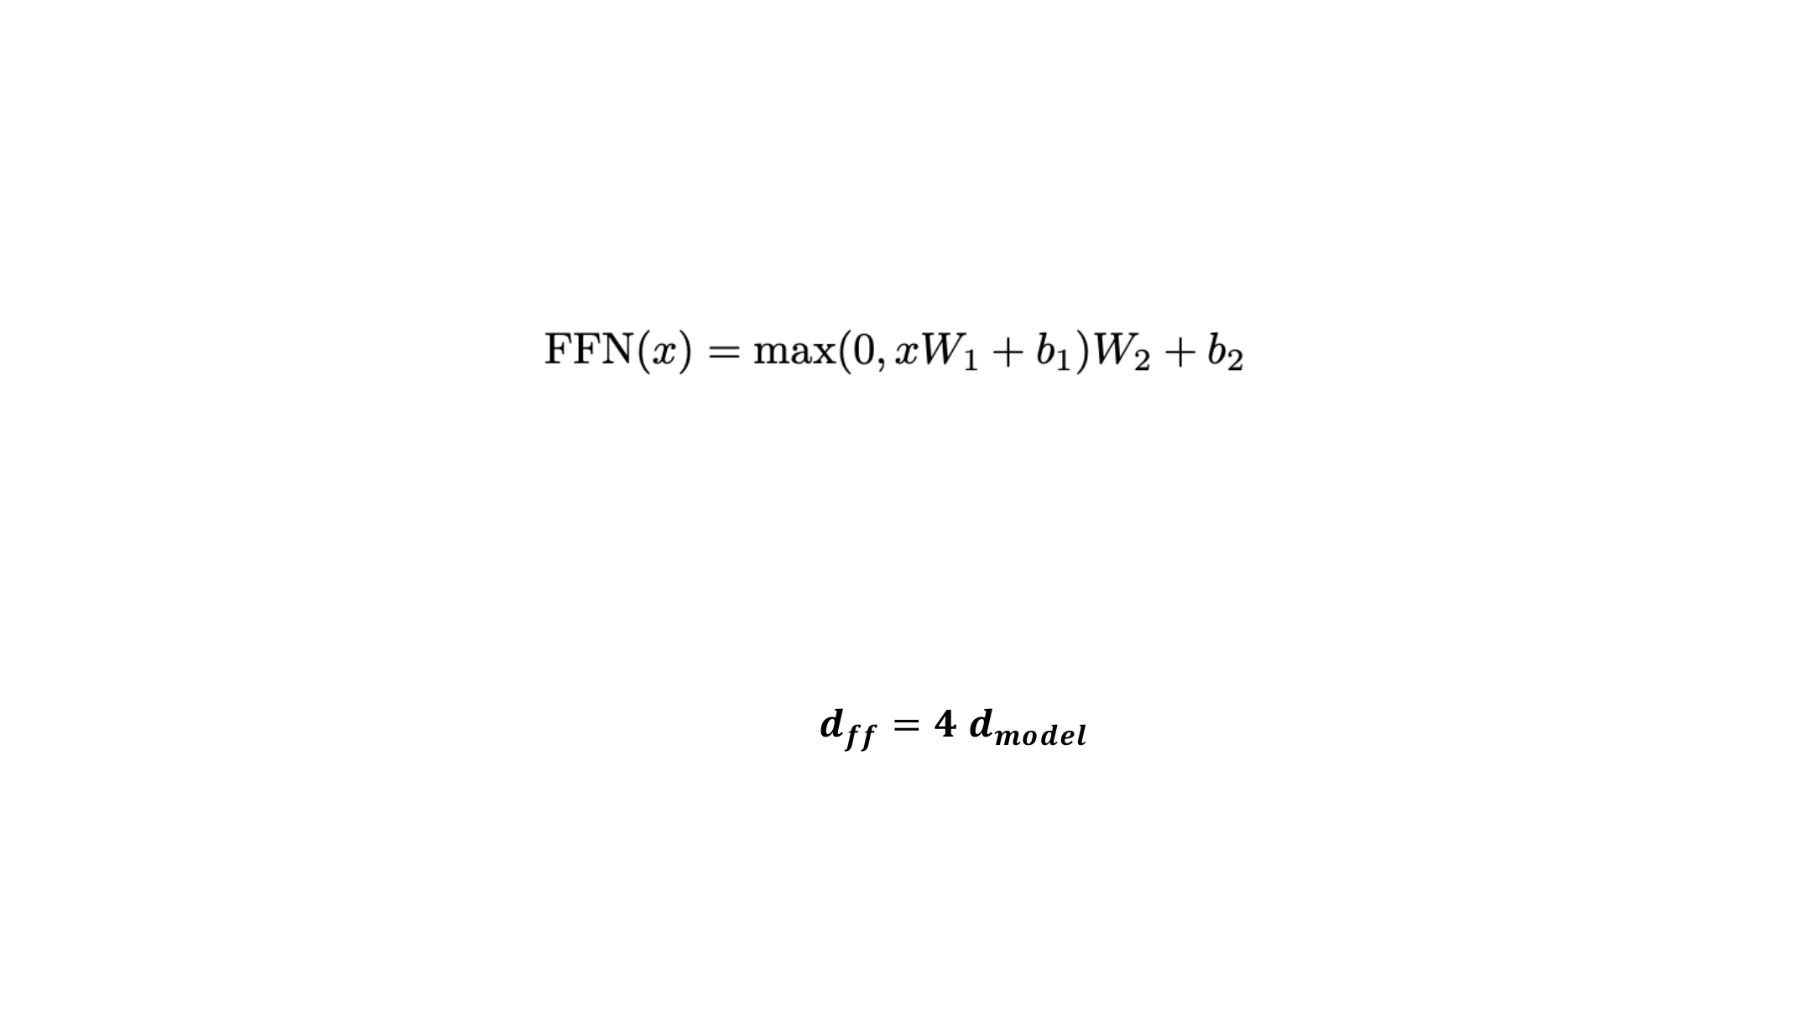
Feedforward width
An ungated feedforward layer uses two weight matrices.
The hidden FFN dimension is usually larger than the model dimension.
A common ungated baseline is 4×; with gating, about 8/3× gives a similar parameter count.
60
Notes:
Adapted from C:\Work\PPCLLM\additionals\lecture_03_lm_architecture_and_hyperparameters.pdf, PDF page 37. Original figures and mathematical artwork retained.

Slide 61
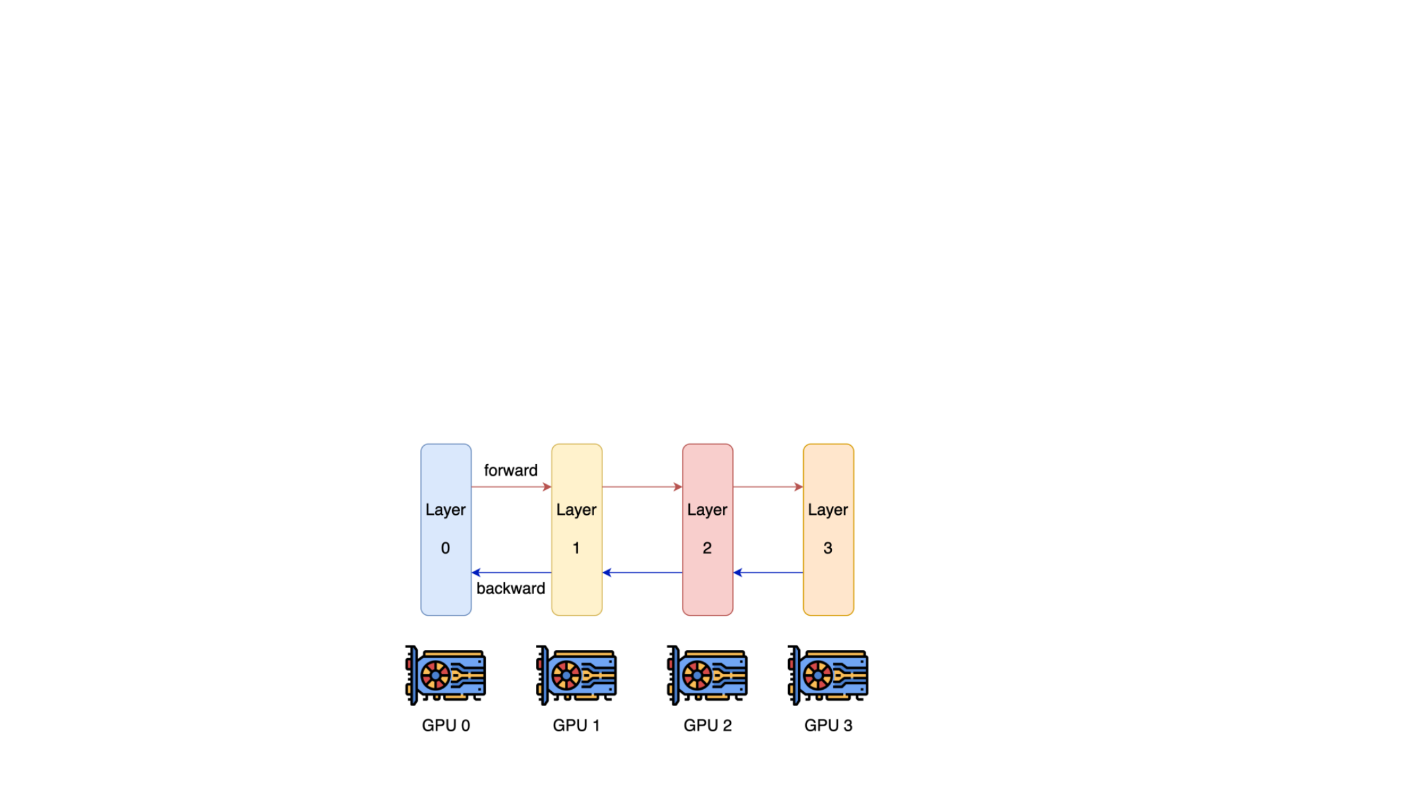
Depth, width, and parallelism
Extremely deep models are harder to parallelize and have higher latency
Depth creates sequential dependencies: each layer waits for the previous layer.
Width allows matrix operations to be split across devices. Pipeline parallelism places groups of layers on separate devices.
[Tay et al 2021]
61
Notes:
Adapted from C:\Work\PPCLLM\additionals\lecture_03_lm_architecture_and_hyperparameters.pdf, PDF page 45. Original figures and mathematical artwork retained.

Slide 62
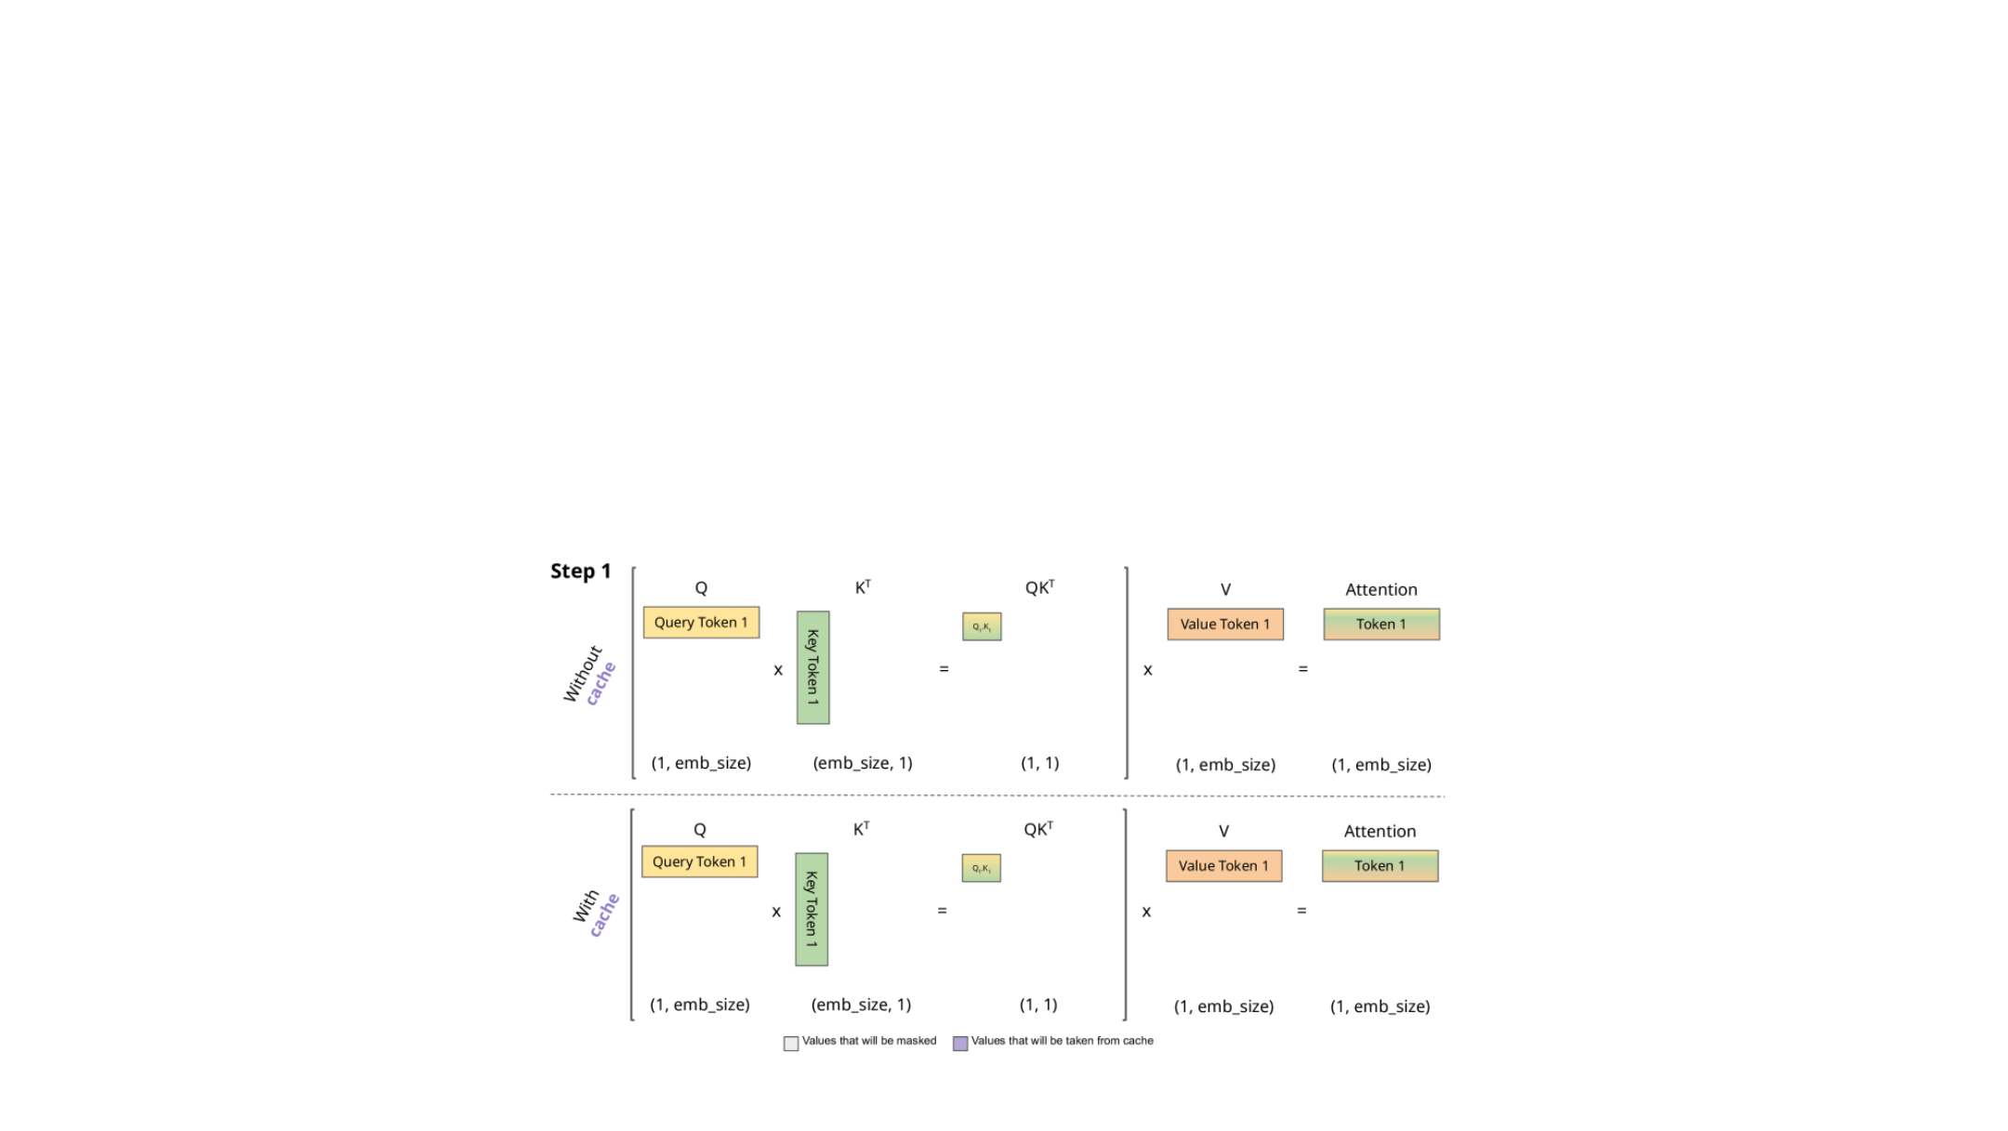
Autoregressive decoding and the KV cache
Generate one token at a time: each new token depends on earlier tokens.
Cache the keys and values of past tokens in every attention layer.
Compute only the new token’s Q, K, and V; attend over cached and new K/V.
62
KV cache illustration: João Lages, “KV caching explained”
Notes:
Adapted from C:\Work\PPCLLM\additionals\lecture_03_lm_architecture_and_hyperparameters.pdf, PDF page 59. Original figures and mathematical artwork retained.
Original illustration: https://medium.com/@joaolages/kv-caching-explained-276520203249

Slide 63
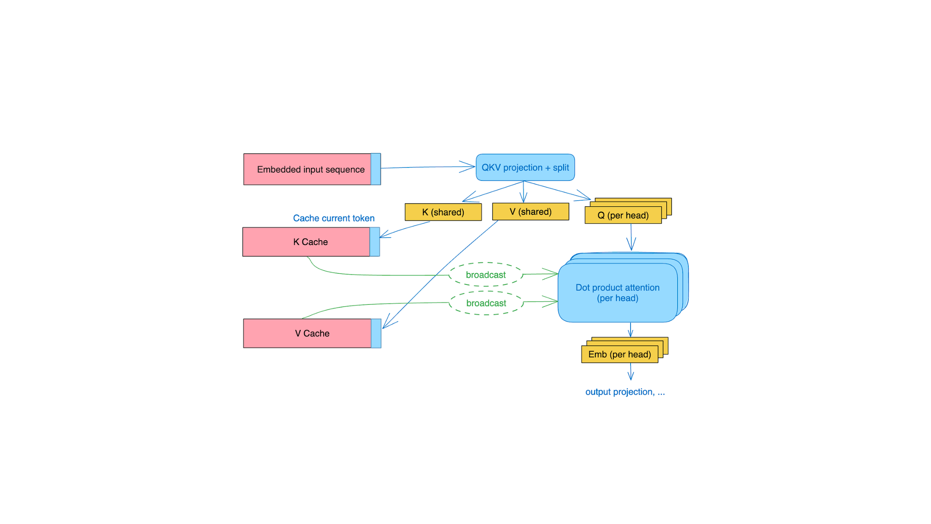
Multi-query attention (MQA)
Many query heads share one key head and one value head.
A smaller KV cache reduces memory traffic during decoding.
Each shared head still contains a vector of features.
63
MQA diagram: Fireworks AI
Notes:
Adapted from C:\Work\PPCLLM\additionals\lecture_03_lm_architecture_and_hyperparameters.pdf, PDF page 61. Original figures and mathematical artwork retained.
Shazeer (2019), https://arxiv.org/abs/1911.02150. MQA shares KV heads, not a single scalar dimension. Original diagram: https://blog.fireworks.ai/multi-query-attention-is-all-you-need-db072e758055

Slide 64
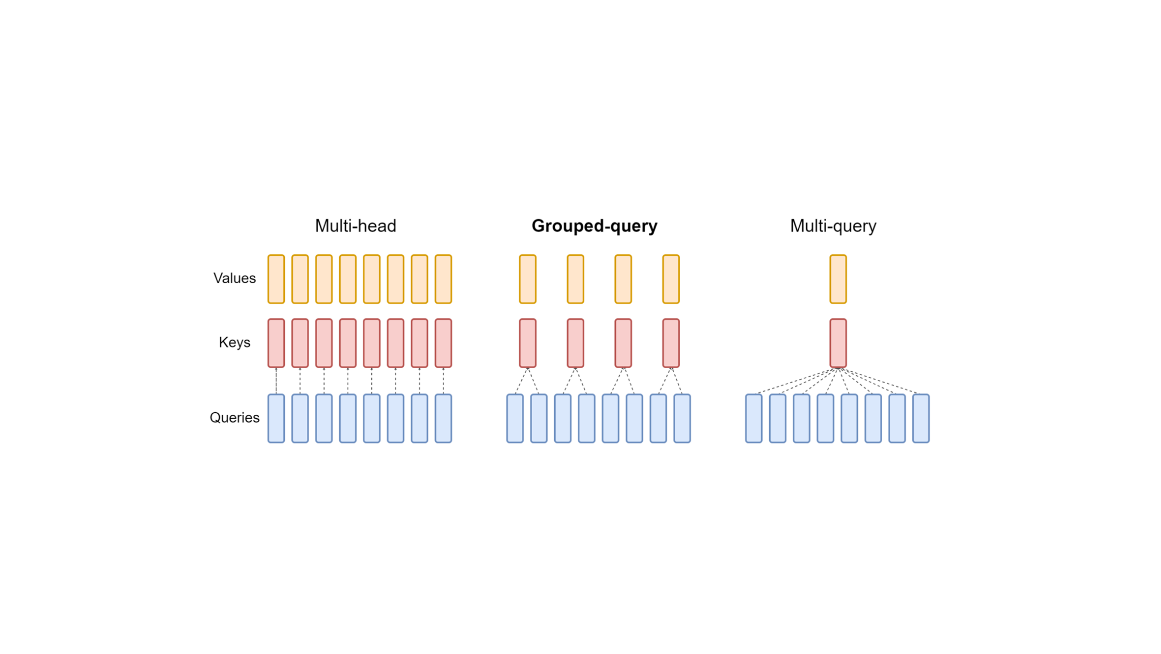
Grouped-query attention (GQA)
Each group of query heads shares a key head and a value head.
Choose the number of KV heads to balance capacity and cache size.
64
MHA: one KV pair per query head. MQA: one shared KV pair.
Notes:
Adapted from C:\Work\PPCLLM\additionals\lecture_03_lm_architecture_and_hyperparameters.pdf, PDF page 62. Original figures and mathematical artwork retained.

Slide 65
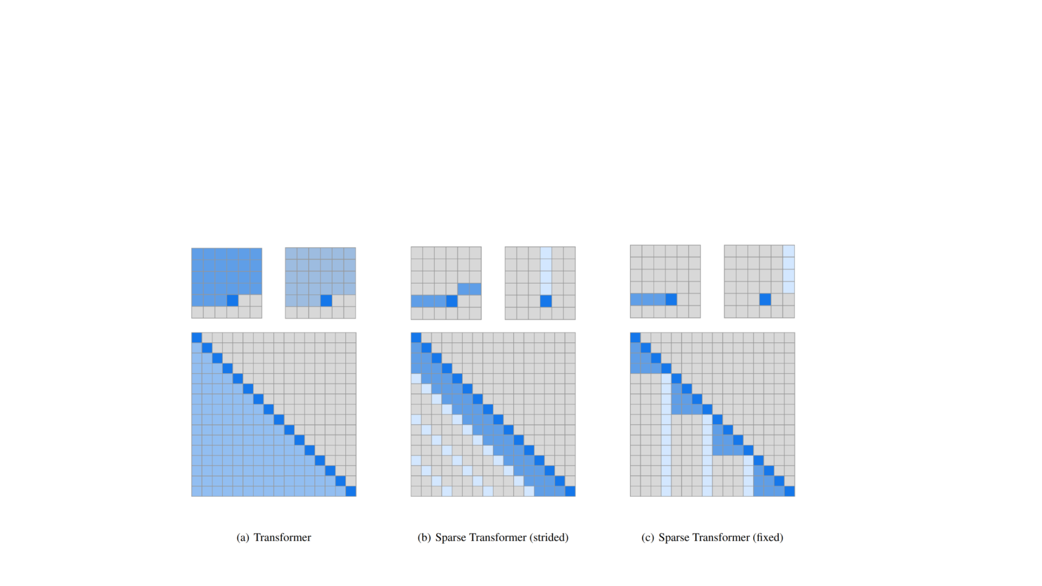
Sparse and sliding-window attention
Attending to the entire context can be expensive (quadratic).
A local window limits direct attention to nearby tokens; sparse patterns can add distant connections.
65
[Child et al 2019]
Notes:
Adapted from C:\Work\PPCLLM\additionals\lecture_03_lm_architecture_and_hyperparameters.pdf, PDF page 64. Original figures and mathematical artwork retained.

Slide 66

Linear attention
With ρ = identity (no softmax), matrix multiplication can be reordered.
This avoids the n × n attention matrix: cost is linear in n for fixed head dimensions.
66
Shen et al. (2018); Katharopoulos et al. (2020)
Notes:
Adapted from C:\Work\PPCLLM\lecture_04.pdf, PDF page 4. Original figures and mathematical artwork retained.
This identity is exact for unnormalized linear attention; it is not an algebraic replacement for softmax attention. Kernelized variants may need a normalization state. Katharopoulos et al. (2020), https://arxiv.org/abs/2006.16236

Slide 67

Linear attention as a recurrence
Recall that in purely linear attention, we consider the reordering
For causal attention, maintain a state that sums key–value outer products.
Training can use parallel scans or chunks. Decoding updates one state per token.
The state size depends on the head dimensions, not the sequence length.
67
Notes:
Adapted from C:\Work\PPCLLM\lecture_04.pdf, PDF page 5. Original figures and mathematical artwork retained.
Equations show unnormalized linear attention with column-vector q, k, v and S_0=0. Kernelized normalized attention also maintains a denominator state. https://arxiv.org/abs/2006.16236

Slide 68

Mixture of experts (MoE)
[Fedus et al 2022]
Replace one feedforward layer with several experts and a learned router.
Keep a fixed number active per token: more experts add parameters, while active FFN compute stays similar.
68
Notes:
Adapted from C:\Work\PPCLLM\lecture_04.pdf, PDF page 15. Original figures and mathematical artwork retained.
Total parameter memory and communication may still grow. Switch Transformer, https://arxiv.org/abs/2101.03961

Slide 69

More capacity at similar active compute
Switch Transformer experiments: more experts improve quality at matched per-token FLOPs.
[Fedus et al 2022]
69
Notes:
Adapted from C:\Work\PPCLLM\lecture_04.pdf, PDF page 16. Original figures and mathematical artwork retained.
Empirical result in the shown Switch Transformer experiments, not a guarantee for every MoE configuration. https://arxiv.org/abs/2101.03961

Slide 70

Routing choices
Many of the routing algorithms boil down to ‘choose top k’
Token chooses
Expert chooses
Global routing via
expert
token
optimization
70
[Fedus et al 2022]
Notes:
Adapted from C:\Work\PPCLLM\lecture_04.pdf, PDF page 27. Original figures and mathematical artwork retained.

Slide 71

Top-k routing
Score the experts, select k, and combine their weighted outputs.
Gating
The router maps each token to one score per expert.
Top-k keeps only the selected experts active.
Weights can be normalized before or after selection.
71
Learned scores determine which experts run.
[Dai et al 2024]
Notes:
Adapted from C:\Work\PPCLLM\lecture_04.pdf, PDF page 31. Original figures and mathematical artwork retained.
Preserved source equations use softmax before top-k. Other variants renormalize selected logits. Figure attributed to Dai et al. (2024) in the source.

Slide 72

Fine-grained and shared experts
Split experts into smaller units; activate several for each token.
72
Shared experts are always active and learn broadly useful transformations.
Notes:
Adapted from C:\Work\PPCLLM\lecture_04.pdf, PDF page 32. Original figures and mathematical artwork retained.

Slide 73

Balancing expert load
Uneven routing can overload a few experts and leave others underused.
From the Switch Transformer [Fedus et al 2022]
The auxiliary loss penalizes concentrating both assignments and router probability on the same experts.
73
Notes:
Adapted from C:\Work\PPCLLM\lecture_04.pdf, PDF page 40. Original figures and mathematical artwork retained.
Preserved Switch Transformer balancing loss: f_i is the fraction of tokens dispatched to expert i, P_i is its mean router probability. https://arxiv.org/abs/2101.03961

Slide 74

Expert parallelism
Place different experts on different devices.
Route tokens to experts, then return their outputs.
74
Notes:
Adapted from C:\Work\PPCLLM\lecture_04.pdf, PDF page 44. Original figures and mathematical artwork retained.

Slide 75

Efficient expert computation
Routing produces groups of tokens with different sizes for each expert.
Grouped or block-sparse matrix multiplication avoids wasting work on padding.
75
Example: MegaBlocks uses block-sparse kernels for expert FFNs.
Notes:
Adapted from C:\Work\PPCLLM\lecture_04.pdf, PDF page 45. Original figures and mathematical artwork retained.

Slide 76

MoE: the design trade-off
Sparse activation increases total model capacity while limiting the experts used per token.
The router chooses experts; balancing keeps their workloads usable.
Parameter memory and token communication still matter. Efficient execution is part of the design.
76
Notes:
Adapted from C:\Work\PPCLLM\lecture_04.pdf, PDF page 60. Original figures and mathematical artwork retained.

