Slide 1
Modern Transformer
design choices
Stable blocks, position information, efficient attention and experts
Parallel Programming for LLMs
Lecture 4
1
Notes:
Continuation of Lecture 3. All 48 original foundation slides remain in Lecture 3. This lecture combines the original 27 architecture slides with selected explanations and figures from CME 295 Lecture 2 by Afshine Amidi and Shervine Amidi.

Slide 2
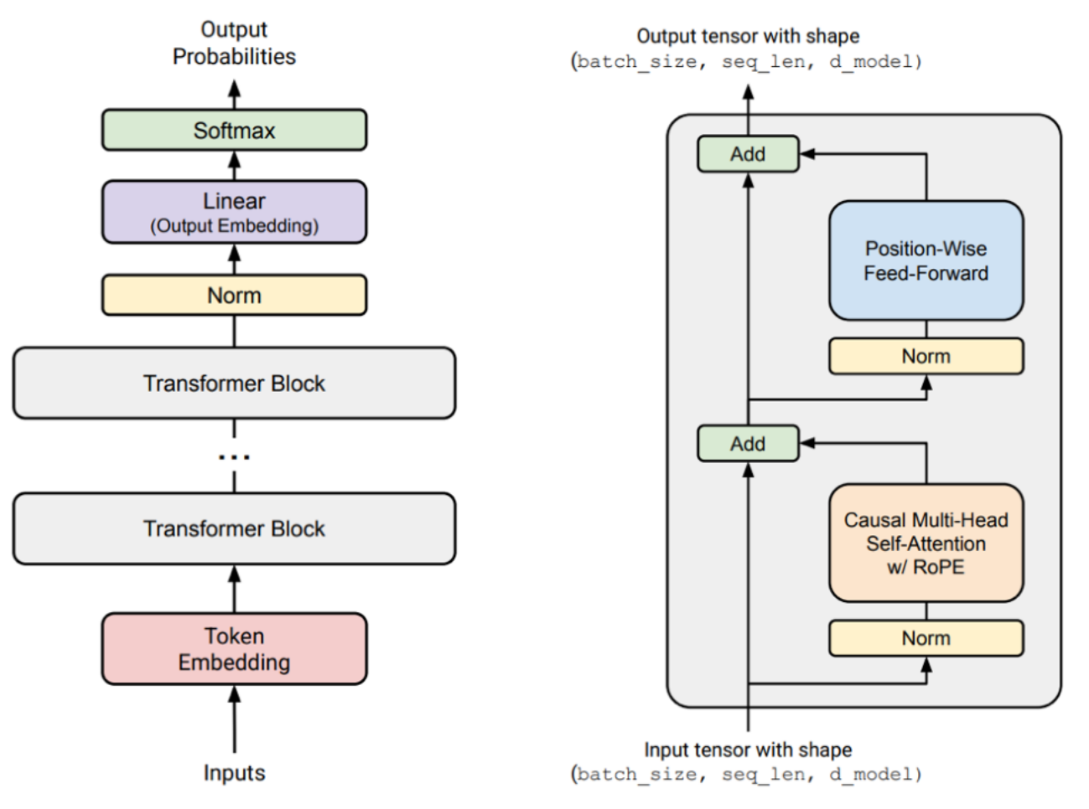
From the basic decoder to a modern block
Stable activations
Choose normalization and its position in the residual block.
Position information
Let attention distinguish token order and distance.
Feedforward computation
Use gating to control which features pass through.
2
Notes:
Adapted from the original course lecture 3, PDF page 50, Git a085b64. Roadmap, not a list to memorize. Begin with normalization and the FFN, then explain the positional rotation. Many modern implementations also omit bias terms in linear layers and normalization.

Slide 3
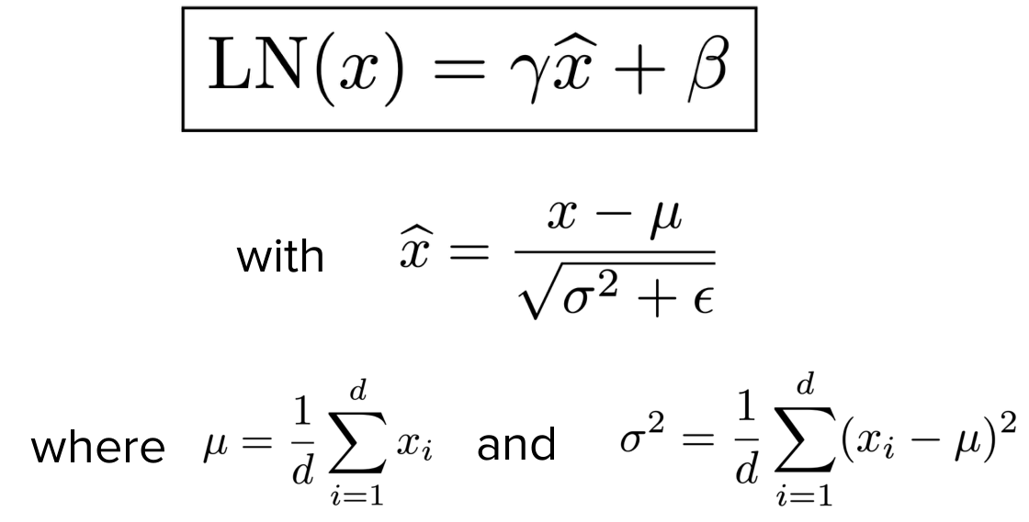
Layer normalization
Normalize each token across its hidden dimensions.
Center using the mean μ, then rescale using the variance σ².
Learned γ and β adjust the scale and offset. ε prevents division by zero.
3
Ba et al., 2016. Layer Normalization
Notes:
Adapted from Afshine Amidi and Shervine Amidi, CME 295 Lecture 2, PDF page 86. Source: fall26-cme295-lecture2.pdf. The normalized vector has approximately zero mean and unit variance before the learned affine transformation. Statistics are per token, across d hidden coordinates.

Slide 4
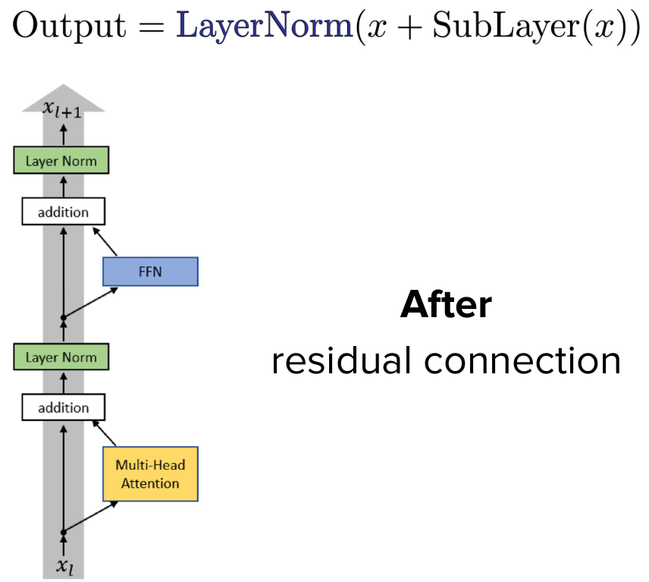
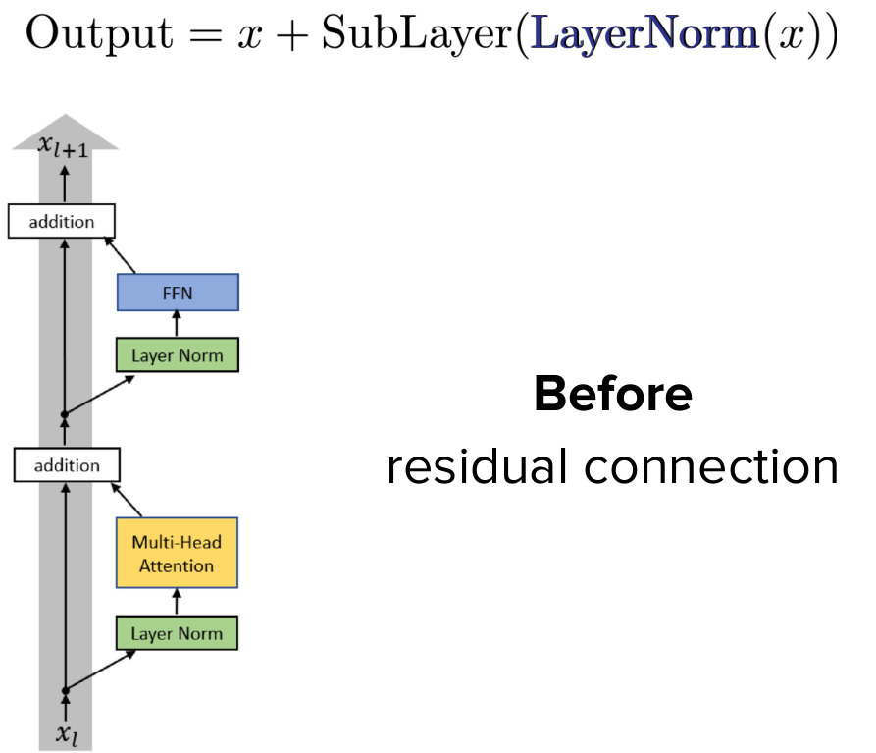
Pre-norm and post-norm
Post-norm
Pre-norm
Normalize after adding the residual.
Keep a direct residual path.
4
Xiong et al., 2020. On Layer Normalization in the Transformer Architecture
Notes:
Adapted from Afshine Amidi and Shervine Amidi, CME 295 Lecture 2, PDF page 84–85. Source: fall26-cme295-lecture2.pdf. The comparison combines the fully visible half of each reveal. Sublayer means either attention or the FFN.

Slide 5
RMSNorm
Rescale the hidden vector without subtracting its mean.
RMS(x) = √[(1/d) ∑ᵢ xᵢ² + ε]
yᵢ = γᵢ xᵢ / RMS(x)
d is the hidden dimension. γ is a learned scale for each coordinate.
Compared with LayerNorm, RMSNorm omits mean centering and usually the additive bias.
5
Zhang and Sennrich, 2019. Root Mean Square Layer Normalization
Notes:
Adapted from Afshine Amidi and Shervine Amidi, CME 295 Lecture 2, PDF page 87. Source: fall26-cme295-lecture2.pdf. Formula includes numerical stabilization epsilon. RMS is defined using the mean of squared coordinates.

Slide 6
Normalization and data movement
Few arithmetic operations can still take a noticeable share of runtime.
Operator class | FLOPs (%) | Runtime (%)
Tensor contraction | 99.80 | 61.0
Normalization | 0.17 | 25.5
Element-wise | 0.03 | 13.5
Normalization and element-wise operations repeatedly read and write activations.
These measurements illustrate one workload. The percentages depend on the model and hardware.
6
Ivanov et al., 2023
Notes:
Adapted from the original course lecture 3, PDF page 53, Git a085b64. Values transcribed from the original table. Arithmetic shares and runtime shares each sum to 100%. This is an example measurement, not a universal cost model.

Slide 7
Gated feedforward layers
An ordinary FFN expands the hidden vector, applies a nonlinearity and projects back.
FFN(x) = ReLU(xW₁) W₂
A gated FFN multiplies two projections element by element before the output projection.
ReGLU(x) = (ReLU(xW₁) ⊙ xV) W₂
⊙ is the element-wise product. The extra projection modulates which features pass through.
7
Shazeer, 2020. GLU Variants Improve Transformer
Notes:
Adapted from the original course lecture 3, PDF page 54, Git a085b64. The product is element-wise. W1 and V map the model dimension to the FFN hidden dimension; W2 projects back.

Slide 8
GeGLU and SwiGLU
GeGLU uses GELU for the gate.
GeGLU(x) = (GELU(xW₁) ⊙ xV) W₂
SwiGLU uses SiLU(x) = x · sigmoid(x).
SwiGLU(x) = (SiLU(xW₁) ⊙ xV) W₂
Both use three weight matrices. The next slide accounts for the extra parameters.
8
Shazeer, 2020. GLU Variants Improve Transformer
Notes:
Adapted from the original course lecture 3, PDF page 55, Git a085b64. SiLU equals Swish with beta equal to one. Source formula uses Swish_1.

Slide 9
Feedforward width and parameter count
Let d be the model dimension and f the FFN hidden width.
Ordinary FFN
Gated FFN
Two matrices: about 2df parameters.
A common width f = 4d gives 8d².
Three matrices: about 3df parameters.
A width f ≈ 8d/3 also gives 8d².
This comparison ignores biases. Implementations often round f to hardware-friendly multiples.
9
Shazeer, 2020
Notes:
Adapted from the original course lecture 3, PDF page 55, 60, Git a085b64. Parameter counts follow directly from matrix dimensions: d by f plus f by d, versus two d by f matrices plus one f by d.

Slide 10
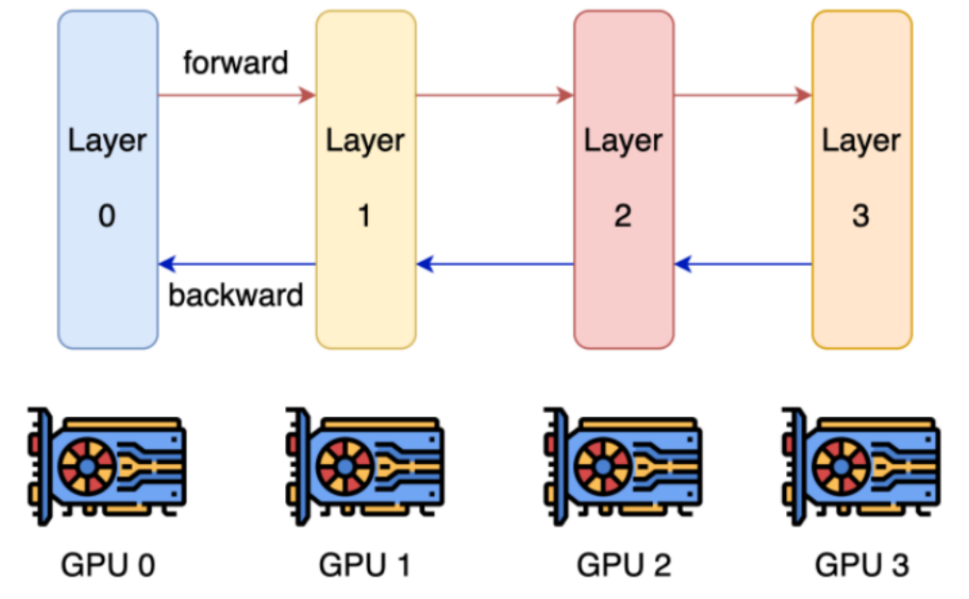
Depth, width and parallelism
Depth creates sequential dependencies between layers.
Width allows matrix operations to be split across devices.
Pipeline parallelism places groups of layers on different devices.
10
Tay et al., 2021
Notes:
Adapted from the original course lecture 3, PDF page 61, Git a085b64. The figure illustrates layer placement. Wider is not universally faster: communication and kernel efficiency also matter.

Slide 11
Position information
How does attention know where a token is?
11
Notes:
Section transition. Connect the new question with the preceding section before introducing notation.

Slide 12
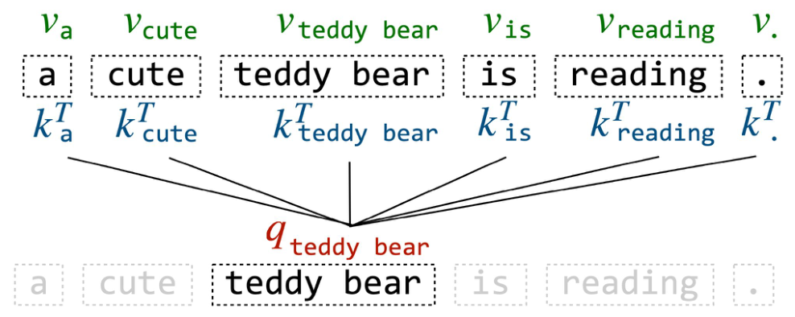
Why position information matters
Content-based attention alone does not identify a token’s position.
For a fixed query, reordering content-only key/value pairs leaves the weighted sum unchanged.
Position signals let the model distinguish word order and distance.
12
Amidi, 2024. Super Study Guide: Transformers & Large Language Models
Notes:
Adapted from Afshine Amidi and Shervine Amidi, CME 295 Lecture 2, PDF page 52. Source: fall26-cme295-lecture2.pdf. The statement concerns content-only attention before positional signals and masking. A causal mask already imposes an ordering constraint.

Slide 13
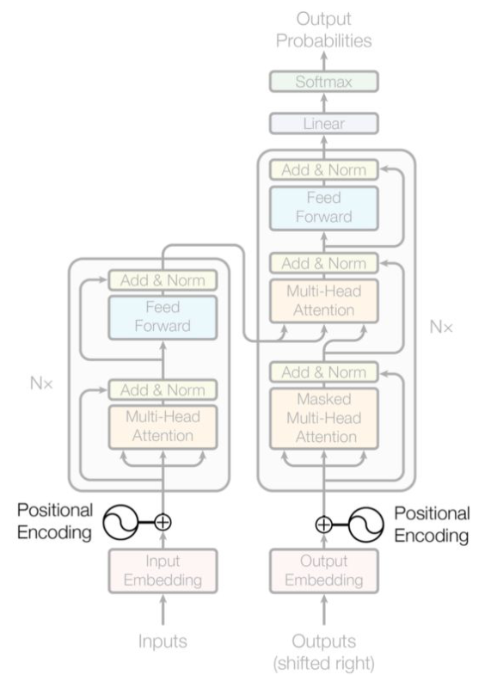
Learned absolute positions
Add a learned position vector to the token embedding.
hₘ = token_embedding(xₘ) + position_embedding(m)
Each position has its own trainable vector.
Positions outside the learned table need an extension strategy.
13
Vaswani et al., 2017; Amidi and Amidi, Lecture 2
Notes:
Adapted from Afshine Amidi and Shervine Amidi, CME 295 Lecture 2, PDF page 53–54. Source: fall26-cme295-lecture2.pdf. The faded architecture is intentional source emphasis: the addition of positional information is highlighted.

Slide 14
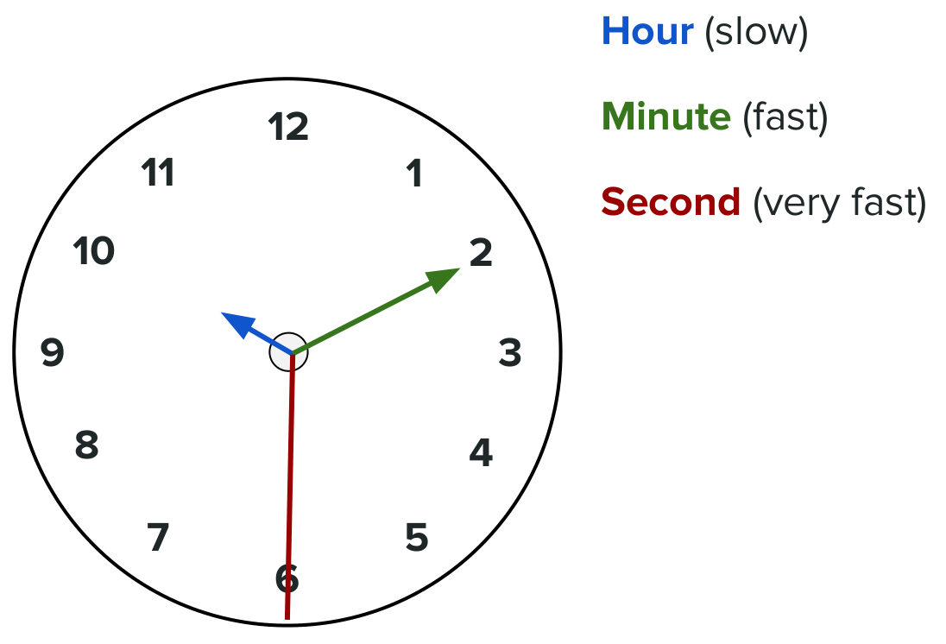
Position signals at different frequencies
A clock combines hands that rotate at different speeds.
Sinusoidal positions use the same idea: coordinate pairs vary at different frequencies.
Together, the pairs encode the token’s position.
14
Amidi and Amidi, Lecture 2
Notes:
Adapted from Afshine Amidi and Shervine Amidi, CME 295 Lecture 2, PDF page 55. Source: fall26-cme295-lecture2.pdf.

Slide 15
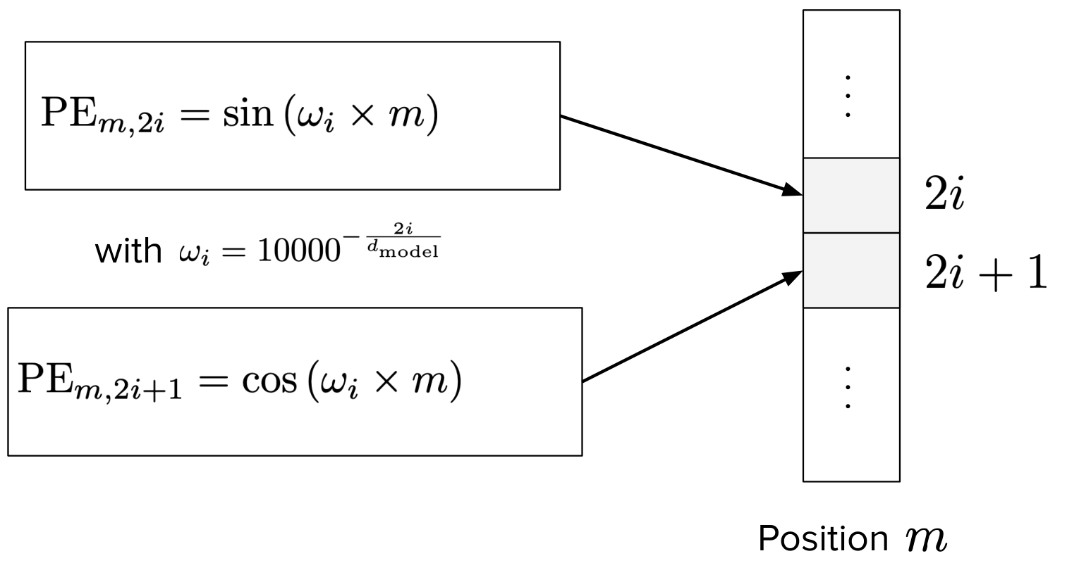
Sinusoidal position embeddings
Each coordinate pair uses one frequency ωᵢ.
m is the token position. d_model is the embedding width.
15
Vaswani et al., 2017. Attention Is All You Need
Notes:
Adapted from Afshine Amidi and Shervine Amidi, CME 295 Lecture 2, PDF page 58. Source: fall26-cme295-lecture2.pdf. These formulas can be evaluated for unseen positions. That does not by itself guarantee reliable generalization to longer sequences.

Slide 16
Relative position in attention
An attention score should reflect both content and the distance between tokens.
Absolute positions
Relative offset
Query at m = 12
Key at n = 9
n − m = −3
Shift both positions by the same amount and the relative offset stays unchanged.
16
Su et al., 2021. RoFormer
Notes:
Adapted from Afshine Amidi and Shervine Amidi, CME 295 Lecture 2, PDF page 66. Source: fall26-cme295-lecture2.pdf. This isolates the positional component of an attention score. Content still affects the score. The next slides show how RoPE obtains relative positional dependence.

Slide 17
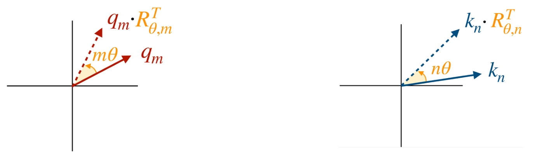
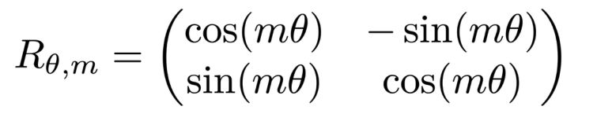
RoPE: rotating queries and keys
Rotate each query and key according to its token position.
One coordinate pair uses a 2 × 2 rotation matrix:
17
Su et al., 2021. RoFormer; Amidi, 2024
Notes:
Adapted from Afshine Amidi and Shervine Amidi, CME 295 Lecture 2, PDF page 71. Source: fall26-cme295-lecture2.pdf. For column vectors the rotated query is R_m q and the rotated key is R_n k. The source illustration labels equivalent row-vector notation.

Slide 18
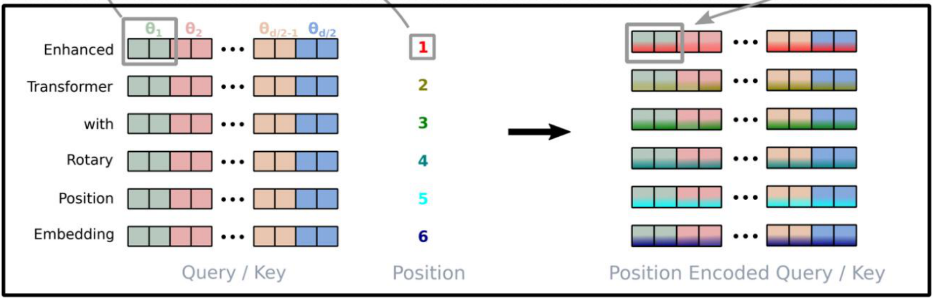
RoPE: coordinate pairs and relative offsets
Rotate every pair of coordinates, with a different frequency for each pair.
For column vectors:
(Rₘq)ᵀ(Rₙk)
= qᵀRₙ₋ₘk
The positional dependence is the relative offset n − m.
18
Su et al., 2021. RoFormer
Notes:
Adapted from the original course lecture 3, PDF page 58, Git a085b64. Adapted from Afshine Amidi and Shervine Amidi, CME 295 Lecture 2, PDF page 73. Source: fall26-cme295-lecture2.pdf. Orthogonal rotations satisfy R_m^T R_n = R_(n-m). The next slide assembles these 2D rotations into the full block-diagonal matrix. Adding absolute position vectors to content creates content-position cross terms in a dot product. RoPE makes the positional part depend on the relative rotation instead.

Slide 19
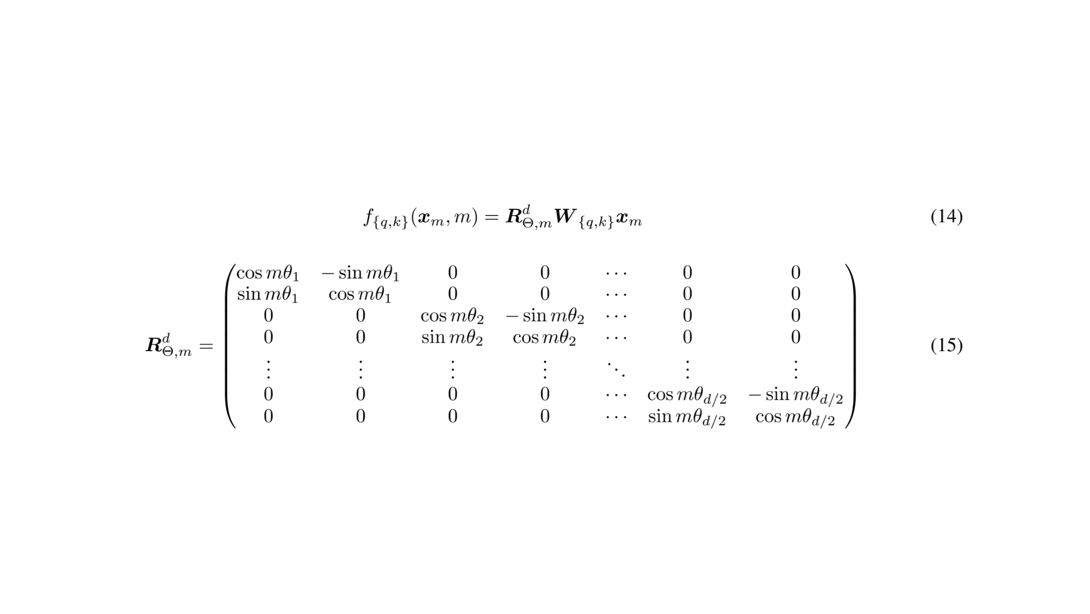
RoPE: the full rotation matrix
Each diagonal block rotates one coordinate pair.
m is the token position; θᵢ is the rotation frequency for coordinate pair i.
19
Notes:
Original lecture 3 page 59. Su et al., 2021, RoFormer. Each 2 by 2 diagonal block rotates one coordinate pair. Its angle is m times theta_i. Point out the repeated blocks rather than asking students to memorize the full matrix. The input projection W creates the query or key before rotation.

Slide 20
Attention efficiency
What grows when the context gets longer?
20
Notes:
Section transition. Connect the new question with the preceding section before introducing notation.

Slide 21
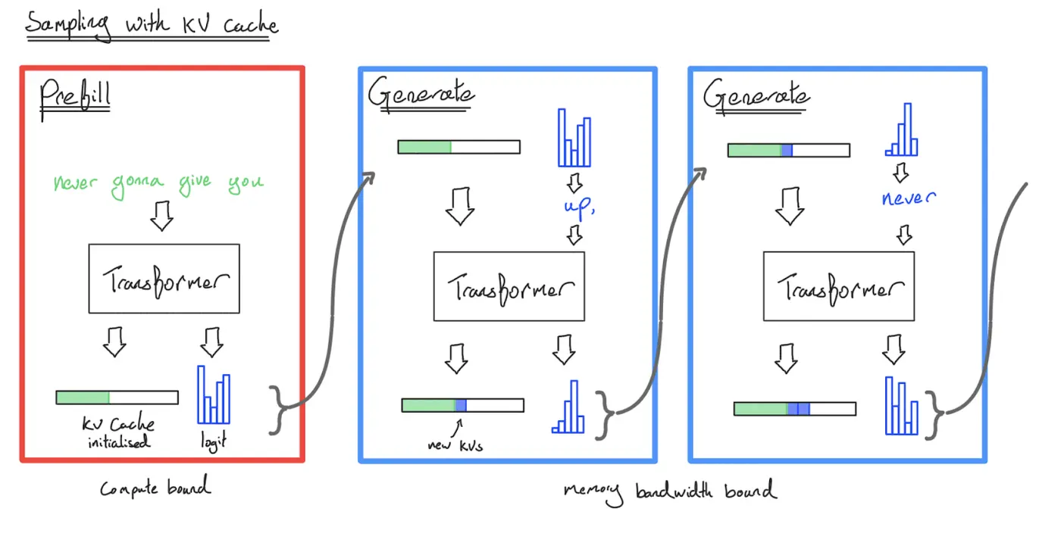
Autoregressive decoding and the KV cache
Prefill initializes the cache. Each decoding step reuses past K/V and appends the new token’s K/V.
21
How to Scale Your Model: inference, JAX scaling book
Notes:
Adapted from the original course lecture 3, PDF page 62, Git a085b64. Illustration already used in course lecture 10. https://jax-ml.github.io/scaling-book/inference/ . The figure contrasts prefill with subsequent cached decoding steps; the exact compute/memory balance depends on batch size and hardware.

Slide 22
KV-cache memory
For a standard attention cache:
bytes ≈ 2 · B · T · L · G · dₕ · b
B: batch size T: cached tokens L: layers
G: KV heads dₕ: head dimension b: bytes per element
The factor 2 stores both keys and values. Fewer KV heads reduce cache memory and reads.
22
Course lecture 10, KV-cache size calculation
Notes:
Derived from the cache shape for conventional MHA, MQA and GQA. Source: lecture_10.py, kv_cache_size_per_seq. Assumes equal key/value head dimensions and an uncompressed cache. Cache metadata and allocation overhead are excluded.

Slide 23
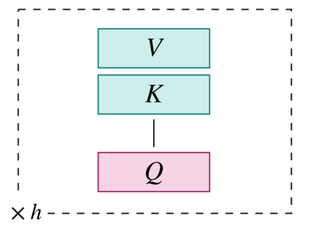
Multi-head attention: separate K/V heads
Each query head has its own key and value projections.
G = h
h query heads
h key heads
h value heads
The cache stores K/V for every head.
23
Amidi, 2024. Super Study Guide: Transformers & Large Language Models
Notes:
Adapted from Afshine Amidi and Shervine Amidi, CME 295 Lecture 2, PDF page 83. Source: fall26-cme295-lecture2.pdf. G denotes the number of KV heads, h the number of query heads. Only the active final row is retained.

Slide 24
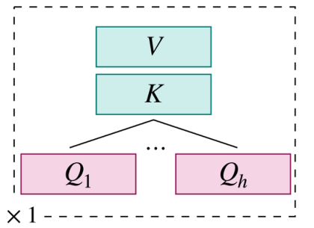
Multi-query attention: one shared K/V head
Keep multiple query heads, but share one key and one value head.
G = 1
For fixed head dimension, the cache uses about 1/h of the MHA K/V storage.
Sharing reduces memory traffic, with a possible quality trade-off.
24
Shazeer, 2019. Fast Transformer Decoding; Amidi, 2024
Notes:
Adapted from Afshine Amidi and Shervine Amidi, CME 295 Lecture 2, PDF page 81. Source: fall26-cme295-lecture2.pdf. Cache ratios refer only to stored keys and values at the same B, T, L, head dimension and dtype.

Slide 25
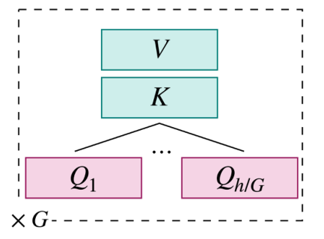
Grouped-query attention
Each group of query heads shares a key and value head.
1 < G < h
Each K/V head serves h/G query heads.
Cache storage is G/h of MHA.
GQA offers an intermediate choice between MHA and MQA.
25
Ainslie et al., 2023. GQA; Amidi, 2024
Notes:
Adapted from Afshine Amidi and Shervine Amidi, CME 295 Lecture 2, PDF page 82. Source: fall26-cme295-lecture2.pdf. The illustration shows one group, repeated G times. Assume the number of query heads is divisible by G.

Slide 26
A KV-cache example
One sequence, 4,096 tokens, 32 layers, 32 query heads.
Each head has 128 features. Each cached value uses 2 bytes.
Attention | K/V heads G | Cache memory
MHA | 32 | 2 GiB
GQA | 8 | 512 MiB
MQA | 1 | 64 MiB
Changing only the number of K/V heads changes the cache size.
26
Notes:
Worked example derived from 2*B*T*L*G*d_h*b, with B=1, T=4096, L=32, d_h=128 and b=2. GiB=2^30 bytes. This is only K/V storage, excluding model weights, activations, allocator overhead and metadata. It illustrates memory scaling, not equal model quality.

Slide 27
Sliding-window attention
A causal window keeps only the most recent w keys for each query.
Full causal attention
Window w = 3
Keys 1–8
Keys 1–8
1
1
2
2
3
3
Query
4
Query
4
5
5
6
6
7
7
8
8
Every earlier token is directly available.
Each token reads at most 3 positions.
Attention-score work changes from O(T²) to O(Tw).
27
Adapted from CME 295 Lecture 2, local attention
Notes:
Source lecture 3 page 65 and CME 295 lecture 2 pages 77-78. Native schematic uses a causal decoder, avoiding the bidirectional/global-CLS pattern in the reference. Rows are query positions, columns are key positions. Teal cells are visible attention entries. w includes the current position. The complexity concerns attention scores at fixed head dimensions. Sparse patterns may also add selected distant connections.

Slide 28
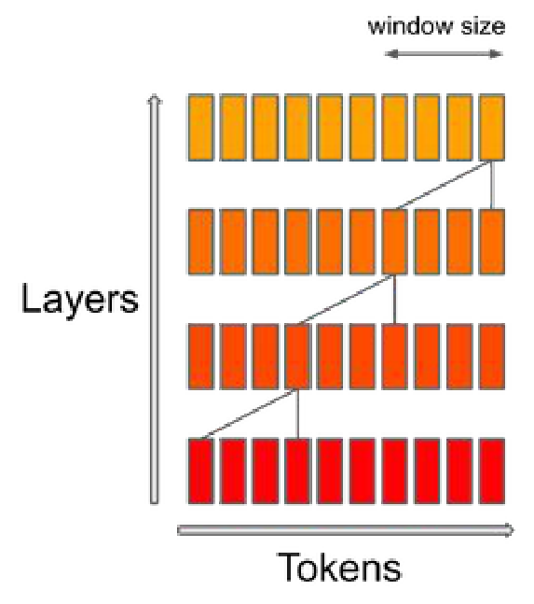
A wider receptive field across layers
Local attention passes information across successive layers.
Deeper layers can depend on tokens outside one layer’s direct window.
Some architectures mix local layers with global attention to retain longer-range access.
28
Jiang et al., 2023. Mistral 7B
Notes:
Adapted from Afshine Amidi and Shervine Amidi, CME 295 Lecture 2, PDF page 78. Source: fall26-cme295-lecture2.pdf. The right-hand figure in the source illustrates growth of receptive field across layers. This is indirect information flow, not full attention at every layer.

Slide 29
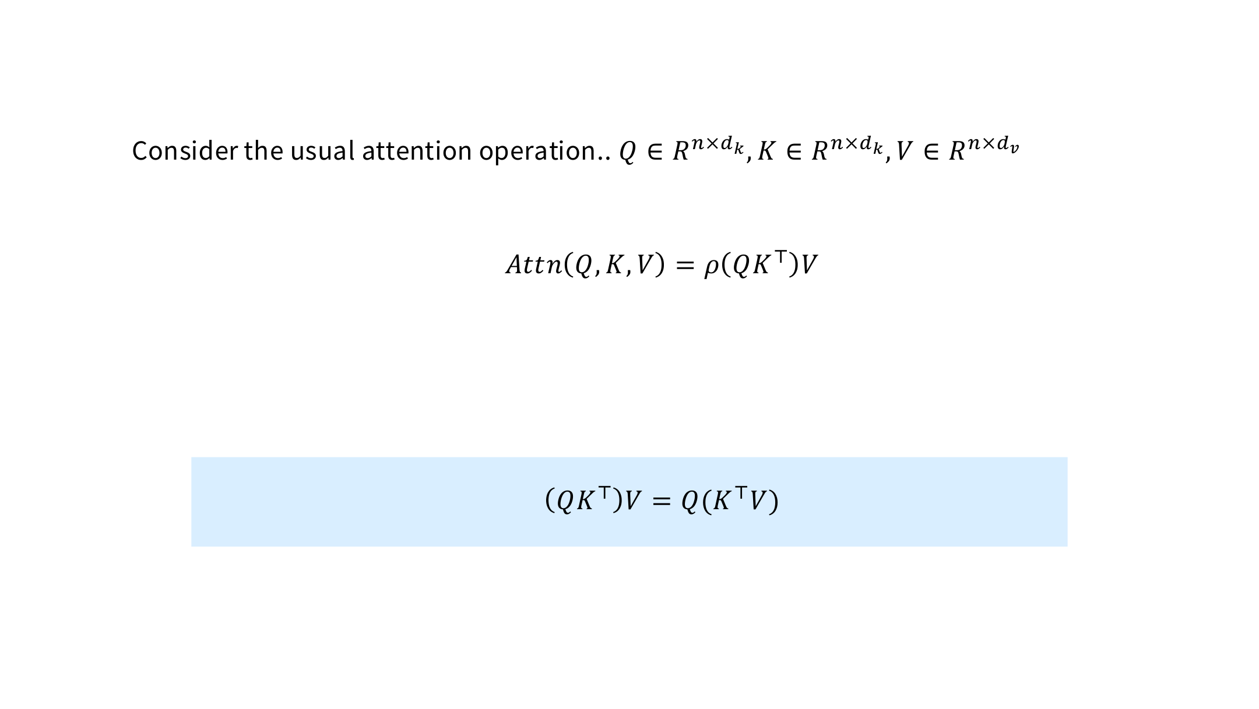
Linear attention: associativity
With ρ = identity (no softmax), matrix multiplication can be reordered.
This avoids the n × n attention matrix: cost is linear in n for fixed head dimensions.
29
Shen et al. (2018); Katharopoulos et al. (2020)
Notes:
Original lecture 3 page 66. Shen et al., 2018; Katharopoulos et al., 2020. Matrix associativity applies here only after removing the softmax. This is a change to the attention mechanism, not an exact rearrangement of softmax attention. Q, K and V are projected matrices, unlike the weight-matrix notation used earlier in Lecture 3.

Slide 30
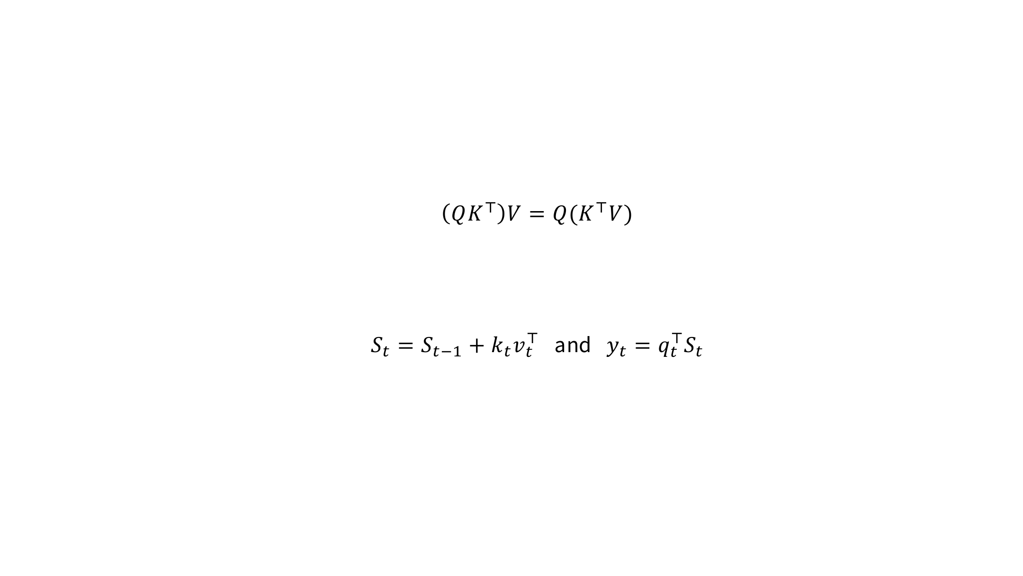
Linear attention as a recurrence
Recall that in purely linear attention, we consider the reordering
For causal attention, maintain a state that sums key–value outer products.
Training can use parallel scans or chunks. Decoding updates one state per token.
The state size depends on the head dimensions, not the sequence length.
30
Notes:
Original lecture 3 page 67. The recurrence S_t=S_(t-1)+k_t v_t^T, y_t=q_t^T S_t uses column k_t and v_t. S_t has d_k by d_v entries. This simplified unnormalized linear attention uses no softmax. Feature maps and normalization appear in other linear-attention variants. The state compresses the past, so individual token values are no longer independently accessible.

Slide 31
Three ways to reduce attention cost
Each method changes a different part of attention.
Method | What gets smaller | Main constraint
MQA / GQA | Stored K/V heads | Less head-specific K/V
Local / sparse attention | Direct token connections | Limited direct context
Linear attention | History state | Changes the attention rule
These choices can be combined, but their quality and speed depend on the model and hardware.
31
Notes:
Comparison of the preceding mechanisms. K/V sharing changes the parameterization and cache size. Local and sparse attention change connectivity. The simplified linear attention just shown changes the weighting rule and stores accumulated statistics. Avoid implying identical quality or universally faster execution.

Slide 32
Mixtures of experts
Can we add parameters without running them all for every token?
32
Notes:
Section transition. Connect the new question with the preceding section before introducing notation.

Slide 33
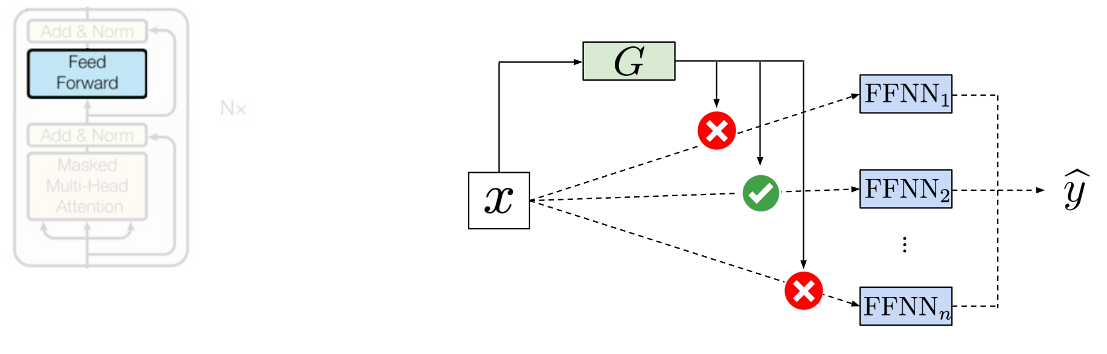
MoE inside a Transformer
Expert FFNs replace selected dense feedforward layers.
Routing happens separately for each token. Attention still mixes information across tokens.
33
Vaswani et al., 2017; Shazeer et al., 2017
Notes:
Adapted from Afshine Amidi and Shervine Amidi, CME 295 Lecture 2, PDF page 43. Source: fall26-cme295-lecture2.pdf. The diagram highlights the FFN position. Architectures may mix dense and MoE layers.

Slide 34
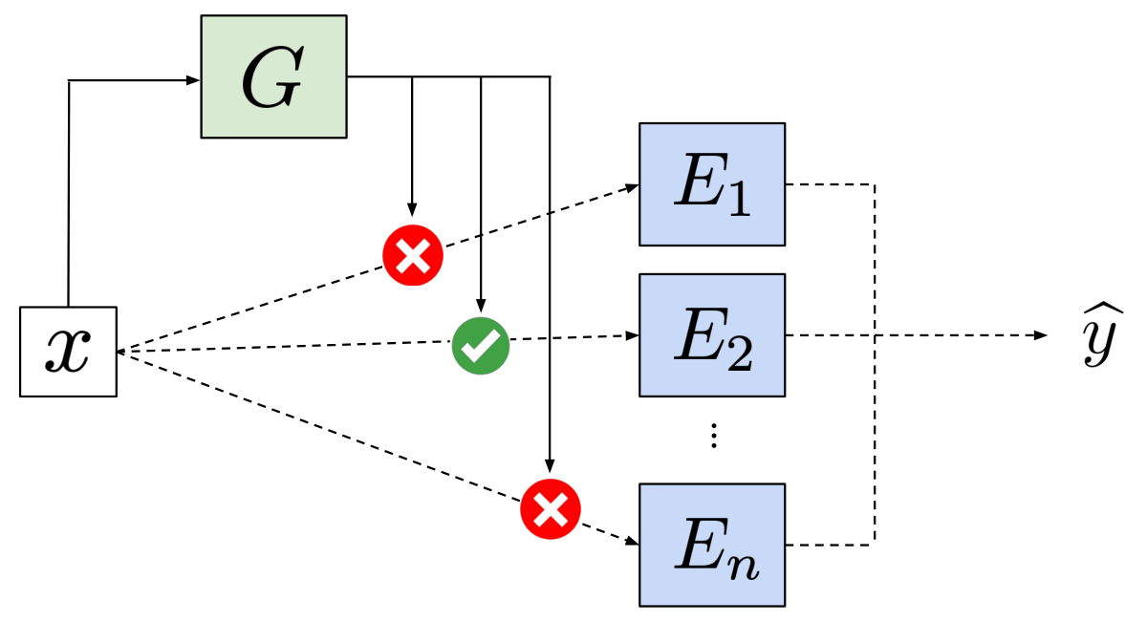
Mixtures of experts
A router chooses a small subset of expert networks for each token.
More expert parameters can increase capacity without running every expert on every token.
34
Shazeer et al., 2017. Sparsely-Gated Mixture-of-Experts Layer
Notes:
Adapted from Afshine Amidi and Shervine Amidi, CME 295 Lecture 2, PDF page 38. Source: fall26-cme295-lecture2.pdf. G is the router. Each E_i is an expert network. Sparse activation changes active computation, while all expert weights still require storage.

Slide 35
A token routed to two experts
Four experts receive these router probabilities. Choose k = 2.
E₁ | E₂ | E₃ | E₄
0.10 | 0.60 | 0.05 | 0.25
E₂ and E₄ receive the token. Their probabilities sum to 0.85.
Renormalized weights: 0.60 / 0.85 ≈ 0.706 and 0.25 / 0.85 ≈ 0.294.
Output ≈ 0.706 E₂(x) + 0.294 E₄(x)
35
Notes:
Illustrative top-2 routing example, not experimental data. Sum of probabilities is 1. Selected probabilities sum to 0.85. This example renormalizes after top-k selection. Other implementations retain the original probabilities. All entries are probabilities, not expert output values. k is the number of active experts for one token.

Slide 36
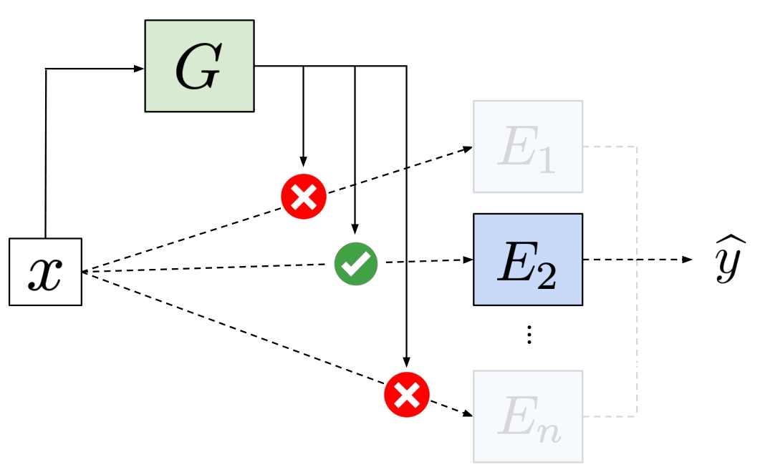
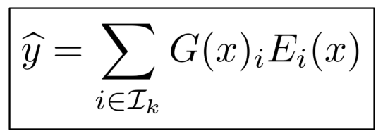
Top-k expert routing
Score the experts, select k, then combine the selected outputs.
Iₖ: selected experts
G(x)ᵢ: routing weight
Eᵢ(x): expert output
The router learns which experts each token uses.
36
Shazeer et al., 2017. Sparsely-Gated Mixture-of-Experts Layer
Notes:
Adapted from Afshine Amidi and Shervine Amidi, CME 295 Lecture 2, PDF page 41. Source: fall26-cme295-lecture2.pdf. Many implementations select top-k router logits. Normalizing all probabilities before selection or renormalizing selected weights are distinct variants. The displayed equation leaves that choice in G.

Slide 37
Top-k routing with normalized weights
1. Score the experts
p = softmax(xWᵣ)
Wᵣ is the learned router projection.
2. Select the k largest probabilities
Iₖ = TopK(p)
3. Normalize the selected weights
gᵢ = pᵢ / (Σⱼ∈Iₖ pⱼ)
y = Σᵢ∈Iₖ gᵢ Eᵢ(x)
37
Shazeer et al., 2017; Dai et al., 2024
Notes:
Re-expresses the original lecture 3 page 71 in the same notation as the preceding example. x is the token representation, W_r is the learned router projection, p is a probability vector, I_k is the selected index set, E_i is expert i and y is the combined expert output. Unselected weights are zero. The surrounding Transformer block adds the residual. Renormalization shown here is one implementation choice; some architectures use the selected original probabilities.

Slide 38
Uneven expert load
Sixteen tokens choose four experts with equal compute capacity.
An overloaded expert can delay the batch.
Other experts may sit idle and receive fewer training updates.
Balancing encourages more even use. Capacity handling may queue, drop or reroute tokens.
38
Fedus et al., 2021. Switch Transformers
Notes:
Adapted from Afshine Amidi and Shervine Amidi, CME 295 Lecture 2, PDF page 44. Source: fall26-cme295-lecture2.pdf. Collapse is an extreme case of skewed assignments. Token capacity handling differs by implementation. The native chart is an illustrative top-1 dispatch count [12,2,1,1], not measurements from the cited paper. Equal counts would be four tokens per expert. Show how the busiest expert can dominate a synchronized batch.

Slide 39
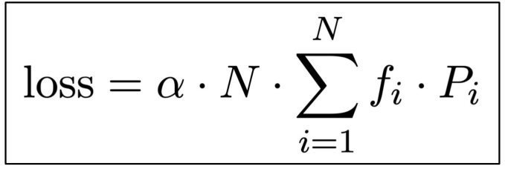
An auxiliary loss for load balancing
For top-1 Switch routing, penalize experts that receive both high probability and many assignments.
fᵢ: fraction of tokens assigned to expert i
Pᵢ: mean router probability for expert i
N: number of experts
α: strength of the auxiliary loss
Add this term to the language-model training loss.
39
Fedus et al., 2021. Switch Transformers
Notes:
Adapted from Afshine Amidi and Shervine Amidi, CME 295 Lecture 2, PDF page 45. Source: fall26-cme295-lecture2.pdf. This definition of f_i follows top-1 Switch routing. P_i averages the differentiable router probability over tokens. The assignment fractions are treated as fixed within the loss gradient. The normalization must be adapted for top-k dispatch.

Slide 40
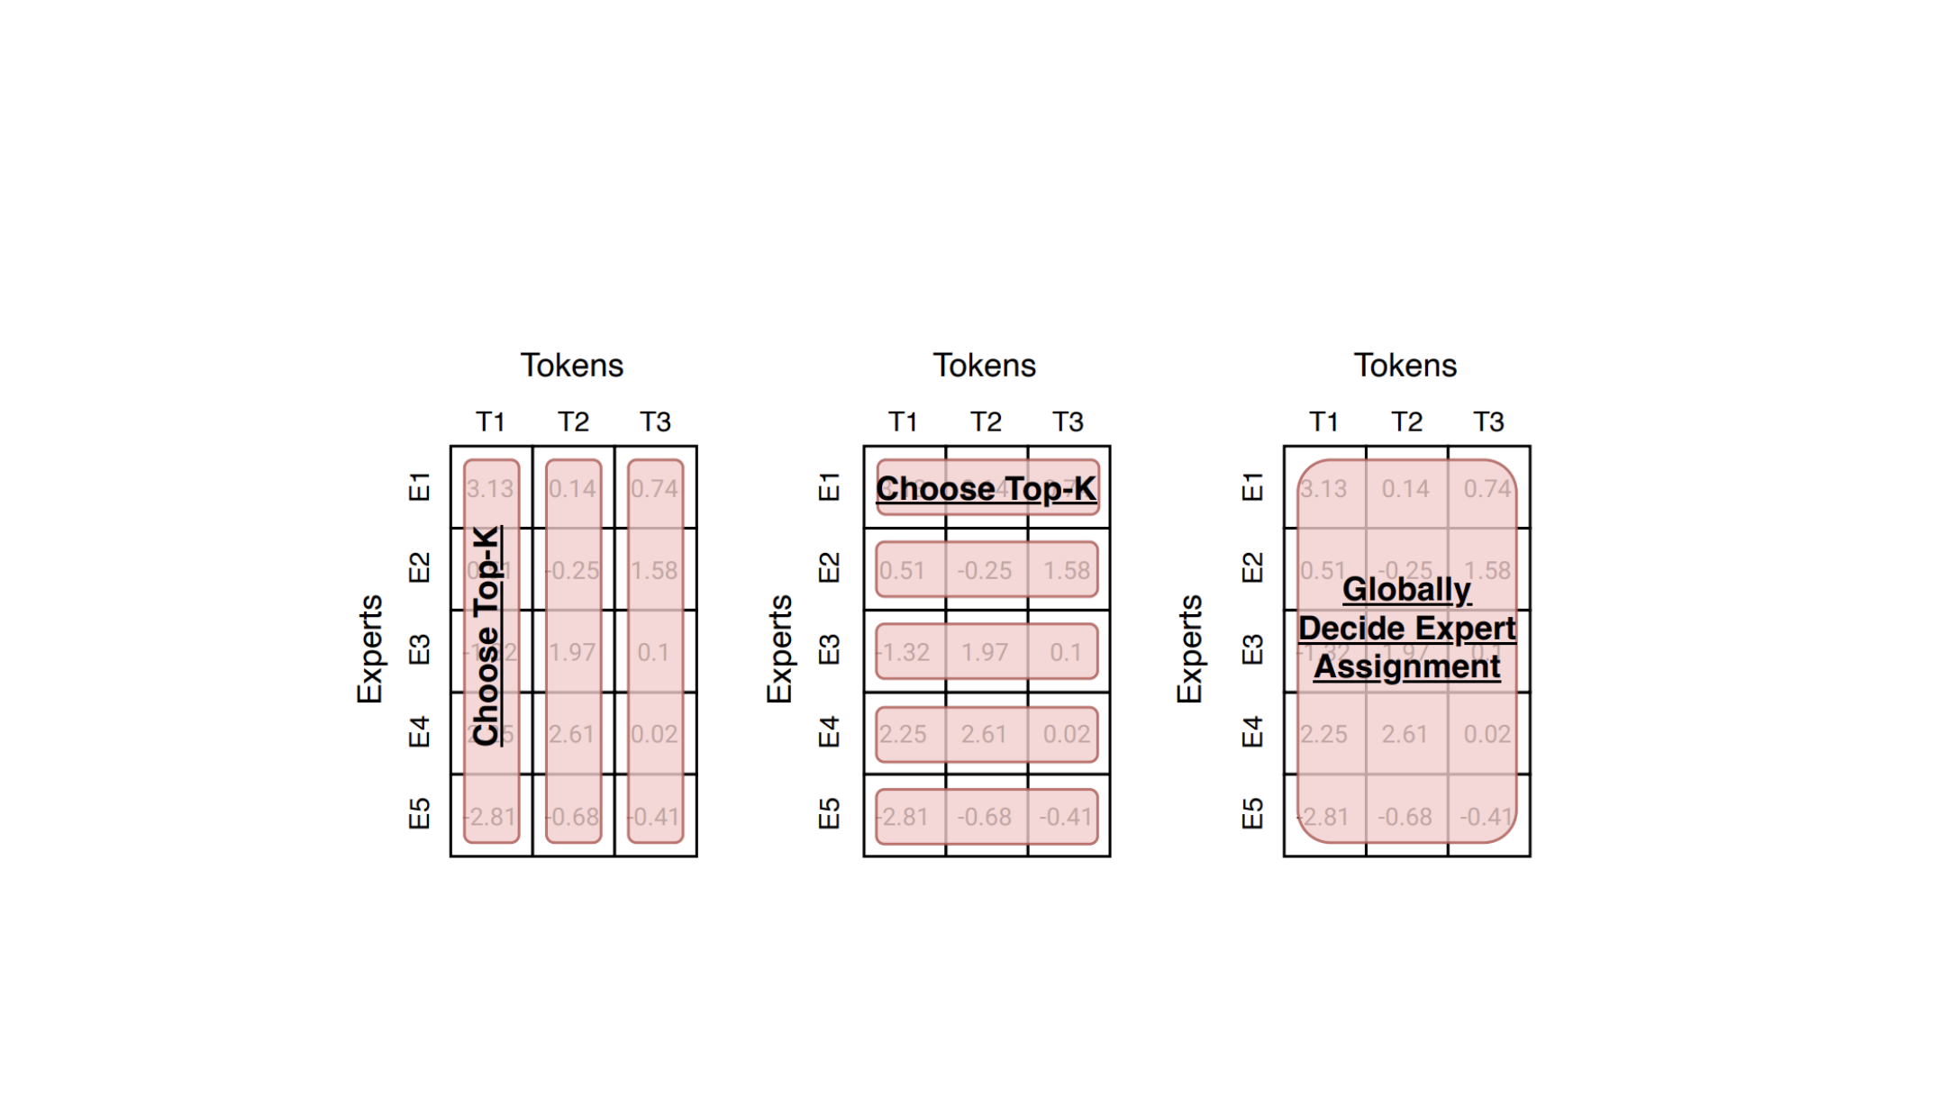
Expert-routing alternatives
Routing alternatives change which side controls the assignment.
Token chooses
Expert chooses
Global routing via
expert
token
optimization
[Fedus et al 2022]
40
Notes:
Original lecture 3 page 70. Fedus et al., 2022. Token-choice routing selects experts for each token. Expert-choice routing selects tokens for each expert, usually with fixed expert capacity. Global assignment optimizes the routing under capacity constraints. These approaches trade off load balance, assignment flexibility and routing overhead.

Slide 41
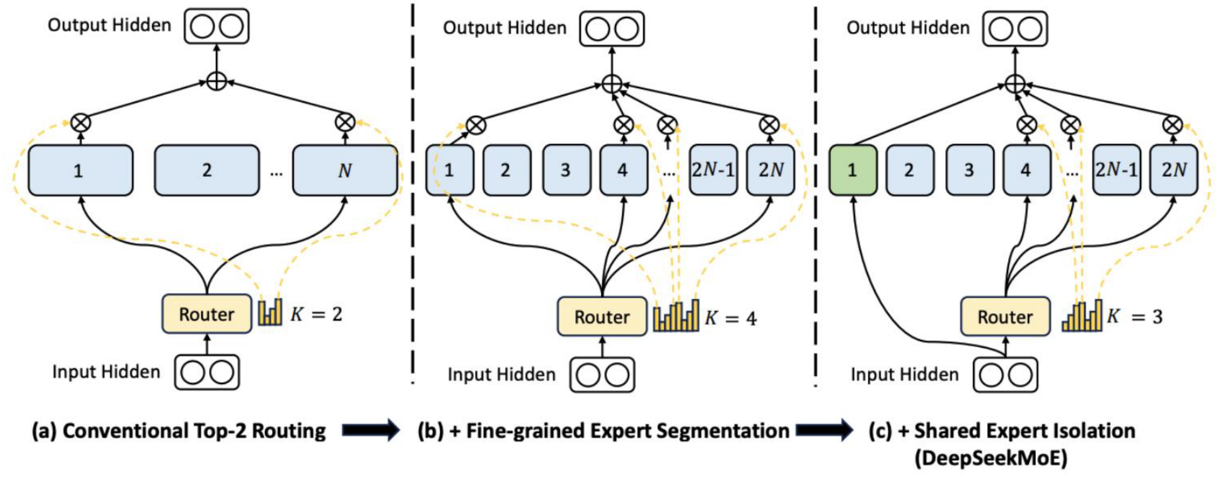
Shared and fine-grained experts
Smaller routed experts provide more combinations at a fixed active budget.
Blue: routed experts. Green: shared experts.
Shared experts run for every token and learn transformations used across inputs.
41
Dai et al., 2024. DeepSeekMoE
Notes:
Adapted from the original course lecture 3, PDF page 72, Git a085b64. Fine-grained segmentation and shared expert isolation are separate architectural choices.

Slide 42
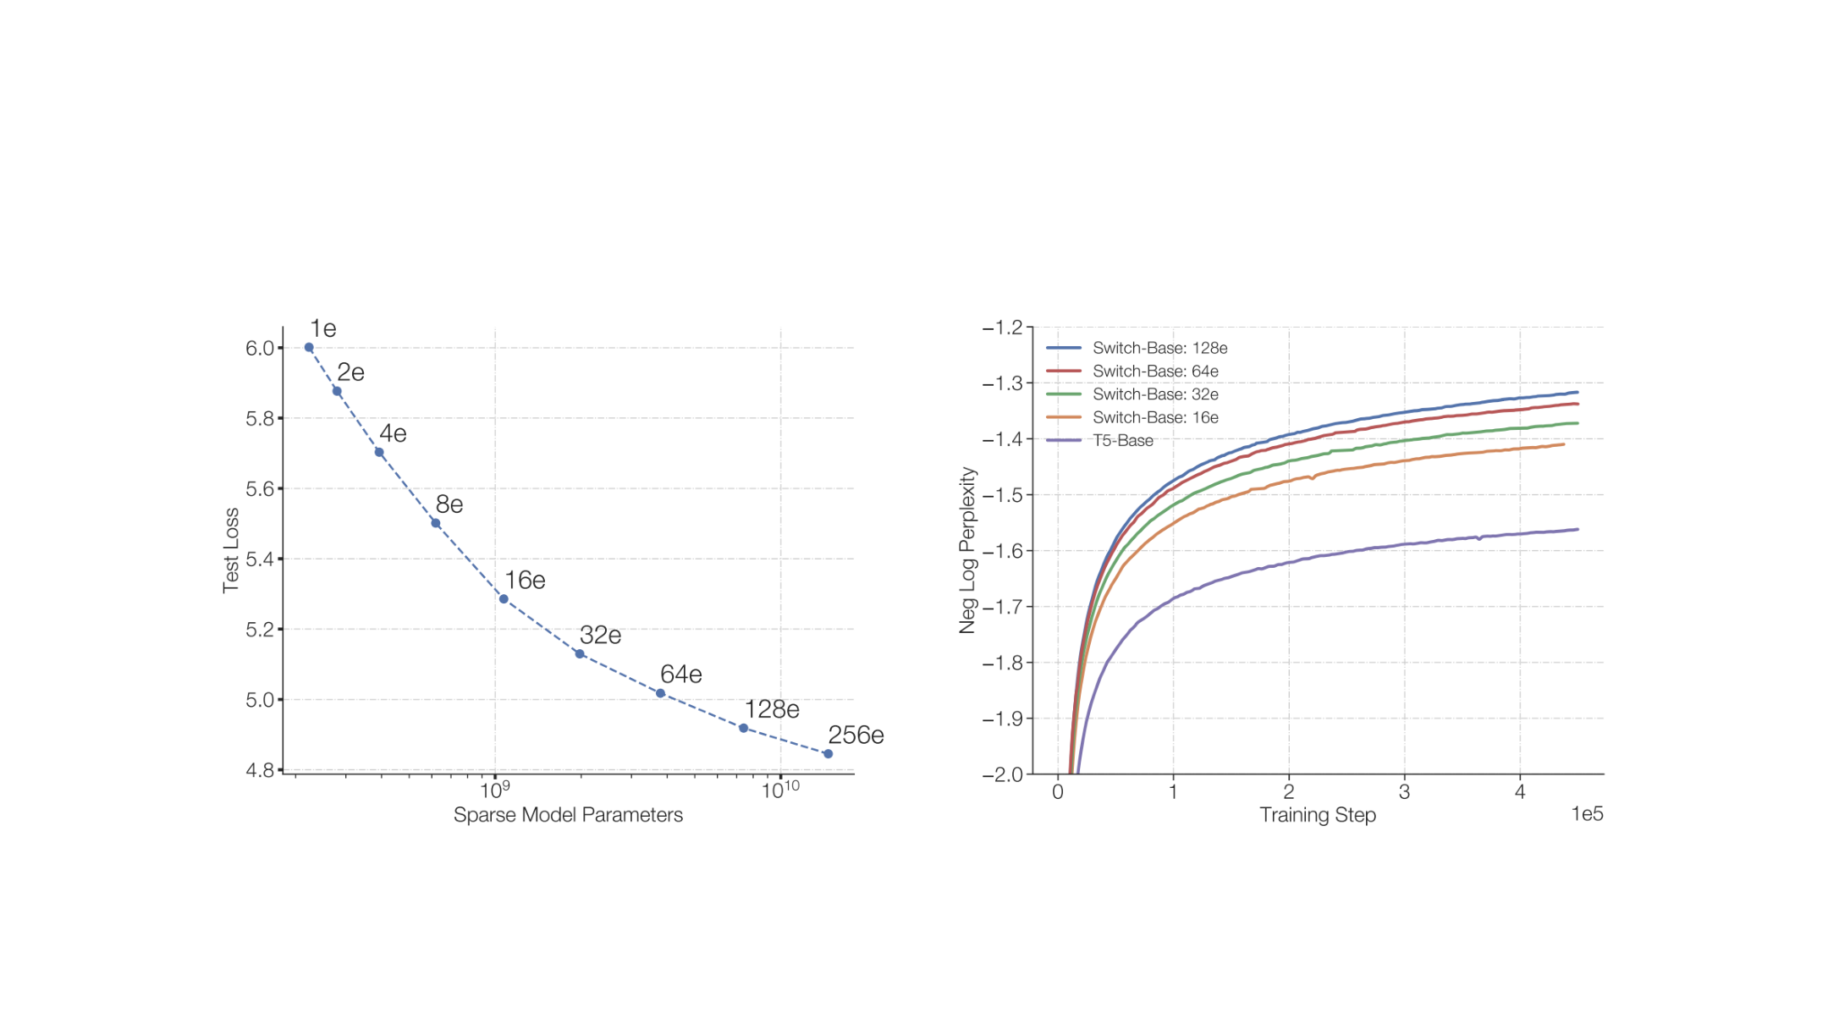
Switch Transformer: an empirical result
Switch Transformer experiments: more experts improve quality at matched per-token FLOPs.
[Fedus et al 2022]
42
Notes:
Original lecture 3 page 69. Fedus et al., 2022, Switch Transformers. These experiments compare model quality at matched per-token FLOPs. The x-axis on the left is total sparse parameter count; more experts increase total memory. The figure is evidence for this experimental setting, not a universal speedup guarantee.

Slide 43
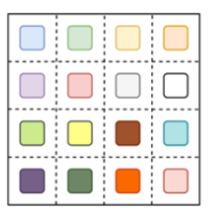
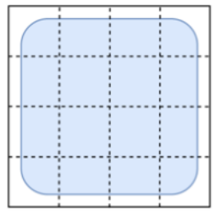
Expert placement across devices
Expert parallelism stores different expert weights on different devices.
Weight placement
Input batch
Each device owns a subset of experts.
The token batch uses experts across devices.
43
Fedus et al., 2021. Switch Transformers
Notes:
Adapted from the original course lecture 3, PDF page 74, Git a085b64. Crops retain the Expert and Data Parallelism column from the source figure. The weights are partitioned by expert. Devices cooperate on the batch; dispatch and combine are shown on the next slide.

Slide 44
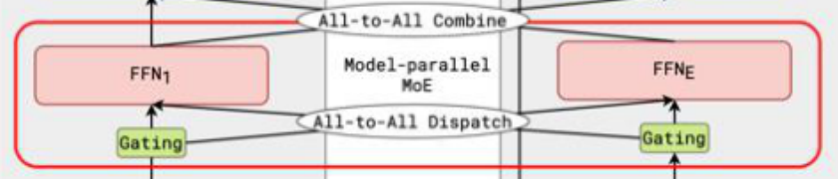
Dispatch, expert computation and combine
Experts on different devices exchange token activations.
Device 1
Other expert devices
1. Dispatch
2. Compute
3. Combine
Send each token to its selected experts.
Run each expert FFN on the tokens it receives.
Return outputs and form the weighted sum.
44
Lepikhin et al., 2020. GShard
Notes:
Adapted from the original course lecture 3, PDF page 74, Git a085b64. All-to-all dispatch and combine appear explicitly in the source diagram. With top-k routing, a token can be sent to multiple experts. Communication is a material part of execution cost. The crop enlarges the routing and expert-computation region from the original figure. Its surrounding dense Transformer blocks were already explained earlier in the lecture.

Slide 45
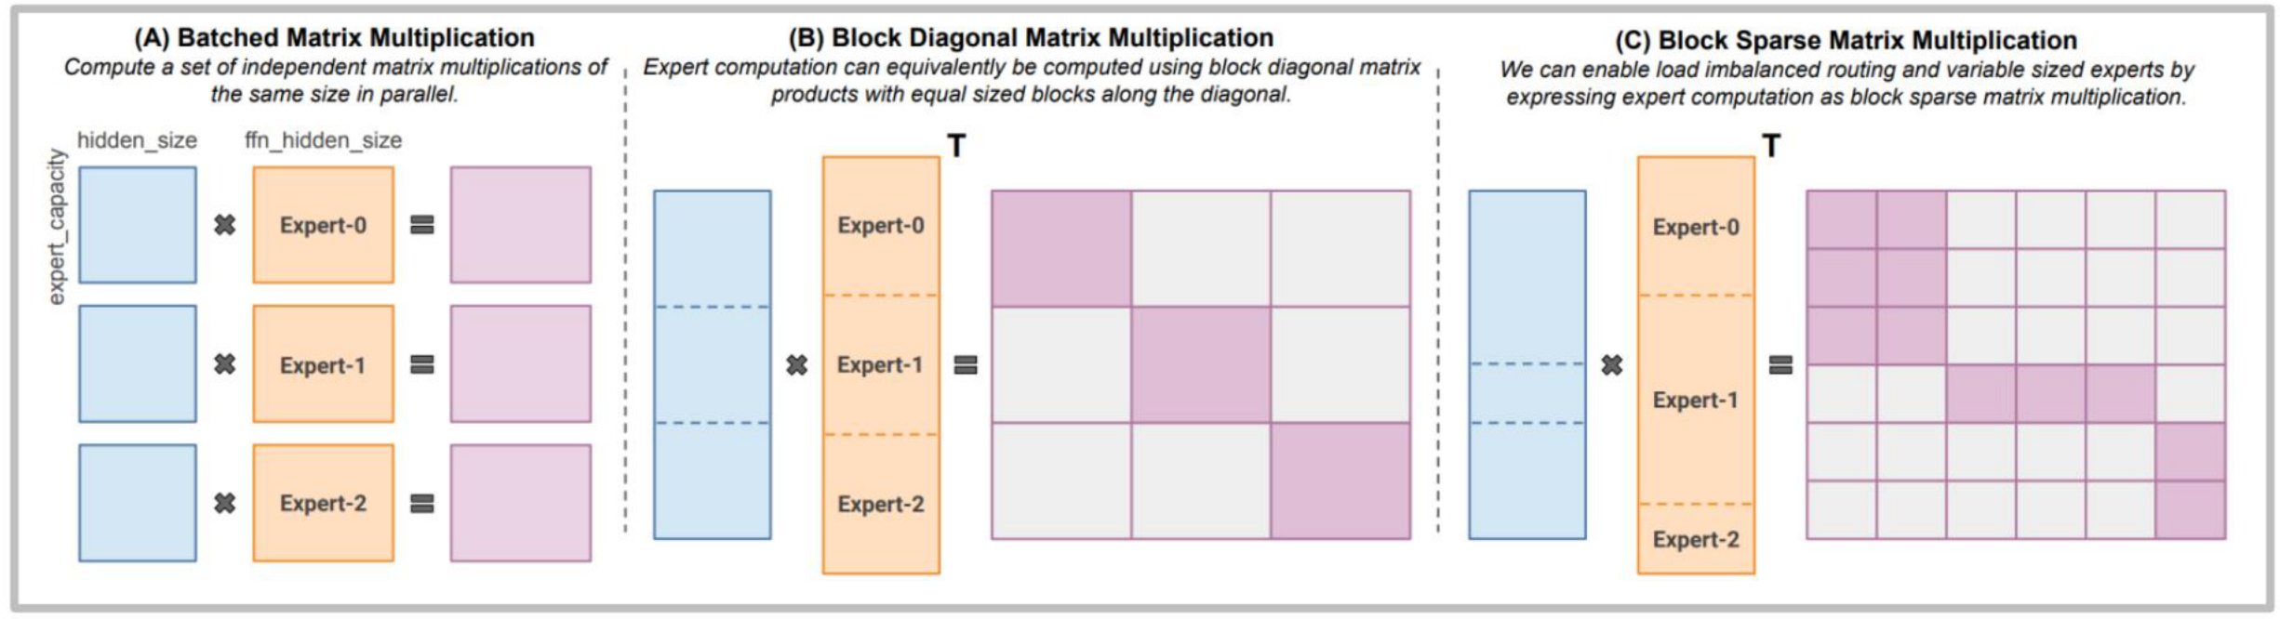
Efficient expert computation
Routing creates token groups of different sizes for each expert.
Grouped and block-sparse kernels handle uneven work without padding every expert to the same size.
45
Gale et al., 2023. MegaBlocks
Notes:
Adapted from the original course lecture 3, PDF page 75, Git a085b64. The figure compares batched, block-diagonal and block-sparse matrix multiplication. Grouped GEMM is another execution strategy; this source figure specifically illustrates block sparsity.

Slide 46
The MoE trade-off
Total capacity
Many expert parameters remain available, even though only a few experts run per token.
Active computation
Top-k routing limits the expert FFNs used by each token.
Memory and communication
All weights still need storage. Routing adds token transfers and load-balancing constraints.
46
Notes:
Adapted from the original course lecture 3, PDF page 76, Git a085b64. Sparse activation does not imply that total parameter memory shrinks, or that wall-clock speed scales directly with the active parameter count.

Slide 47
From architecture to execution cost
Block design
Normalization, residual paths and gating change training behavior and activation traffic.
Attention
Positions determine how order enters the model. K/V sharing and windows change memory and attention work.
Experts
Sparse computation adds capacity, while placement and routing determine communication costs.
47
Notes:
Closing synthesis of Lecture 4. Ask students to connect each mechanism to the resource it changes: normalization and residuals to training behavior, positional rotation to attention scores, K/V sharing and windows to memory and work, and MoE to capacity plus communication. The next lecture examines GPU execution.

