Slide 1
When does the LLM disambiguation stage actually help?
A decomposition of retriever–LLM interaction in biomedical entity linking
Moritz · Mohamed · Snehpreet
Supervisor: Frederik · NLP Lab, University of Bonn (9 CP)

Slide 2
Why we pivoted: from method to analysis
The old goal is closed
The question nobody answers
SOTA on BC5CDR is 94.7 (ANGEL, trained generative) — a saturated, specialised slot.
The "LLM as disambiguator" idea was already published as SOTA (Ye & Mitchell, ACL 2025, "+16 pts").
Beating either with an open 4B model is not realistic — and not a paper.
When and why does the LLM stage help — and when does it hurt?
The field keeps bolting LLMs onto EL pipelines, tested on easy benchmarks.
We use our reproduced BioLinkerAI pipeline as a measuring instrument.

Slide 3
Where the closest work stands
Ye & Mitchell (ACL 2025)
LLM4BioEL (EMNLP 2025)
ANGEL (2024)
Closest to us: LLM disambiguator on top of a retriever, training-free. Shows value depends on base-model strength — but qualitatively, two fixed models.
Method: restrictive + contrastive decoding. Their own ablation: the LLM machinery adds ≤0.3 pts on BC5CDR — quiet support for us.
Trained generative model, negative-aware. BC5CDR SOTA 94.7 = the ceiling. Not a retriever, so orthogonal to our analysis.
Gap: nobody characterises the effect systematically, and nobody studies what fine-tuning does to it.

Slide 4
What we did
The pipeline as a measuring instrument, not a product
1
3 datasets
BC5CDR · BioRED (MeSH) · MedMentions (full UMLS) — easy to hard
2
Retriever sweep
Vary retriever strength on the SAME mentions (lexical → +SapBERT)
3
Two model regimes
Qwen3-4B: zero-shot AND LoRA fine-tuned (GPT-4o-mini as reference)
4
Decomposition
Recall@1, final Acc@1, picker accuracy, intervention precision, failure stage
Retrieval → Rules → LLM. We measure each stage separately, so the LLM's marginal contribution (P4 − P3) is isolated.

Slide 5
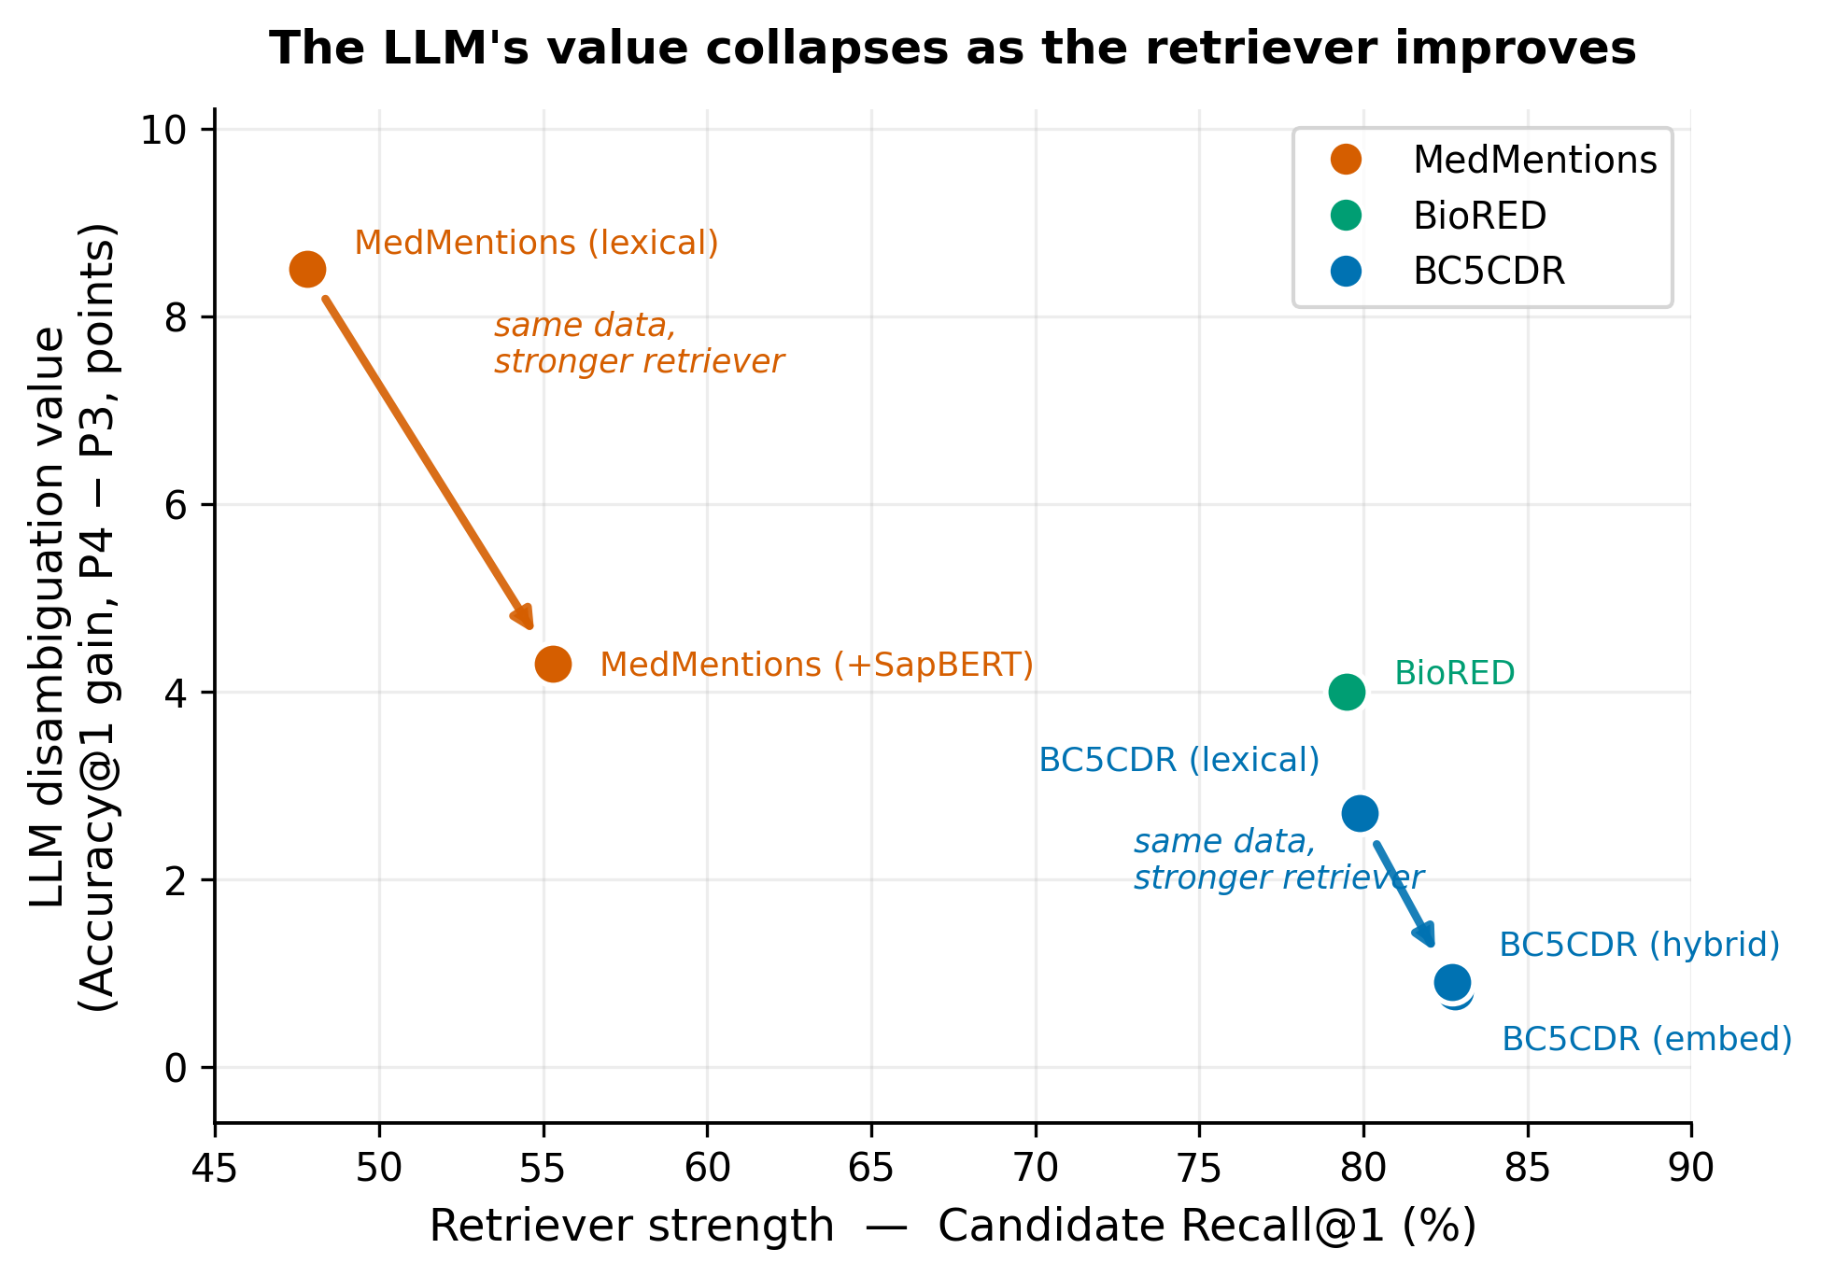
Frame: the LLM's value is set by the retriever
Same LLM, same prompt — its gain swings ~10×, from +8.5 (MedMentions) to +0.9 (BC5CDR).
Causal: on the SAME mentions, only strengthening the retriever halves the gain (+8.5 → +4.3).
Honest: known in IR reranking & Ye & Mitchell. Our value = the continuous curve, and it survives headroom-normalisation (recovery rate falls too: 59% → 30%).
Zero-shot Qwen3-4B (all points).

Slide 6
Consequence: retriever and LLM are substitutes
+7.5
~57% of the retriever improvement is absorbed by the LLM.
Why: mentions the retriever now gets right were already being fixed by the LLM — credit just moves.
Practical: improving the retriever shows diminishing returns on the bottom line.
Note: this is the arithmetic mirror of the frame, not a separate finding.
retriever R@1 gain
→ only +3.2
final accuracy gain

Slide 7
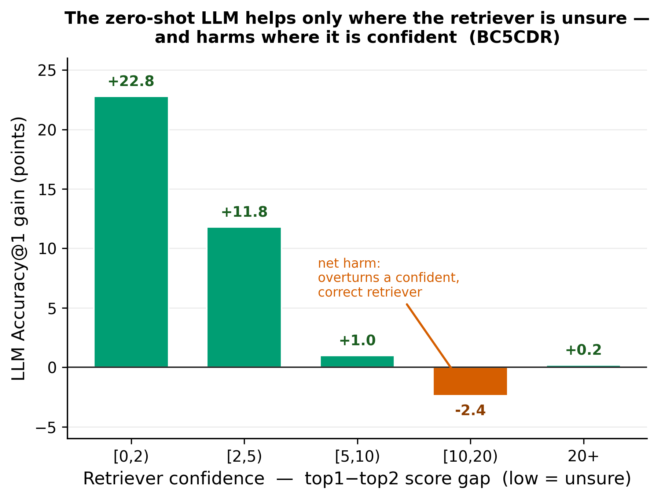
Finding: a mid-confidence "danger zone", and a gate
Intervention RATE tracks retriever uncertainty cleanly (24%→0.7%): the LLM correctly stays out when the retriever is sure.
But in a mid-high band [10,20) it over-intervenes and is wrong: 20 fixes vs 89 breaks (precision 18%).
A confidence gate keeps ~80–90% of the benefit on <30% of calls. On BC5CDR it beats full — but only for the un-tuned LLM.
Phenomenon known (Ye & Mitchell; IR reranking). Our value: per-mention prediction + the gate. Zero-shot; tune threshold on dev (Pareto).

Slide 8
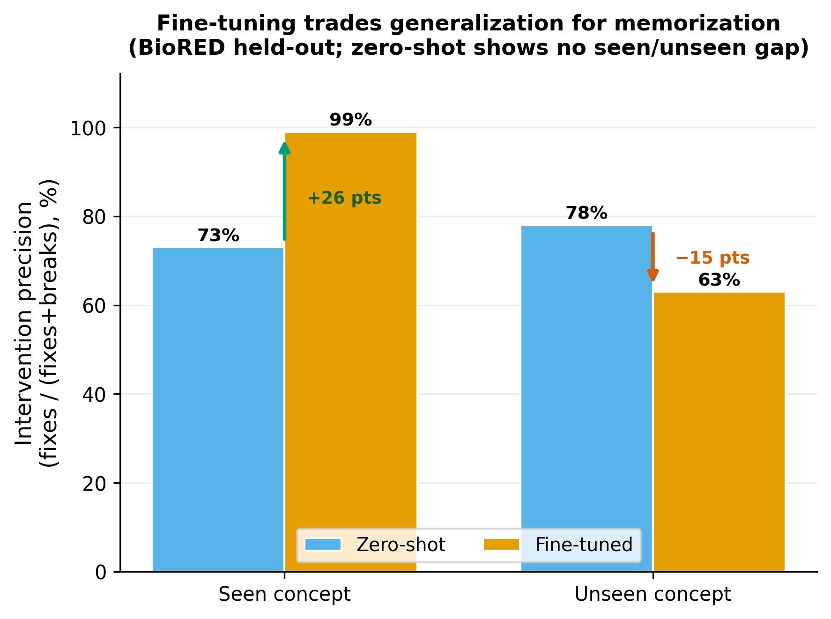
Finding: fine-tuning shifts seen vs unseen concepts
Intervention precision (BioRED, held-out): seen 73→99 (+26), unseen 78→63 (−15).
Fine-tuning becomes reliable on memorised concepts, less reliable on new ones.
Honest caveats: report n (seen 1007 / unseen 654) + CIs; frequency is confounded with seen/unseen (control it).
Prior art exists (Logeswaran/ZESHEL, entity matching) — we show it for the LLM stage, with a zero-shot control.

Slide 9
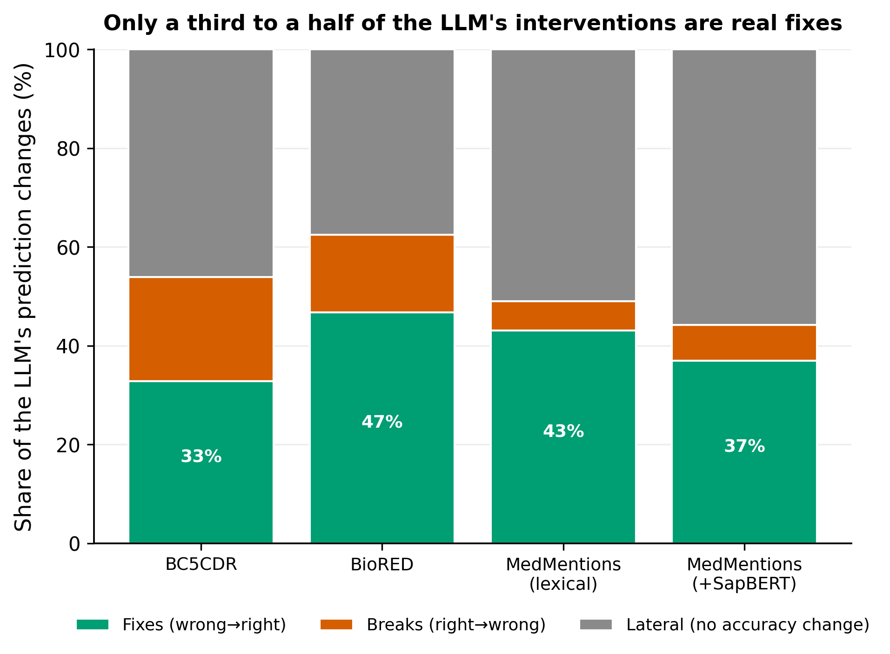
Finding: the anatomy of the LLM's interventions
Zero-shot: only ~1/3 of changes are real fixes; the rest break a correct answer or are lateral (no accuracy change).
Fine-tuning halves the breaks (21%→8%) — restraint, not new skill.
"overeager where there's nothing to gain, underpowered where it matters" (not "timid").
To lock in: split lateral by gold-in-list (809 forced), and add a cross-encoder baseline for "weak".

Slide 10
The one claim the material supports
Fine-tuning buys DEFERENCE, not COMPETENCE.
It changes WHEN the disambiguation stage intervenes — not HOW WELL it decides.
One mechanistic thesis that subsumes Findings 3–5 — instead of five observations with precursors.

Slide 11
Evidence for the thesis (cross-tabulate our own runs)
Truly-hard band [0,2)
competence flat
zero-shot ≈ fine-tuned — fine-tuning does NOT help where the retriever is stuck
1
Mid/high bands
restraint learned
breaks halved; band [10,20) precision 39%→69% (BioRED) — it learns to stay out
2
Unseen concepts
deference mis-fires
the learned restraint is distribution-bound; precision drops below zero-shot
3
The confirming table (precision × confidence band × seen/unseen × zs/ft) is ~one afternoon: BioRED is ready now; BC5CDR needs one enriched re-run.

Slide 12
How this becomes a paper
Contribution structure
To lock it in (in order)
THESIS: fine-tuning changes when, not how well.
Leg 1 — confidence stratification (competence flat, deference rises)
Leg 2 — intervention anatomy (breaks halved, lateral stays)
Leg 3 — seen/unseen (deference is distribution-bound)
Frame — retriever sweep + substitution + gate (known, cleanly measured)
Utility — the gate Pareto curve
Split lateral by gold-in-list (Finding 5).
Build the cross-tab (the thesis test).
Label every figure zero-shot / fine-tuned; add n + CIs.
Add a cross-encoder baseline for "weak".
Dev-tuned gate threshold → full Pareto curve.
Densify the curve with real retrievers (not ANGEL).

