Slide 1
Moodle

Slide 2
Indice
Create users
Create courses
Add users to a group
Edit course
Add activity or resource
Student view

Slide 3
Create users

Slide 4
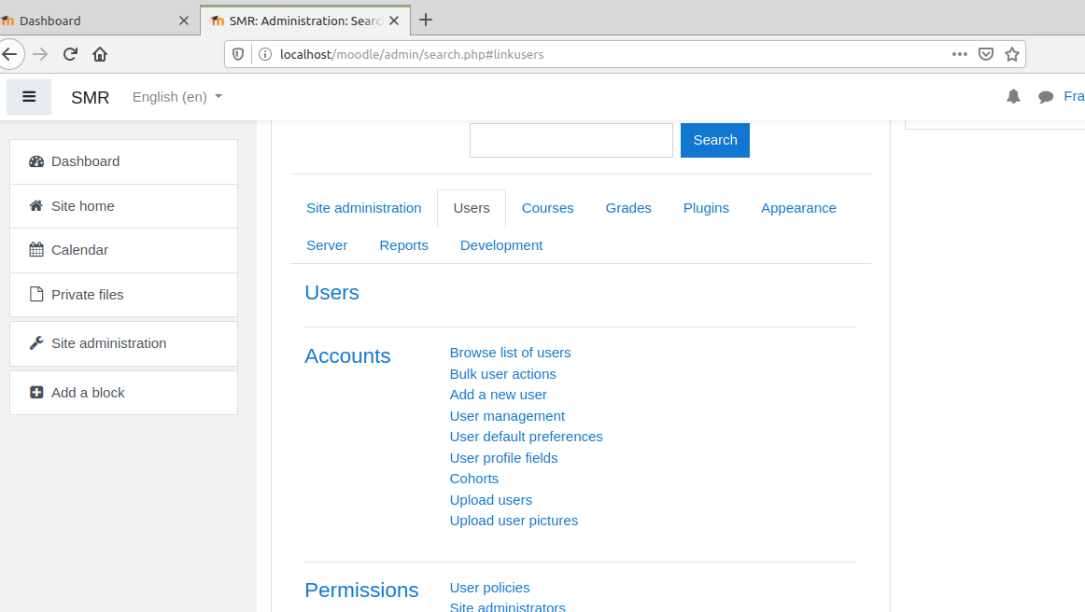
Create users

Slide 5

Create users

Slide 6
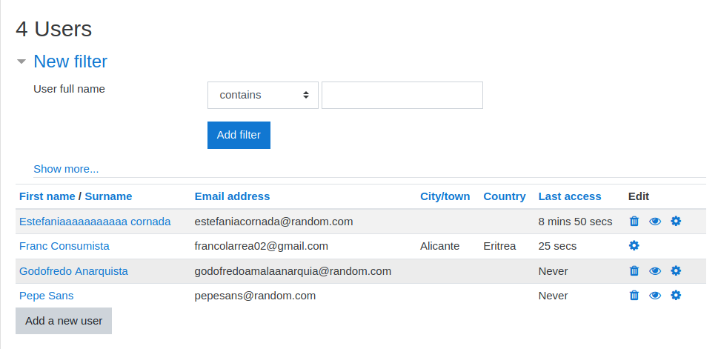
Create users

Slide 7
Create courses

Slide 8
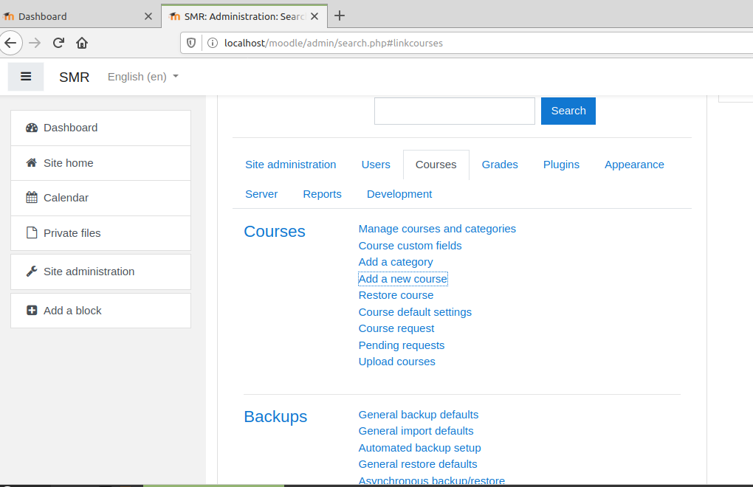
Create courses

Slide 9
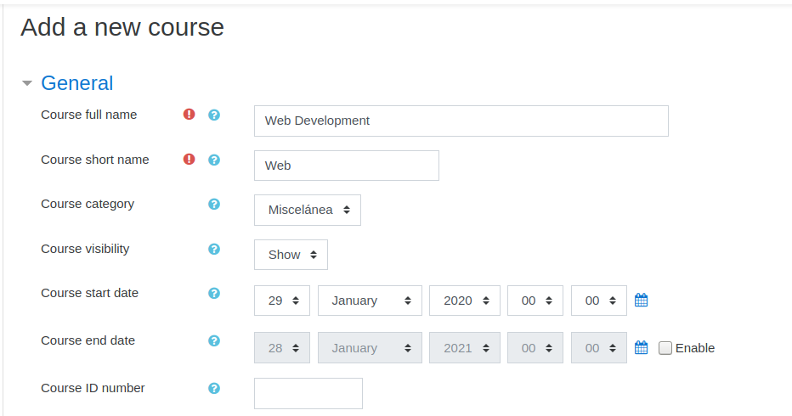

Create courses

Slide 10
Add users to a group

Slide 11
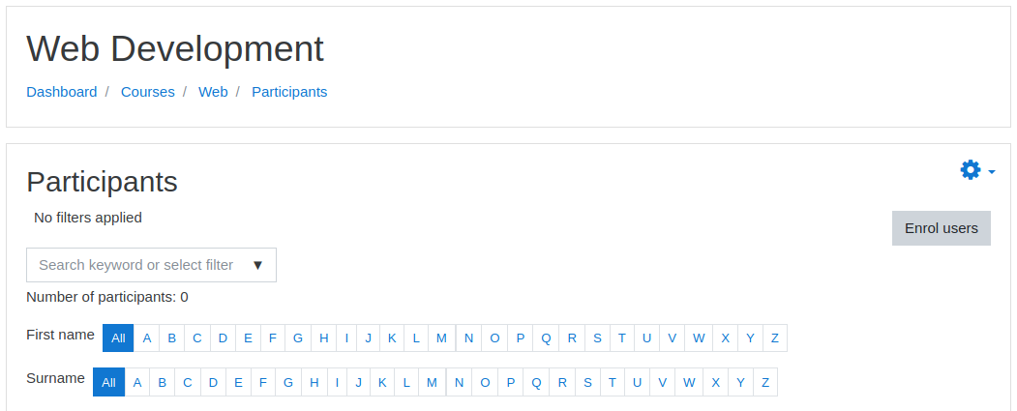
Add users to a group

Slide 12
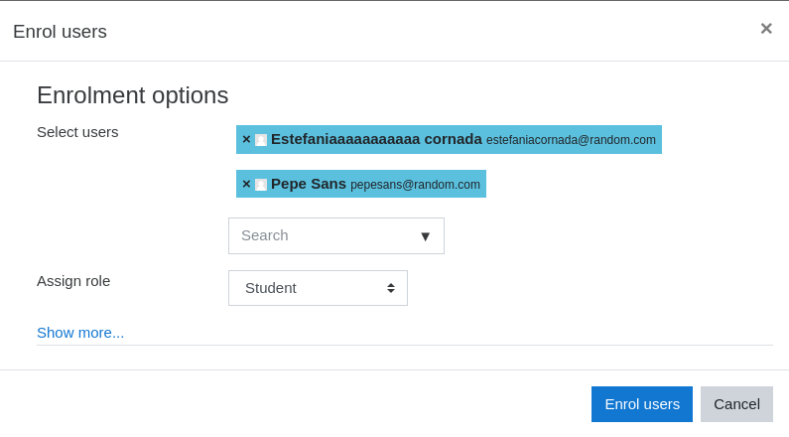
Add users to a group

Slide 13
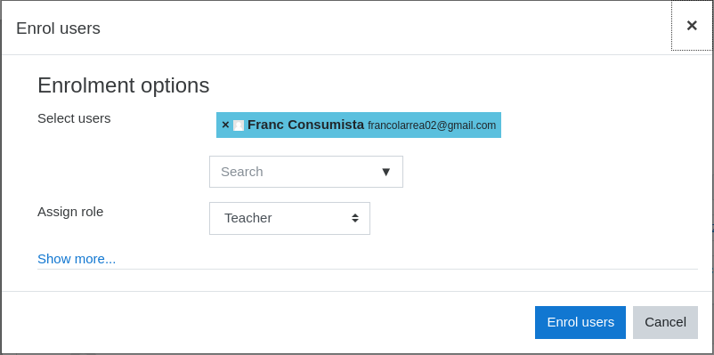
Add users to a group

Slide 14
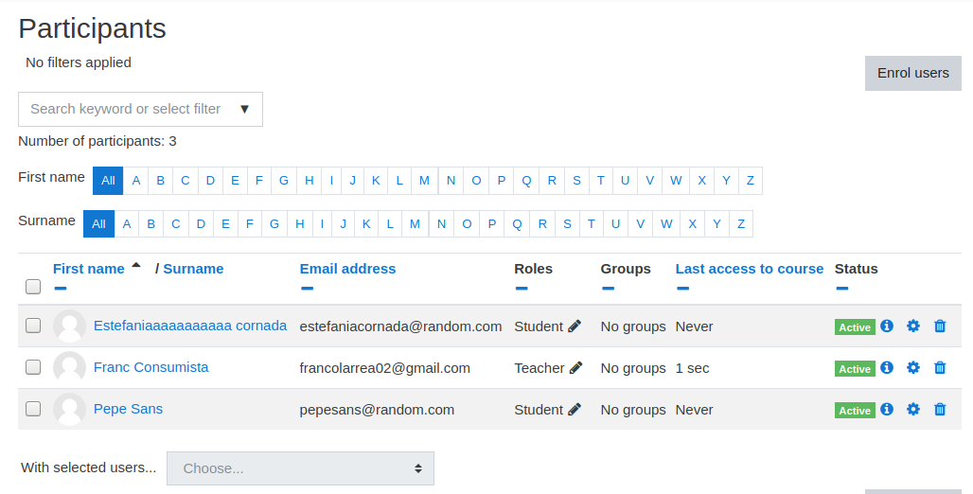
Add users to a group

Slide 15
Edit course

Slide 16
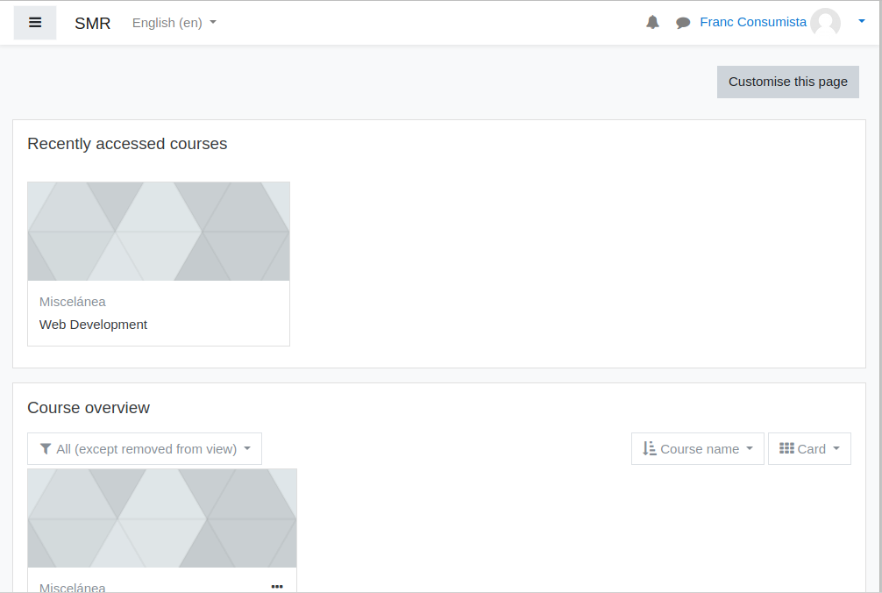
Edit course

Slide 17
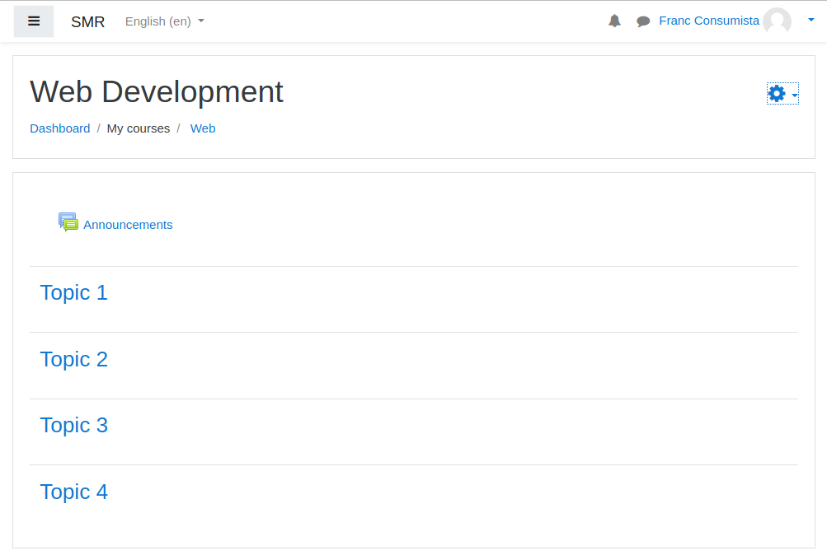
Edit course

Slide 18
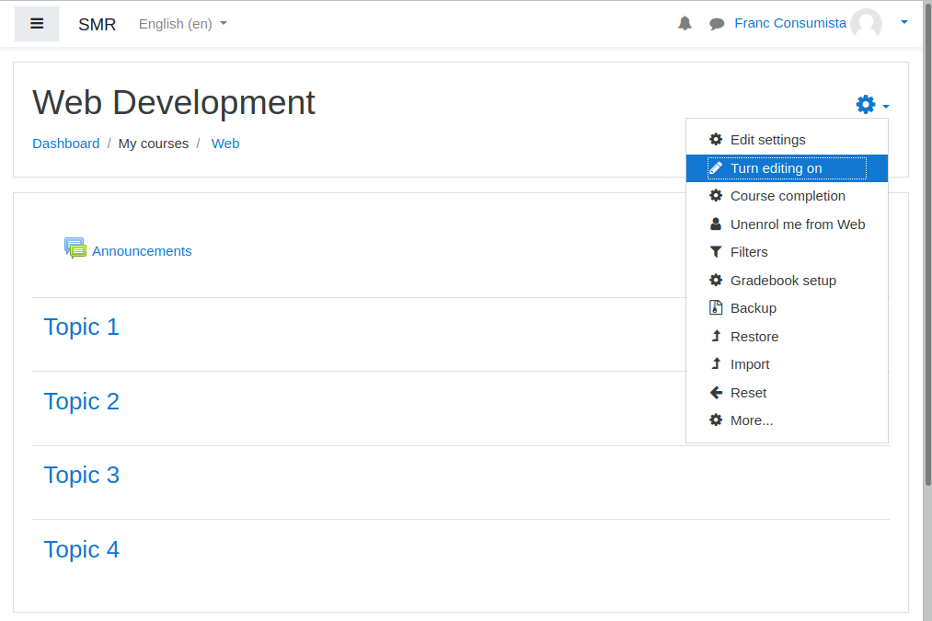
Edit course

Slide 19
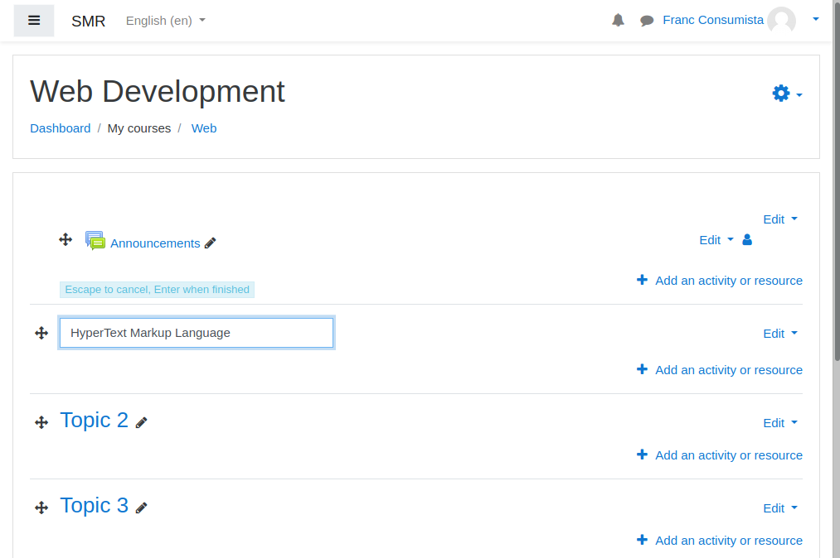
Edit course
v

Slide 20
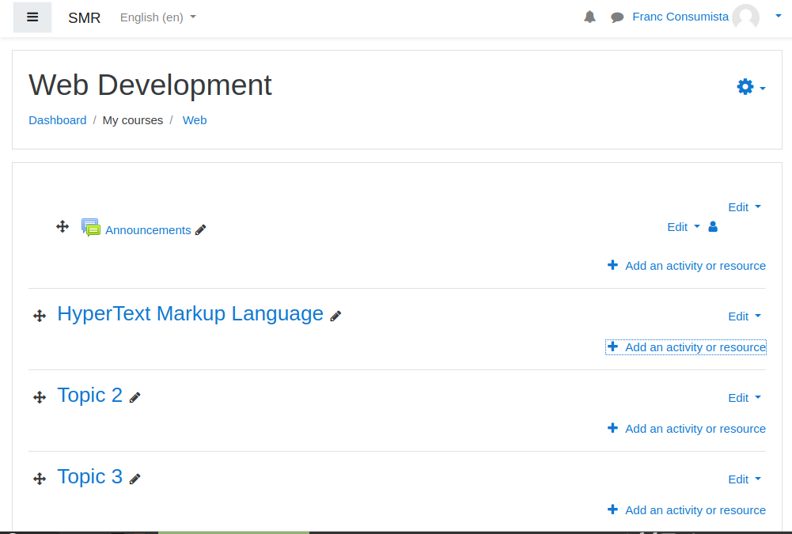
Add activity or resource

Slide 21
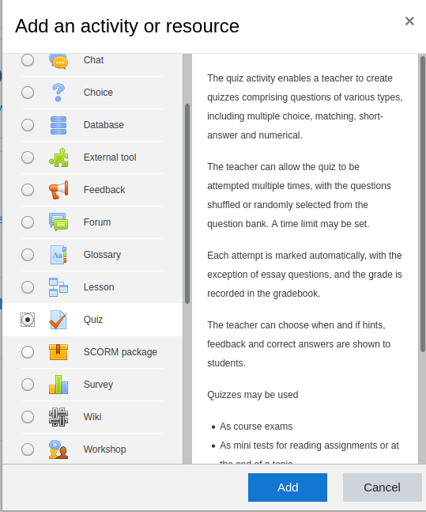
Add activity or resource

Slide 22
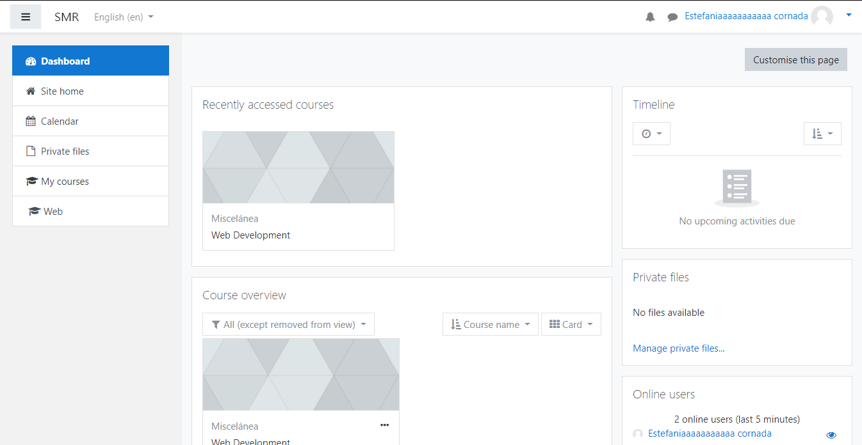
Student view

Slide 23
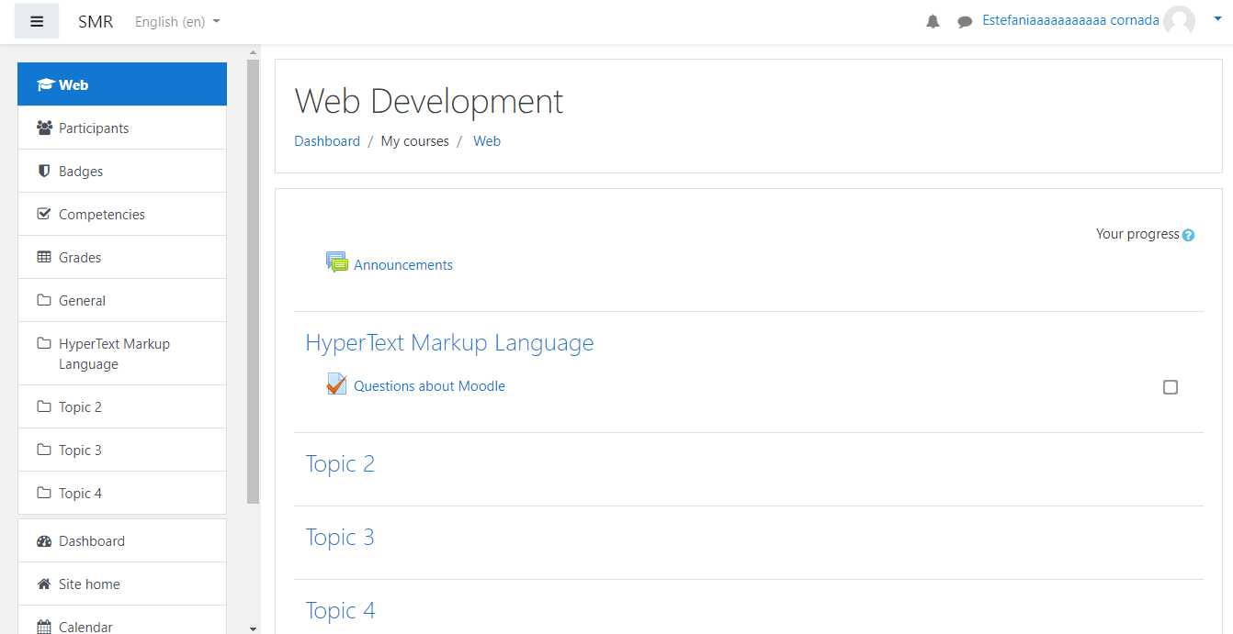
Student view

Slide 24
Franco Larrea & Francisco Gomez
This work is licensed under a Creative Commons Attribution-ShareAlike 3.0 Unported License.
It makes use of the works of Mateus Machado Luna.

