Slide 1

Using FAMA to Analyse Feature Models
by Pablo Trinidad and David Benavides

Slide 2
Outline
Information extraction from Feature Models
Automated Analysis to extract that information
Exercise 1
FAMA Eclipse plug-in
Exercise 2
FAMA FW insides
Dynamic Binding
Exercise 3
Bibliography

Slide 3
Information extraction
Domain knowledge/
requirements
Product 1
Configuration 1
SPL
Configuration 2
Product 2
Features
Configuration N
…
Quality requirements
Product N

Slide 4
Information extraction
Feature Models represent the products that are derivable from an SPL
Domain knowledge/
requirements
Product 1
Configuration 1
FM
Features
Configuration 2
Product 2
Configuration N
…
Quality requirements
Product N
Why is Configuration N not valid?

Slide 5
Information extraction
Which product has the minimum time-to-market?
Domain knowledge/
requirements
Product 1
Configuration 1
FM
Features
Configuration 2
Product 2
Configuration N
…
Quality requirements
Product N

Slide 6
Information extraction
Which product costs less than £5000 and contains feature M?
Domain knowledge/
requirements
Product 1
Configuration 1
FM
Features
Configuration 2
Product 2
Configuration N
…
Quality requirements
Product N
Why there is no product satisfying those constraints?

Slide 7
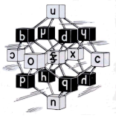

Automated Analysis
Automated analysis of feature models:
Computer-aided extraction of information from feature models
Feature Model
Logic
Analysis result
Translation
Solver
filter ● void ● explanation
filter
optimization
dead
void
explanation
#products
….
●

Slide 8
Automated Analysis
Number of products
How many products?
68

Slide 9
Automated Analysis
FAQ
And now?
148!!

Slide 10
Automated Analysis
Dead features detection
Explanation
Dead features now?
Yes, because the new relationship

Slide 11
Automated Analysis
Filter
I want a product with PDA, WS and Repository
Explanation
Sorry, PDA and Repository are incompatible features

Slide 12
Automated Analysis
Valid
Void
Products
#products
Filter
Core Features
Partial Variability
Total
Variability
Variants
Partial Equivalence
Analysis
Total
Equivalence
Commonality
Dead Features
Explanations
Corrective
Explanations
optimization
Modification
Reducing the number of products
Propagating
decisions
Simplification

Slide 13

Automated Analysis
Features:
Multiple reasoners supported to extract information: CSP, BDD, SAT,…
Multiple metamodels are supported as an input/output: Czarnacki’s, FODA, Extended FM,…
Multiple analysis operations are supported: #Products, Products, Valid, Filter, Error Detection,…
Multiple criteria to select the proper reasoner to perform an operation
Benchmarking system (Optional)
FM random generation (Optional)

Slide 14
Automated Analysis
Operation | JaCoPReasoner | SAT4jReasoner | JavaBDDReasoner
Valid | Yes | Yes (no Cardinality) | Yes (no Cardinality)
#Products | Yes | Yes (no Cardinality) | Yes (no Cardinality)
List of Products | Yes | Yes (no Cardinality) | Yes (no Cardinality)
Filters | Yes | Yes (no Cardinality) | Yes (no Cardinality)
Error Detection | Yes | Yes (no Cardinality) | No
Error Explanation | Yes | No | No
Commonality | Yes | Yes (no Cardinality) | Yes (no Cardinality)

Slide 15
Exercise 1
From the above FAMA FW features , try to draw the feature model that will describe all the derivable products from FAMA FW.

Slide 16
Automated Analysis
Q: How do we communicate FAMA FW a feature model to be analysed?
A: XML file format
Q: But GUIs were invented long time ago, why not using them?
A: Well, we’ll use FAMA Eclipse plug-in to edit and analyse FM although FAMA FW can still be used as an standalone application.

Slide 17
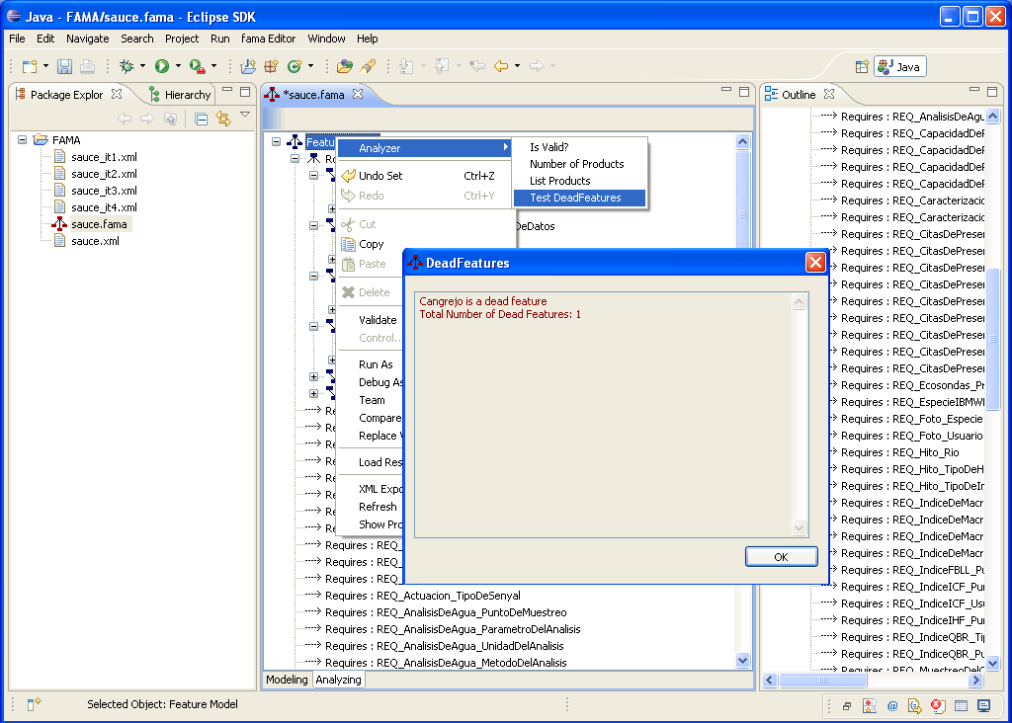
FAMA Eclipse plug-in

Slide 18
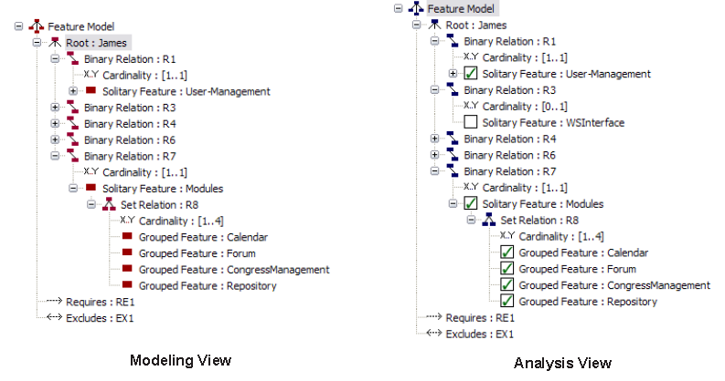
FAMA Eclipse plug-in

Slide 19
FAMA Eclipse plug-in
[0,1] = Optional feature
Cardinality
[1,1] = Mandatory feature
[N,M] = Cardinal feature
Binary
1 Solitary feature
Relationships
[1,M] = inclusive-or
Cardinality
[1,1] = exclusive-or
[N,M] = Cardinal relationship
Set
M Grouped features
Cross-tree
contrainst
Requires: feature A requires feature B to work
Excludes: feature A is incompatible with feature B

Slide 20
Exercise 2
Describe the FAMA FW feature model using FAMA Eclipse plug-in.
Detect the errors that you may have commited
Try to repair the errors from the information provided
Count the products and share the information with your classmates
Compare your feature model with your classmates’
Export the feature model in XML file and store it in a file

Slide 21
FAMA FW Insides
FAMA FW Architecture
FAMA Extensions
Questions architecture

Slide 22
FAMA FW Architecture
QuestionTrader
CORE
Metamodels
Reasoners
Questions
Reasoner
Selector
Bench marking
FAMA MM
SPL Reasoner
…
JaCoP
SAT4j
Java
BDD
…
#Products
List Products
…
Pre-defined
…
FW
FAMA Extensions

Slide 23
FAMA Extensions
Product-specific
features
Core features
FW
SDK
+
+
=
Customized

Slide 24
Questions Architecture
App
FW
Load / Set FM

Slide 25
Questions Architecture
App
Question Trader
FW
Load / Set FM

Slide 26
Questions Architecture
App
Question Trader
FW
Question type
Question Instance

Slide 27
Questions Architecture
App
Question Trader
FW
Ask Question
Response

Slide 28
Dynamic Binding
Java is an interpreted language. Java compiler generates a bytecode that keeps many of the information from code. It is the reason why you may obtain code from decompilers with an accurate result.
It means that code is able to know properties from itself such as its classes, methods, attributes, etc. Reflection API is provided to access such an information.
We use Reflection API to decouple code from interface implementations.

Slide 29
Dynamic Binding
Imagine that we define an IReasoner interface. We need an implementation to that interface such as JaCoPReasoner.
IReasoner reasoner;
reasoner = new JaCoPReasoner();
What if I produce a new product that uses SAT4jReasoner instead of JaCoPReasoner?
IReasoner reasoner;
reasoner = new SAT4jReasoner();
Quite easy but you still have to recompile. May we avoid compiling again?

Slide 30
Dynamic Binding
We use Reflection API to create an instance of class JaCoPReasoner
IReasoner reasoner;
String className = “es.us.isa.JaCoPReasoner”;
Class<IReasoner> reasonerClass = Class.forName(className);
reasoner = reasonerClass.newInstance();
It has the same effect than previous code. What’s new on it?
The name of the class is just a string so it may be taken from a configuration file for example
…
String className = ConfigurationFile.getReasoner();
…

Slide 31
Dynamic Binding
Common structure of frameworks:
IReasoner
IQuestion
<<create>>
JaCoPReasoner
JaCoPValidQuestion
<<create>>

Slide 32
Dynamic Binding
Structure of a framework that uses Reflection API:
IReasoner
IQuestion
<<create>>
A configuration file couples JaCoPReasoner and JaCoPValidQuestion
JaCoPReasoner
JaCoPValidQuestion

Slide 33
Dynamic Binding
Metamodels
Reasoners
IParser
VModel
GenericReaoner
FM
ITransform
Reasoner
JaCoPReasoner
IWriter
FAMA FM
FMTransform

Slide 34
Dynamic Binding
An example of FAMA FW configuration file:
<questionTrader>
<reasoner id="JavaBDD" file="lib/JavaBDDReasoner.jar" class="es.us.isa.JavaBDDReasoner.JavaBDDReasoner"/>
<reasoner id="JaCoP" file="lib/JaCoPReasoner.jar" class="es.us.isa.JaCoPReasoner.JaCoPReasoner"/>
<criteriaSelector name="default" class="es.us.isa.FAMA.Reasoner.DefaultCriteria"/>
<question id="Products“
interface="es.us.isa.FAMA.Reasoner.questions.ProductsQuestion"
file="lib/FAMAquestions.jar"/>
<models>
<reader extensions="xml,fama" class="es.us.isa.FAMA.models.fileformats.XMLReader" file="lib/FAMAmodel.jar"/>
<writer extensions="xml,fama" class="es.us.isa.FAMA.models.fileformats.XMLWriter" file="lib/FAMAmodel.jar"/>
</models>
</questionTrader>

Slide 35
Exercise 3
An air conditioning system in a home integration system needs the external temperature to set the power of the air conditioner. A termostat is available, but it is frequent that it fails so the system may obtain the external temperature either from weather.com Internet service or from a forecast system that stores previous temperatures to give an estimated temperature.
Analyse the feature model to describe the reconfiguration scenarios.
Design a solution to the air conditioning system.
Implement the solution in Java

Slide 36
Bibliography
Benavides, D., Ruiz-Cortés, A., Trinidad, P. Automated reasoning on feature models. In LNCS, 17th International Conference, CAiSE 2005, vol. 3520, pp. 491–503.
Benavides, D., Ruiz-Cortés, A., Trinidad, P. and Segura, S. A
survey on the automated analyses of feature models. In JISBD 2006.
D. Benavides, S. Segura, P. Trinidad, and A. Ruiz-Cortés. FAMA: Tooling a framework for the automated analysis of feature models. In VAMOS 2007.
Batory, D., 2005. Feature models, grammars, and propositional formulas.
In Software Product Lines Conference, LNCS 3714, pp. 7–20.
Batory, D., Benavides, D., Ruiz-Cortés, A., 2006. Automated analysis of feature models: challenges ahead. Commun. ACM 49 (12), 45–47.
Or just visit www.lsi.us.es\~trinidad and www.isa.us.es

Slide 37
Thanks!
FW
www.isa.us.es/fama

