Slide 1
Groupware:
Some Concepts, Issues and Principles
Li Yi
from Domain and Requirements Engineering Research Group
Instructor: Hong Mei
2010.04.27
Notes:
Suggested title: Concepts and Issues

Slide 2
Agenda
Core concepts
Key issues
Important principles
Our work

Slide 3

What is groupware?
Computer-based systems that support groups of people engaged in a common task (or goal) and that provide an interface to a shared environment.
  Ellis, Gibbs, Rein, Groupware: Some Issues and Experiences, Communications of the ACM, 1991
  This term is frequently used almost synonymously with CSCW (Computer-Supported Cooperative Work) technology.
CONCERNS
Core concepts that all groupware must focus on
Key issues related to these concepts
Important principles that groupware designers should consider
One of the most successful groupware

Slide 4
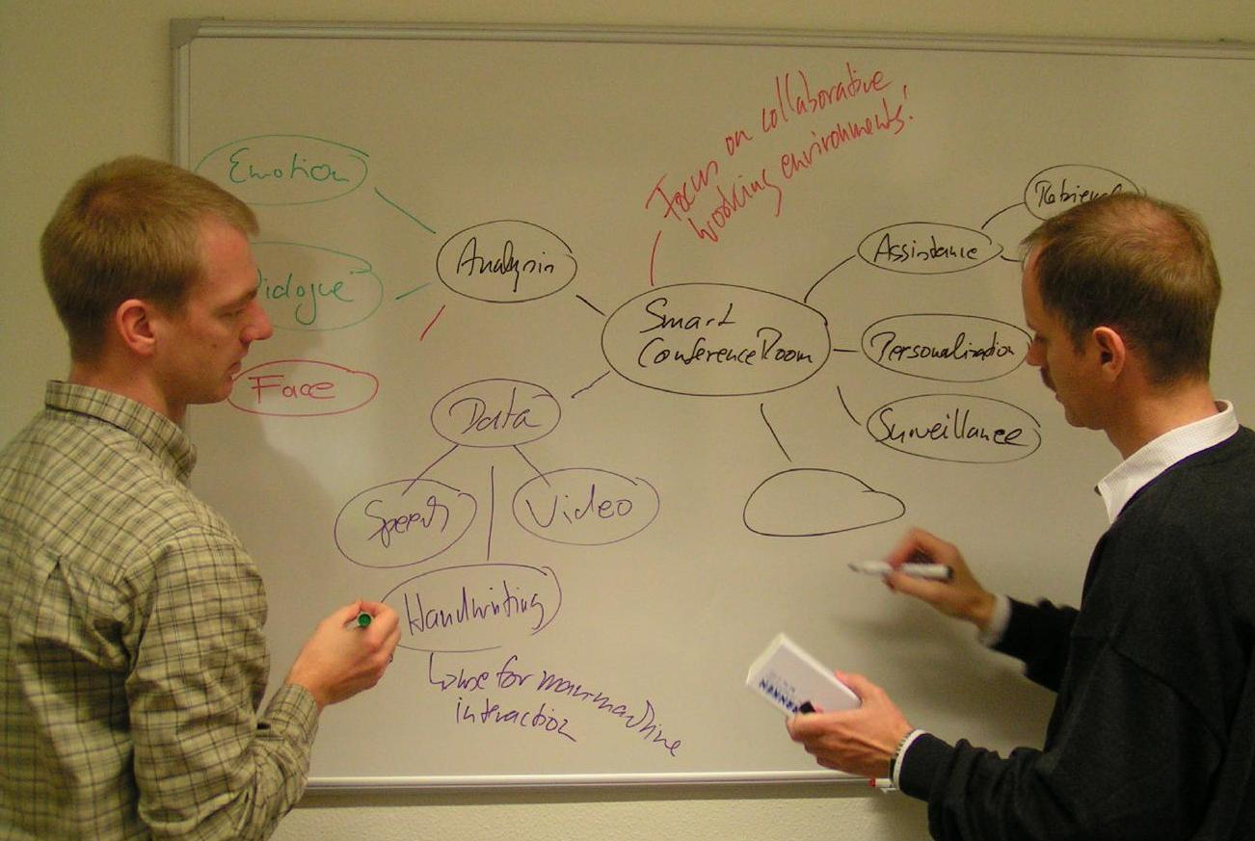




Observations in face-to-face group work
Notes:
用一个图（多人之间Communication+Awareness，他们的工作集合到一个地方去Coordination）说明三个concern的位置。
给三个concerns各下一句话定义。
用两个人在白板上讨论问题来解释
Awareness：一个人在某个图元上画画时，另一个人必然就会注意到，然后就会去关注和思考同一个部分。
Coordination：两个人不能同时在白板的相同位置画画。
Why these concerns？因为从面对面协同 到 隔着软件、分布到各地，甚至还是异步，那么上述例子中所说的那些情况就不能“自然而然”的获得了，就需要通过软件来支持，尽可能把中间隔着的这一层东西给透明化。

Slide 5
Core concepts of groupware
Communication
  The process by which people exchange information or express their thoughts and feelings. -- Longman Dictionary
Awareness
  An understanding of the activities of others which provides the context for your own activity.
  The up-to-the-moment understanding of another person’s interaction with the shared workspace.
Coordination
  The mediating and meshing of individual work in a shared workspace in order to reduce possibilities of conflict and repetition.

Slide 6
Agenda
Core concepts
Key issues
  Related to Awareness
Important principles
Our work

Slide 7
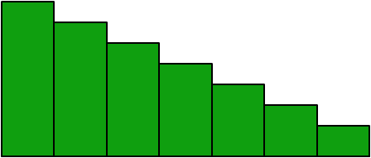
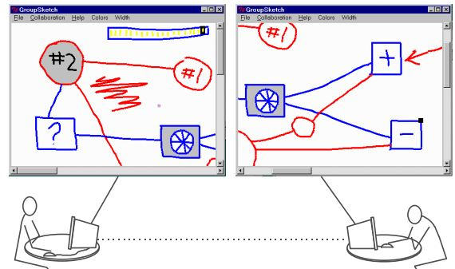
The need of awareness in groupware
Face-to-face group work vs. Groupware
body movements, eye contact, expression conversation, overhearing, self-talking, other sound
keyboard, mouse
screen
video/audio devices
Information
GroupKit [Roseman and Greenberg 1995]
Notes:
There are three main reasons why this is so. First, the input and output devices used in
groupware systems generate only a fraction of the perceptual information that is available
in a face-to-face workspace. Second, a user’s interaction with a computational workspace
generates much less information than actions in a physical workspace. Third, groupware
systems often do not present even the limited awareness information that is available to the
system
Systems like this one show almost none of the awareness information that would be
available to a group working with a physical whiteboard. People’s hands and bodies are
reduced to simple telepointers, there is no sound, and only a small piece of the entire
drawing can be seen at one time. In this situation, it will be difficult or impossible for the
two participants to discuss particular objects, provide timely assistance, monitor the other
person’s activities, or anticipate their actions. In short, lack of information about others
means that many of the little things that contribute to smooth and natural collaboration will
be missing from the interaction.

Slide 8

Issues of awareness
What information makes up awareness?
How is awareness information gathered?
How is awareness used in groupware?
Awareness Elements
Techniques
Examples
Principles
Examples
Observations
Impact on
Communication
Coordination
Other group work activities

Slide 9
What information makes up awareness?
Who we are/were working with
What they are doing/have done
Where they are working/have been
When various events happen
How those events occur

Slide 10
Awareness Elements
Category | Element | Specific question
Who | Presence | Is anyone in the workspace?
 | Identity | Who is that?
 | Authorship | Who is doing that?
 | Presence history | Who was here, and when?
What | Action | What are they doing?
 | Intention | What goal is that action part of?
 | Artifact | What object are they working on?
 | Action history | What has a person been doing?
Where | Location | Where are they working?
 | View | Where can they see?
 | Reach | Where can they reach?
 | Location history | Where has a person been?
When | Event history | When did that event happen?
How | Action history | How did that action happen?
 | Artifact history | How did that artifact come to be in this state?
Notes:
应该注意到：大多数情况是face-to-face中很容易获得的，但是其他信息却在groupware中才容易获得，这也是Groupware的一个优势。

Slide 11
Supporting Awareness Elements
Category | Element | Specific question
Who | Presence | Is anyone in the workspace?
 | Identity | Who is that?
 | Authorship | Who is doing that?
 | Presence history | Who was here, and when?
What | Action | What are they doing?
 | Intention | What goal is that action part of?
 | Artifact | What object are they working on?
 | Action history | What has a person been doing?
Where | Location | Where are they working?
 | View | Where can they see?
 | Reach | Where can they reach?
 | Location history | Where has a person been?
When | Event history | When did that event happen?
How | Action history | How did that action happen?
 | Artifact history | How did that artifact come to be in this state?
Not so important
Important for real-time groupware
Important for both real-time and non-real-time groupware
Notes:
应该注意到：大多数情况是face-to-face中很容易获得的，但是其他信息却在groupware中才容易获得，这也是Groupware的一个优势。

Slide 12

Example awareness techniques
Participant list
  Presence (Is anyone there?)
  Identity (Who is that?)
Creation coloring
  Authorship (Who is doing that?)
Mode indicator
  Action (What’s happening? What is s/he doing?)
Action animation
  Action
Notes:
• Participant list (e.g. Sohlenkamp and Chwelos 1994). The most basic awareness
display, the participant list shows who is currently logged in to the system
(although several other types of awareness information can be added to this basic
idea). Presence is shown by presence in the list.

Slide 13
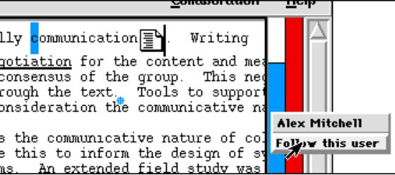
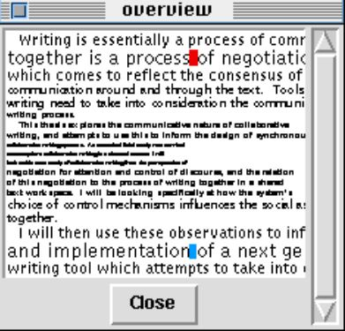
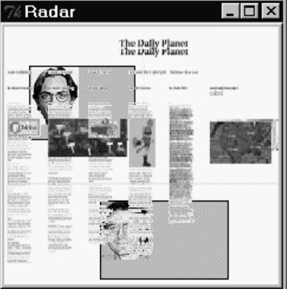
Example awareness techniques (cont.)
Telepointer
  Presence
  Location (Where is s/he working?)
View slaving
  View (What can s/he see?)
Radar View
  Presence
  Identity
  Location
  View
  Reach (Where can s/he manipulate?)
Notes:
View slaving. Being able to temporarily switch to another person’s view shows
what they can see in full detail (Gutwin, Roseman, and Greenberg 1996)

Slide 14
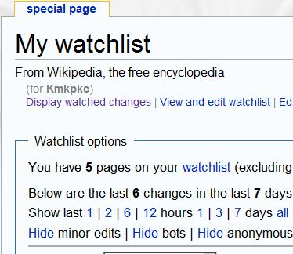
Example awareness techniques (cont.)
Watch list
  Event History
  Artifact History
What’s New
  Action
  Artifact
Revision History
  Event History
  Artifact History

Slide 15
How is awareness information gathered?
The Least-Overhead Principle:
Awareness information should NOT be actively provided by users, but passively collected by the system.
From Articulation to Awareness
  Articulate: to pronounce what you are saying in a clear way.
  Awareness: the ability to notice something using your senses.
  … the cooperating workers have to articulate their distributed individual activities … thus, the participants must engage in activities that are extraneous to the activities that contribute directly to the product …
-- Schmidt, Taking CSCW Seriously, 92

Slide 16
From actively to passively
Actively generating
  The user who provides activity information does not directly benefit.
  The sender cannot predict what information will be needed and when.
Passively collecting
  No extra work needed.
  The information is always available.
  The information can be customized according to individual needs.
Notes:
actively：一个人在干活的时候不停地给你通报情况，你其实很难真正理解他的工作。
passively: 通过一个监视器进行指挥

Slide 17
How is awareness used in groupware?
Simplify communication
  Awareness simplifies communication by providing more contextual information for people.
Make coordination easier
  The more aware people are, the less there is a need to coordinate activities.
Improve group work
  Work coupling management
  Anticipation
  Assistance
Notes:
对Communication的影响举例：知道了author是谁，就可以直接找他讨论; 没有上下文信息的时候交流就比较困难。

Slide 18
Agenda
Core concepts
Key issues
  Related to Communication
Important principles
Our work

Slide 19
Key issues of communication
How can technologies make distributed communication as effective as face-to-face conversations?
From face-to-face to groupware
Lost
  Information about people
  Responsiveness
Gain
  Information about the work
  Flexibility

Slide 20
The essential requirements of groupware
Provide contextual information for communication:
The contextual information is essential as it provides a common reference point for participants.
Contextual information could be
  common terminologies
  related artifacts
  related awareness information (e.g. revision history or people)

Slide 21
Example: the famous wiki-policies
Wikipedia policies are developed by the community to describe principles and best practice further the goal of creating a reliable encyclopedia.
Example Policies
Policy | Meaning
Edit Warring | If someone challenges your edits, discuss it with them and seek a compromise. Do not start fights over competing views and versions.
No personal attacks | Comment on the content, not on the contributor.
Neutral point of view | Everything should be written from a neutral point of view.
Verifiability | Articles should cite sources whenever possible.

Slide 22
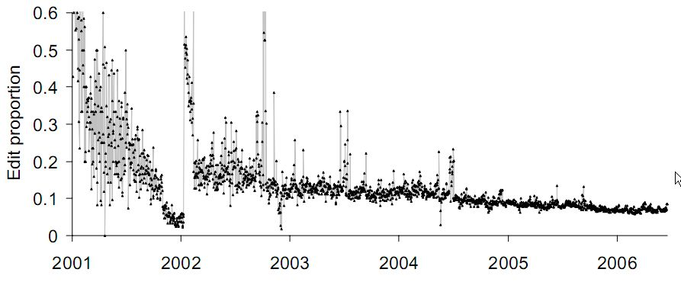
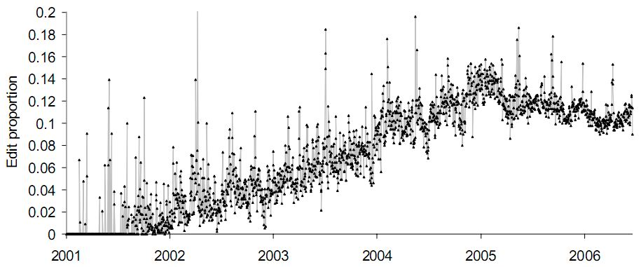
Observations on the Wikipedia
Less new articles, more debate
More debate, better quality
More debate, higher percentage of policy use
More development of policies themselves
Wikipedia is becoming
less anarchic and more driven by policies and
guidelines.

Slide 23
Agenda
Core concepts
Key issues
  Related to Coordination
Important principles
Our work

Slide 24
The key issue of coordination
How does the system deal with multiple participants’ sequential or simultaneous access to the same set of objects?
Typical Approaches
Locking
Serialization
Reversible Execution
Operation Transformation
Notes:
Individual work could be synchronized (real-time) or non-real-time
should be responsively

Slide 25
Comparison of these approaches
 | Locking | Serialization | Reversible Execution | Operation Transformation
Operation generating | Serialized | Concurrent | Concurrent | Concurrent
Operation executing | Serialized | Serialized | Concurrent | Concurrent
Conflict Resolution | Not needed | Manually | Undo invalid operations | Transform problematic operations
Main drawbacks | The granularity of locking is hard to decide in many systems. | Its application is limited to asynchronous group work. | Possibility of unpleasant user experience because of undo. | High overhead.
Example | OntoEdit [2002] | SVN, Wikipedia | Most real-time collaborative writing (co-authoring) systems

Slide 26



Operation transformation
An algorithm developed in the study of real-time collaborative writing systems, to solve the problem of inconsistency of replicated documents in distributed sites.
Site 2
Broadcasting to
Site 1
Site 3

Slide 27
An example of the inconsistency problem
abcd
abcd
abd
delete(3)
delete(2)
acd
Time
When operations initiated by one site are still on the air, other sites have changed. (Overlapping)
ac
ad
Site 1
Site 2

Slide 28
Overlapping and non-overlapping
delete(3)
delete(3)
delete(2)
delete(2)
Site 1
Site 2
Site 1
Site 2
Unsafe
Safe

Slide 29
The basic idea
When I received an operation O from site S
if O is overlapped with past operations (POs) in my site, then O is transformed to another operation OT where:
The semantics of O in S == The semantics of OT in my site
delete(3)
Overlapped PO
How to find overlapped POs?
How to transform the original operation according to these POs?
delete(2)
according to
Received and Transformed
Site S
My Site

Slide 30
Define the transformation (example)
if (o < p)
ot =o;
else if (o> p)
ot = o– 1;
else no deletion;
Received operation: delete(o)
Overlapped PO: delete(p)
Transform delete(o) to delete(ot)
abcd
abcd
abd
delete(3)
delete(2)
acd
Time
o=3, q=2
delete(2)
ad
o=2, q=3
delete(2)
ad
Site 1
Site 2

Slide 31
Transformation by multiple POs
Input: received operation O; Overlapped POs (OPOs)
for operation P in OPOs from oldest to newest
O ← Transform O according to P;
abcde
abcde
abde
delete(3)
delete(2)
acde
o=2, p=3
delete(2)
Time
ade
delete(4)
acd
if (o < p)
delete(o);
else if (o > p)
delete(o - 1);
else no deletion;
o=3, p=2
delete(2);
o=2, p=4
delete(2)
o=4, p=3
delete(3)
ad
ad

Slide 32

Find overlapped past operations
Step 0: Define a state vector (SV) for each site
Assume there are N sites total (site 1, 2, …, N);
SV for site X = (E_{i})_{N} , 1 <= i <= N
where E_{i} = how many operations from site i has been executed in site X.
Step 1: See if overlap happens (if not, return)
generate
op
generated by site X
The X-th component of
SV_{Receiver @ received op}
The X-th component of
SV_{Sender @ generating op}
receive
Sender
Receiver

Slide 33
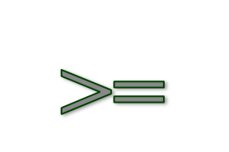
Find overlapped past operations (cont.)
Step 2: Track back for OPOs until we find the first one
generated by site X (an OPO)
generate
op
The X-th component of
SV_{Receiver @ executing q}
The X-th component of
SV_{Sender @ generating op}
q
execute
Sender
Receiver
Determine which is the first OPO
if all components of SV_{Receiver @ executing q}
< all corresponding components of SV_{Sender @ generating op}
then first OPO = the next operation of q executed on receiver, or
if q == null, then first OPO = the first operation executed on receiver.
The sender knows everything the received knew when generating op.

Slide 34
Example: find overlapped POs
Site 1
Site 2
Generated by 2, SV₂ = (0, 0) at generating
1, (0, 0)
a
c
2, (0, 0)
2, (1, 0)
b
2, (0, 1)
Generated by 2, SV₁ = (1, 0) at executing
d
Find OPOs for d when site 1 received d
Is Overlapped – The 1st component of SV_{1@received d} (1, 1) > of SV_{2@generating d} (0, 1)
Find First OPO – Search for (-1, 0) … null; First OPO = a
Check next – The 2nd component of SV_{1@executing b} (1, 0) < of SV_{2@generating d}(0, 1); b does NOT overlap with d.
END – OPO = {a}

Slide 35
Notes on operation transformation
Deal with the limitations of fixed site number and the increasing overhead of finding OPOs
A suggested solution
  When the system falls quiet for an extended period of time (e.g. five seconds), the log of past operations can be reset and participants can enter and leave the session. Furthermore the session object can be check-pointed by each site.

Slide 36
Agenda
Core concepts
Key issues
Important principles
Our work

Slide 37
General principles of groupware
Individual first, then group:
Successful groupware should first provide successful support for individual work.
Organizations are structured and responsibilities are divided in order to minimize the overall collaboration requirements.
Groupware features are used less frequently than many features supporting individual activity.
Who would abandon their favorite word processor to use a co-authorship application?

Slide 38
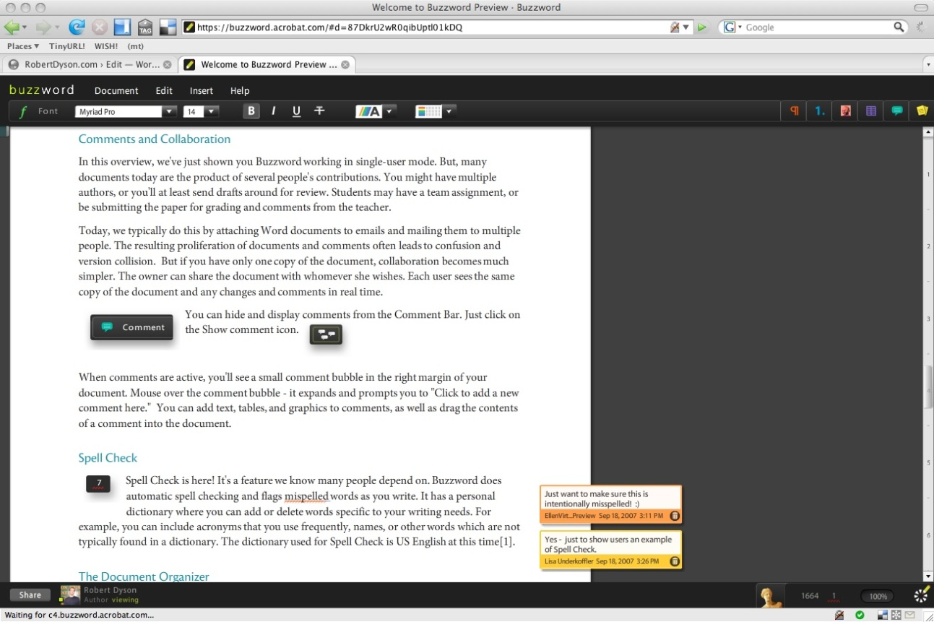
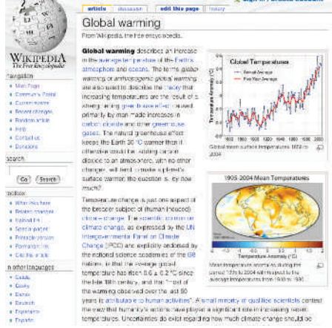
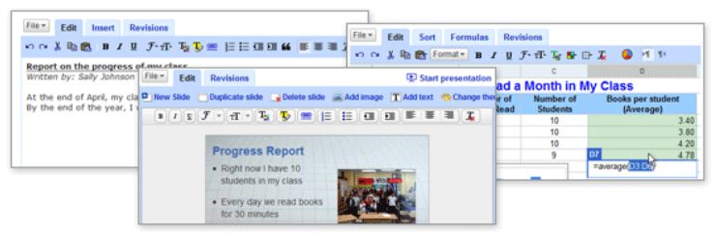
Example: Successful ones

Slide 39
General principles of groupware
Everyone Works and Benefits (Maximize Acceptance):
Successful groupware requires effort from and provides benefit to every group member.
Failure of some early groupware
  Automatic meeting scheduling in many electronic calendar systems
  Voice annotation to documents, which has been implemented many times
  Callisto: An intelligent project management system
  ZOG: A computer-assisted management system for naval vessels
Successful ones
  Wikipedia

Slide 40
Agenda
Core concepts
Key issues
Important principles
Our work

Slide 41
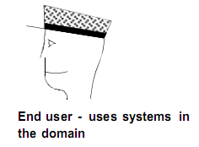
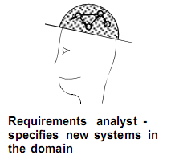
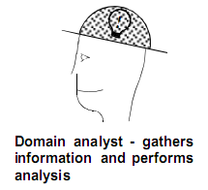
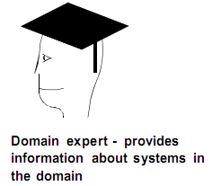
Collaborative feature modeling
Our Work
Motivation
  In most of existing feature modeling approaches, collaboration among stakeholders is a key factor to the construction of feature models
  But few of them provide explicit support for such collaboration
  It takes a lot of effort for domain analysts to obtain knowledge from others, leading to problems:
    FM constructions are time-consuming and error-prone
    FMs are difficult to maintain and evolve with the domain
(from FODA & FORM)

Slide 42

The basic idea
The Shared Feature Model
...
User 1 created feature Play Control
User 1 created feature Audio Control
User 2 created relation Audio Control refines Play Control
User 2 voted NO to feature Online Playing
User 1 created relation Online Playing requires Play Control
...
create/vote
create/vote
Global View
Working View
Personal View

Slide 43
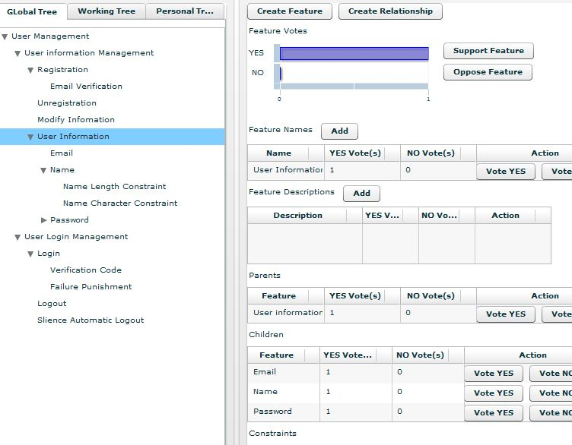
Awareness, Communication & Coordination
Coordination
  Broadcasting + Reversible Execution
Awareness
  Views
  Telepointer
  Participant List
Communication
  Talk page
  Talk is associated with features and/or relationships.

Slide 44
References
Most cited
  CA Ellis, SJ Gibbs, G Rein, Groupware: some issues and experiences, Communications of the ACM, 1991
  J Grudin, Groupware and social dynamics: eight challenges for developers, Communications of the ACM, 1994
  WJ Orlikowski, Learning from Notes: organizational issues in groupware implementation, CSCW 92
  K Schmidt, L Bannon , Taking CSCW seriously, CSCW 92
  P Dourish, V Bellott, Awareness and coordination in shared workspaces, CSCW 92
  C Gutwin, S Greenberg, A descriptive framework of workspace awareness for real-time groupware, CSCW 2002
  M Roseman, S Greenberg , Building real-time groupware with GroupKit, a groupware toolkit, CSCW 96
  CA Ellis, SJ Gibbs, Concurrency control in groupware systems, ACM SIGMOD 90
  C Sun, Achieving convergence, causality preservation, and intention preservation in real-time cooperative editing systems, ACM TOCHI 98
  J. Conklin, M. Begeman, gIBIS: A Hypertext Tool for Exploratory Policy Discussion, ACM Trans. On Information Systems (TOIS), 1988

Slide 45
References (cont.)
Others
  C Ellis, J Wainer, A conceptual model of groupware, CSCW 94
  Y Sure, M Erdmann, OntoEdit: Collaborative ontology development for the semantic web, ISWC 2002
  V. Shiha, B. Sengupta, S. Chandra, Enabling Collaboration in Distributed Requirements Management, IEEE Software, 2006
  D. Damian, S. Marczak, I. Kwan, Collaboration patterns and the impact of distance on awareness in requirements-centred social networks, ICRE, 2007
  Barry Boehm et al., Developing groupware for requirements negotiation: lessons learned, IEEE Software, 2001
  Teasley, Covi, Krishnan, Olson, How does radical collocation help a team succeed?, CSCW 2000

Slide 46
Thanks for your listening!
Questions and comments are appreciated!

