Slide 1
Collaborative Feature Modeling: A Voting Based Approach with Divergence Tolerance and Consensus Facilitation
RE’10
Yi Li

Slide 2
Agenda
Introduction
An Example
Related Work

Slide 3
Agenda
Introduction
An Example
Related Work

Slide 4
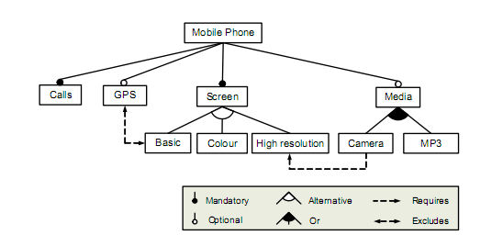
Background: Feature modeling
from Kang, Feature Oriented Domain Analysis (FODA) Feasibility Study, CMU/SEI-90-TR-21, 1990

Slide 5
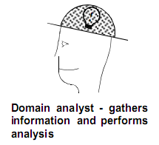
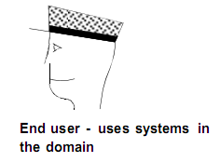
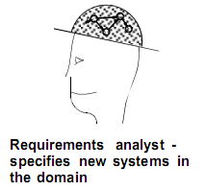
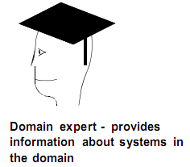
First, a feature model needs to be constructed…
…with collaboration between stakeholders
(from FODA & FORM)
FM

Slide 6
However, no method has supported such collaborations explicitly
It takes a lot of effort for domain analysts to obtain knowledge from others, leading to problems:
FM constructions are time-consuming and error-prone
FMs are difficult to maintain

Slide 7
Our approach: collaborative feature modeling
Our collaboration mechanism matches the purpose of feature models: capturing commonality and variability in a domain
Facilitate achieving consensus between collaborators
Keep their divergence as a reflection of variability in the domain
Show consensus and divergence by voting

Slide 8
Agenda
Introduction
An Example
Related Work

Slide 9
A feature model of “music player software” is collaboratively constructed by 2 users
1. User A created some features as a start
Music Player
Play Control
Online Song Playing
Play
Pause
Stop

Slide 10
2.1 User B made some changes.
FMB
Music Player
Music Player
…
Play Control
Play Control
Online Song Playing
Play
Pause
Stop
Basic Control
Vote NO
Create
Play
Pause
Stop

Slide 11
2.2 User B made more changes.
FMB
Music Player
Music Player
…
Online Song Playing
Play Control
Online Play
Vote NO
Online Song
Basic Control
Online Radio
Play
Pause
Stop
Create

Slide 12
3.1 After that, our system will inform user A that some features have more than one parent (an error).
FMA
Music Player
Play Control
Online Play
Created by B
Basic Control
Created by A
Online Radio
Online Song
Play
Pause
Stop

Slide 13
3.4 User A have to vote on the model to solve the errors.
FMA
Music Player
Music Player
…
…
Play Control
Play Control
Vote NO
Basic Control
Basic Control
Play
Pause
Stop
Play
Pause
Stop

Slide 14
3.5 User A makes further decisions.
FMA
Music Player
Music Player
…
Vote NO
Online Play
Online Song
Play Control
Online Radio
Basic Control
Online Song
Play
Pause
Stop

Slide 15
4 Current feature model looks like…
Music Player
Play Control
Online Play
Basic Control
Online Radio
Online Song
Play
Pause
Stop
A &B achieved consensus
A voted YES, B voted NO
A voted NO, B voted YES

Slide 16
Agenda
Introduction
An Example
Related Work

Slide 17
Feature Model Construction
Provided guidelines or processes, mentioned the need of collaboration
FODA: Kang, CMU/SEI-TR, 1990
FORM: Kang, Annals of SE, 1998
FeatuRSEB: Griss, ICSR ’98
FOPLE: Lee, IEEE Software, 2002
FODM: Zhang, MoDELS ‘05, SoSyM ‘06, REJ 06

Slide 18
Computer supported cooperative work (CSCW)
Core concepts of CSCW must be implemented
A. Ellis, CSCW ’91
Dourish, CSCW ’92
C. Ellis, CSCW ’94
Schmidt, CSCW Journal 96
Laurillau, CSCW ‘02
CSCW Systems
Production
Communication
Coordination
Awareness

Slide 19
Collaborative Requirements Engineering
Requirements Elicitation and Validation
CREWS: Hauner, TSE 98; Rolland, TSE 98
OCPI: Castro-Herrera, RE ’08, RE ’09
IOTC: IBM, RE ’08
Requirements Management
OpenProposal: Rashid, RE ‘07
Damian, RE ‘07

Slide 20
Collaborative Modeling
Collaborative Ontology Construction
Ontolingua Server: Stanford, 1997
Over 200 serious users in 1998
OntoEdit (2002)
OntoStudio (Commercial)

