Slide 1



Slide 2
Managing .odt files with node.js
Gabriele Falasca

Slide 3
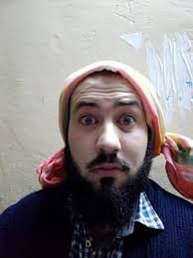
Managing .odt files with node.js – Gabriele Falasca
Who am I?
Gabriele Falasca (aka gabrycaos)
Frontend developer @Sourcesense
Javascript enthusiast
Open source lover
Bassist during free time
/gabrycaos on facebook
@gabrycaos on twitter
gabriele.falasca@sourcesense.com

Slide 4
Managing .odt files with node.js – Gabriele Falasca
.odt format
I don’t need to explain what is it here :)

Slide 5

Managing .odt files with node.js – Gabriele Falasca
Node.js
Javascript V8 engine for writing server side applications.

Slide 6
Managing .odt files with node.js – Gabriele Falasca
Node.js: async and event driven
Syncronous Flow:
Async Flow:
Data request
Data request
Data request
Data request
Waiting for data
Waiting for data
Waiting for data
Data!
Other actions
Data!
Other actions

Slide 7
Managing .odt files with node.js – Gabriele Falasca
Node.js: async and event driven
// sync function
const data = getData(params)
// make something with data variable
---
// async function
getData(params, (data) => {
// make something with data variable
})

Slide 8
Managing .odt files with node.js – Gabriele Falasca
Node.js: Stream
A sort of data-flow divided in chunk, that goes from a Producer to a Consumer, event driven.
A stream can be:
Readable,
Writable,
Duplex,
Transform

Slide 9
Managing .odt files with node.js – Gabriele Falasca
.odt files structure
mimetype
Thumbnails/
content.xml
Configurations2/
manifest.rdf
styles.xml
settings.xml
meta.xml
META-INF

Slide 10
Managing .odt files with node.js – Gabriele Falasca
content.xml structure in the editor!

Slide 11
Managing .odt files with node.js – Gabriele Falasca
Let’s see some code!

Slide 12
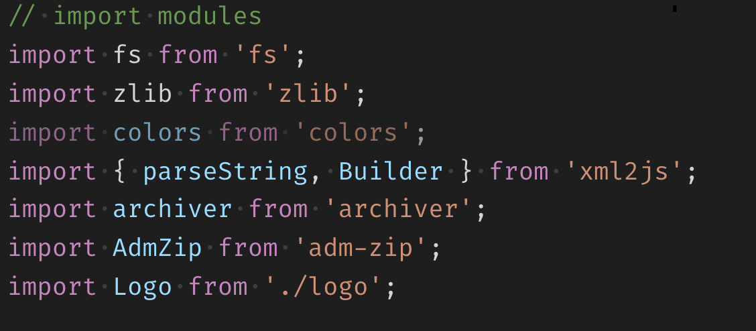
Managing .odt files with node.js – Gabriele Falasca
Let’s see some code!

Slide 13
Managing .odt files with node.js – Gabriele Falasca
Let’s see the rest of the code directly in the editor!

Slide 14
Managing .odt files with node.js – Gabriele Falasca
QUESTIONS?!
Demo code can be found on https://github.com/gabrycaos/node-odt-managment-demo

