Slide 1
Runtime View
Software Architecture

Slide 2
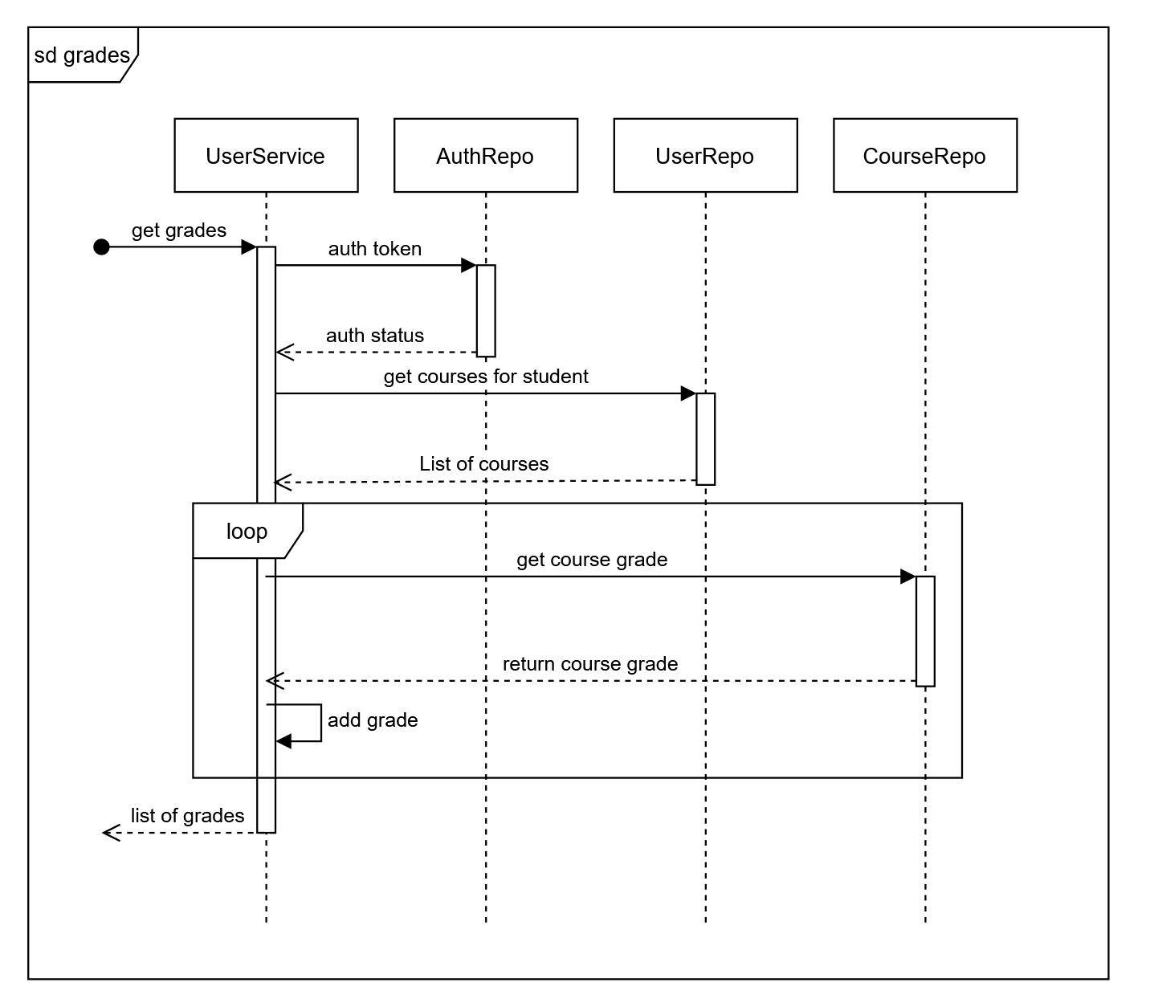
Get all grades for student

Slide 3
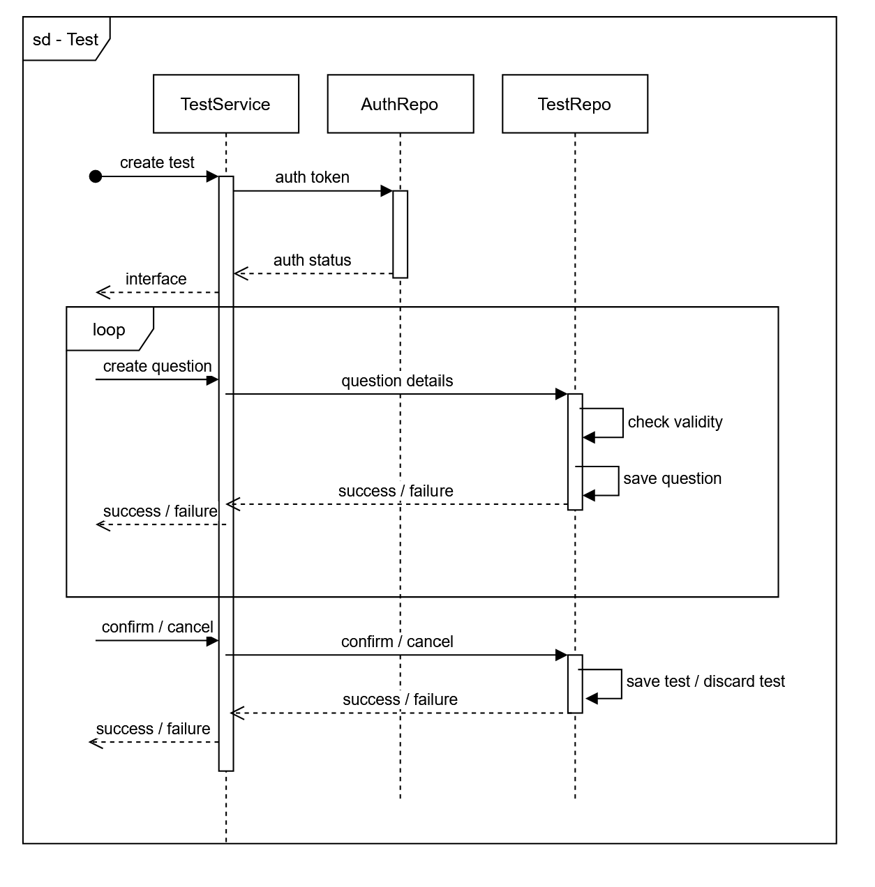
Lector creates a test

