Slide 1
Architecture Constraints
Software Architecture

Slide 2
Architecture Constraints
Constraints | Background and/or motivation
Time plan | begin: 06.10.23 end: 26.01.24
Language | Arc42 documentation & Code naming in English
Team size | 4 Juniors
Support Mobile and Desktop | Resources should be always accessible and anywhere
Documentation | Documentation should follow the arc42 template
Architects should know exactly where they are free in their design decisions and where they must adhere to constraints. Constraints must always be dealt with; they may be negotiable, though.
Define five constraints that constrains software architects in their freedom of design and implementation decisions or decision about the development process.
Help: https://docs.arc42.org/section-2/ & https://biking.michael-simons.eu/docs/index.html#section-architecture-constraints

Slide 3
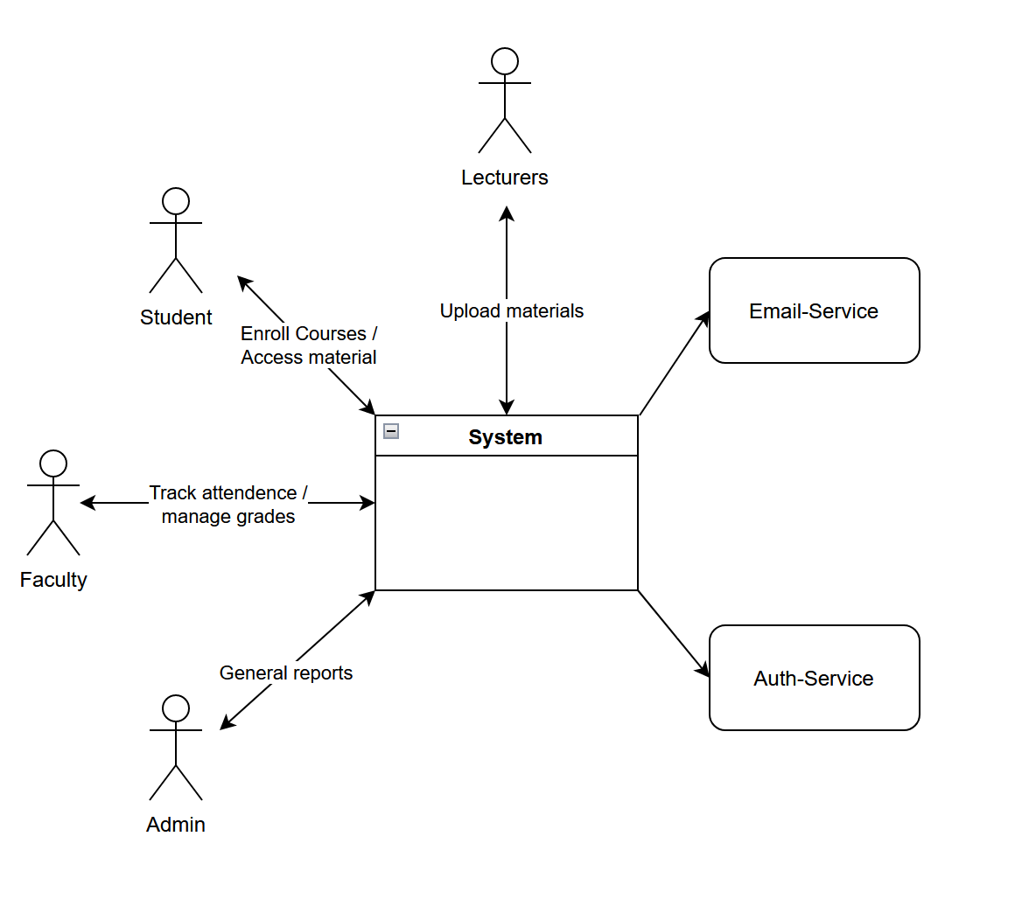
Business Context

