Slide 1

Your Tech Bootcamp
Group 2
Fake News Detector

Slide 2

Group members
Frédéric Mendes Semedo
Machine Learning & Deep Learning
Deployment
Mohamed Boumrar
Machine Learning & Deep Learning
Yannick Howaton
EDA & Visualization
Topic Modeling (LDA)

Slide 3
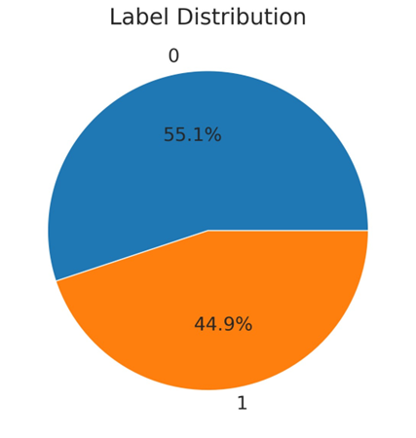
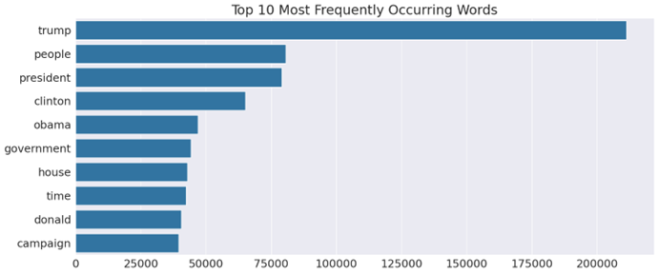

Dataset Overview & Label Distribution
Dataset Summary: Total Articles: 72,134
Topic analysis: diverse themes U.S. political discourse to international geopolitical issues

Slide 4

LDA Visualization

Slide 5
Models & Results - i
 | TFIDF / Logistic Reg | Word2Vec | Bert
Preprocessing | document cleaning tokenization | document cleaning tokenization padding regularization | BERT - tokenizer padding troncation
Accuracy | 0.91 | 0.75 | 0.90
F1-Score | 0.90 | 0.76 | 0.89
Conclusion | Good balance between speed and accuracy | Val Accuracy stagnates at the same level et the model tends to overfit after 50 epochs | Excellent performance but resource-heavy

Slide 6
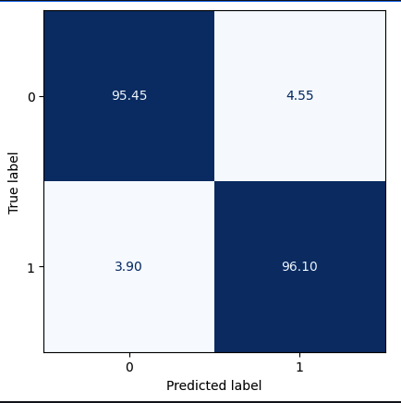
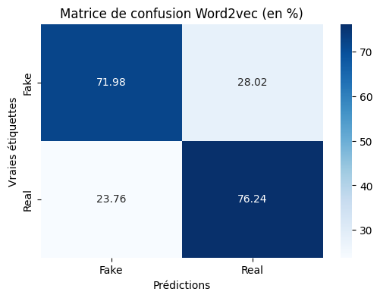
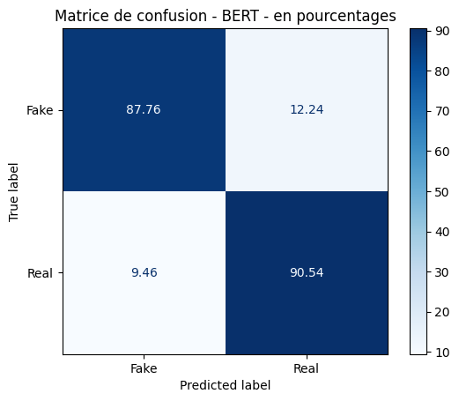
Models & Results - ii

Slide 7
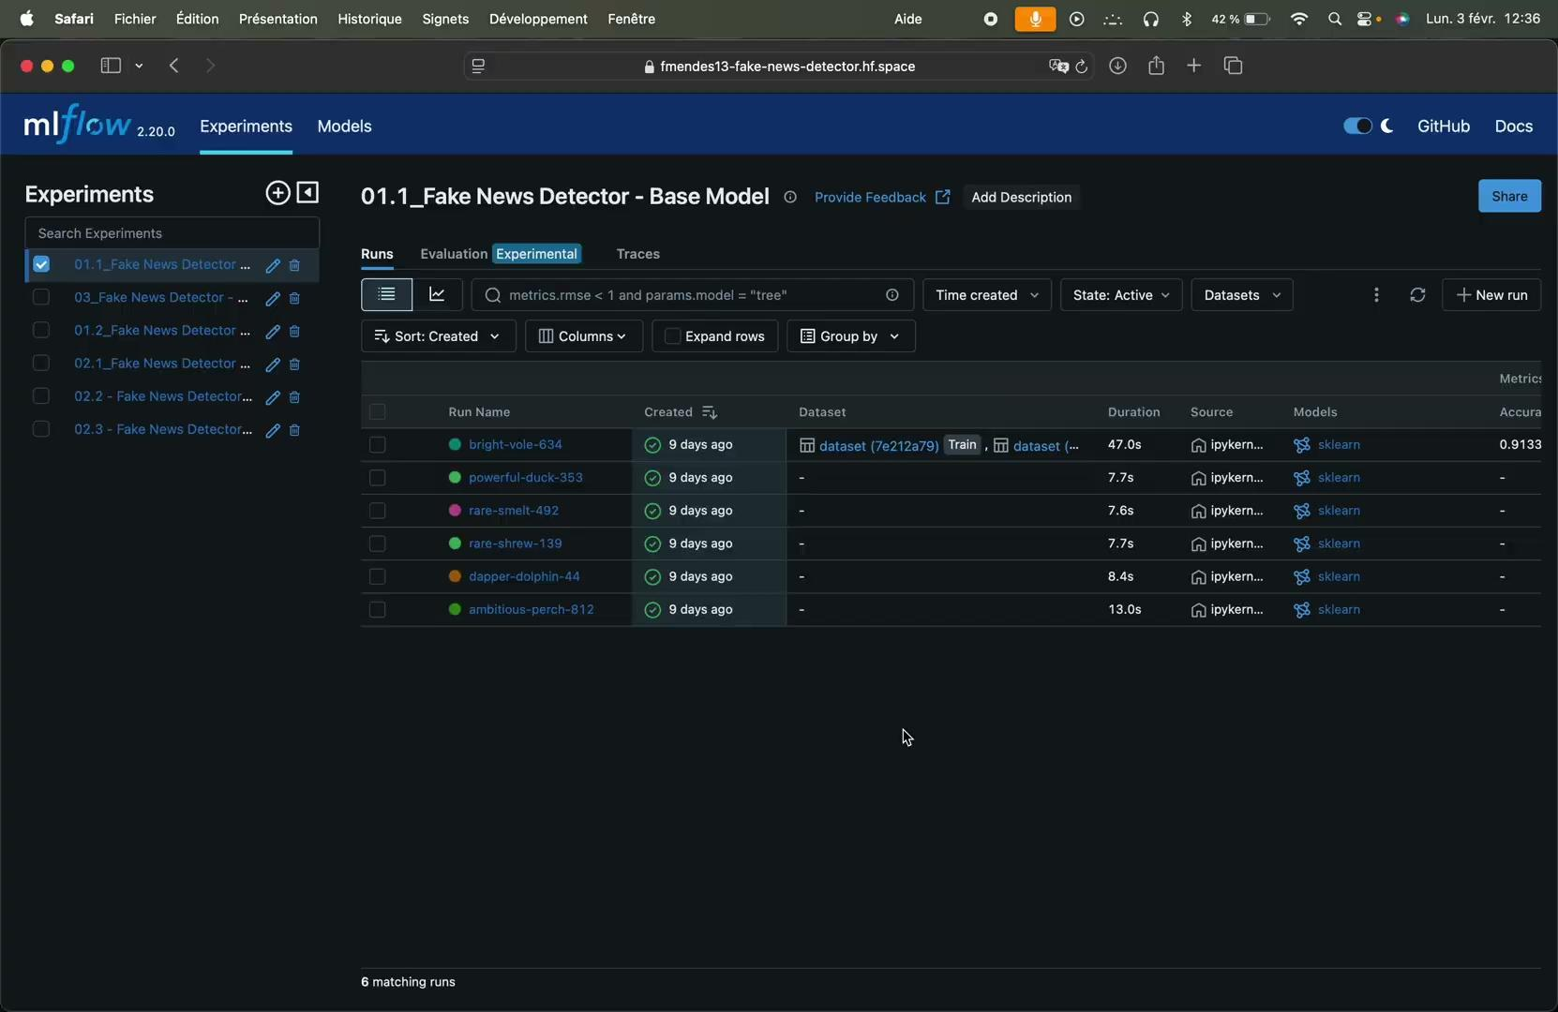
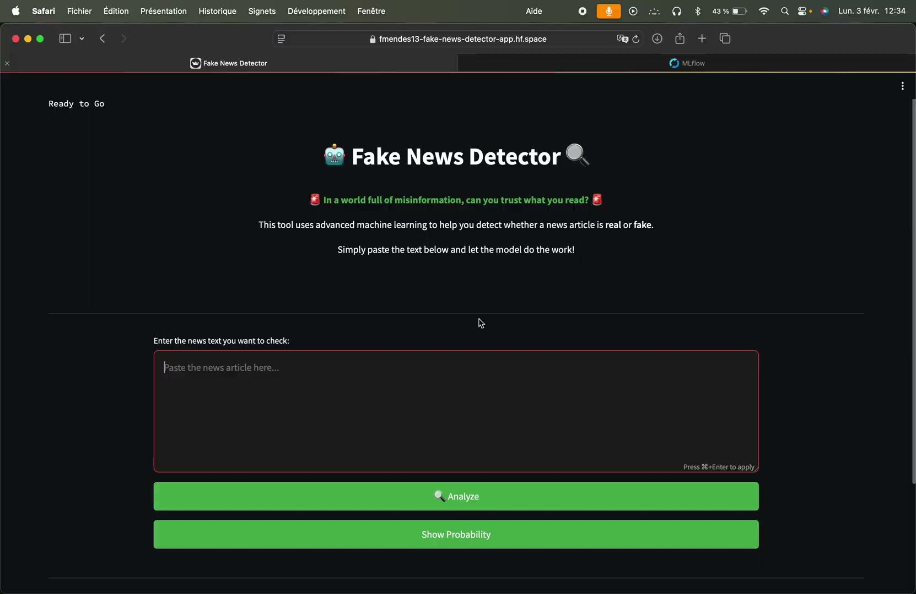
Deployment - Hugging Face

Slide 8
Conclusion
Effective fake news detection requires a balance between model complexity and performance.
• TF-IDF + Logistic Regression - best overall performance (Accuracy: 95.81%, Fl-score: 95.75%}.
• Word2vec - moderatly performing model, yet a lot of over fitting to monitor (Val_Accuracy: 75%)
• BERT - provided advanced context understanding but was resource­ intensive and less practical for large datasets.
Final Insight:
While deep learning approaches like BERT are powerful, simpler models like TF-IDF + Logistic Regression can still deliver competitive results when paired with thoughtful techniques like SMOTE.

Slide 9
What’s next?
Pre processing | Modelling
Check Sources Updating Expand the app’s base of training Data augmentation | Improving the Streamlit App Improving choses & optimisation of models Alternative models: RoBERTa / BERT’s alternatives

Slide 10

Thank you for your attention. Any questions ?

