Slide 1
“Listen to the Sounds”
During the next experiment you will hear sound sequences,
to which you should simply listen passively.
You don't have to do anything, think of anything specific,
but simply follow the sounds.
Please fixate on the cross on the screen in front of you and
move as little as possible (this includes blinking and muscle tension).
‘→’ for the next page

Slide 2

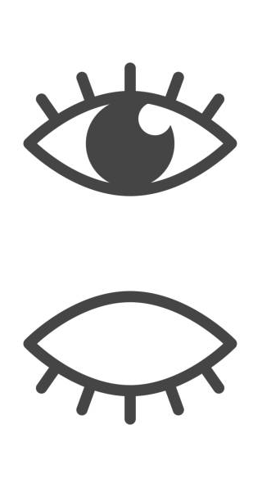
And please remember
(because of the EEG):
Move eyes or blink
as little as possible
Move
as little as possible
‘↓’ to start

