Slide 1
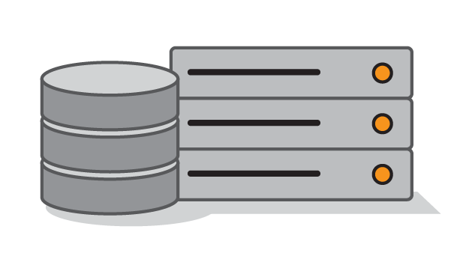
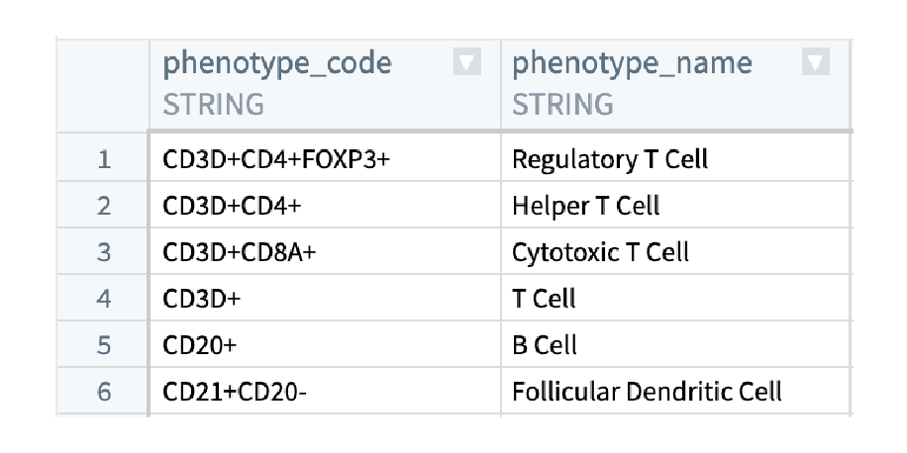
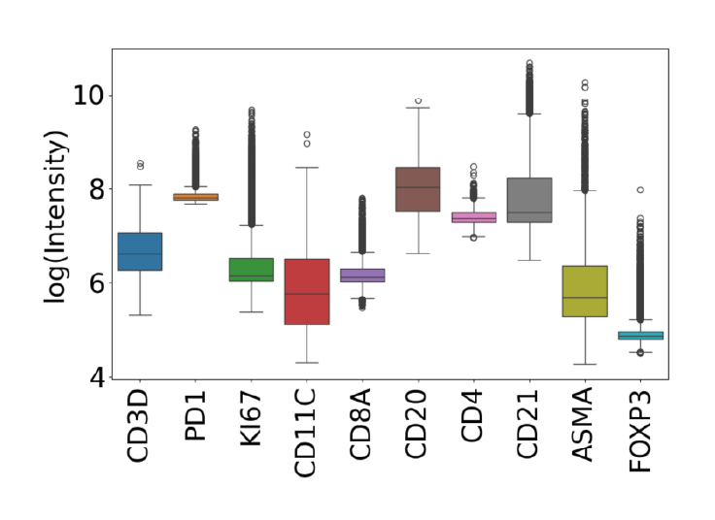
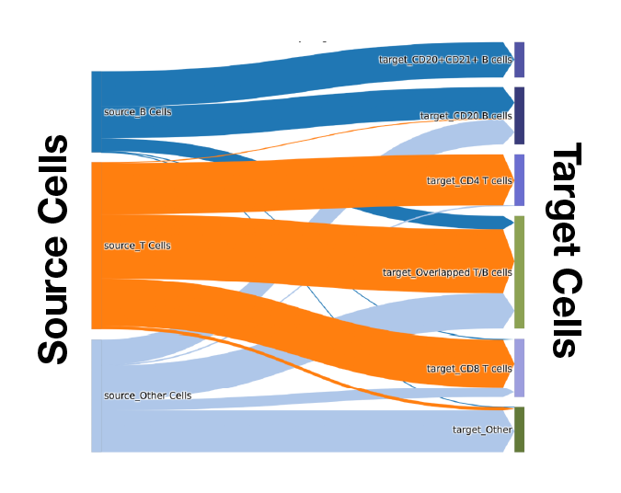
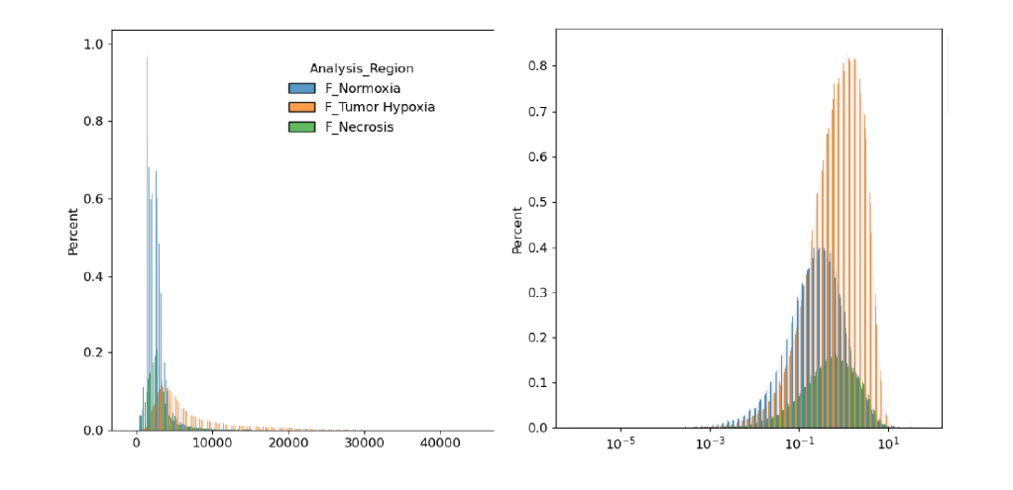
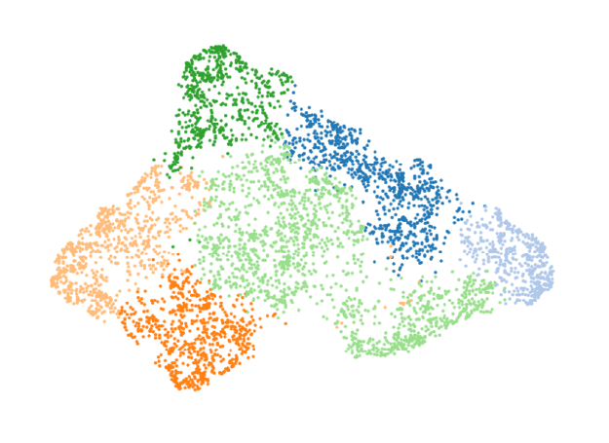
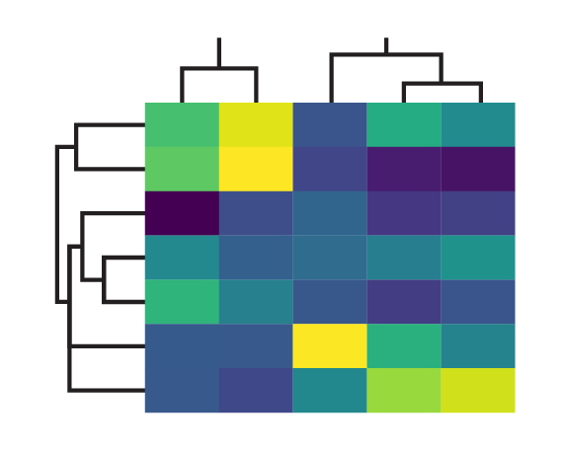
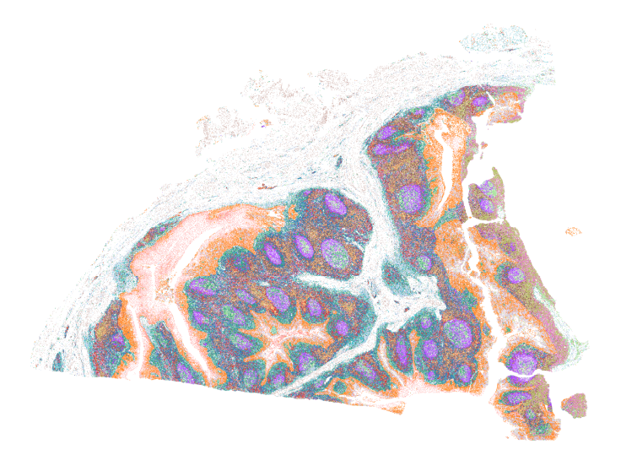
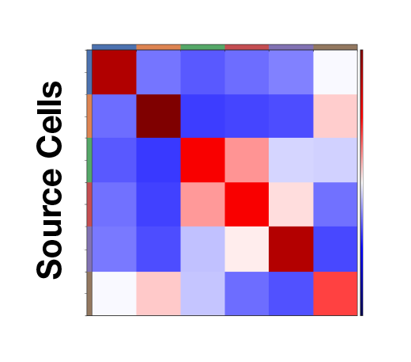
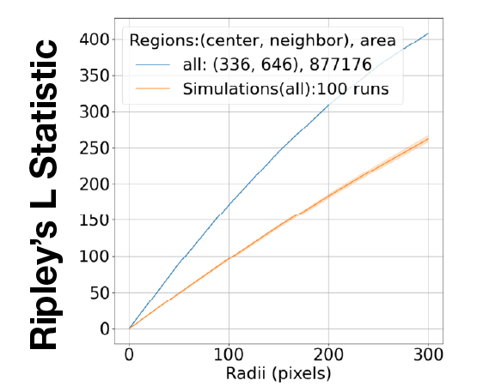
1
Single Cell Data
• HALO
• Visiopharm
• QuPath
• IMC
• CSV files
2
Single Cell Data
Data Ingestion
• Add new annotations
• Subsampling
• Manual phenotyping
• Pin color mapping
3
Manual Phenotyping via Phenotypes Codes
Visualization
• Histogram
• Boxplot
• Heatmap
• Hierarchical clustering
• Relational heatmap
• Sankey plot
• Scatter plot
Distribution of
annotations or features
Relation analysis between annotations
4
Data Preprocessing
• Arcsinh transformation
• Quantile normalization
• Rescaling
• Z-score normalization
• Batch correction
Feature expression before vs. after z-score normalization
5
Clustering and Phenotyping
• Phenograph clustering
• UTAG clustering
• tSNE/UMAP
• Spatial UMAP
Clustering and phenotyping identification
Hierarchical clustering and feature expression
6
Spatial Analysis
• Interactive spatial plot
• Nearest neighbor
• Cluster interaction matrix
• Neighborhood enrichment
• Ripley’s L
• Spatial hypothesis testing
Spatial distribution
Neighborhood enrichment
Ripley’s L

