Slide 1

Exploratory Data Analysis : Electric Vehicles in Germany and UK Fahad Al-Nafisa

Slide 2
Introduction.
Exploratory Data Analysis : Electric Vehicles in Germany and UK
The goal of this exploratory data analysis project is to find out if car manufacturing companies around the world are interested manufacturing electric vehicles that are designed for families

Slide 3
Exploratory Data Analysis : Electric Vehicles in Germany and UK
Electric Cars
Name
Subtitle
Acceleration
Top Speed
Range
Efficiency
Fast Charge Speed
Drive
Number of Seats
Price in Germany
Price in UK
:
:
:
:
:
:
:
:
:
:
:
Text
Text
Number
Number
Number
Number
Number
Text
Number
Number
Number
180
observations
11
Features
The dataset was imported from Kaggle and originally collected from Electric Vehicles Database website

Slide 4
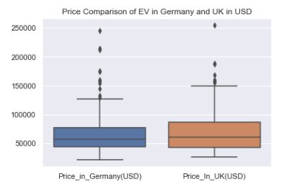
Exploratory Data Analysis : Electric Vehicles in Germany and UK
The following plots show the prices of EV car in Germany and UK
We made comparison between the prices in the two countries, and it is quite clear the are similar in quantities and they follow the same pattern

Slide 5
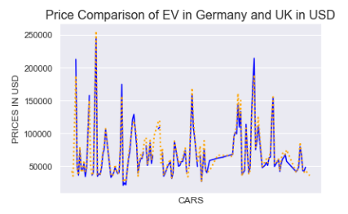
Exploratory Data Analysis : Electric Vehicles in Germany and UK
The following plots show the prices of EV car in Germany and UK
We made comparison between the prices in the two countries, and it is quite clear the are similar in quantities and they follow the same pattern

Slide 6
Family Cars!
Exploratory Data Analysis : Electric Vehicles in Germany and UK
EV market is huge, but here we only interested in some of them; we want to know the options that are provided from car companies to a specific chip of customers
Our target customers are families, so we created a new category called “Family Car” that represents the properties that most families look for when buying a car
Since there is no noticeable difference between Germany and UK either in options or car prices, we decided to treat them in the same way in our analysis for Family cars

Slide 7
Family Cars!
Exploratory Data Analysis : Electric Vehicles in Germany and UK
Firstly: we define the characteristics of a Family Car based on the available features in the dataset
Secondly: we see the portion of Family Car against the others

Slide 8
Family Cars!
Exploratory Data Analysis : Electric Vehicles in Germany and UK
This type of car is defined by the following characteristics:
Name
Acceleration
Top Speed
Range
Efficiency
Fast Charge Speed
Number of Seats (most important)
Price

Slide 9
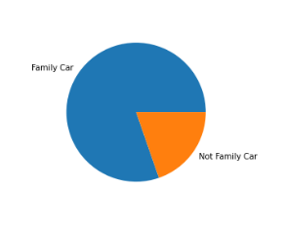
Exploratory Data Analysis : Electric Vehicles in Germany and UK
what makes a car convenient for a family is its capacity or in other words the number of seats it has, and we categorized based on that as shown in this pie chart
It appears from this pie chart that this kind of cars is having a large portion of the pie meaning that car companies care to provide many options of EVs for their family customers

Slide 10
Thank you…

