Slide 1

Lesson 3:
Derivatives

Slide 2


Introduction

Slide 3

Lecture Overview:
Goals of the lecture:
Understanding what are derivatives

Slide 4
Derivatives

Slide 5
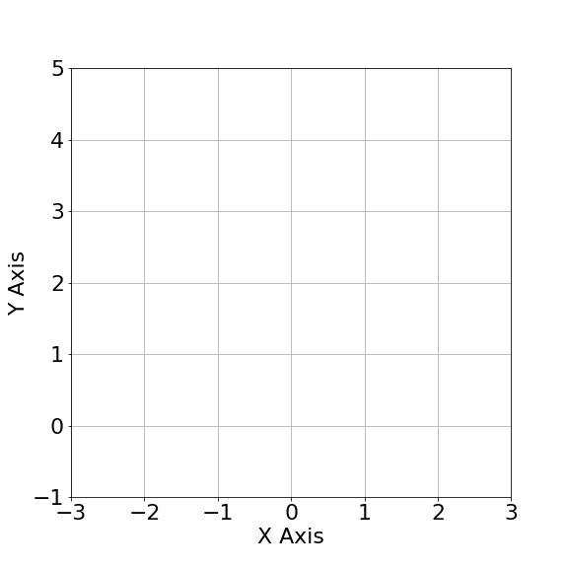
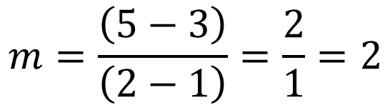

What is “m”?
p2
“m” a.k.a. slope:
Indicates how steep the line is
p1
$$m=\frac{\left(y_{2}−y_{1}\right)}{\left(x_{2}−x_{1}\right)}$$
$$m=\frac{\left(5−3\right)}{\left(2−1\right)}=\frac{2}{1}=2$$

Slide 6
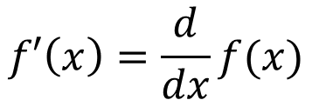
Derivative Notation
$$f′\left(x\right)=\frac{d}{dx}f(x)$$

Slide 7
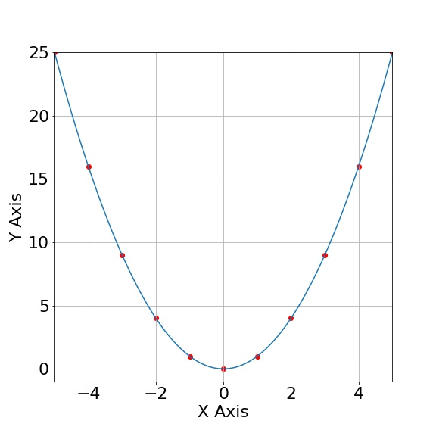

Derivative of a Function
$$f\left(x\right)=x^{2}$$

Slide 8
Derivative of a Function
$$f\left(x\right)=x^{2}$$

Slide 9
Derivative of a Function
$$f\left(x\right)=x^{2}$$
m<0
m>0
m=0

Slide 10
Derivative of a Function
$$f\left(x\right)=x^{2}$$

Slide 11
Derivative of a Function
$$f\left(x\right)=x^{2}$$

Slide 12
Derivative of a Function
$$f\left(x\right)=x^{2}$$

Slide 13
Derivative of a Function
$$f\left(x\right)=x^{2}$$

Slide 14

Derivative of a Function
$$f\left(x\right)=x^{2}$$

Slide 15

Derivative of a Function
$$m=\frac{\left(y_{2}−y_{1}\right)}{\left(x_{2}−x_{1}\right)}$$
m<0

Slide 16
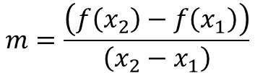
Derivative of a Function
$$m=\frac{\left(y_{2}−y_{1}\right)}{\left(x_{2}−x_{1}\right)}$$
$$m=\frac{\left(f\left(x_{2}\right)−f\left(x_{1}\right)\right)}{\left(x_{2}−x_{1}\right)}$$
m<0

Slide 17

Derivative of a Function
$$m=\frac{\left(y_{2}−y_{1}\right)}{\left(x_{2}−x_{1}\right)}$$
$$m=\frac{\left(f\left(x_{2}\right)−f\left(x_{1}\right)\right)}{\left(x_{2}−x_{1}\right)}$$
m<0
$$x_{2}=x_{1}+h$$

Slide 18
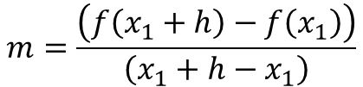
Derivative of a Function
$$m=\frac{\left(y_{2}−y_{1}\right)}{\left(x_{2}−x_{1}\right)}$$
$$m=\frac{\left(f\left(x_{2}\right)−f\left(x_{1}\right)\right)}{\left(x_{2}−x_{1}\right)}$$
m<0
$$x_{2}=x_{1}+h$$
$$m=\frac{\left(f\left(x_{1}+h\right)−f\left(x_{1}\right)\right)}{\left(x_{1}+h−x_{1}\right)}$$

Slide 19

Derivative of a Function
$$m=\frac{\left(y_{2}−y_{1}\right)}{\left(x_{2}−x_{1}\right)}$$
$$m=\frac{\left(f\left(x_{2}\right)−f\left(x_{1}\right)\right)}{\left(x_{2}−x_{1}\right)}$$
m<0
$$x_{2}=x_{1}+h$$
$$m=\frac{\left(f\left(x_{1}+h\right)−f\left(x_{1}\right)\right)}{\left(x_{1}+h−x_{1}\right)}$$
$$m=\frac{\left(f\left(x_{1}+h\right)−f\left(x_{1}\right)\right)}{h}$$

Slide 20

Derivative of a Function
$$m=\frac{\left(f\left(x_{1}+h\right)−f\left(x_{1}\right)\right)}{h}$$
m<0

Slide 21

Derivative of a Function
$$m=\frac{\left(f\left(x_{1}+h\right)−f\left(x_{1}\right)\right)}{h}$$
$$f\left(x\right)=x^{2}$$
m<0

Slide 22

Derivative of a Function
$$m=\frac{\left(f\left(x_{1}+h\right)−f\left(x_{1}\right)\right)}{h}$$
$$f\left(x\right)=x^{2}$$
Assume h = 0.1
$$m=\frac{f\left(−3+0.1\right)−f\left(−3\right)}{0.1}=\frac{8.41−9}{0.1}=−5.1$$
m<0
h

Slide 23

Derivative of a Function
$$m=\frac{\left(f\left(x_{1}+h\right)−f\left(x_{1}\right)\right)}{h}$$
$$f\left(x\right)=x^{2}$$
Assume h = 0.1
$$m=\frac{f\left(−3+0.1\right)−f\left(−3\right)}{0.1}=\frac{8.41−9}{0.1}=−5.1$$
m<0
Assume h = 0.01
$$m=\frac{f\left(−3+0.01\right)−f\left(−3\right)}{0.01}=\frac{8.94−9}{0.01}=−5.99$$
h

Slide 24

Derivative of a Function
$$m=\frac{\left(f\left(x_{1}+h\right)−f\left(x_{1}\right)\right)}{h}$$
$$f\left(x\right)=x^{2}$$
Assume h = 0.1
$$m=\frac{f\left(−3+0.1\right)−f\left(−3\right)}{0.1}=\frac{8.41−9}{0.1}=−5.1$$
m<0
Assume h = 0.01
$$m=\frac{f\left(−3+0.01\right)−f\left(−3\right)}{0.01}=\frac{8.94−9}{0.01}=−5.99$$
Assume h = 0.001
h
$$m=\frac{f\left(−3+0.001\right)−f\left(−3\right)}{0.001}=\frac{8.994−9}{0.001}=−5.999$$

Slide 25

Derivative of a Function
$$m=\frac{\left(f\left(x_{1}+h\right)−f\left(x_{1}\right)\right)}{h}$$
m<0
h

Slide 26

Derivative of a Function
$$m=\frac{\left(f\left(x_{1}+h\right)−f\left(x_{1}\right)\right)}{h}$$
m<0
$$f^{′}\left(x_{1}\right)=\lim_{h→0}\frac{f\left(x_{1}+h\right)−f\left(x_{1}\right)}{h}$$
h

Slide 27


Derivative of a Function
$$f\left(x\right)=x^{2}$$
$$f^{′}\left(x_{1}\right)=\lim_{h→0}\frac{f\left(x_{1}+h\right)−f\left(x_{1}\right)}{h}$$
m<0
h

Slide 28
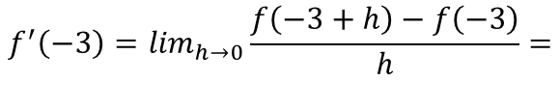
Derivative of a Function
$$f\left(x\right)=x^{2}$$
$$f^{′}\left(x_{1}\right)=\lim_{h→0}\frac{f\left(x_{1}+h\right)−f\left(x_{1}\right)}{h}$$
$$f^{′}\left(−3\right)=\lim_{h→0}\frac{f\left(−3+h\right)−f\left(−3\right)}{h}=$$
m<0
h

Slide 29
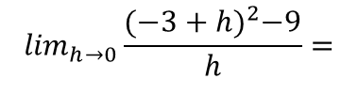
Derivative of a Function
$$f\left(x\right)=x^{2}$$
$$f^{′}\left(x_{1}\right)=\lim_{h→0}\frac{f\left(x_{1}+h\right)−f\left(x_{1}\right)}{h}$$
$$f^{′}\left(−3\right)=\lim_{h→0}\frac{f\left(−3+h\right)−f\left(−3\right)}{h}=$$
m<0
$$\lim_{h→0}\frac{{(−3+h)}^{2}−9}{h}=$$
h

Slide 30

Derivative of a Function
$$f\left(x\right)=x^{2}$$
$$f^{′}\left(x_{1}\right)=\lim_{h→0}\frac{f\left(x_{1}+h\right)−f\left(x_{1}\right)}{h}$$
$$f^{′}\left(−3\right)=\lim_{h→0}\frac{f\left(−3+h\right)−f\left(−3\right)}{h}=$$
m<0
$$\lim_{h→0}\frac{{(−3+h)}^{2}−9}{h}=$$
$$\lim_{h→0} \frac{9−6h+h^{2}−9}{h}=$$
h

Slide 31

Derivative of a Function
$$f\left(x\right)=x^{2}$$
$$f^{′}\left(x_{1}\right)=\lim_{h→0}\frac{f\left(x_{1}+h\right)−f\left(x_{1}\right)}{h}$$
$$f^{′}\left(−3\right)=\lim_{h→0}\frac{f\left(−3+h\right)−f\left(−3\right)}{h}=$$
m<0
$$\lim_{h→0}\frac{{(−3+h)}^{2}−9}{h}=$$
$$\lim_{h→0} \frac{9−6h+h^{2}−9}{h}=$$
$$\lim_{h→0}\frac{h^{2}−6h}{h}=$$
h

Slide 32

Derivative of a Function
$$f\left(x\right)=x^{2}$$
$$f^{′}\left(x_{1}\right)=\lim_{h→0}\frac{f\left(x_{1}+h\right)−f\left(x_{1}\right)}{h}$$
$$f^{′}\left(−3\right)=\lim_{h→0}\frac{f\left(−3+h\right)−f\left(−3\right)}{h}=$$
m<0
$$\lim_{h→0}\frac{{(−3+h)}^{2}−9}{h}=$$
$$\lim_{h→0} \frac{9−6h+h^{2}−9}{h}=$$
$$\lim_{h→0}\frac{h^{2}−6h}{h}=$$
h
$$\lim_{h→0}\frac{h−6}{1}=\frac{0−6}{1}=−6$$

Slide 33
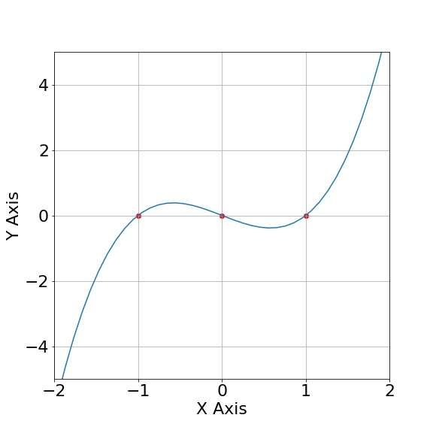


Problem 1:
Problem 1: Calculate f ’(x) at x₁=1
$$f\left(x\right)=x^{3}−x$$
$$f^{′}\left(x_{1}\right)=\lim_{h→0}\frac{f\left(x_{1}+h\right)−f\left(x_{1}\right)}{h}$$

Slide 34
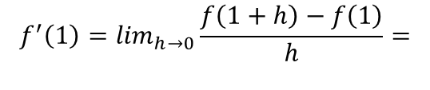


Problem 1:
$$f\left(x\right)=x^{3}−x$$
$$f^{′}\left(x_{1}\right)=\lim_{h→0}\frac{f\left(x_{1}+h\right)−f\left(x_{1}\right)}{h}$$
$$f^{′}\left(1\right)=\lim_{h→0}\frac{f\left(1+h\right)−f\left(1\right)}{h}=$$

Slide 35
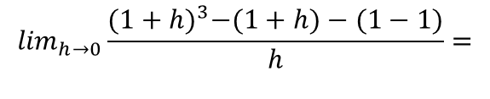
Problem 1:
$$f\left(x\right)=x^{3}−x$$
$$f^{′}\left(x_{1}\right)=\lim_{h→0}\frac{f\left(x_{1}+h\right)−f\left(x_{1}\right)}{h}$$
$$f^{′}\left(1\right)=\lim_{h→0}\frac{f\left(1+h\right)−f\left(1\right)}{h}=$$
$$\lim_{h→0}\frac{{(1+h)}^{3}−(1+h)−(1−1)}{h}=$$

Slide 36
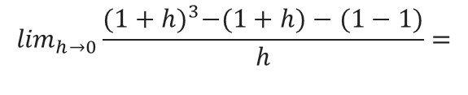
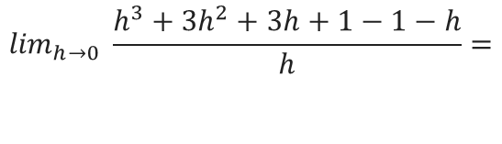
Problem 1:
$$f\left(x\right)=x^{3}−x$$
$$f^{′}\left(x_{1}\right)=\lim_{h→0}\frac{f\left(x_{1}+h\right)−f\left(x_{1}\right)}{h}$$
$$f^{′}\left(1\right)=\lim_{h→0}\frac{f\left(1+h\right)−f\left(1\right)}{h}=$$
$$\lim_{h→0}\frac{{(1+h)}^{3}−(1+h)−(1−1)}{h}=$$
$$\lim_{h→0} \frac{h^{3}+{3h}^{2}+3h+1−1−h}{h}=$$

Slide 37
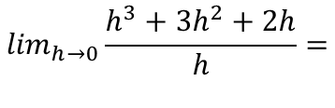
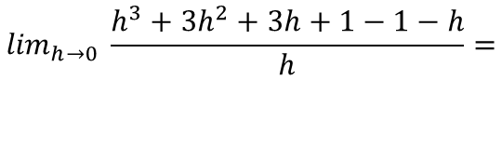
Problem 1:
$$f\left(x\right)=x^{3}−x$$
$$f^{′}\left(x_{1}\right)=\lim_{h→0}\frac{f\left(x_{1}+h\right)−f\left(x_{1}\right)}{h}$$
$$f^{′}\left(1\right)=\lim_{h→0}\frac{f\left(1+h\right)−f\left(1\right)}{h}=$$
$$\lim_{h→0}\frac{{(1+h)}^{3}−(1+h)−(1−1)}{h}=$$
$$\lim_{h→0} \frac{h^{3}+{3h}^{2}+3h+1−1−h}{h}=$$
$$\lim_{h→0}\frac{h^{3}+3h^{2}+2h}{h}=$$

Slide 38
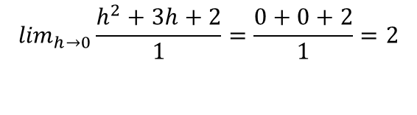
Problem 1:
$$f\left(x\right)=x^{3}−x$$
$$f^{′}\left(x_{1}\right)=\lim_{h→0}\frac{f\left(x_{1}+h\right)−f\left(x_{1}\right)}{h}$$
$$f^{′}\left(1\right)=\lim_{h→0}\frac{f\left(1+h\right)−f\left(1\right)}{h}=$$
$$\lim_{h→0}\frac{{(1+h)}^{3}−(1+h)−(1−1)}{h}=$$
$$\lim_{h→0} \frac{h^{3}+{3h}^{2}+3h+1−1−h}{h}=$$
$$\lim_{h→0}\frac{h^{3}+3h^{2}+2h}{h}=$$
$$\lim_{h→0}\frac{h^{2}+3h+2}{1}=\frac{0+0+2}{1}=2$$

Slide 39
Continuous Functions

Slide 40
Continuous Functions
Definition:
A continuous function is a function for which sufficiently small changes in the input result in arbitrarily small changes in the output.

Slide 41
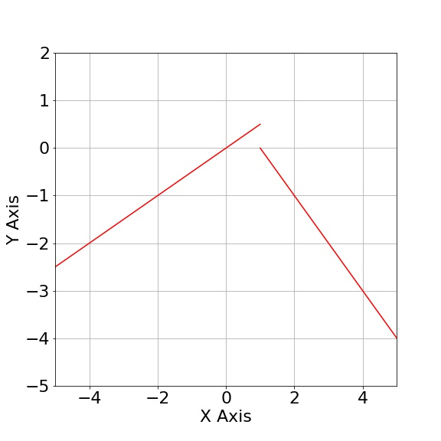
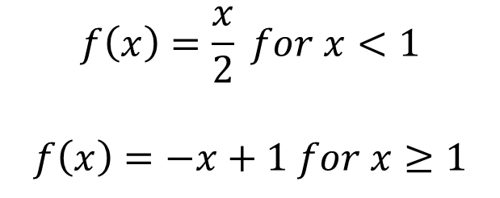
Continuous Functions
Definition:
A continuous function is a function for which sufficiently small changes in the input result in arbitrarily small changes in the output.
Discontinuous Function
$$f\left(x\right)=\frac{x}{2} for x<1$$
$$f\left(x\right)=−x+1 for x≥1$$

Slide 42
Continuous Functions
Definition:
A continuous function is a function for which sufficiently small changes in the input result in arbitrarily small changes in the output.
Discontinuous Function
$$f\left(x\right)=\frac{x}{2} for x<1$$
$$f\left(x\right)=−x+1 for x≥1$$
Derivatives exist only on continuous functions

Slide 43
QUESTIONS?

