Slide 1

Data Cleaning
Notes:
Photo by The Creative Exchange on Unsplash - feel free to change!

Slide 2
Objectives
Develop data cleaning strategies:
Handling missing values
Tidying string data
Cleaning datasets through case studies

Slide 3
What is
Data Cleaning?
Notes:
Photo by The Creative Exchange on Unsplash - feel free to change!

Slide 4
Data Analysis Workflow
What does the data analysis workflow look like?

Slide 5
Data Analysis Workflow
What does the data analysis workflow look like?
START WITH A QUESTION

Slide 6
Data Analysis Workflow
What does the data analysis workflow look like?
START WITH A QUESTION
COLLECT &
CLEAN DATA

Slide 7
Data Analysis Workflow
What does the data analysis workflow look like?
START WITH A QUESTION
EXPLORATORY DATA ANALYSIS (EDA)
COLLECT &
CLEAN DATA

Slide 8
Data Analysis Workflow
What does the data analysis workflow look like?
START WITH A QUESTION
MODELS & ALGORITHMS
EXPLORATORY DATA ANALYSIS (EDA)
COLLECT &
CLEAN DATA
COMMUNICATE RESULTS

Slide 9
Data Analysis Workflow
What does the data analysis workflow look like?
START WITH A QUESTION
MODELS & ALGORITHMS
EXPLORATORY DATA ANALYSIS (EDA)
COLLECT &
CLEAN DATA
COMMUNICATE RESULTS

Slide 10
Data Analysis Workflow
What does the data analysis workflow look like?
START WITH A QUESTION
MODELS & ALGORITHMS
EXPLORATORY DATA ANALYSIS (EDA)
COLLECT &
CLEAN DATA
COMMUNICATE RESULTS

Slide 11

How can data be messy?
Notes:
Photo by Rick Mason on Unsplash

Slide 12
How can data be messy?
Duplicate or unnecessary data
Inconsistent text and typos
Missing data
Outliers
… and more!
Notes:
Photo by Rick Mason on Unsplash

Slide 13
How can data be messy?
Most Visited US Websites (as of 2020)
Duplicate or unnecessary data
Inconsistent text and typos
Missing data
Outliers
… and more!
rank
1
2
2
3
4
5
6
7
36
website
youtube.com
en.wikipedia.org
en.wikipedia.org
twitter.com
Facebook
amazon.com
yelp.com
reddit.com
netflix.com
monthly_traffic
1,626,000,000
1,032,000,000
1,032,000,000
536,000,000
512,000,000
492 million
---
184,000,000
37,000,000
Notes:
Data source: https://ahrefs.com/blog/most-visited-websites/ -- I’m a little dubious of the claim that google is 26th on this list though...

Slide 14
How can data be messy?
Most Visited US Websites (as of 2020)
Duplicate or unnecessary data
Inconsistent text and typos
Missing data
Outliers
… and more!
rank
1
2
2
3
4
5
6
7
36
website
youtube.com
en.wikipedia.org
en.wikipedia.org
twitter.com
Facebook
amazon.com
yelp.com
reddit.com
netflix.com
monthly_traffic
1,626,000,000
1,032,000,000
1,032,000,000
536,000,000
512,000,000
492 million
---
184,000,000
37,000,000
Notes:
Source: https://ahrefs.com/blog/most-visited-websites/ -- I’m a little dubious of the claim that google is 26th on this list though...

Slide 15
How can data be messy?
Most Visited US Websites (as of 2020)
Duplicate or unnecessary data
Inconsistent text and typos
Missing data
Outliers
… and more!
rank
1
2
2
3
4
5
6
7
36
website
youtube.com
en.wikipedia.org
en.wikipedia.org
twitter.com
Facebook
amazon.com
yelp.com
reddit.com
netflix.com
monthly_traffic
1,626,000,000
1,032,000,000
1,032,000,000
536,000,000
512,000,000
492 million
---
184,000,000
37,000,000
Notes:
Source: https://ahrefs.com/blog/most-visited-websites/

Slide 16
How can data be messy?
Look for duplicates and dig into why there are multiple values
Filter data down as appropriate
Duplicate or unnecessary data
Inconsistent text and typos
Missing data
Outliers
… and more!
Notes:
Source: https://ahrefs.com/blog/most-visited-websites/

Slide 17
How can data be messy?
Most Visited US Websites (as of 2020)
Duplicate or unnecessary data
Inconsistent text and typos
Missing data
Outliers
… and more!
rank
1
2
3
4
5
6
7
website
youtube.com
en.wikipedia.org
twitter.com
Facebook
amazon.com
yelp.com
reddit.com
monthly_traffic
1,626,000,000
1,032,000,000
536,000,000
512,000,000
492 million
---
184,000,000
Notes:
Source: https://ahrefs.com/blog/most-visited-websites/

Slide 18
How can data be messy?
Most Visited US Websites (as of 2020)
Duplicate or unnecessary data
Inconsistent text and typos
Missing data
Outliers
… and more!
rank
1
2
3
4
5
6
7
website
youtube.com
en.wikipedia.org
twitter.com
Facebook
amazon.com
yelp.com
reddit.com
monthly_traffic
1,626,000,000
1,032,000,000
536,000,000
512,000,000
492 million
---
184,000,000
Notes:
Source: https://ahrefs.com/blog/most-visited-websites/

Slide 19
How can data be messy?
Check summary statistics for each column of data.
Minimum and maximum of numerical values
Unique values of categoricals
Duplicate or unnecessary data
Inconsistent text and typos
Missing data
Outliers
… and more!
Notes:
Source: https://ahrefs.com/blog/most-visited-websites/

Slide 20
How can data be messy?
Most Visited US Websites (as of 2020)
Duplicate or unnecessary data
Inconsistent text and typos
Missing data
Outliers
… and more!
rank
1
2
3
4
5
6
7
website
youtube.com
en.wikipedia.org
twitter.com
facebook.com
amazon.com
yelp.com
reddit.com
monthly_traffic
1,626,000,000
1,032,000,000
536,000,000
512,000,000
492,000,000
---
184,000,000
Notes:
Source: https://ahrefs.com/blog/most-visited-websites/

Slide 21
How can data be messy?
Most Visited US Websites (as of 2020)
Duplicate or unnecessary data
Inconsistent text and typos
Missing data
Outliers
… and more!
rank
1
2
3
4
5
6
7
website
youtube.com
en.wikipedia.org
twitter.com
facebook.com
amazon.com
yelp.com
reddit.com
monthly_traffic
1,626,000,000
1,032,000,000
536,000,000
512,000,000
492,000,000
---
184,000,000
Notes:
Source: https://ahrefs.com/blog/most-visited-websites/

Slide 22
How can data be messy?
Outliers
Are distant from other observations
Do not accurately represent real world
Can significantly impact analysis
Duplicate or unnecessary data
Inconsistent text and typos
Missing data
Outliers
… and more!
Notes:
Source: https://ahrefs.com/blog/most-visited-websites/

Slide 23
How can data be messy?
How to find outliers:
Plots
Statistics
Duplicate or unnecessary data
Inconsistent text and typos
Missing data
Outliers
… and more!
Notes:
Source: https://ahrefs.com/blog/most-visited-websites/

Slide 24
How can data be messy?
How to find outliers:
Plots
Statistics
How to deal with outliers:
Remove them
Assign mean or median value
Predict value with model
Duplicate or unnecessary data
Inconsistent text and typos
Missing data
Outliers
… and more!
Notes:
Source: https://ahrefs.com/blog/most-visited-websites/

Slide 25
How can data be messy?
Duplicate or unnecessary data
Inconsistent text and typos
Missing data
Outliers
… and more!
Notes:
Photo by Rick Mason on Unsplash

Slide 26
Data Analysis Workflow
What does the data analysis workflow look like?
START WITH A QUESTION
MODELS & ALGORITHMS
EXPLORATORY DATA ANALYSIS (EDA)
COLLECT &
CLEAN DATA
COMMUNICATE RESULTS

Slide 27
Handling Missing Values
Notes:
Photo by The Creative Exchange on Unsplash - feel free to change!

Slide 28
Missing Values
Unfortunately very common
Occur for many reasons
Detect with pandas
Several ways to handle missings

Slide 29
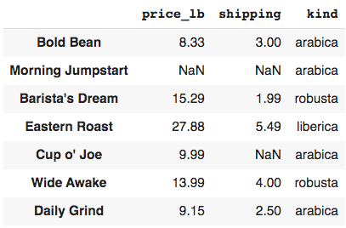
Detecting Missing Values
Load in data about coffee
import pandas as pd
df = pd.read_csv("coffee.csv")
df

Slide 30
Detecting Missing Values
Dataset contains several missings
import pandas as pd
df = pd.read_csv("coffee.csv")
df

Slide 31
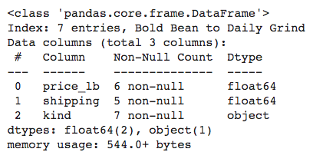
Detecting Missing Values
Quickly check missings with .info()
df.info()

Slide 32
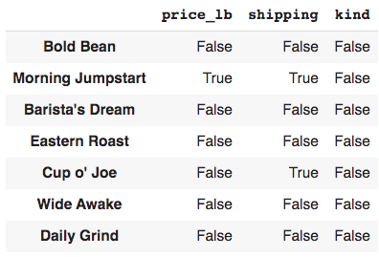
Detecting Missing Values
Use .isna() for elementwise True/False values
df.isna()

Slide 33
Detecting Missing Values
Use .isna() for elementwise True/False values
df.isna()

Slide 34
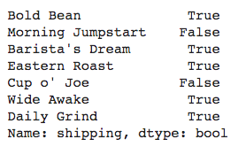
How to Detect Missing Values
Use .isna() result as data mask
~df.shipping.isna()

Slide 35
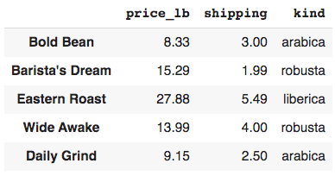
How to Detect Missing Values
Use .isna() result as data mask
~df.shipping.isna()
df[~df.shipping.isna()]

Slide 36
Methods to Handle Missings
Drop rows with missing values
Fill missing values with a standard value such as zero
Impute missings with mean or median

Slide 37
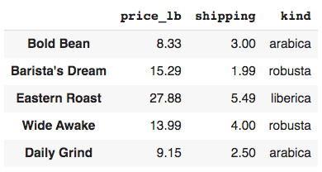
Dropping Missing Values
Use pandas to drop with .dropna()
Drops all rows with any missing by default
df.dropna()

Slide 38
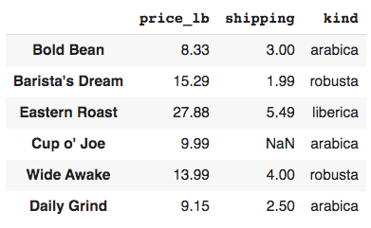
Dropping Missing Values
Use pandas to drop with .dropna()
Drops all rows with any missing by default
Use subset to drop only some missings
df.dropna(subset=["price_lb"])

Slide 39
Filling Missings with a Value
Use pandas .fillna() to fill missings
df.shipping.fillna(0)

Slide 40
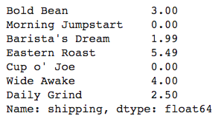
Filling Missings with a Value
Use pandas .fillna() to fill missings
Only fill with reasonable values!
df.shipping.fillna(0)

Slide 41
Imputing Missings
Use pandas .fillna() to fill missings with mean or median values
price_avg = df.price_lb.mean()
price_avg
14.105

Slide 42
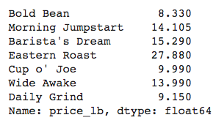
Imputing Missings
Use pandas .fillna() to fill missings with mean or median values
price_avg = df.price_lb.mean()
df.price_lb.fillna(price_avg)

Slide 43
Detecting Missing Values
.info()
Count of non-null values for each column
.isna()
Boolean True/False for each element
Can be used as data mask

Slide 44
Methods to Handle Missings
.dropna()
Drop rows with missing values
.fillna()
Fill missing values with a standard value such as zero
Impute missings with mean or median
Use a model to predict missing (advanced)

Slide 45
Managing Columns of Data
Notes:
Photo by The Creative Exchange on Unsplash - feel free to change!

Slide 46
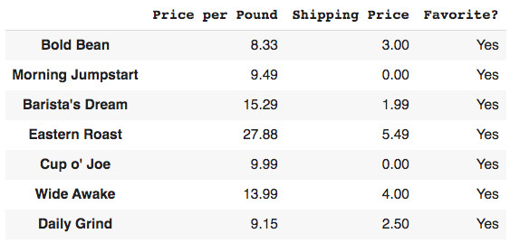
Rename Data Columns
Load in data about coffee
import pandas as pd
df = pd.read_csv("coffee_data.csv")
df

Slide 47
Rename Data Columns
None of these column names are valid Python variables
Rename to make analysis easier
df.columns
Index(['Price per Pound', 'Shipping Price', 'Favorite?'], dtype='object')

Slide 48
Rename Data Columns
Pass a dictionary to the columns argument of pandas .rename()
df.rename(columns={
'Price per Pound': 'price_lb', 'Shipping Price': 'shipping', 'Favorite?': 'favorite'
}, inplace=True)

Slide 49
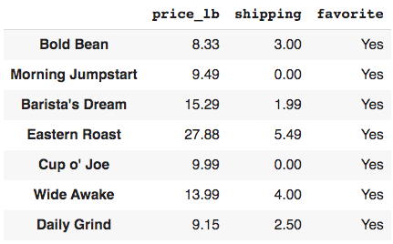
Rename Data Columns
Pass a dictionary to the columns argument of pandas .rename()
df.rename(columns={
'Price per Pound': 'price_lb', 'Shipping Price': 'shipping', 'Favorite?': 'favorite'
}, inplace=True)
df

Slide 50
What is the average shipping?
Why does using .mean() on shipping column causes error?
df.shipping.mean()
TypeError: Could not convert 3.000.001.995.490.004.002.50 to numeric

Slide 51
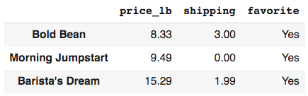
What is the average shipping?
Why does using .mean() on shipping column causes error?
df.shipping.mean()
TypeError: Could not convert 3.000.001.995.490.004.002.50 to numeric
df.head(3)

Slide 52

What is the average shipping?
Checking .dtypes shows the shipping column contains strings
df.dtypes

Slide 53
Updating a Column Datatype
Convert a column’s datatype with the .astype() method
df['shipping'] = df.shipping.astype('float')

Slide 54

Updating a Column Datatype
Convert a column’s datatype with the .astype() method
df['shipping'] = df.shipping.astype('float')
df.dtypes

Slide 55
Updating a Column Datatype
Convert a column’s datatype with the .astype() method
df['shipping'] = df.shipping.astype('float')
df.dtypes
df.shipping.mean()
2.4257142857142857

Slide 56

Dropping Columns
The favorite column contains the same value for every row
df.favorite.value_counts()

Slide 57
Dropping Columns
Drop unnecessary columns with pandas .drop()
axis=0 refers to the row dimension
axis=1 refers to column dimension
df.drop('favorite', axis=1)

Slide 58
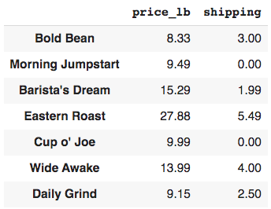
Dropping Columns
Drop unnecessary columns with pandas .drop()
axis=0 refers to the row dimension
axis=1 refers to column dimension
df.drop('favorite', axis=1)

Slide 59
Managing Columns of Data
Rename columns by passing an update dictionary into .rename()
Convert column’s datatype with .astype()
Use .drop() and axis=1 to drop a column from the dataframe

Slide 60
Cleaning
String Data
Notes:
Photo by The Creative Exchange on Unsplash - feel free to change!

Slide 61
Analyzing Text Data
Text data is notoriously messy.
Inconsistent text
Typos
Extra whitespace
Extra characters in numerical values (e.g. commas, dollar signs)

Slide 62
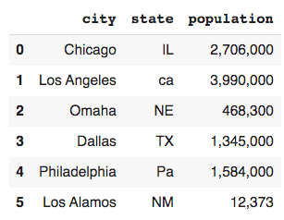
Analyzing Text Data
Load in data about US cities
import pandas as pd
df = pd.read_csv("cities.csv")
df

Slide 63
Convert Column to Upper- or Lowercase
Inconsistencies in state column
df

Slide 64
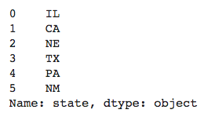
Convert Column to Upper- or Lowercase
Inconsistencies in state column
Convert column to uppercase
Reference string methods, .str
df.state = df.state.str.upper()
df.state

Slide 65
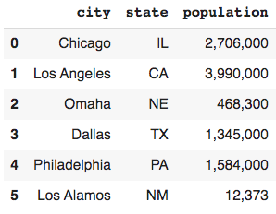
Remove Specific Characters
Commas in population column
df

Slide 66
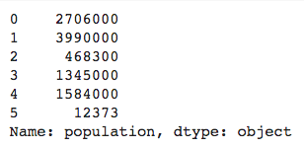
Remove Specific Characters
Commas in population column
Remove by replacing commas with the empty string
pop = df.population.str.replace(',', '')
pop

Slide 67
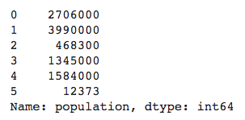
Remove Specific Characters
Commas in population column
Remove by replacing commas with the empty string
pop = df.population.str.replace(',', '')
pop
pop.astype('int')

Slide 68
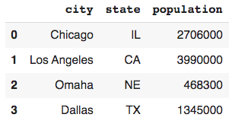
Analyzing Text Data
df

Slide 69
Analyzing Text Data
df
df.city.unique()
array(['Chicago ', 'Los Angeles ',
'Omaha ', 'Dallas ', 'Philadelphia ',
'Los Alamos '], dtype=object)

Slide 70
Removing Whitespace
Strip whitespace from front or end of string data
Whitespace includes spaces, tabs, new line characters, etc.
city = df.city.str.strip()

Slide 71
Removing Whitespace
Strip whitespace from front or end of string data
Whitespace includes spaces, tabs, new line characters, etc.
city = df.city.str.strip()
city.unique()
array(['Chicago', 'Los Angeles',
'Omaha', 'Dallas', 'Philadelphia',
'Los Alamos'], dtype=object)

Slide 72
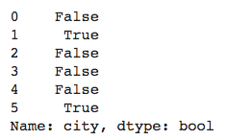
Checking for Substrings
Which cities contain “Los”?
Check elementwise with .contains()
df.city.str.contains('Los')

Slide 73

Checking for Substrings
Which cities contain “Los”?
Check elementwise with .contains()
Use result as data mask
df.city.str.contains('Los')
df[df.city.str.contains('Los')]

Slide 74
Analyzing Text Data
Text data is notoriously messy.
Inconsistent text or typos
.str.upper(), .str.lower()
.str.replace()
Extra whitespace
.str.strip()
Characters in numerical values
.str.replace()
Searching for substrings
.str.contains()

Slide 75
Case Study #1:
Exploring New Data
Notes:
Photo by The Creative Exchange on Unsplash - feel free to change!

Slide 76
What should we do when exploring new data?
Ask many questions and be skeptical.
How do these data help answer the project question?
What kind of data is given in each column?
Do the data contain missing values?
What steps are necessary to make these data ready for analysis?

Slide 77
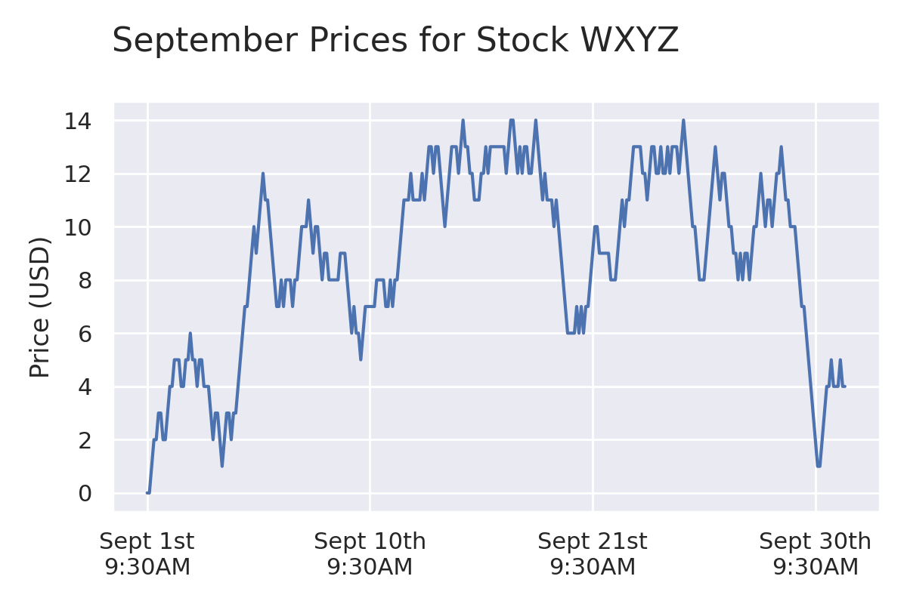
Stock Prices Case Study
Which Monday time saw the highest stock price in September?

Slide 78
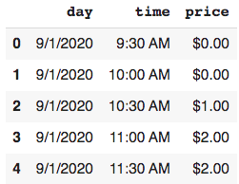
Stock Prices Case Study
What kind of data do we have?
import pandas as pd
df = pd.read_csv("wxyz.csv")
df.head()

Slide 79
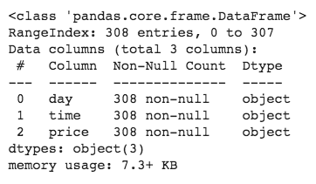
Stock Prices Case Study
What kind of data do we have?
df.shape
(308, 3)
df.info()

Slide 80
Stock Prices Case Study
What kind of data do we have?
df.shape
(308, 3)
df.info()
All columns contain strings

Slide 81
Convert Strings to Numerics
Convert the price column to numerical values
df.head()

Slide 82
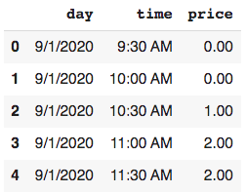
Convert Strings to Numerics
Convert the price column to numerical values
Remove dollar signs
df.price = df.price.str.replace('$', '')
df.head()

Slide 83

Convert Strings to Numerics
Convert the price column to numerical values
Remove dollar signs
Convert from strings to floats
df.price = df.price.astype('float')
df.dtypes

Slide 84
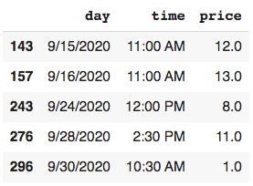
Stock Prices Case Study
Which Monday time saw the highest stock price in September?
df.sample(5)

Slide 85
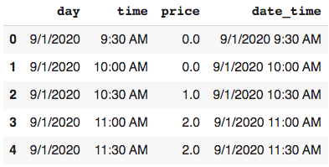
Create Datetime Column
Combine day and time columns
df['date_time'] = df.day + ' ' + df.time
df.head()

Slide 86
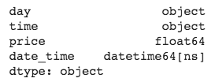
Create Datetime Column
Combine day and time columns
Convert to datetime
df['date_time'] = df.day + ' ' + df.time
df.head()
df['date_time'] = pd.to_datetime(df.date_time)
df.dtypes

Slide 87
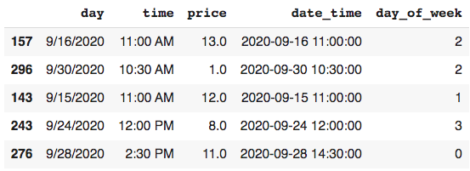
Create Day of Week Column
Use weekday property of datetime
df['day_of_week'] = df.date_time.dt.weekday
df.sample(5)

Slide 88
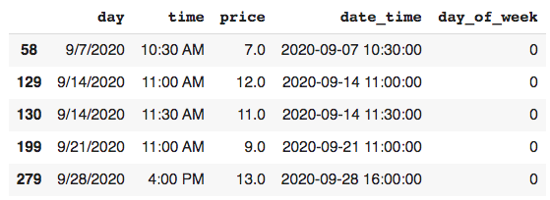
Stock Prices Case Study
Which Monday time saw the highest stock price in September?
Select Mondays
mondays = df[df.day_of_week == 0]
mondays.sample(5)

Slide 89
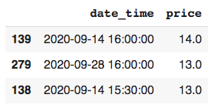
Stock Prices Case Study
Which Monday time saw the highest stock price in September?
Select Mondays
Sort to find the maximum price
(mondays[['date_time', 'price']]
.sort_values('price', ascending=False)
.head(3))

Slide 90
What should we do when exploring new data?
.head(), .info(), .dtypes, .shape
What kind of data is given in each column?
Do the data contain missing values?
.replace(), .to_datetime()
What steps are necessary to make data ready for analysis?
How do these data help answer the project question?

Slide 91
Case Study #2:
Diagnosing Errors
Notes:
Photo by The Creative Exchange on Unsplash - feel free to change!

Slide 92
How can we diagnose errors?
Data inconsistencies may cause errors when operating on columns.
Build custom functions to:
Include print statements
Add conditional statements
Use exceptions

Slide 93
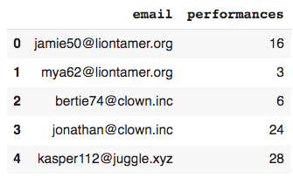
Circus Performers Case Study
Which type of performer is the most experienced on average?
import pandas as pd
df = pd.read_csv("circus.csv")
df.head()

Slide 94
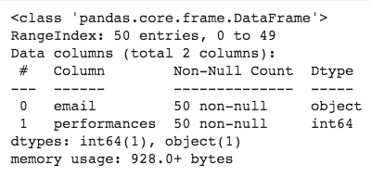
Circus Performers Case Study
Which type of performer is the most experienced on average?
df.shape
(50, 2)
df.info()

Slide 95
Manipulating Email Data
Create new columns for domain
str.split("jamie50@liontamer.org", "@")
['jamie50', 'liontamer.org']
str.split("jamie50@liontamer.org", "@")[1]
'liontamer.org’

Slide 96

Manipulating Email Data
Create new columns for domain
df.loc[:2].email.map(
lambda x: str.split(x, "@")[1]
)

Slide 97
Manipulating Email Data
Create new columns for domain
df.email.map(
lambda x: str.split(x, "@")[1]
)
IndexError: list index out of range

Slide 98
Creating Custom Function
Create a custom Python function to diagnose error
def check_for_at_symbol(email): if '@' not in email:
print(email)
return ('@' in email)
at_symbol_test = df.email.map(check_for_at_symbol)
jonathan104ringmaster.net

Slide 99
Creating Custom Function
Create a custom Python function to create domain column
def get_domain(email): if '@' not in email:
return None
return str.split(email, '@')[1]
df['domain'] = df.email.map(get_domain)

Slide 100
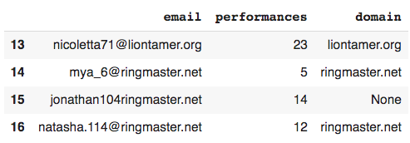
Creating Custom Function
Create a custom Python function to create domain column
def get_domain(email): if '@' not in email:
return None
return str.split(email, '@')[1]
df['domain'] = df.email.map(get_domain)
df.loc[13:16]

Slide 101
Using Python Exceptions
Create domain column by catching errors with exception
def get_domain_exception(email): try:
return str.split(email, '@')[1]
except IndexError:
print(email)
return None
df['domain'] = df.email.map(get_domain_exception)
jonathan104ringmaster.net

Slide 102
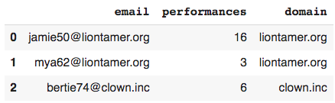
Circus Performers Case Study
Which type of performer is the most experienced on average?
df.head(3)
df.shape
(50, 2)
df.email.nunique()
40

Slide 103
Remove Duplicate Rows
Use pandas to remove duplicate rows with .drop_duplicates()
Entire row must be exact match
df.drop_duplicates().shape()
(40, 3)

Slide 104
Remove Duplicate Rows
Use pandas to remove duplicate rows with .drop_duplicates()
Entire row must be exact match
Use subset argument with column name or list to match specific columns
df.drop_duplicates().shape()
(40, 3)
df.drop_duplicates(subset='email').shape()
(40, 3)

Slide 105
Circus Performers Case Study
Which type of performer is the most experienced on average?
df.drop_duplicates(inplace=True)
(df.groupby('domain')
.performances
.mean()
.sort_values(ascending=False))

Slide 106
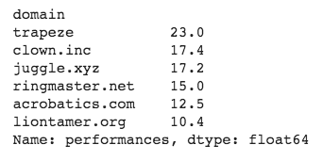
Circus Performers Case Study
Which type of performer is the most experienced on average?
df.drop_duplicates(inplace=True)
(df.groupby('domain')
.performances
.mean()
.sort_values(ascending=False))

Slide 107
Case Study #3:
Comparing Against Group Statistics
Notes:
Photo by The Creative Exchange on Unsplash - feel free to change!

Slide 108
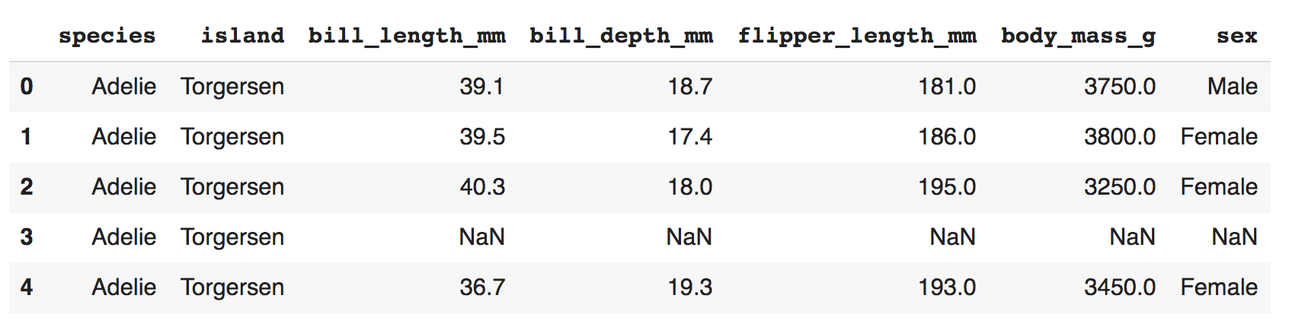
Penguins Case Study
Standardize the penguin masses by species and sort by standard mass ascending.
import seaborn as sns
df = sns.load_dataset("penguins")
df.head()

Slide 109
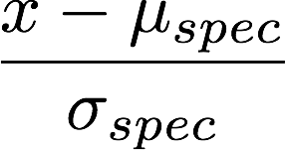
Penguins Case Study
Standardize the penguin masses by species and sort by standard mass ascending.
import seaborn as sns
df = sns.load_dataset("penguins")
df.head()

Slide 110
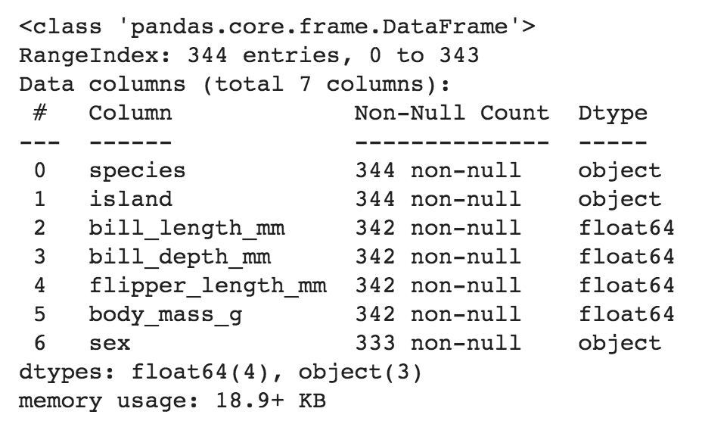
Penguins Case Study
What kind of data do we have?
df.shape
(344, 7)
df.info()

Slide 111
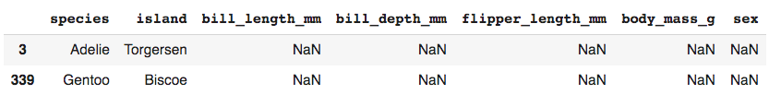
Handling Missing Values
What kind of missings do we have?
df[df.bill_length_mm.isna()]
df.dropna(subset=["bill_length_mm"], inplace=True)
df.shape
(342, 7)

Slide 112
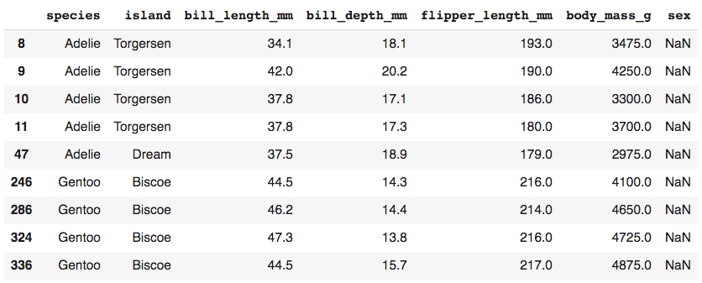
Handling Missing Values
What kind of missings do we have?
df[df.sex.isna()]

Slide 113
Penguins Case Study
Standardize the penguin masses by species and sort by standard mass ascending.

Slide 114
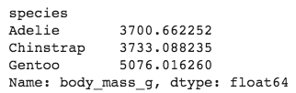
Pandas Transform
Use transform to produce group aggregates for each row
df.groupby("species").body_mass_g.mean()

Slide 115
Pandas Transform
Use transform to produce group aggregates for each row
df["mass_species_mean"] = (df.groupby("species").body_mass_g
.transform(lambda x: x.mean()))

Slide 116
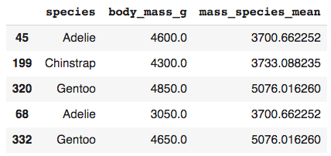
Pandas Transform
Use transform to produce group aggregates for each row
df["mass_species_mean"] = (df.groupby("species").body_mass_g
.transform(lambda x: x.mean()))
df[["species", "body_mass_g", "mass_species_mean"]].sample(5)

Slide 117
Standard Penguin Mass
Standardize the penguin masses by species.
df["mass_standard"] = (df.groupby("species").body_mass_g
.transform(lambda x: (x - x.mean())/x.std()))

Slide 118
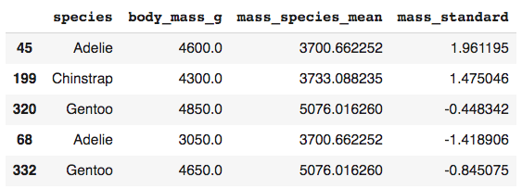
Standard Penguin Mass
Standardize the penguin masses by species.
df["mass_standard"] = (df.groupby("species").body_mass_g
.transform(lambda x: (x - x.mean())/x.std()))
df[["species", "body_mass_g", "mass_species_mean", "mass_standard"]].sample(5)

Slide 119
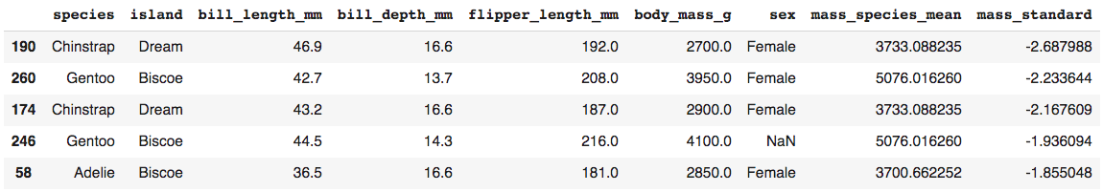
Penguins Case Study
Standardize the penguin masses by species and sort by standard mass ascending.
df.sort_values("mass_standard").head()

