Slide 1

Intro to Calculus

Slide 2
What is calculus?
Calculus is the study of change
Calculus revolves around derivatives and integrals

Slide 3
Calculus is used throughout data science
Used to train machine learning models:
Gradient Descent
Maximize accuracy
Minimize error

Slide 4

Linear Functions and Slope

Slide 5
Learning Objectives
Describe the form of a linear function.
Recognize what the slope and intercept of a linear function are and how to calculate them.

Slide 6
What is a function?
y = f(x)
x: Input ➝ y: Output

Slide 7
What is a linear function?
y = mx + b
Given multiple <x, y> combinations, solve for m and b.

Slide 8
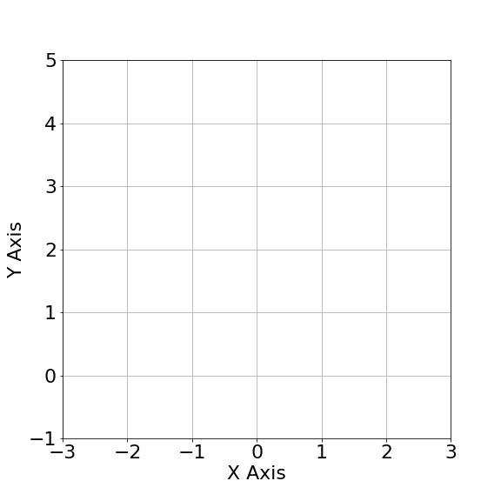
Linear Functions in Two Dimensions
Let <x₁, y₁> = <1, 3>, <x₂, y₂> = <2, 5>:
y₁ = mx₁ + b, y₂ = mx₂ + b
y₁ - y₂ = m(x₁ - x₂)
m = (5 - 3) / (2 - 1) = 2
b = y₁ - mx₁ = y₂ - mx₂ = 1
<m, b> = <2, 1>

Slide 9


What is b?
The y-intercept:
the point where the line crosses the y axis

Slide 10
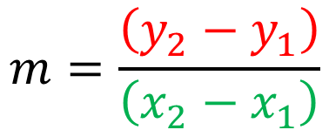
What is m?
p2
The slope, or derivative:
How much y changes as x changes
p1
y2 –y1
x2 –x1

Slide 11
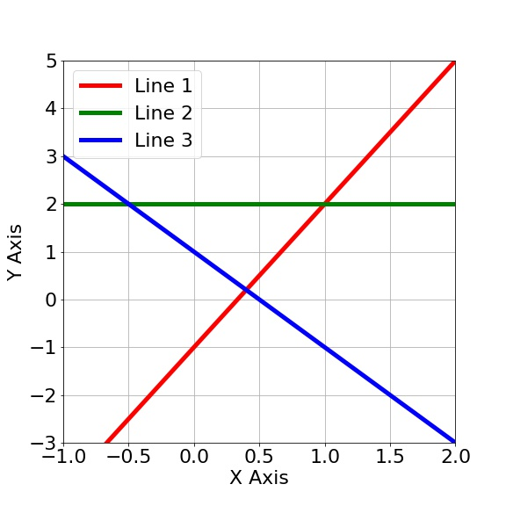

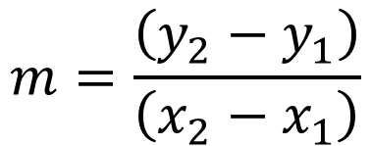
Exercise - Line Equations
Calculate the line equation for the following lines. Helper equations:
Problem 1:

Slide 12
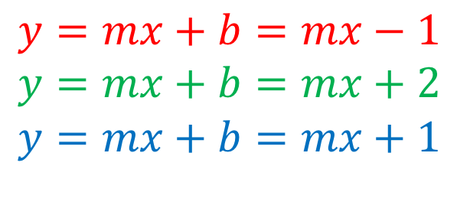
Exercise - Line Equations
Let’s first extract the intercept:

Slide 13
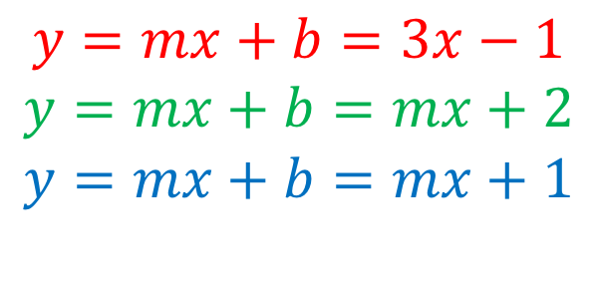
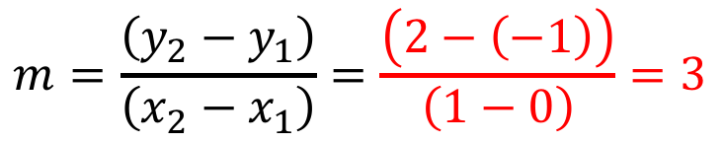
Exercise - Line Equations
Let’s extract the slope:

Slide 14
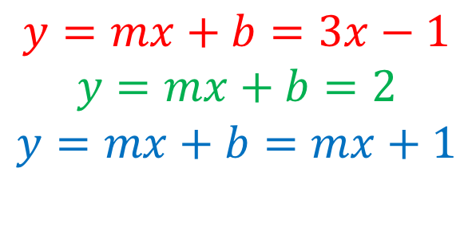
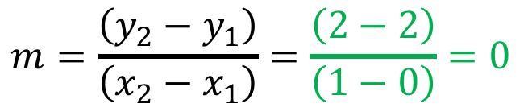
Exercise - Line Equations
Let’s extract the slope:

Slide 15
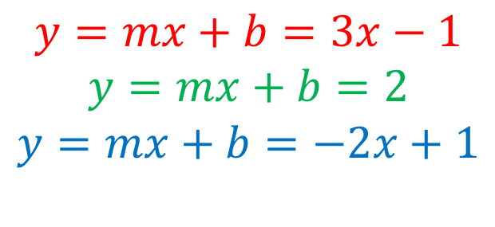
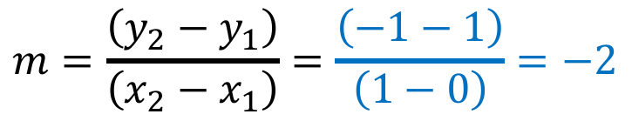
Exercise - Line Equations
Let’s extract the slope:

Slide 16

Derivatives

Slide 17
Learning Objectives
Recognize that the derivative is a non-constant slope.
Calculate the first derivative of a function.

Slide 18
Slope of a Line
p2
How much y changes as x changes
p1
y2 –y1
x2 –x1

Slide 19
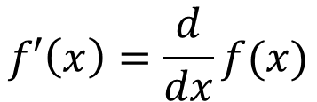
Derivative of a Function
p2
How much y changes as x changes
Slope = Derivative
p1
y2 –y1
x2 –x1

Slide 20
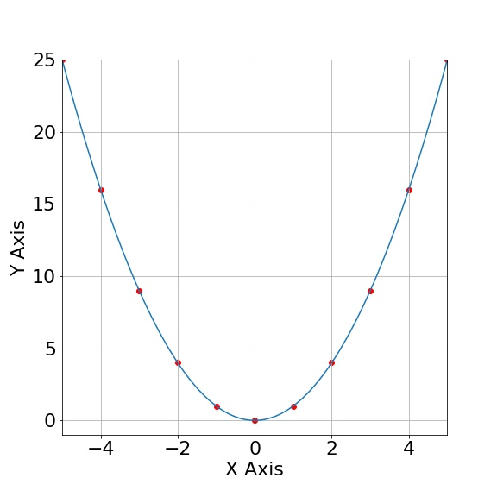

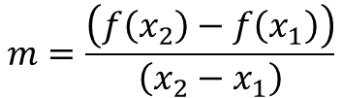


Derivative of x²
m<0

Slide 21



Derivative of x²
m = ((x₁ + h)² - x²) / h
m = (x₁² + 2hx₁ + h² - x₁²) / h
m = (2hx₁ + h²) / h = 2x₁ + h
f ’(x₁) = 2x₁ + h ➝ 2x₁
m<0
h

Slide 22
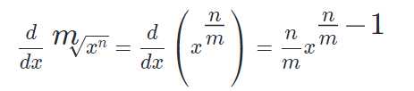

Common Derivatives
Polynomials
Radicals

Slide 23
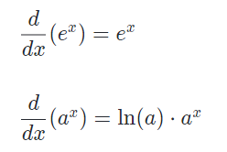
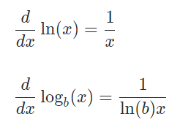
Common Derivatives
Exponentials
Logarithms

Slide 24
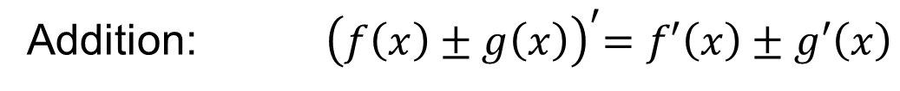
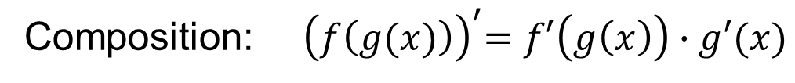
Rules for Derivatives
Definition:

