Slide 1

Lesson 2:
Functions

Slide 2


Introduction

Slide 3

Lecture Overview:
Goals of the lecture:
Understand functions and how to plot them

Slide 4
Functions

Slide 5
Functions
Definition:
A function is a rule that assigns to each element from a set (for example x) a unique value (for example y)

Slide 6

Functions
Definition:
A function is a rule that assigns to each element from a set (for example x) a unique value (for example y)
$$f\left(x\right)=y=2x+1$$

Slide 7

Functions
Definition:
A function is a rule that assigns to each element from a set (for example x) a unique value (for example y)
$$f\left(x\right)=y=2x+1$$
$$f\left(x\right)=x^{2}$$

Slide 8

Functions
Definition:
A function is a rule that assigns to each element from a set (for example x) a unique value (for example y)
$$f\left(x\right)=y=2x+1$$
$$f\left(x\right)=x^{2}$$
$$f\left(x\right)=sin(x)$$

Slide 9

Functions
Definition:
A function is a rule that assigns to each element from a set (for example x) a unique value (for example y)
$$f\left(x\right)=y=2x+1$$
$$f\left(x\right)=x^{2}$$
$$f\left(x\right)=sin(x)$$
$$f\left(x_{1},x_{2}\right)={3x}_{1}+2x_{2}$$

Slide 10




Independent Variables
Definition:
A variable whose variation does not depend on that of another
$$f\left(x\right)=y=2x+1$$
$$f\left(x\right)=x^{2}$$
$$f\left(x\right)=sin(x)$$
$$f\left(x_{1},x_{2}\right)={3x}_{1}+2x_{2}$$

Slide 11




Dependent Variables
Definition:
A variable whose variation depends on that of another
$$f\left(x\right)=y=2x+1$$
$$f\left(x\right)=x^{2}$$
$$f\left(x\right)=sin(x)$$
$$f\left(x_{1},x_{2}\right)={3x}_{1}+2x_{2}$$

Slide 12
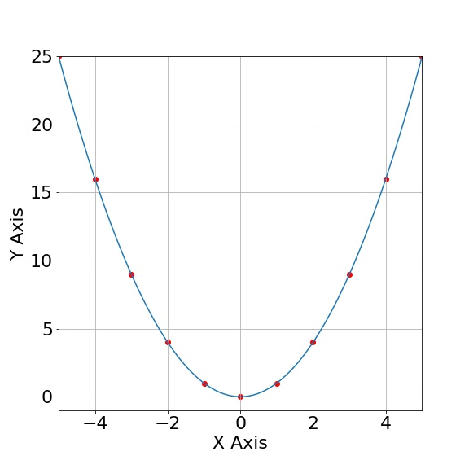

Plotting a Function
$$f\left(x\right)=x^{2}$$

Slide 13
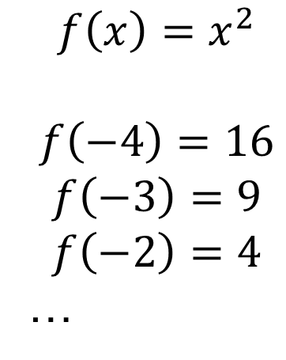
Plotting a Function
$$f\left(x\right)=x^{2}$$
$$f\left(−4\right)=16$$
$$f\left(−3\right)=9$$
$$f\left(−2\right)=4$$
…

Slide 14
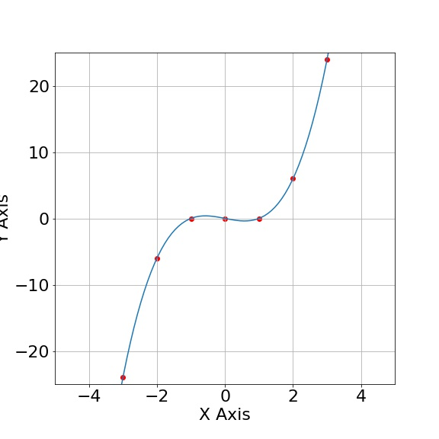

Plotting a Function
$$f\left(x\right)=x^{3}−x$$

Slide 15
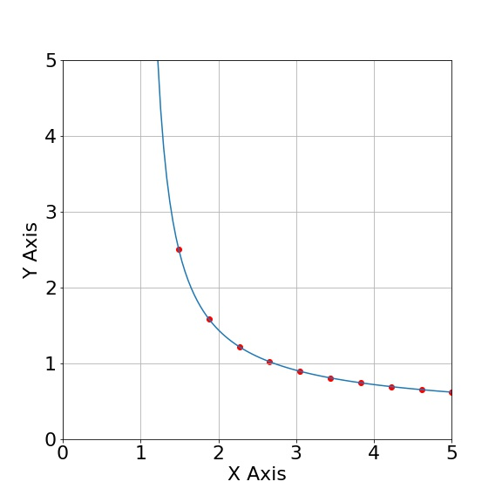

Plotting a Function
$$f\left(x\right)=\frac{1}{ln\left(x\right)}$$

Slide 16
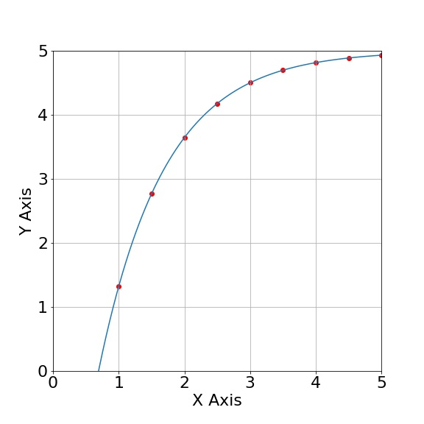

Plotting a Function
$$f\left(x\right)=5−10∙e^{−x}$$

Slide 17

Problem 1:
Problem 1: Plot the following function.
$$f\left(x\right)=2x^{2}−0.5x^{3}−2$$

Slide 18
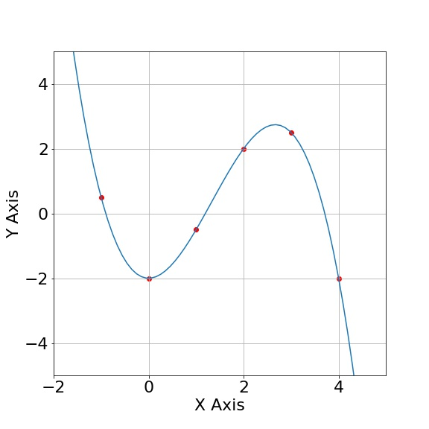

Problem 1:
Problem 1: Plot the following function.
$$f\left(x\right)=2x^{2}−0.5x^{3}−2$$
$$f\left(−1\right)=0.5$$
$$f\left(0\right)=−2$$
$$f\left(1\right)=−0.5$$
$$f\left(2\right)=2$$

Slide 19
QUESTIONS?

