Slide 1
AI in Disaster Response
Advantages of Using AI in Government and Public Sector
By Funsho Orogun

Slide 2
Introduction
Disaster response is a critical area where AI supports rapid, data-driven decisions
AI Tools Used: machine learning, satellite imagery, drones, and NLP
AI complements human judgment in high-risk and time-sensitive situations AI Tools Used: machine learning, satellite imagery, drones, and NLP

Slide 3
Disaster Response
Traditional damage assessments are slow, costly, and dangerous
Agencies such as FEMA use AI for
prediction
damage assessment
coordination

Slide 4
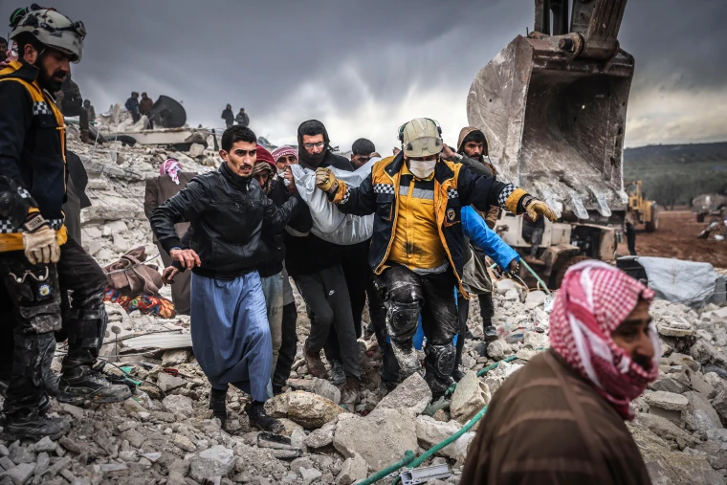
CASE STUDY
Turkey-Syria Earthquake
February 6th 2023
7.8-Magnitude Earthquake

Slide 5
CASE STUDY
In the 2023 Turkey-Syria Earthquake, AI…..
helped identify collapsed buildings within hours
Find damage zones in real time
predicted where survivors were most likely located
flagged urgent help requests and guided responders
significantly reduced time needed to assess large‑scale destruction

Slide 6
Benefits
Helps governments
plan evacuations
allocate resources
predict damage
reduce loss of life
lower recovery costs
Faster response times
better resource allocation

Slide 7
Challenges
high costs
AI tools, drones, and communication systems can be hacked or manipulated
Challenges Involving:
data quality
privacy concerns
need for human oversight

Slide 8
Ethical Concerns
may reinforce existing data biases, causing unequal aid distribution
Lack of transparency in AI‑driven decisions
Large‑scale data collection can compromise privacy during vulnerable moments
Vulnerable groups may be excluded if AI systems overlook undocumented or offline populations

Slide 9
Societal Impact
Improves community safety
Better coordination between agencies and responders
helps reduce confusion during crises
Automation shifts workforce roles and requires new training
Increased data collection may normalize long‑term surveillance

Slide 10
Conclusion
AI significantly enhances disaster response capabilities in the public sector
Innovative applications like digital twins can further strengthen preparedness
human oversight remain essential

Slide 11
References
Federal Emergency Management Agency (2024). Artificial Intelligence Use Case Inventory
Government Accountability Office (2023). AI in Natural Hazard Modeling
Deloitte Center for Government Insights (2023). AI in Emergency Management
RAND Corporation (2025). How AI Is Changing Disaster Response
Xu, J., Nair, D. J., & Waller, S. T. (2025). AI in Disaster Management

