Slide 1


72.5%
GAMING ADDICTION
RISK PREDICTION
Best Model Accuracy
1,000
Using Gradient Boosting & XGBoost
Dataset Records
Abdulrahman Bajunaid · Faisal Alsulami · Saad Alshahrani
4 Classes
Instructor: Khulud Alshammari | TA: Abdullah Alharbi

Slide 2



Presentation Structure
Three-part delivery across the team
PART 1
PART 2
PART 3
Algorithm
Explanation
Data &
Exploration
Evaluation
Metrics
Mathematical and statistical foundations of Gradient Boosting and XGBoost
Dataset overview, EDA visualizations, preprocessing pipeline
Model results, confusion matrices, comparison, and feature importance

Slide 3
01
Algorithm
Explanation
Mathematical and statistical foundations of Gradient Boosting & XGBoost

Slide 4

What is Gradient Boosting?
Definition
Key Properties
Gradient Boosting is an ensemble learning method that combines many weak learners (typically shallow decision trees) sequentially. Each new tree is trained to correct the residual errors of the combined ensemble so far, using gradient descent on a loss function to guide improvement.
Sequential ensemble — trees are added one at a time
Loss-driven — minimizes a differentiable loss function
Additive model — final prediction is sum of all tree outputs
Regularized — learning rate shrinks each tree's contribution
Unlike bagging (parallel trees), boosting builds trees one after another, each focusing on where the model currently fails.

Slide 5
How Gradient Boosting Works — The Math
1
Initialize Model
Start with a constant prediction that minimizes the loss over all training samples.
F₀(x) = argminₙ ΣL(yᵢ, γ)
2
Compute Residuals
Calculate the negative gradient of the loss function — these pseudo-residuals tell each new tree where the current model is wrong.
rᵢₘ = −∂L(yᵢ, F(xᵢ)) / ∂F(xᵢ)
3
Fit a New Tree
Train a shallow decision tree on the pseudo-residuals. The tree learns to predict the direction and magnitude of errors.
hₘ(x) fitted to {(xᵢ, rᵢₘ)}
4
Update Model
Add the new tree's predictions scaled by learning rate η to the ensemble. Repeat M times.
Fₘ(x) = Fₘ₋₁(x) + η · hₘ(x)

Slide 6

XGBoost — Extreme Gradient Boosting
XGBoost extends Gradient Boosting with a regularized objective function and engineering optimizations that make it faster, more accurate, and more robust.
Regularized Objective Function
Obj = ΣL(yᵢ, ŷᵢ) + Σ[γT + ½λw²]
Loss term drives accuracy | Regularization term (γT + λw²) penalizes tree complexity to prevent overfitting
Second-Order Gradients
Column Subsampling
Uses both first and second derivatives (Hessian) for more precise split finding
Randomly selects features per tree and per level, reducing overfitting
Sparsity-Aware Splits
Weighted Quantile Sketch
Natively handles missing values by learning optimal default split directions
Approximate split finding for scalability on large datasets

Slide 7
When to Use | Advantages | Limitations
WHEN TO USE
ADVANTAGES
LIMITATIONS
Multi-class classification tasks
Handles non-linear relationships
Prone to overfitting if untuned
Structured/tabular datasets
Built-in feature importance
Slower training than simple models
When high accuracy is priority
Robust to outliers and noise
Sensitive to hyperparameters
Imbalanced class distributions
Supports class weighting
Less interpretable than trees
Complex feature interactions exist
Strong generalization ability
Requires careful regularization

Slide 8
02
Dataset &
Exploration
Understanding the Gaming and Mental Health dataset through EDA

Slide 9
Dataset Structure & Features
1,000
27
4 Classes
2
Records
Columns
Target
Missing Cols
Feature Category | Examples | Type
Demographics | age, gender | Numeric / Categorical
Gaming Behavior | daily_gaming_hours, game_genre, platform | Mixed
Sleep & Health | sleep_hours, sleep_quality, eye_strain | Numeric / Categorical
Social & Academic | social_isolation_score, grades_gpa | Numeric
Target Variable | gaming_addiction_risk_level | Low / Moderate / High / Severe

Slide 10
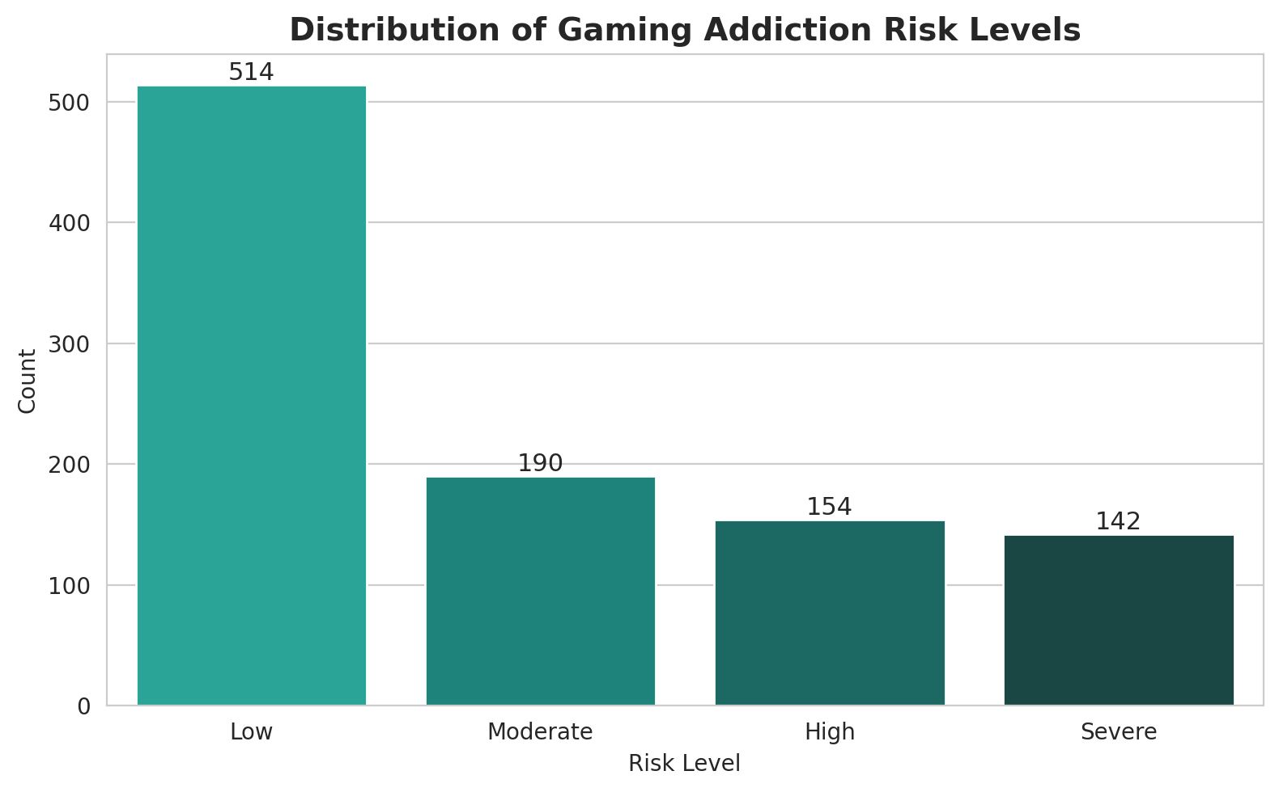

EDA — Target Variable Distribution
Key Insight
The dataset is clearly imbalanced — the Low risk class dominates, while Severe cases are under-represented. This imbalance can bias the model toward the majority class, requiring techniques like class weighting or SMOTE to ensure fair predictions across all risk levels.

Slide 11
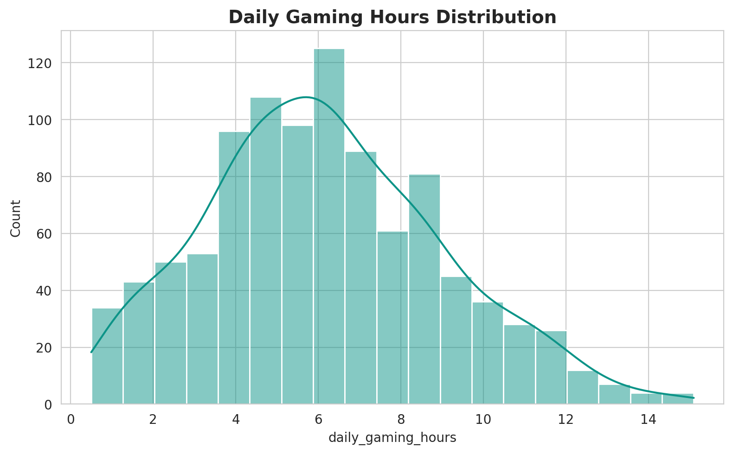
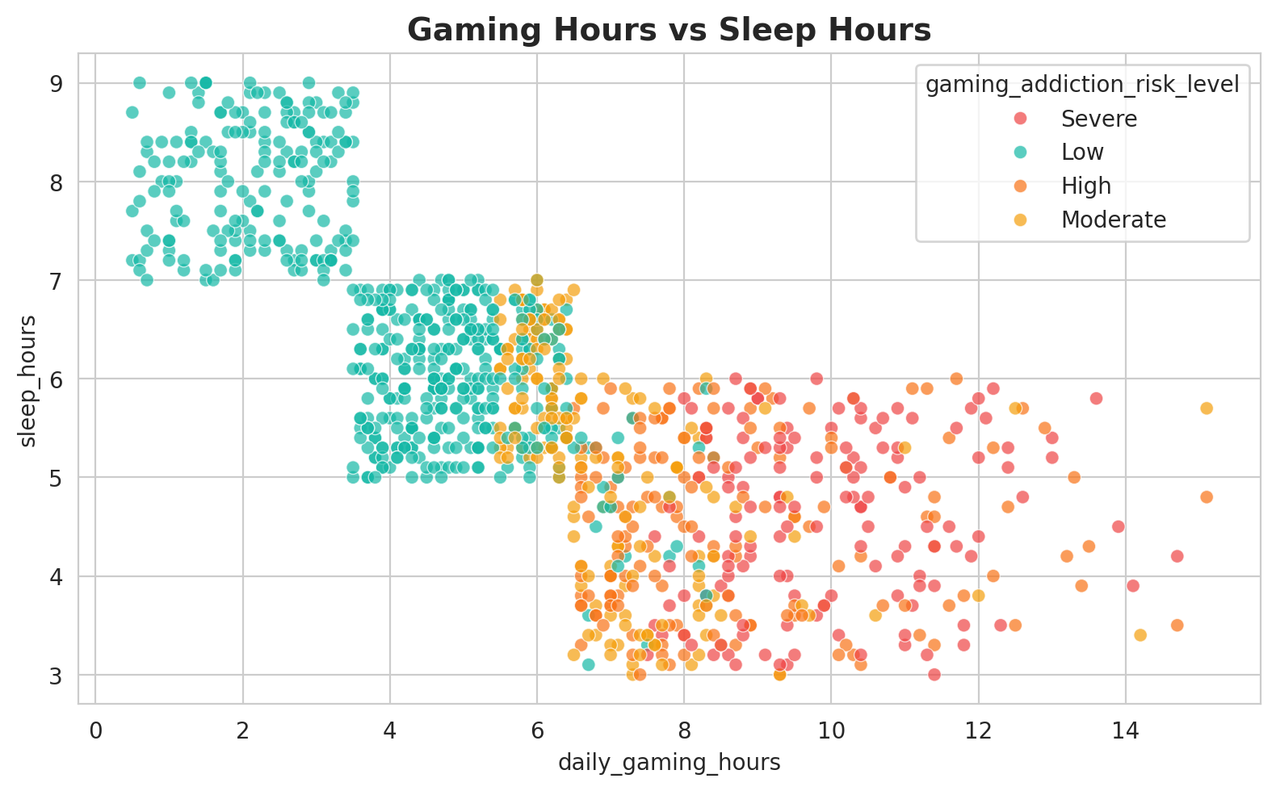
EDA — Gaming Hours & Sleep Patterns
Most users game 4-8 hours/day (right-skewed). A clear negative relationship exists between gaming hours and sleep — higher gaming is associated with higher addiction risk, making both features strong predictors.

Slide 12
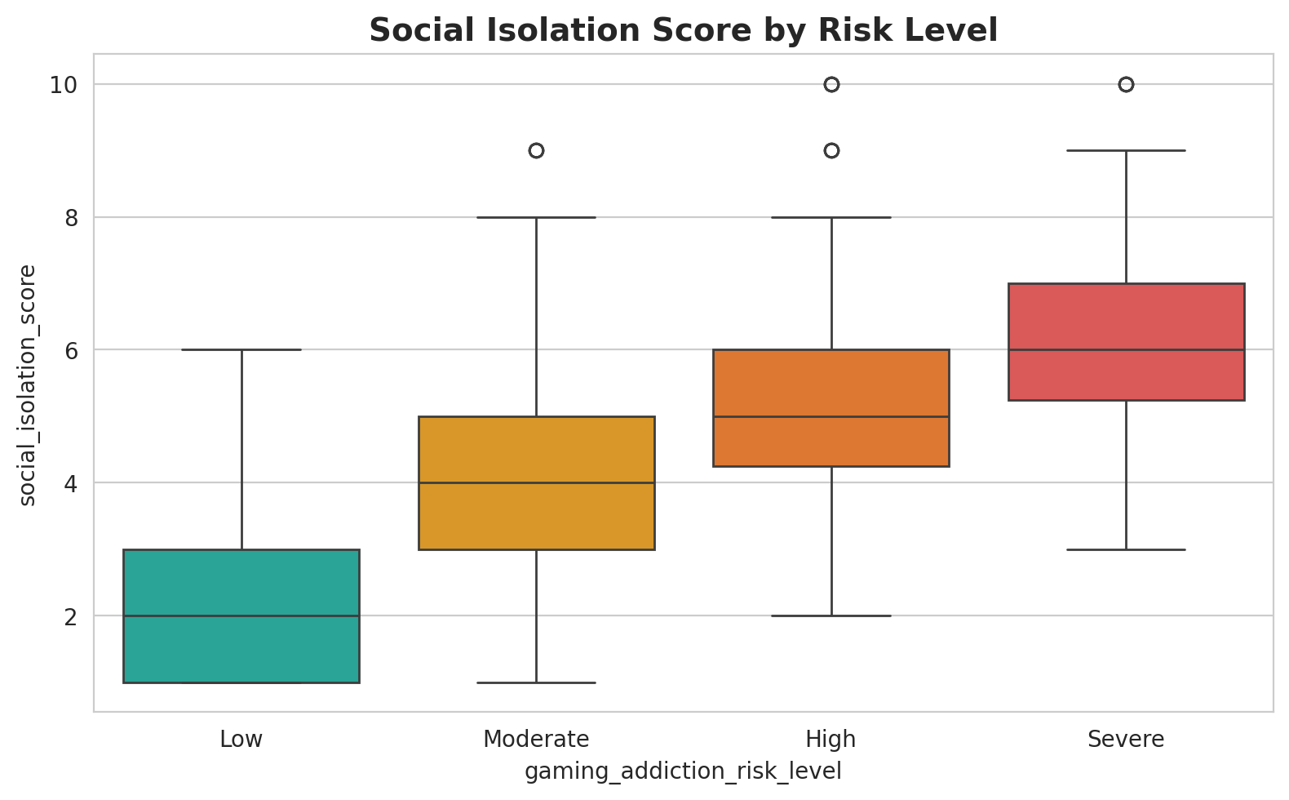
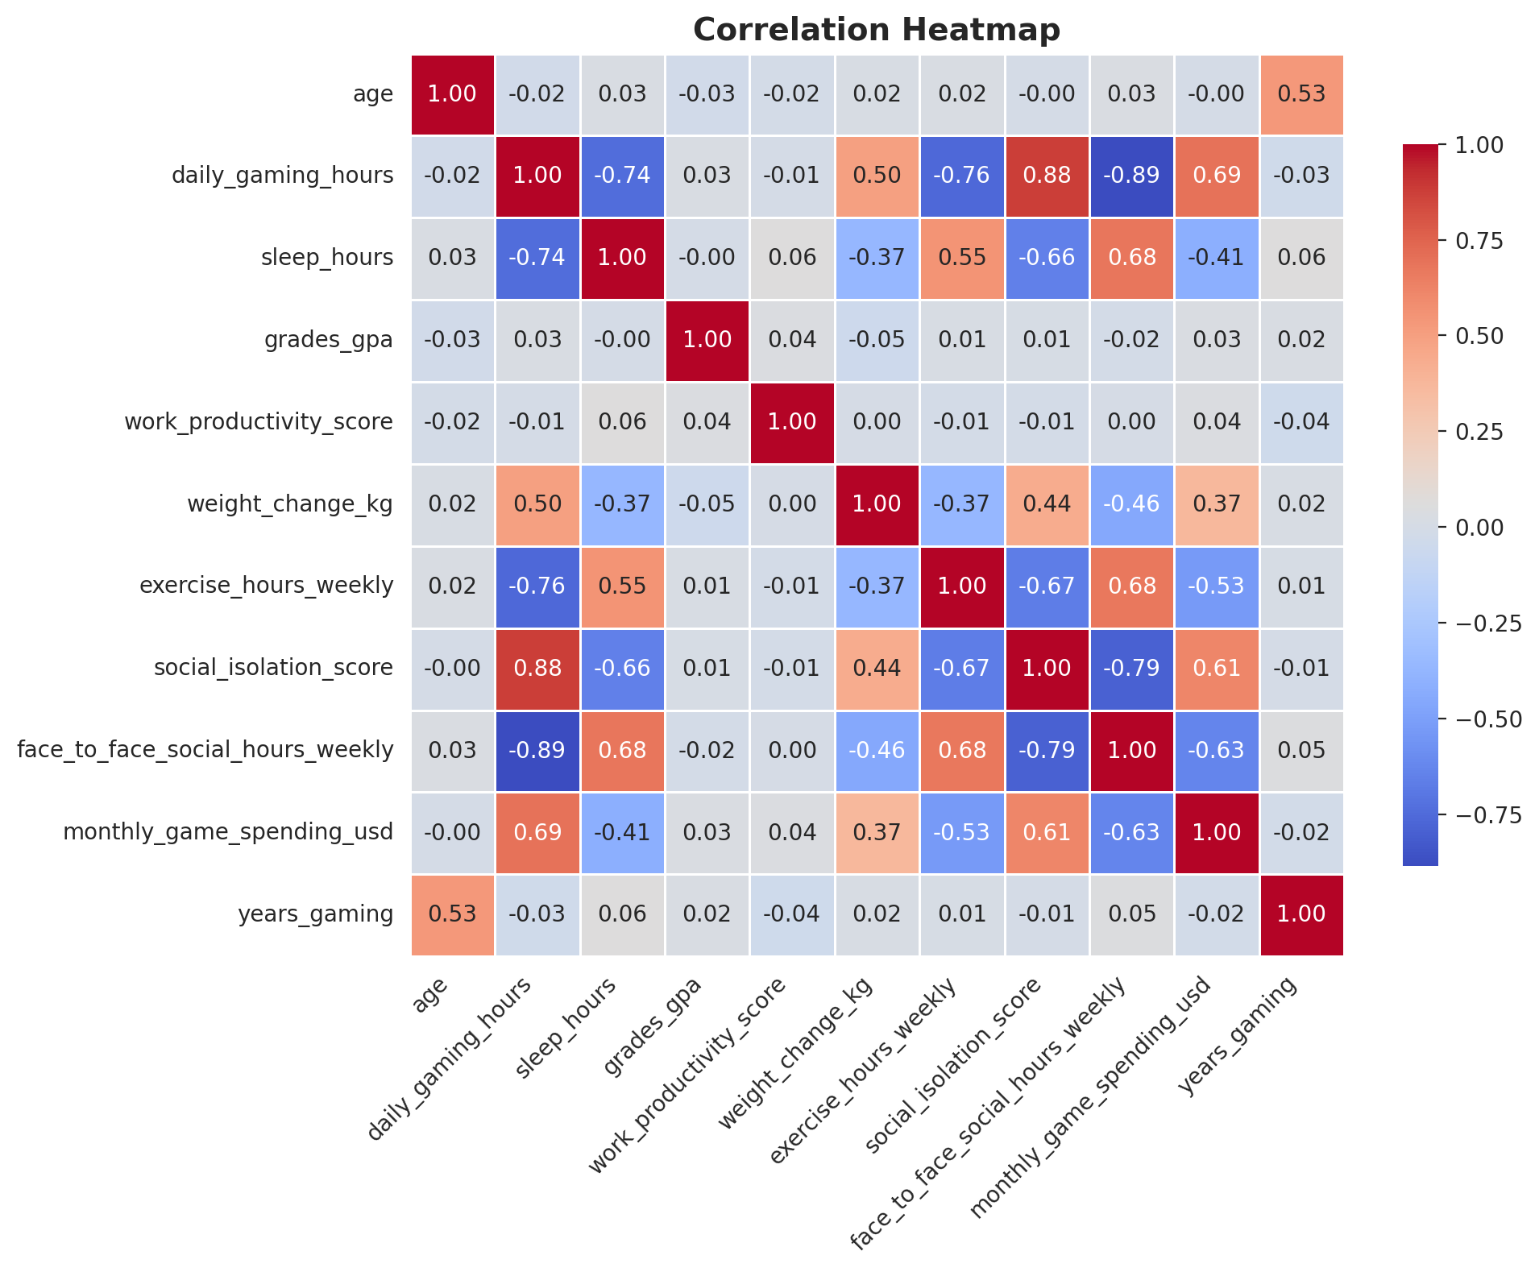
EDA — Social Isolation & Correlation Analysis
Social isolation scores increase with addiction severity. The heatmap reveals interconnected behavioral features — gaming addiction is linked to a combination of factors, not a single predictor.

Slide 13
Data Preprocessing Pipeline
Handle Missing Values
Remove Data Leakage
1
2
grades_gpa and work_productivity_score filled with median — robust to outliers, preserves distribution.
Dropped withdrawal_symptoms, loss_of_other_interests, continued_despite_problems — these define addiction, not predict it.
Remove Irrelevant Columns
Encode Categoricals
3
4
Dropped record_id (identifier) and primary_game (high-cardinality, adds noise).
One-Hot Encoding applied to gender, game_genre, gaming_platform, mood_state, etc. via ColumnTransformer.
Train/Test Split
Label Encode Target
5
6
80/20 stratified split (random_state=42). Stratification ensures class proportions are preserved.
Target encoded: High=0, Low=1, Moderate=2, Severe=3 for multi-class classification.

Slide 14

03
Model
Evaluation
Performance metrics, confusion matrices, comparison, and feature importance

Slide 15
Understanding Evaluation Metrics
Accuracy
Precision
(TP + TN) / Total
TP / (TP + FP)
Overall proportion of correct predictions across all classes. Can be misleading for imbalanced datasets.
Of all samples predicted as class X, how many actually belong to class X? Measures false positive rate.
Recall
F1 Score
TP / (TP + FN)
2 × (P × R) / (P + R)
Of all actual class X samples, how many did the model correctly identify? Measures false negative rate.
Harmonic mean of precision and recall. Balances both metrics — especially important for imbalanced classes.

Slide 16

Baseline Model Results
Model | Accuracy | Precision | Recall | F1 Score
Gradient Boosting | 69.0% | 70.6% | 69.0% | 68.8%
XGBoost | 67.5% | 67.4% | 67.5% | 67.2%
Tuned XGBoost | 72.5% | 73.7% | 72.5% | 72.5%
KNN (k=5) | 66.0% | 62.8% | 66.0% | 63.8%
Key Findings
Tuned XGBoost achieved the best performance across all metrics (72.5% accuracy, 72.5% F1). Hyperparameter tuning with RandomizedSearchCV and class weighting improved XGBoost by +5% accuracy over the baseline. Tree-based models consistently outperformed KNN, indicating that distance-based methods are less suitable for this structured dataset with high-cardinality encoded features.

Slide 17
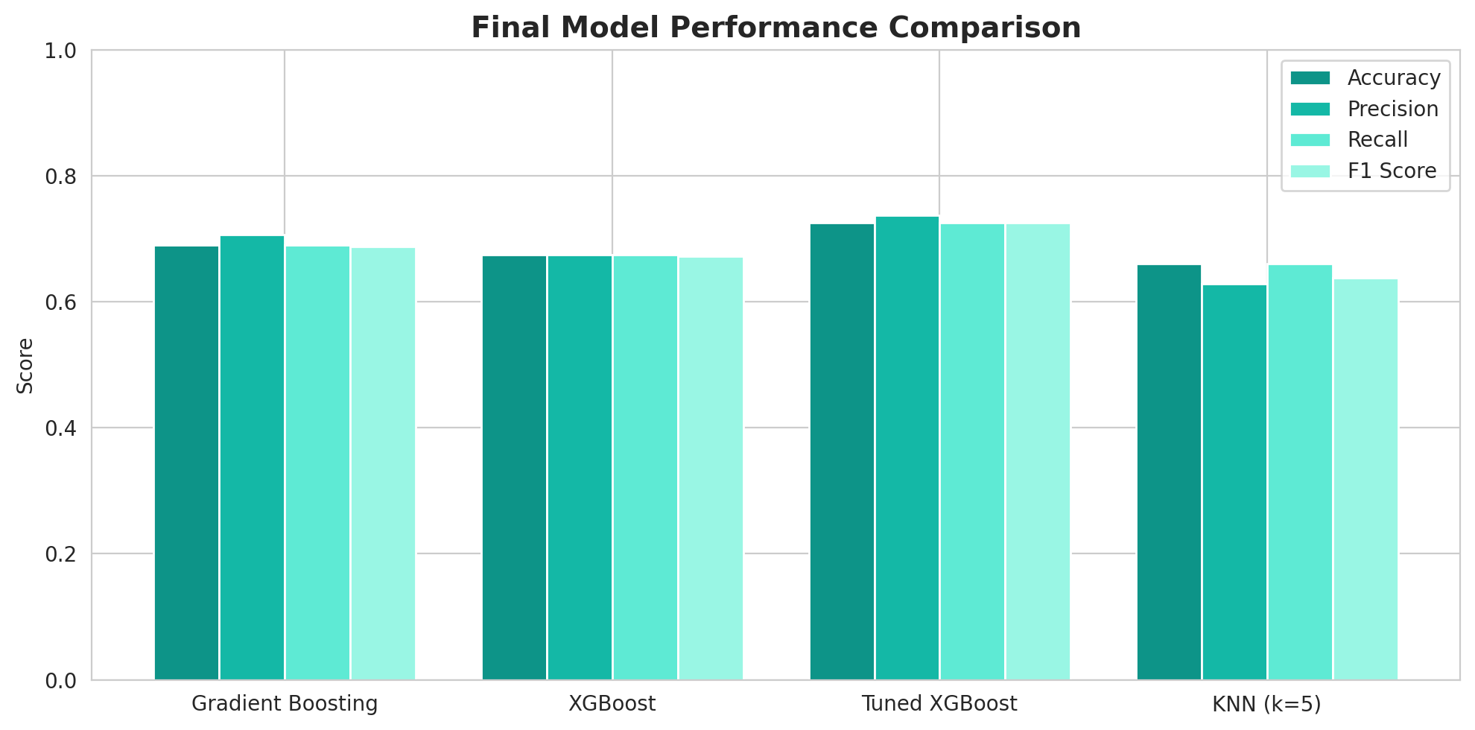
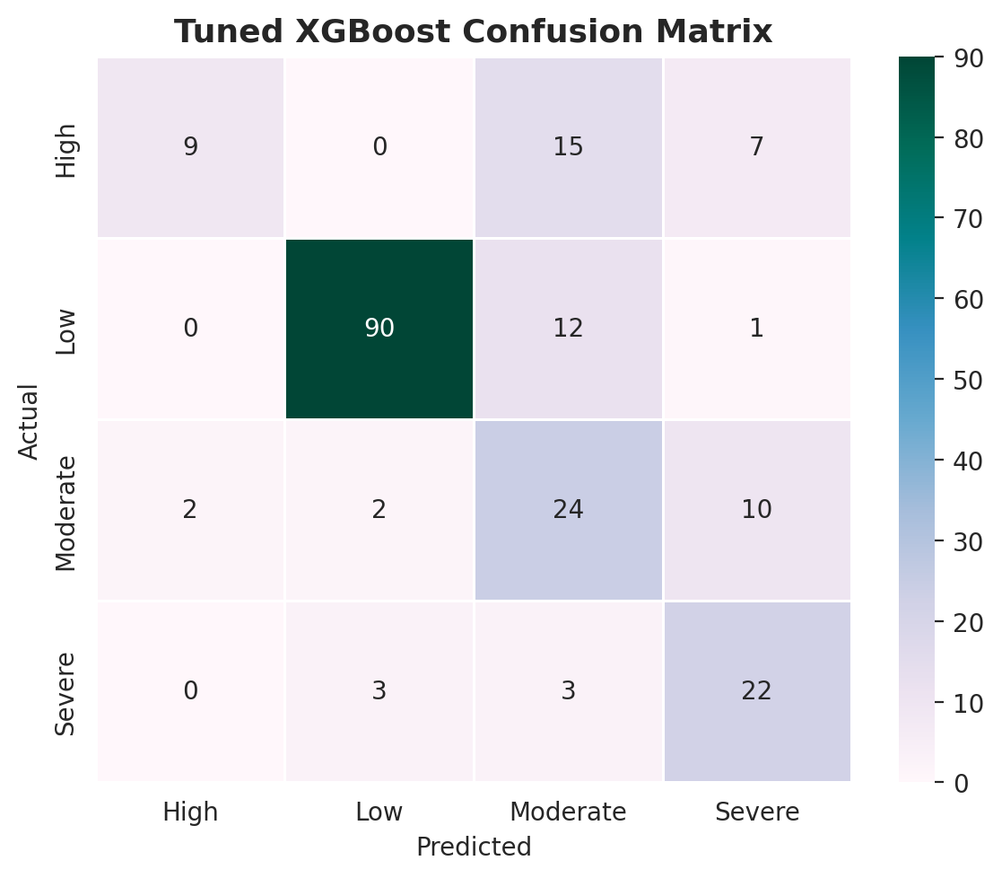
Model Comparison & Confusion Matrix
The confusion matrix shows Tuned XGBoost predicts Low risk reliably (90/103 correct) but struggles more with High and Moderate classes due to class imbalance and feature overlap between adjacent risk levels.

Slide 18
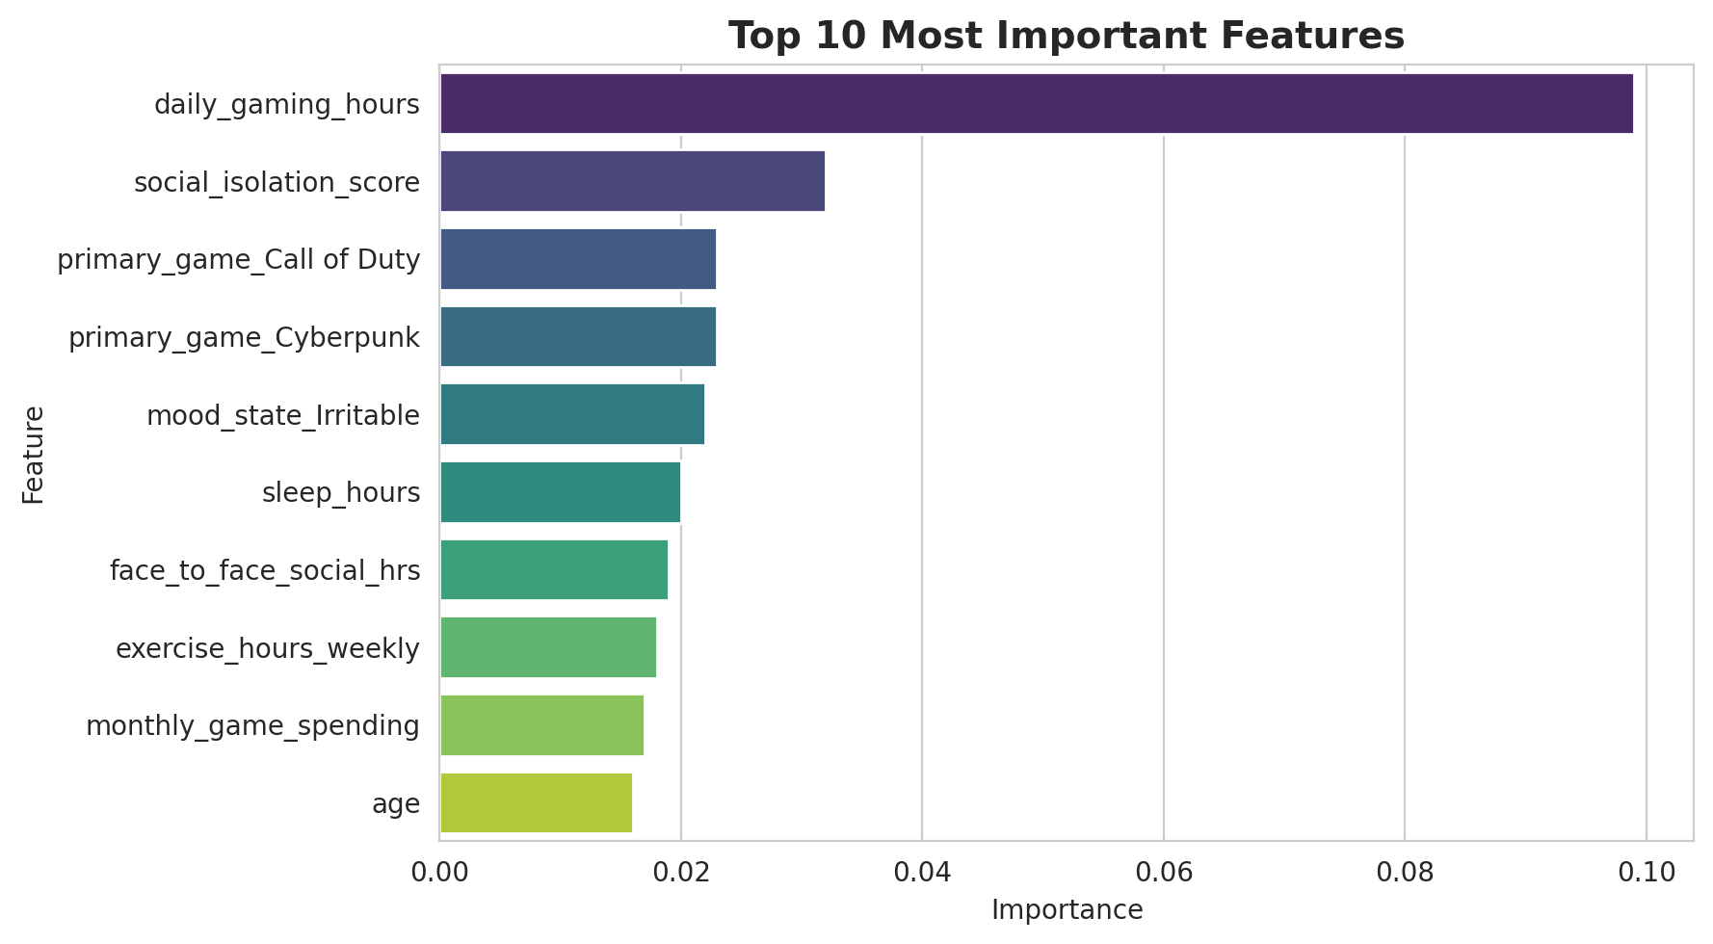
Feature Importance — What Drives Addiction Risk?
Top Predictors
daily_gaming_hours
9.9%
Dominant predictor — gaming behavior matters most
social_isolation_score
3.2%
Social withdrawal strongly linked to higher risk
sleep_hours
2.0%
Less sleep correlates with increased addiction
exercise_hours_weekly
1.8%
Physical activity serves as a protective factor
Behavioral features (gaming hours, social isolation) are far more impactful than demographic ones (age, gender), confirming that addiction risk is driven by modifiable habits rather than fixed traits.

Slide 19
Key Insights & Conclusion
1
Behavioral Factors Dominate
2
Tuning Matters Significantly
Daily gaming hours is the single most important predictor, followed by social isolation score. Demographic variables contribute relatively little.
Hyperparameter optimization with RandomizedSearchCV improved XGBoost accuracy from 67.5% to 72.5% — a meaningful gain for a real-world classification task.
3
Class Imbalance Is a Challenge
4
Tree Models Outperform KNN
The Low risk class dominates the dataset. Using sample weights partially mitigated this, but minority classes (High, Severe) remain harder to predict.
Gradient Boosting and XGBoost consistently beat KNN, confirming tree-based ensembles handle structured tabular data with encoded categoricals more effectively.

Slide 20
72.5%
Thank You
Best Accuracy
72.5%
Any Questions?
Best F1 Score
1,000
Instructor: Khulud Alshammari | TA: Abdullah Alharbi
Records
4
Models Compared

