Slide 1

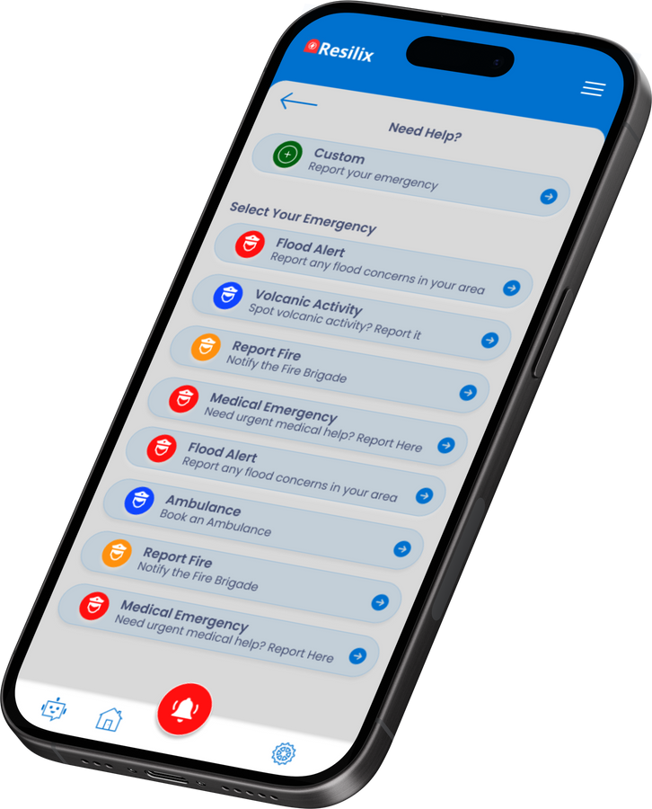
Database Design and Implementation
Disaster Management System
Presented by Group 25

Slide 2

Introduction
Database design for Resilix emergency management system. The system includes functionalities for user management, emergency reporting, safety information, real-time incident reporting, resource management, alerts and notifications, and more.

Slide 3
Relational Schema
CustomUser
AlertChoices:
Location
Alert
Contains user details like
userId
username
password
userType
phone number
otp
Contains alert types with attributes like
alertChoiceId
emergency name
Contains location details with attributes like
locationId
longitude
latitude
Contains alert details with attributes like:
alertIduserId
alertChoiceId
date_time_of_alert
locationId
description
first_aid_response
DisasterFeedback
Contains feedback details with attributes like
feedbackId, alertId, description, date_time_of_feedback.

Slide 4

Normalization
First Normal Form (1NF)
All tables have a primary key and each field contains only atomic values.
Second Normal Form (2NF)
All non-key attributes are fully functionally dependent on the primary key. Composite keys are split into separate tables.
Third Normal Form (3NF)
All attributes are functionally dependent only on the primary key. Transitive dependencies are eliminated.

Slide 5
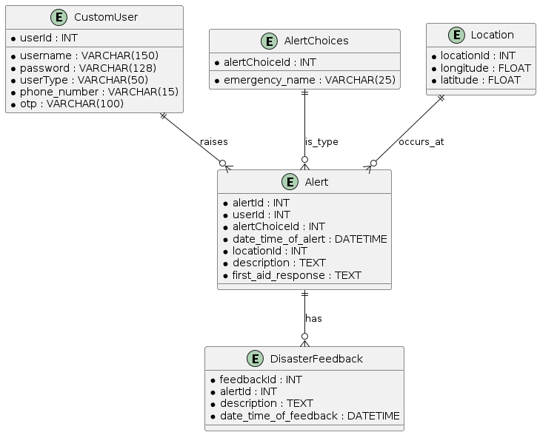

Entity-Relationship Diagram (ERD)
Entity-Relationship Diagram (ERD)
Visual representation of the database structure and relationships between entities.

Slide 6
Relationships in the Database
CustomUser and Alert
AlertChoices and Alert
Location and Alert:
One-to-Many relationship
Each user can raise multiple alerts, but each alert is associated with only one user.
One-to-Many relationship
Each type of emergency (e.g., fire, flood) is recorded in the AlertChoices table and linked to alerts.
One-to-Many relationship
Alerts are linked to specific geographical locations.
Alert and DisasterFeedback
One-to-Many relationship
Each alert can have multiple feedback entries.

Slide 7

Importance of Relationships
Ensures the system accurately captures interactions between users, alerts, locations, and feedback.
Enables efficient data retrieval and meaningful analysis.
Supports robust reporting and decision-making processes.
Enhances the system’s capability to manage emergencies and disasters effectively.

Slide 8
Caching Needs in the Database with Redis
For this database caching is needed to improve performance, reduce repeated database queries, quick access etc
In-Memory Caching with Redis
Optimized for fast read operations.
Time-Based Caching
Ensures the cache is refreshed periodically for data that changes over time.
Query Caching
Reduces the load on the database and improves response times.
Application-Level Caching
Manages cache lifecycle and invalidation efficiently.

Slide 9
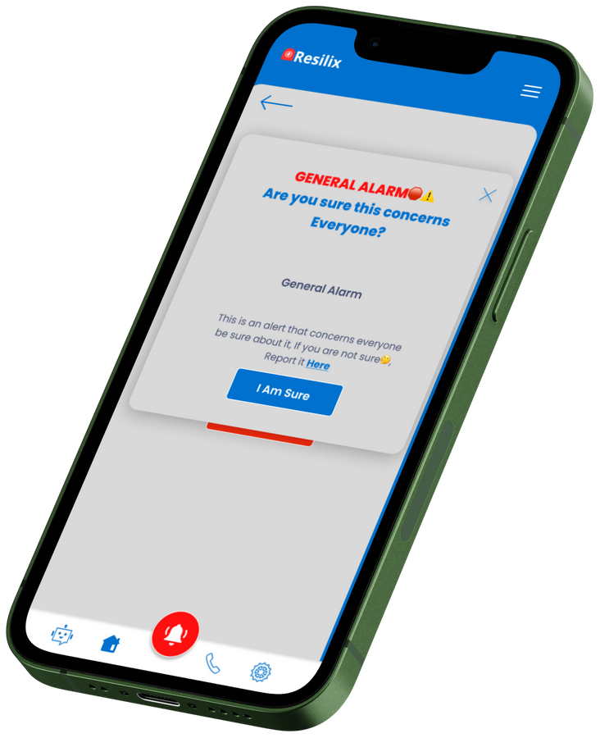
Conclusion
By implementing robust database normalization techniques, defining clear entity relationships, and integrating efficient caching strategies with Redis, our database design ensures optimal performance, data integrity, and scalability.

