Slide 1


System Modeling and Design
Disaster Management System
GROUP 25
1

Slide 2


Introduction:
System modeling is a methodological approach used to create abstract representations of complex
systems. These models help in understanding, analyzing, and designing systems by providing a
clear and structured visualization of their components and interactions.
Key UML Diagrams for the Disaster Management System
Use Case Diagram
Sequence Diagram
Class & Context Diagram
Deployment Diagram
11

Slide 3
Use Case Diagram
Outlines the structure and interactions of the Emergency Management System (EMS).
Main actors:
Local Authorities and Emergency Units
Insurance Companies
Emergency Agents
Normal Users (General Public)
Use Cases
Login/Signup Authentication:
Error: Credentials Error
Login/Signup Credentials
Error: Unauthorized Access
RELATIONSHIPS
Extends Relationship
Includes Relationship
Generalization (Unauthorized Access)

Slide 4

USE CASES WITHIN THE EMS
(EMERGENCY MANAGEMENT SYSTEM)
Use of Sensors
Community Engagement
Safety Information
EMS
Alerts and Notifications
Emergency Reporting
Analytics and Reporting
ACCESS AUTHORIZATION
Insurance Companies
Normal Users (General Public)
Local Authorities and Emergency Agents

Slide 5
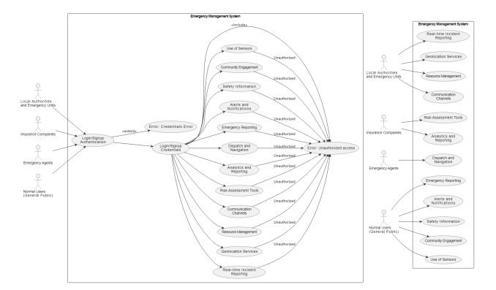

Slide 6
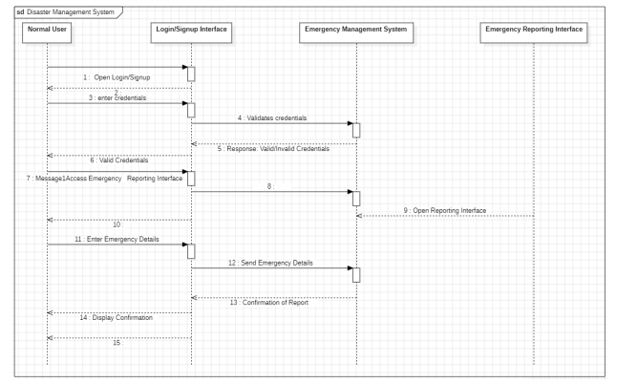
Sequence Diagram
Illustrates interactions between users and system components during a disaster event.
CASE: NORMAL USER REPORTING AN
EMERGENCY
Actors:
Normal User (General Public)
Emergency Management System
Objects:
Login/Signup Interface
Emergency Reporting Interface

Slide 7

Class Diagram
Illustrates the structure of the Disaster Management System. Shows system classes, attributes, methods, and relationships.
Classes and Attributes
USER
LOGIN
CREDENTIALS
EMERGENCYMANAGEMENTSYSTEM

Slide 8
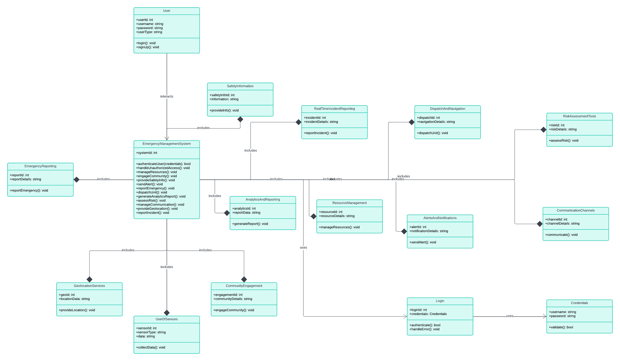

Slide 9
Context Diagram
Describes the Disaster Management System interfaces with users, authorities, emergency units, and other systems.
Four Main External Entities
Local Authorities and Emergency Units
Insurance Companies
Emergency Agents
Normal Users (General Public)

Slide 10
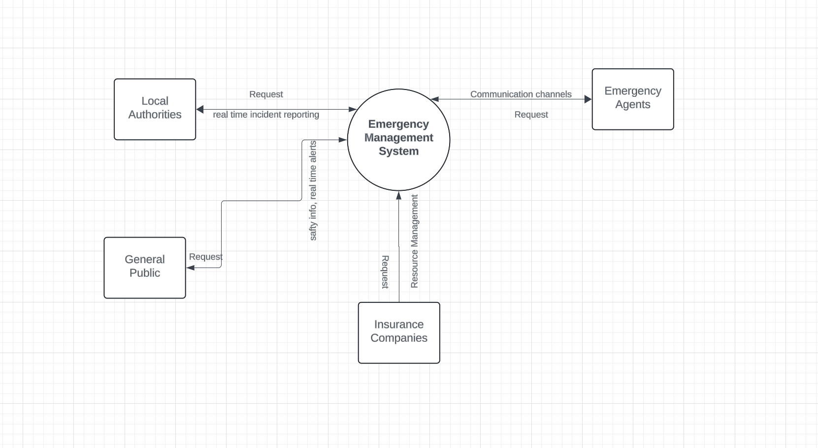

Slide 11
DEPLOYMENT DIAGRAM
CENTRAL ARCHITECTURE
COMMUNICATION WITH EXTERNAL COMPONENTS
FLOW OF INFORMATION
A deployment diagram in the context of a Disaster Management System represents the physical deployment of the software system's components across the hardware infrastructure.

Slide 12
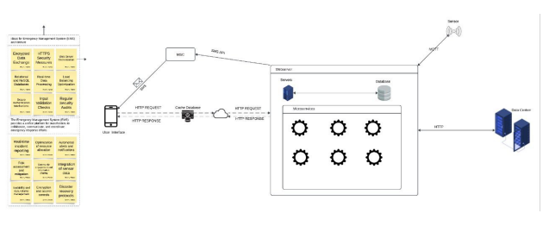

Slide 13
Conclusion
Comprehensive modeling and design are crucial for effective disaster management.
UML diagrams provide clear visualization and standardization.
The designed system ensures robust response strategies and efficient emergency management.

Slide 14

THANK YOU

