Slide 1
Udacity Connect Session
Session 10

Slide 2
Content
Matrix

Slide 3
Matrix

Slide 4
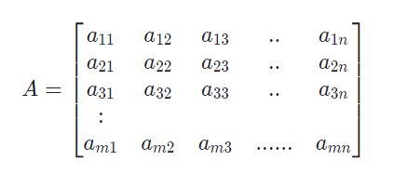
Matrix:
Matrix
A Matrix is a two-dimensional array
A Matrix can have m rows and n columns.
If a Matrix has mm rows and n columns, is it called an m x n matrix.

Slide 5
Matrix Addition:
Matrix
To add one matrix to the other we need to:
Verify that the matrices are of the same dimensions.
Make sure we add elements in the correct corresponding index.

Slide 6

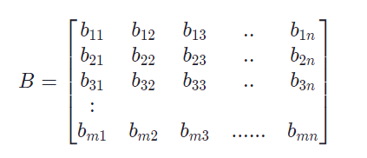
Matrix Addition:
Matrix

Slide 7
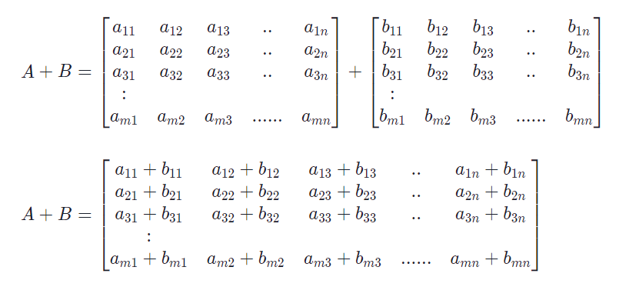
Matrix Addition:
Matrix

Slide 8
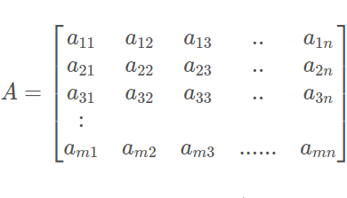

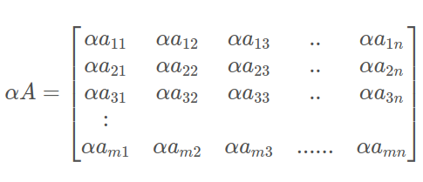
Scalar Multiplication:
Matrix

Slide 9
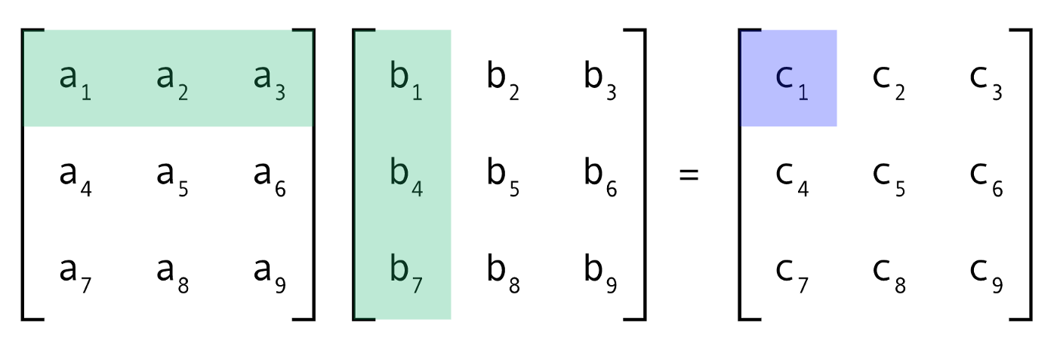
Matrix Multiplication:
Matrix
The easiest multiplication to consider is that of 2 matrices of the same size nn X nn

Slide 10
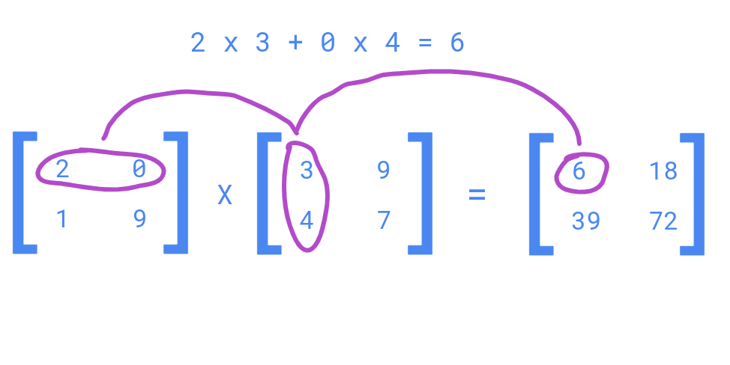
Matrix Multiplication:
Matrix

Slide 11
Matrix Multiplication:
Matrix
In order to multiply matrix P and matrix Q:
Number of columns in matrix P must be equal to number of rows in matrix Q
The shape of the result is nXz
Pnxm
Qmxz

Slide 12
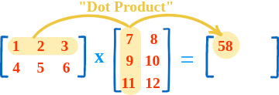
Matrix Multiplication:
Matrix

Slide 13
Quiz

Slide 14
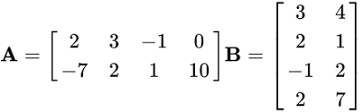
Quiz
4 (3 A x 2 B)

Slide 15






Quiz
4
x
x
4
x
x
4
x

Slide 16
Any Questions?

Slide 17
Thank You

