Slide 1
Udacity Connect Session
Session 2

Slide 2
Content
Python basics
Variables
Data Types
String
Data Structures
List
Set
Tuple
Dictionary

Slide 3
Python Basics

Slide 4
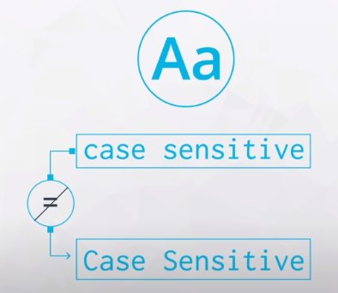
Python is case sensetive
Python Basics

Slide 5
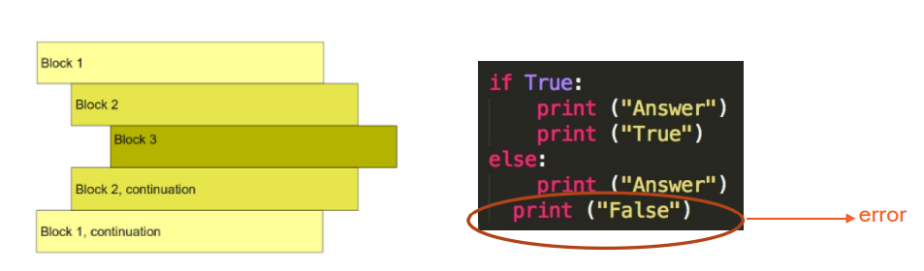
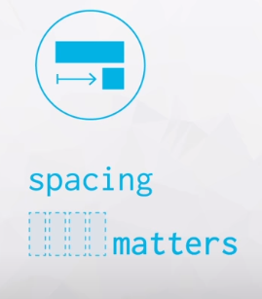
Spacing matters
Python Basics
Since it isn’t very heavy on syntax, it relies a lot on spacing.

Slide 6
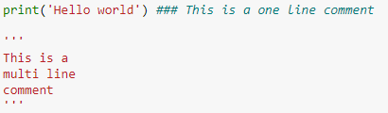
Comments in Python
Python Basics
# starts a single line comment.
‘’’ starts a multi line comment

Slide 7
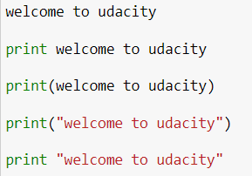
How to output (welcome to udacity) to a user
Quiz

Slide 8

How to output (welcome to udacity) to a user
Quiz

Slide 9
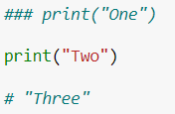
What is the output of the following code
Quiz
One
Two
Three
Two
One
Three

Slide 10
What is the output of the following code
Quiz
One
Two
Three
Two
One
Three

Slide 11
Variables

Slide 12

Variables
A variable is simply a name to which a value can be assigned.
Variables allow us to give meaningful names to data.
The simplest way to assign a value to a variable is through the = operator.

Slide 13
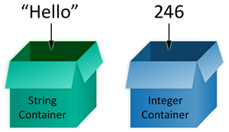
Variables
A big advantage of variables is that they allow us to store data so that we can use it later to perform operations in the code.
Variables are mutable. Hence, the value of a variable can always be updated or replaced.

Slide 14
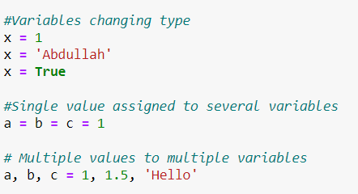
Some variable characteristics
Variables

Slide 15
Data Types

Slide 16
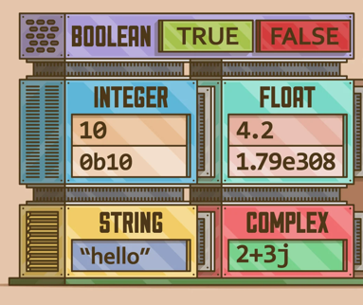
Data Types

Slide 17
Data Types
Data types
Integer
Float
Bool
String
10
15
2.3
True
False
“Hello”
‘Hello’

Slide 18
Data Types: String

Slide 19
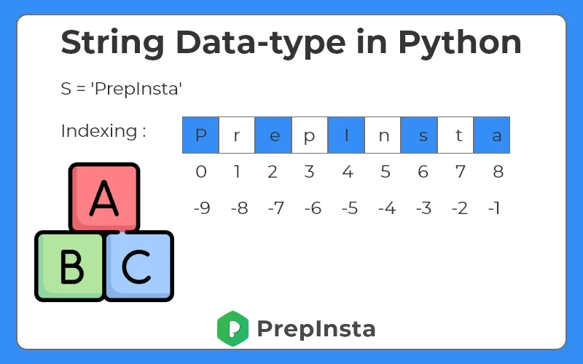
Data Types: String
A string can be accessed from both ways
A string is immutable

Slide 20
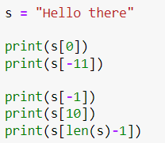
What is the output of the following code
Quiz
This is also called string indexing

Slide 21
Data Types: String
But what if we want to access multiple characters at the same time?
This is called string slicing.
Step
Start index
String [ 0 : n : s ]
String name
End index

Slide 22
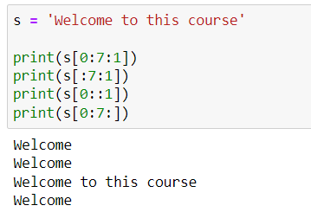
Data Types: String

Slide 23


What is the output of the following code
Quiz
Wm s
oosr
welcom
welco

Slide 24
What is the output of the following code
Quiz
Wm s
oosr
welcom
welco

Slide 25

What is the output of the following code
Quiz
esruoc siht ot emocleW
Welcome to this course
error
Wloe ohi ourse

Slide 26
What is the output of the following code
Quiz
esruoc siht ot emocleW
Welcome to this course
error
Wloe ohi ourse

Slide 27

What is the output of the following code
Quiz
course
error
eoiome
tco dc

Slide 28
What is the output of the following code
Quiz
course
error
eoiome
tco dc

Slide 29
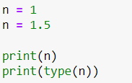
What is the output of the following code
Quiz
1.5
<class ‘float’>
1
<class ‘int’>
1.5
<class ‘int’>
1
<class ‘float’>

Slide 30
What is the output of the following code
Quiz
1.5
<class ‘float’>
1
<class ‘int’>
1.5
<class ‘int’>
1
<class ‘float’>

Slide 31
Data Structures

Slide 32
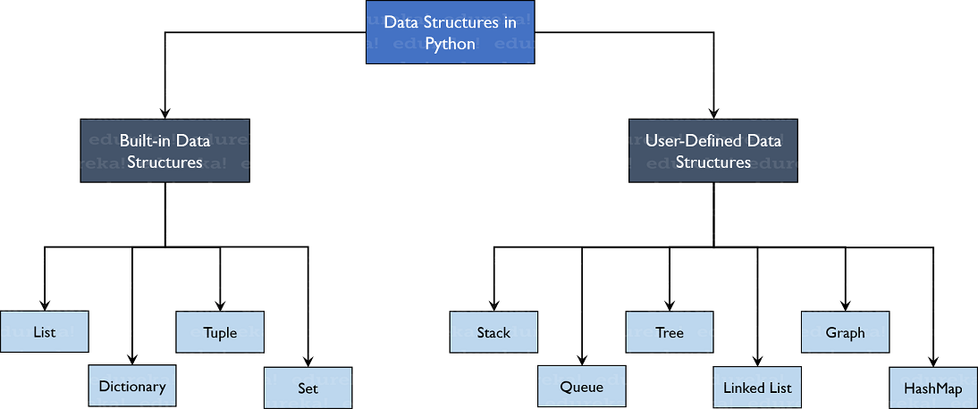
Data Structures

Slide 33
Data Structures: Lists

Slide 34

Data Structures: Lists
List can be initialized using [] or list()
Ordered
Mutable
Contains duplicates

Slide 35
Data Structures: Sets

Slide 36

Data Structures: Sets
Set can be initialized using {} or set()
Unordered
Immutable
Unique values

Slide 37
Data Structures: Tuples

Slide 38

Data Structures: Tuples
Tuple can be initialized using () or tuple()
Ordered
Immutable
Contains duplicates

Slide 39
Data Structures: Dictionary

Slide 40

Data Structures: Dictionary
Dictionary can be initialized using {} or dict()
Unordered
Mutable
Unique keys

Slide 41
Break Time

Slide 42
Project

Slide 43
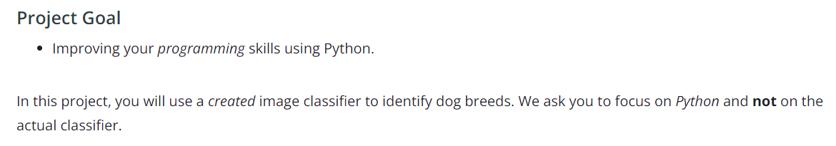
Use a Pre-trained Image Classifier To Identify Dog Breeds

Slide 44
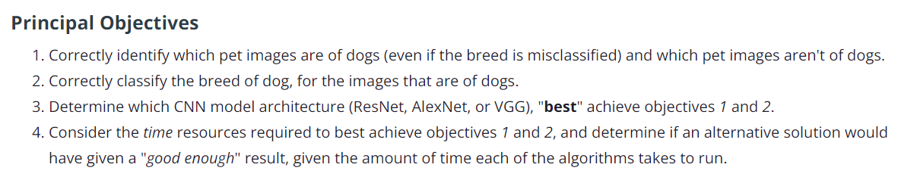
Use a Pre-trained Image Classifier To Identify Dog Breeds

Slide 45
Use a Pre-trained Image Classifier To Identify Dog Breeds
For this image classification task, you will be using an image classification application using a deep learning model called a convolutional neural network (often abbreviated as CNN).
You'll use a CNN that has already learned the features from a giant dataset of 1.2 million images called ImageNet.
There are different types of CNNs that have different structures (architectures) that work better or worse depending on your criteria. With this project, you'll explore the three different architectures (AlexNet, VGG, and ResNet) and determine which is best for your application.

Slide 46
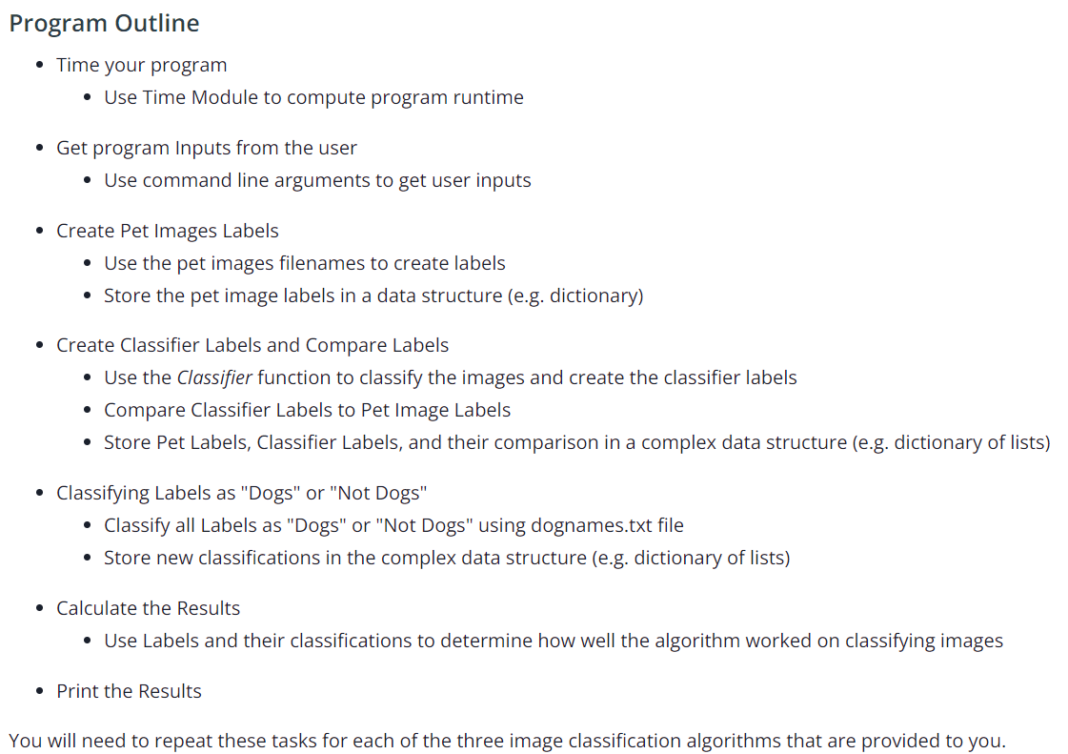
Use a Pre-trained Image Classifier To Identify Dog Breeds

Slide 47
Next Session
Introduction to Python for AI Programmers
Control flow
Functions
Also take a look on the first project

Slide 48
Any Questions?

Slide 49
Thank You

