Slide 1
Udacity Connect Session
Session 3

Slide 2
Content
Comparison Operators
If Statements
Loops:
For
While
Break, Continue
Function
Project

Slide 3
Comparison Operators

Slide 4
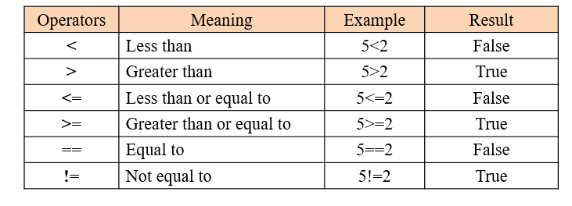
Comparison Operators

Slide 5
If Statements

Slide 6
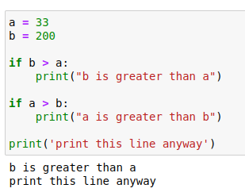
if Statement
If Statements

Slide 7
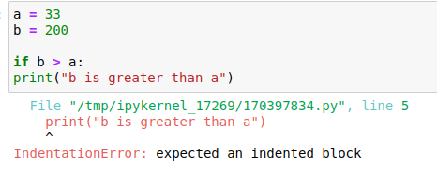
if Statement
If Statements
4 spaces
OR
1 tab
No spaces

Slide 8
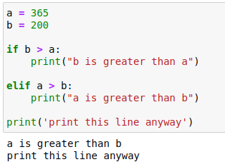
elif Statement
If Statements

Slide 9
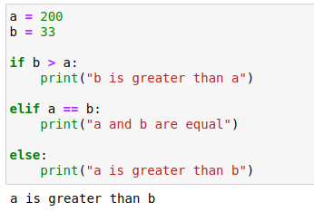
else Statement
If Statements

Slide 10
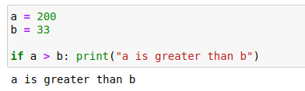
Short hand if
If Statements

Slide 11
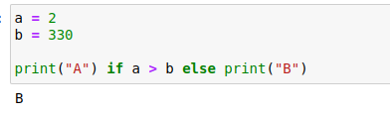
Short hand if, else
If Statements

Slide 12
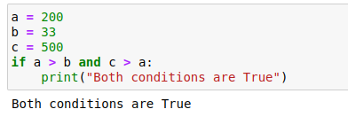
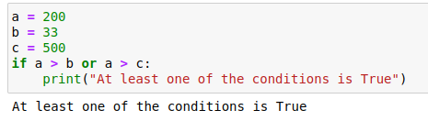
Multiple conditions
If Statements

Slide 13
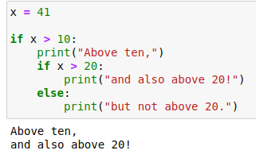
Nested if
If Statements

Slide 14
Loops

Slide 15
Loops: For Loop

Slide 16
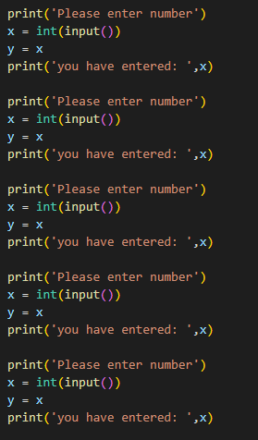
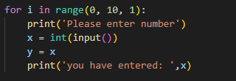
Why use loops?
Loops: For Loop

Slide 17
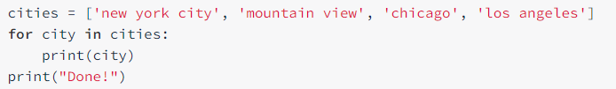
For city in cities :
Loops: For Loop
End of loop
For loop start index
Variable name
List to loop through

Slide 18
Loops: While Loop

Slide 19
A for loop is run a predefined number of times. Meaning, the number of times it has to be run is known before hand. But what if that number is not known?
Loops: While Loop

Slide 20
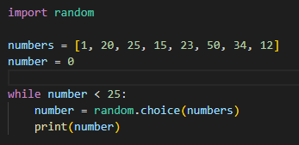

Loops: While Loop

Slide 21
Break, Continue

Slide 22
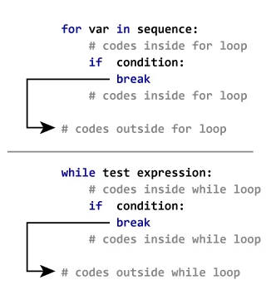
A break statement exits the loop without finishing the remaining epochs
Break, Continue

Slide 23
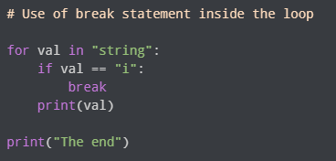
What is the expected output of this code?
Quiz

Slide 24

What is the expected output of this code?
Quiz

Slide 25
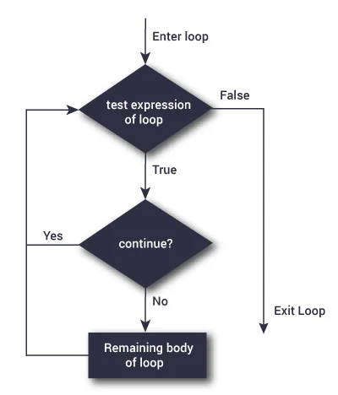
A continue statement skips just 1 epoch
Break, Continue

Slide 26
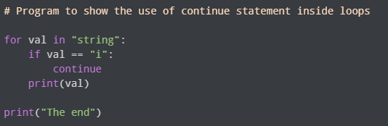
What is the expected output of this code?
Quiz

Slide 27
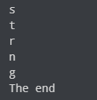
What is the expected output of this code?
Quiz

Slide 28
Break Time

Slide 29
Functions

Slide 30
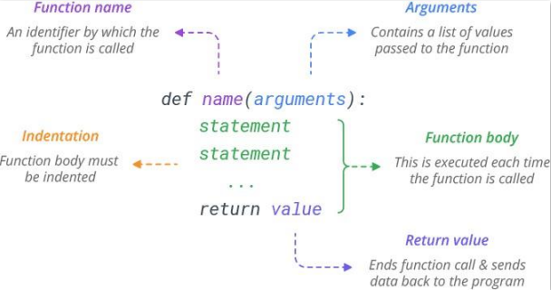
Functions
Functions are used to help organize and optimize code.
They break code down to smaller chunks, make it easier to write and easier to read.
A function can have multiple arguments or no arguments.
A function may or may not have a return statement

Slide 31

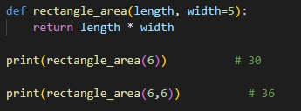
Default argument
Functions
An argument can have a default value

Slide 32

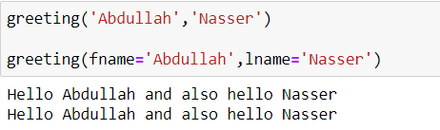
Function calling
Functions

Slide 33
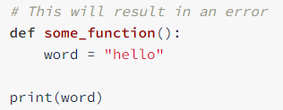
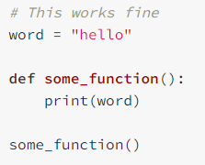
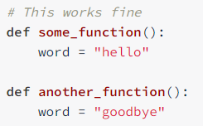
Variable scope
Functions

Slide 34
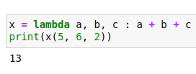
Lambda function
Functions

Slide 35
Task

Slide 36
Calculator
Functions
Create a calculator that performs addition, subtraction, division, multiplication
Your code should take the 2 operands and one of the 4 operations mentioned above

Slide 37
Any Questions?

Slide 38
Thank You

