Slide 1
Udacity Connect Session
Session 4

Slide 2
Content
Scripting
Try, Except
File Handling
OOP
Inheritance

Slide 3
Scripting

Slide 4
Running a python script
Scripting
Open the terminal
Navigate to the file location using cd
Write the following command ‘python file_name.py’

Slide 5

VS Code
Scripting
Download Vscode

Slide 6
Try, Except

Slide 7
Running a python script
Try, Except
Python has many built-in errors that are raised when your program encounters an error (something wrong in the program)
Exceptions examples

Slide 8
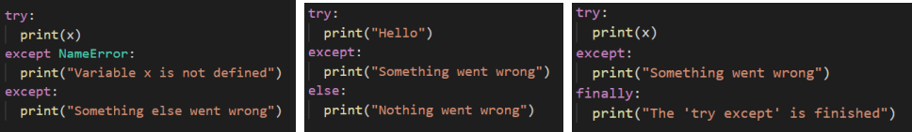
Try, Except
Try: Contains the main code block.
Except: Contains the action you want done when there is an error.
Else: Executes if there was no error.
Finally: Executes regardless there was an error or not.

Slide 9
Try, Except
When an error occurs, or exception as we call it, Python will normally stop and generate an error message.
The try block raises an error, the except block will be executed.
Without the try block, the program will crash and raise an error

Slide 10
File Handling

Slide 11
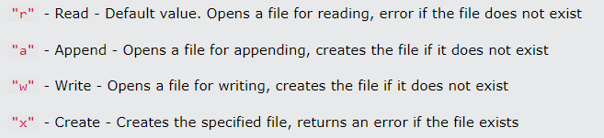
File Handling
With open(“file_path”, “r”) as f:

Slide 12
OOP

Slide 13
OOP
Python is an Object Oriented Programming (OOP) language
Almost everything in python is an object with its properties and methods.
A class is like a blueprint for creating object

Slide 14
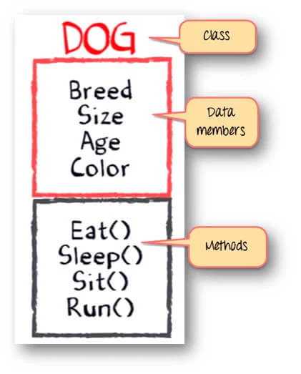
What is a class?
OOP
Attributes

Slide 15

Creating a class
OOP

Slide 16

Creating an object or instance of a class
OOP

Slide 17
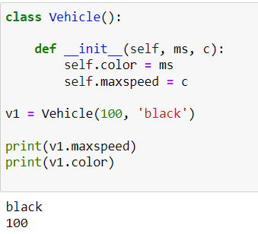
Constructor: __init__ function
OOP

Slide 18
OOP
So you can think of a class as a blueprint or an empty cup.
That is filled by different data with every object or instance created.

Slide 19
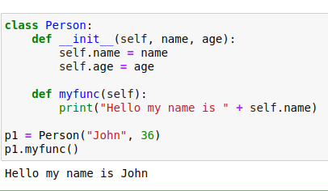
Object methods
OOP

Slide 20
Self keyword
OOP
Self is used as the first parameter in every method in a class
It is used to access the attributes and methods of the class
Doesn’t have to be named self, but it has to be the first parameter

Slide 21
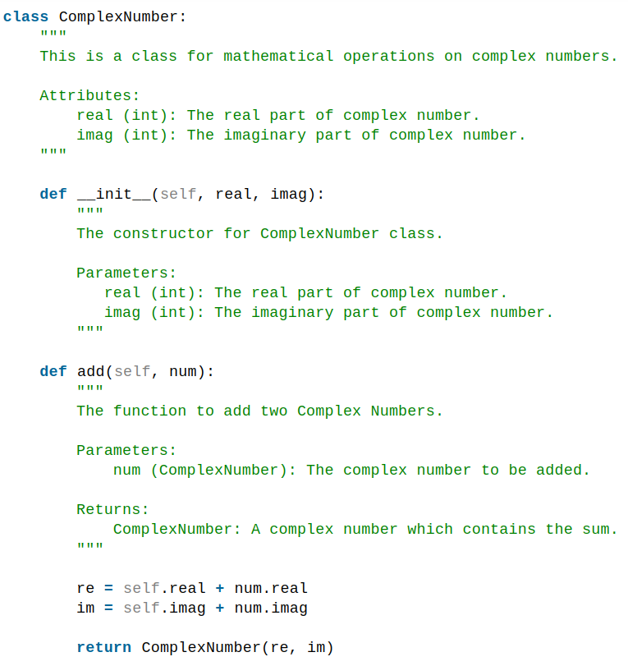
Doc strings
OOP
Always try to use doc strings, to make it easier for the person using the code later

Slide 22
Inheritance

Slide 23
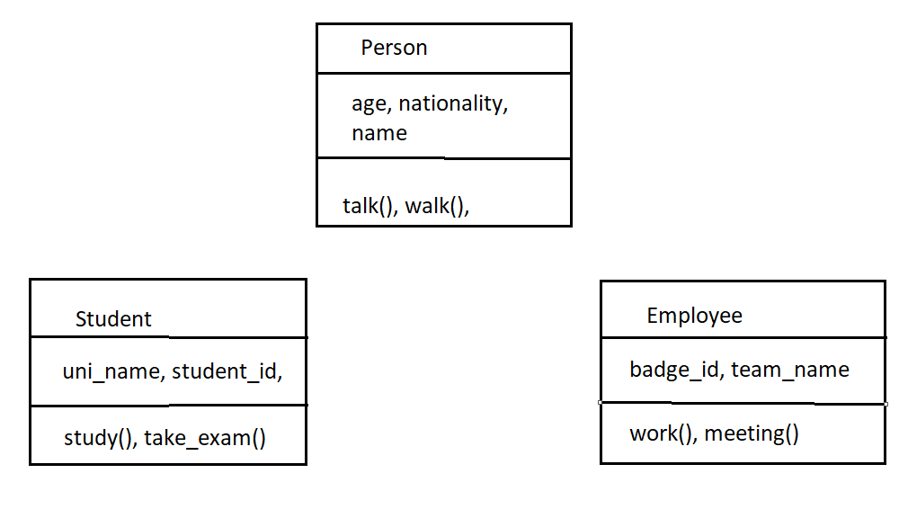
Inheritance

Slide 24
Inheritance
So inheritance is used to reduce code size and make things easier for developers
It allows us to inherit all the methods and properties of another class
Parent class is the class being inherited from
Child class is the class inheriting

Slide 25
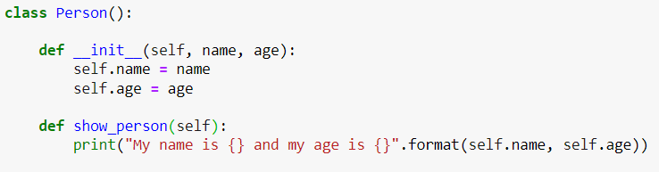
Creating a parent class
Inheritance

Slide 26
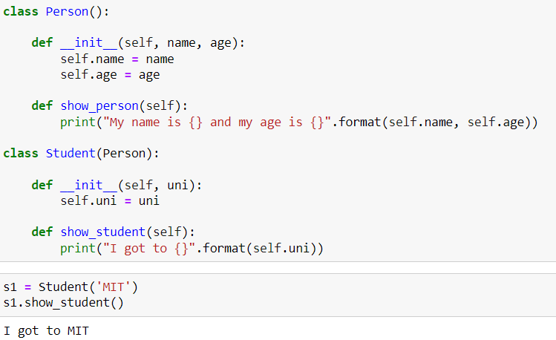
Creating a child class
Inheritance

Slide 27
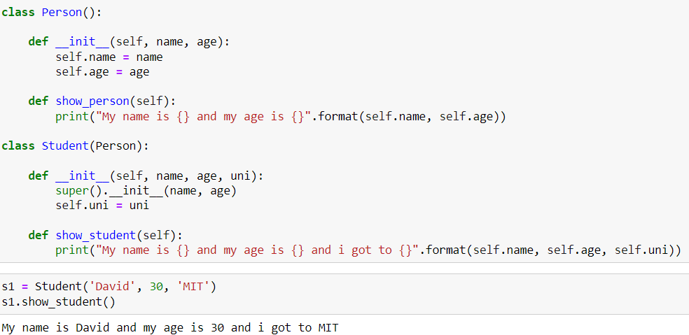
Super function
Inheritance

Slide 28
Break Time

Slide 29
Electronic Safe
Task
Create an electronic safe
Ask user wether he wants to register or login
If register then take username and password and save them
If login then take username and password and check if they are stored
If they are stored login, else ask user to register

Slide 30
Any Questions?

Slide 31
Thank You

