Slide 1
Udacity Connect Session
Session 6

Slide 2
Content
What Is a Data Analyst
Numpy

Slide 3
What Is a Data Analyst

Slide 4

What Is a Data Analyst
A data analyst is someone who uses data to answer questions
We will ask questions like:
What characteristics make a tumor more likely to be cancerous.

Slide 5


Where is data analysis used?
What Is Data Analysis
Netflix uses data analysis in its recommendation system
Facebook uses it in its news feed algorithm

Slide 6
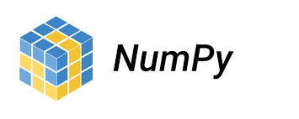


Commonly used libraries in data analysis
What Is Data Analysis
Numpy
Pandas
Matplotlib and Seaborn

Slide 7
Numpy

Slide 8
Numpy
NumPy is a Python package which stands for 'Numerical
Python’.
It is a library consisting of multidimensional array
objects and a collection of routines for processing of array.

Slide 9
Install numpy
Numpy
Use numpy

Slide 10

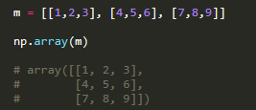
Creating Numpy array
Numpy
1D array
2D array

Slide 11

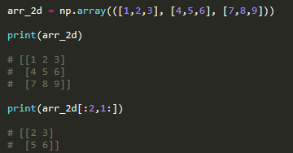
Indexing
Numpy
1D indexing
2D indexing

Slide 12
Common Numpy functions
Numpy
Max
Min
Average
Sum
Arange
Array
Power
Sqrt
Exp
log

Slide 13
Any Questions?

Slide 14
Thank You

