Slide 1
Udacity Connect Session
Session 7

Slide 2
Content
Data
Pandas
Creating a dataframe
Column manipulation
Row manipulation
Reading and saving tables

Slide 3
Data

Slide 4
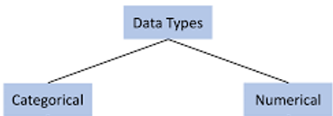
Numerical or Quantitive
Pandas
Data made of numbers:
Age.
Weight.
Number of children
Categorical or Qualitive
Data made of words:
Eye color
Gender
Blood type.

Slide 5
Pandas

Slide 6
Install Pandas
Pandas
Use Pandas

Slide 7
Creating Data Frames: From a list

Slide 8
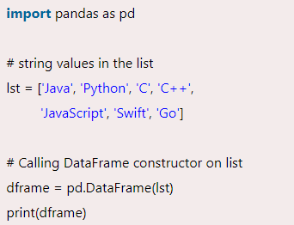
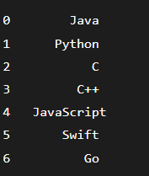
Creating a data frame from a list
Pandas

Slide 9
Creating Data Frames: With more than a column

Slide 10
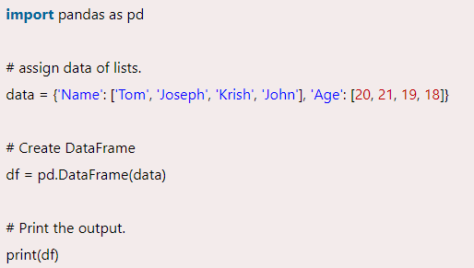
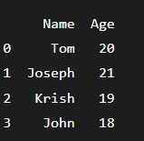
Creating a dataframe with more than 1 column
Pandas

Slide 11
Creating Data Frames: With a specified index and column

Slide 12
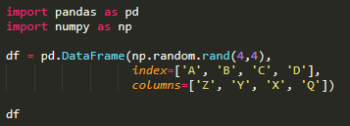
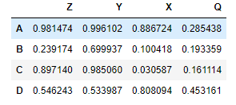
Creating a dataframe with specified index and column
Pandas

Slide 13
Pandas: Column manipulation

Slide 14
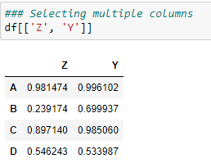
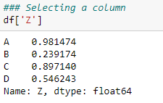
Selecting columns
Pandas

Slide 15
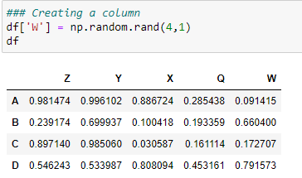
Creating columns
Pandas

Slide 16
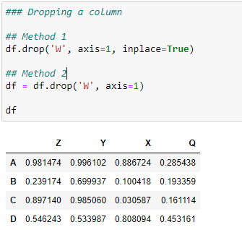
Dropping columns
Pandas

Slide 17
Pandas: Row manipulation

Slide 18
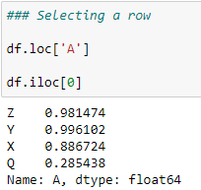
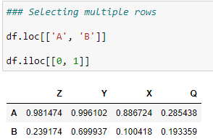
Selecting rows
Pandas

Slide 19
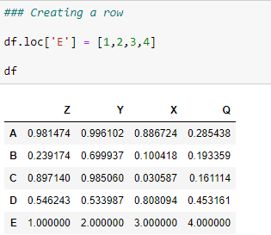
Creating rows
Pandas

Slide 20
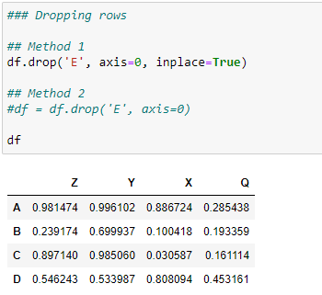
Dropping rows
Pandas

Slide 21
Pandas: Reading tables

Slide 22
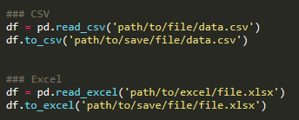
Reading and saving tables
Pandas

Slide 23
Missing Data

Slide 24

Missing Data
Check if data contains any missing data

Slide 25

Missing Data
Drop missing data

Slide 26
Missing Data
Fill missing data with mean

Slide 27
Common Pandas functions
Pandas
ons:
df.info()
df.head()
df.shape
df.corr()
len
df.dtypes
df.unique()
df.nunique()

Slide 28
Any Questions?

Slide 29
Thank You

