Slide 1
Udacity Connect Session
Session 8

Slide 2
Content
What Is Data Visualization
Seaborn and Matplotlib
Distribution Plots
Categorical Plots
Matrix Plots

Slide 3
What Is Data Visualization

Slide 4
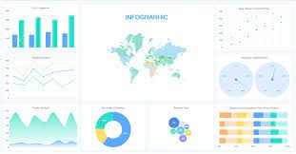
What Is Data Visualization
Data visualization is the graphical representation of information and data. By using visual elements like charts, graphs, and maps. Data visualization tools provide an accessible way to see and understand trends, outliers, and patterns in data.
Our eyes are drawn to colours and patterns. We can quickly identify red from blue, square from circle. Our culture is visual, including everything from art and advertisements to TV and movies.
Data visualization is another form of visual art that grabs our interest and keeps our eyes on the message

Slide 5
Seaborn and Matplotlib

Slide 6
Seaborn and Matplotlib
Seaborn and Matplotlib are two of Python's most powerful visualization libraries. Seaborn is built on top of matplotlib so it’s more like a wrapper. Seaborn uses fewer syntax and has stunning default themes and Matplotlib is more easily customizable through accessing the classes.

Slide 7


Install
Seaborn and Matplotlib
Use

Slide 8
Distribution Plots

Slide 9
Distribution Plots
Distribution Plots:
Univariant Plots:
1) distplot
2) kdeplot
Bivariant Plots:
1)pairplot

Slide 10
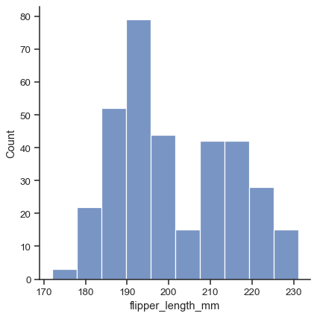
Distribution Plots
Distributon Plots:
Univariant Plots:
1) distplot
2) kdeplot
Bivariant Plots:
1)pairplot

Slide 11
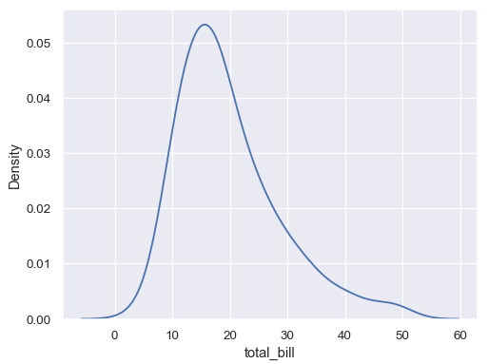

Distribution Plots
Distributon Plots:
Univariant Plots:
1) distplot
2) kdeplot
Bivariant Plots:
1)pairplot

Slide 12
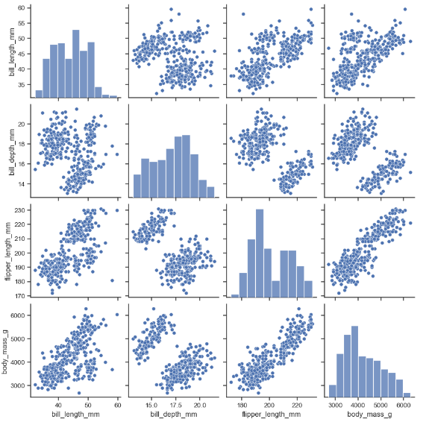
Distribution Plots
Distributon Plots:
Univariant Plots:
1) distplot
2) kdeplot
Bivariant Plots:
1)pairplot

Slide 13
Categorical Plots

Slide 14
Categorical Plots
Categorical Plots:
Categorical Distribution Plots:
1) boxplot
2) violinplot
categorical Scatter Plots:
1) swarmplot
Categorical Estimate Plots:
3) countplot

Slide 15
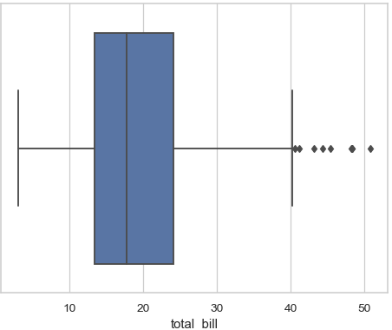

Categorical Plots
Categorical Plots:
Categorical Distribution Plots:
1) boxplot
2) violinplot
categorical Scatter Plots:
1) swarmplot
Categorical Estimate Plots:
3) countplot

Slide 16
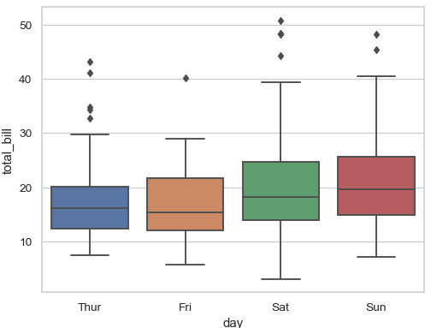

Categorical Plots
Categorical Plots:
Categorical Distribution Plots:
1) boxplot
2) violinplot
categorical Scatter Plots:
1) swarmplot
Categorical Estimate Plots:
3) countplot

Slide 17
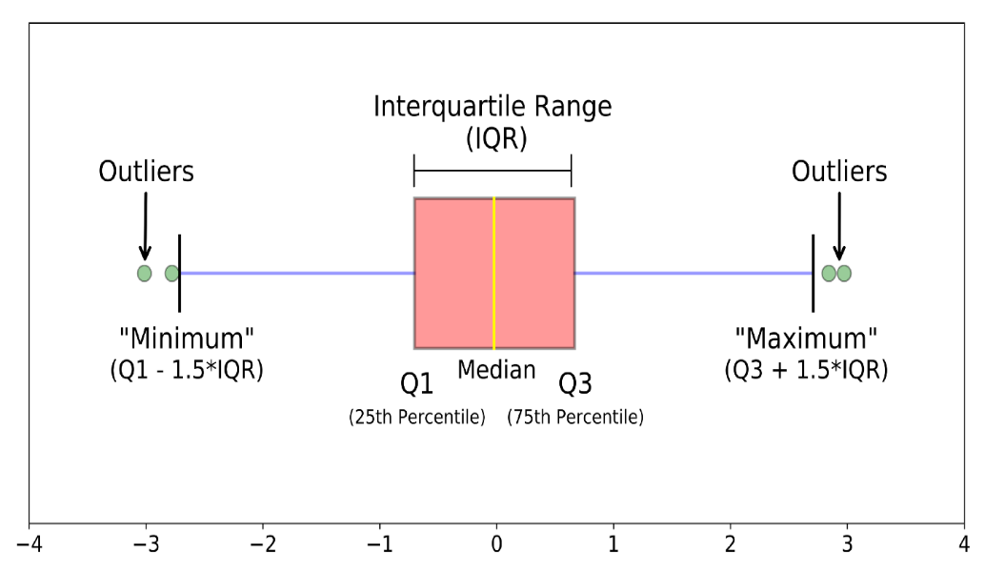
Categorical Plots
What is boxplot?
A boxplot is a standardized way of displaying the distribution of data based on a five number summary (“minimum”, first quartile (Q1), median, third quartile (Q3), and “maximum”).
It can tell you about your outliers and what their values are. It can also tell you if your data is symmetrical, how tightly your data is grouped, and if and how your data is skewed.

Slide 18
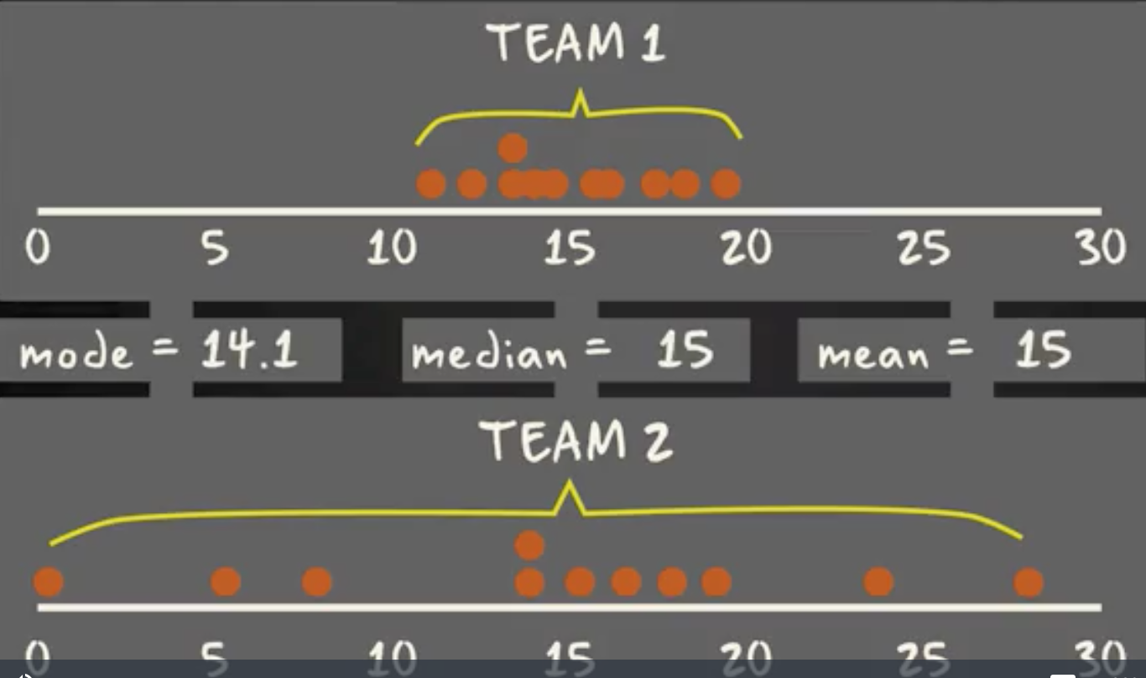
Categorical Plots
Same mode, mean and median
But different distribution

Slide 19
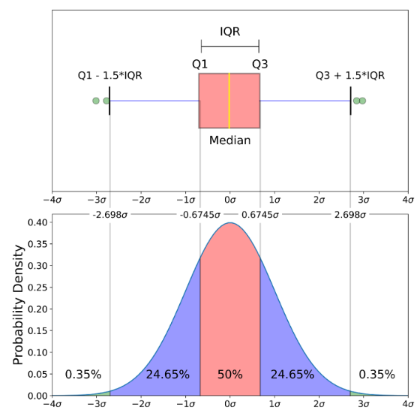
Categorical Plots

Slide 20
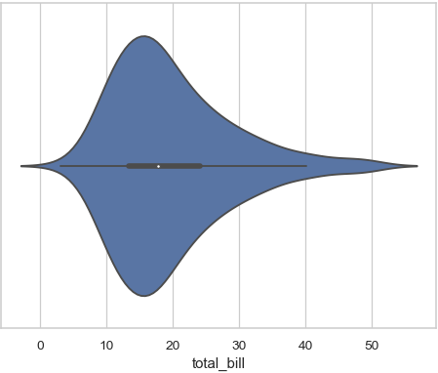
Categorical Plots
Categorical Plots:
Categorical Distribution Plots:
1) boxplot
2) violinplot
categorical Scatter Plots:
1) swarmplot
Categorical Estimate Plots:
3) countplot

Slide 21
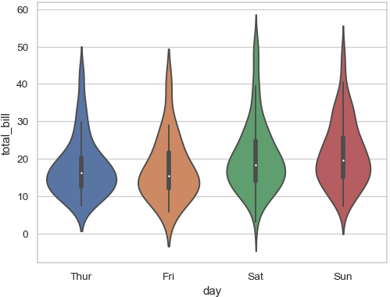

Categorical Plots
Categorical Plots:
Categorical Distribution Plots:
1) boxplot
2) violinplot
categorical Scatter Plots:
1) swarmplot
Categorical Estimate Plots:
3) countplot

Slide 22
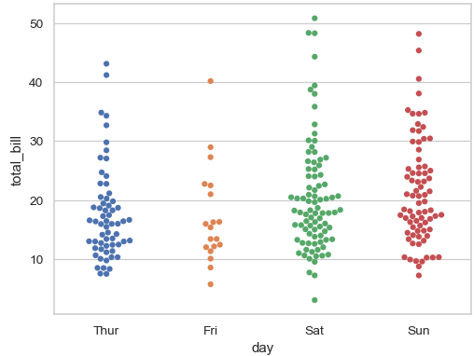

Categorical Plots
Categorical Plots:
Categorical Distribution Plots:
1) boxplot
2) violinplot
categorical Scatter Plots:
1) swarmplot
Categorical Estimate Plots:
3) countplot

Slide 23
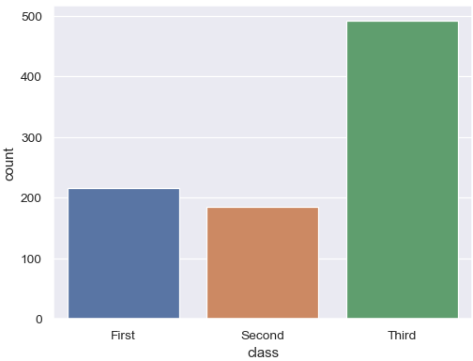

Categorical Plots
Categorical Plots:
Categorical Distribution Plots:
1) boxplot
2) violinplot
categorical Scatter Plots:
1) swarmplot
Categorical Estimate Plots:
3) countplot

Slide 24
Matrix Plots

Slide 25
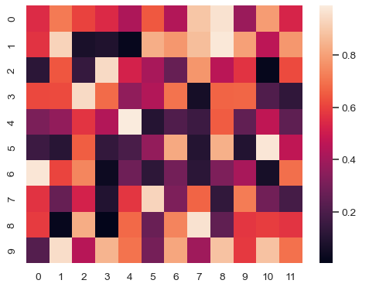
Matrix Plots
Matrix Plots:
Heat map

Slide 26
Thank You

