Slide 1
Udacity Connect Session
Session 9

Slide 2
Content
Vectors
Linear Combination

Slide 3
Vectors

Slide 4
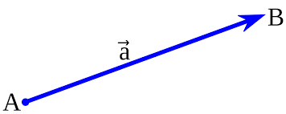
Vector:
Vectors
Is an object that has both a magnitude and a direction

Slide 5
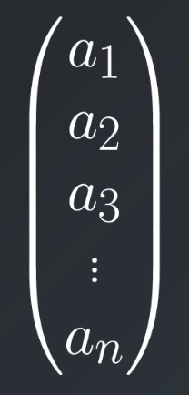
Vectors
You can also think of vectors as an ordered list of numbers

Slide 6


Vector magnitude
Vectors
X
Y

Slide 7


Vector direction
Vectors
X
Y

Slide 8
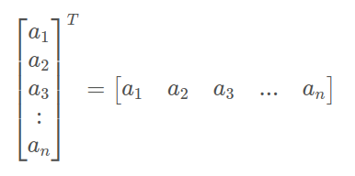
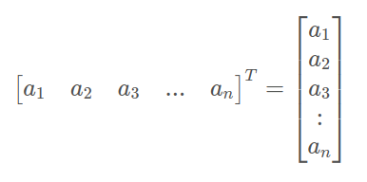
Vector Transpose
Vectors

Slide 9
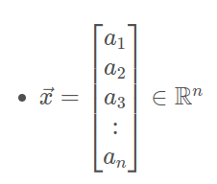
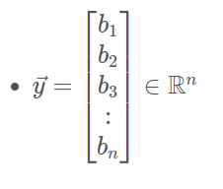
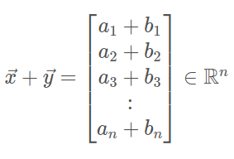
Vector Addition
Vectors

Slide 10
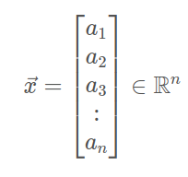

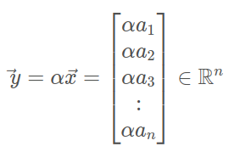
Vector Multiplication to a constant
Vectors
Constant number

Slide 11
Linear Combination

Slide 12

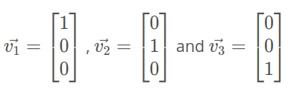
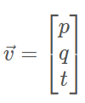
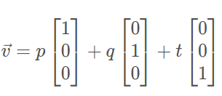
Linear Combination
Linear Combination
is the multiplication of a scalar to a variable and addition of those terms

Slide 13
Linear Span

Slide 14
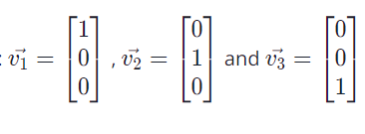


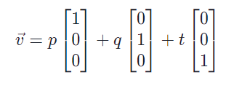
Linear Span
Linear Span
the set of all possible linear combinations of those vectors

Slide 15
Linear Dependency

Slide 16
Linear Dependency
Linear Dependency
When one vector can be defined as a linear combination of the other vectors, they are a set of linearly dependent vectors.
When each vector in a set of vectors vector can not be defined as a linear combination of the other vectors, they are a set of linearly independent vectors.

Slide 17
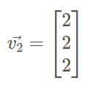
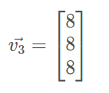


Linear Dependency
Linear Combination

Slide 18
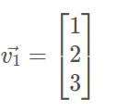

Linear Dependency
Linear Combination

Slide 19
Any Questions?

Slide 20
Thank You

