Slide 1


Introducing stipw: inverse probability weighted parametric survival models
@Micki_Hill
10.09.2021
UK Stata Conference 2021
Micki Hill¹
PC Lambert^{1,2} and MJ Crowther²
¹University of Leicester; Leicester (UK), ²Karolinska Institutet; Stockholm (Sweden)
stipw (logit tvar tmvarlist [, tmoptions]) [if] [in] , d(distname) [options]

Slide 2
Contents
Background
Inverse probability weighting (IPW)
Point estimation
Methods and Stata code
Variance estimation
Robust, bootstrapping and M-estimation
stipw
Algorithm, syntax and example code and output
Conclusion
Recommendations with stipw

Slide 3
Inverse Probability Weighting (IPW)
Randomized Trials
Treatment allocation is random.
Observational studies
Treatment allocation may depend on patient factors. How much of the difference in treatment groups is due to the treatment or the confounders?
Solution
Inverse probability weighting to remove confounding.
Survival setting
Time to an event, where events may be censored.

Slide 4



Inverse Probability Weighting (IPW)
What is it?
A method to remove confounding resulting in a pseudo-population where treatment is independent of the measured confounders.
Why is it used?
To obtain causal estimates.
Give larger weights to individuals less likely to have their treatment, given the confounder values.

Slide 5
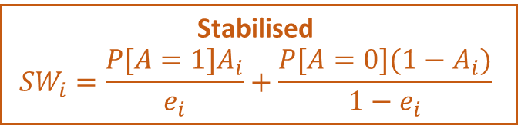

How do you perform an IPW analysis?
Model treatment
Model treatment/exposure variable against the measured confounders, e.g. using logistic regression.
Calculate the weights
Propensity score: $e_{i}=P[A=1|X_{i}]$
Unstabilised
$${UW}_{i}=\frac{A_{i}}{e_{i}}+\frac{1−A_{i}}{1−e_{i}}$$
Stabilised
$${SW}_{i}=\frac{{P[A=1]A}_{i}}{e_{i}}+\frac{P[A=0](1−A_{i})}{1−e_{i}}$$
Model outcome
Fit a survival model to the weighted data with treatment/exposure as the only covariate.
Estimate variance
Robust
Bootstrapping
M-estimation

Slide 6
How do you do it in Stata?
Load the data
webuse brcancer, clear
rename hormon h
Model treatment
logit h x1 x2 x3 x5 x6 x7
Calculate the weights
predict ps, pr
Unstabilised: gen double uw = h/ps + (1-h)/(1-ps)
Stabilised: sum h, meanonly
local ph = r(mean)
gen double sw = `ph’*h/ps + (1-`ph’)*(1-h)/(1-ps)
Model outcome
stset rectime [pw = sw], f(censrec==1) streg h, distribution(weibull)
Estimate variance
Robust
Bootstrapping
M-estimation

Slide 7

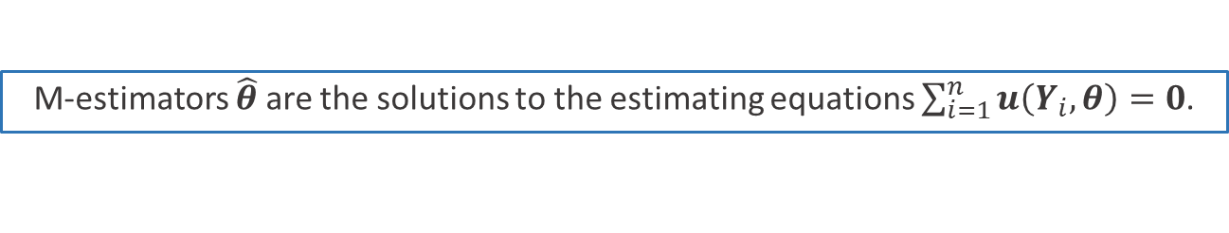
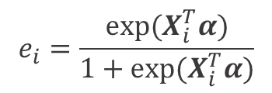
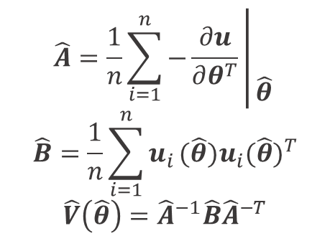
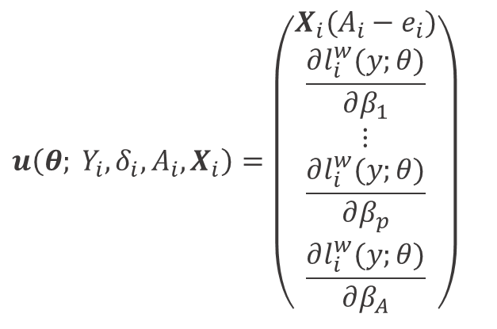
M-estimation
Stefanski and Boos 2002
Williamson et al 2014
M-estimators $\hat{θ}$ are the solutions to the estimating equations $\sum_{i=1}^{n}{u\left(Y_{i},θ\right)=0}$.
Score function
Variance estimator
Logistic regression treatment model
$$u\left(θ; Y_{i},δ_{i},A_{i},X_{i}\right)=\left(\begin{matrix}X_{i}(A_{i}−e_{i}) \\ \frac{∂l_{i}^{w}(y;θ)}{∂β_{1}} \\ \begin{matrix}⋮ \\ \frac{∂l_{i}^{w}(y;θ)}{∂β_{p}} \\ \frac{∂l_{i}^{w}(y;θ)}{∂β_{A}}\end{matrix}\end{matrix}\right)$$
$$\hat{A}=\frac{1}{n}\sum_{i=1}^{n}{−\frac{∂u}{∂θ^{T}}\left|\begin{matrix} \\ \\ \hat{θ}\end{matrix}\right.}$$
$$\hat{B}=\frac{1}{n}\sum_{i=1}^{n}{u_{i}}(\hat{θ})u_{i}{(\hat{θ})}^{T}$$
$$\hat{V}\left(\hat{θ}\right)={\hat{A}}^{−1}\hat{B}{\hat{A}}^{−T}$$
$$α, β,β_{A}$$
Weighted log-likelihoood
Parametric survival model
$$e_{i}=\frac{exp(X_{i}^{T}α)}{1+exp(X_{i}^{T}α)}$$

Slide 8
Introducing stipw
Stefanski and Boos 2002
Williamson et al 2014
Motivation
Robust variances can be conservative (Austin 2016).
Bootstrap variances can be computationally intensive (large datasets) and depends on starting seed.
Closed form variance estimators have been provided for the Cox model in R using linearisation (Hajage et al 2018) and M-estimation (Shu et al 2020).
Goal
To create a program that performs IPW on survival data and provide a closed form variance estimator using M-estimation for parametric models.
stteffects
stteffects facilitates IPW in Stata for survival data. However, censoring weights must be used to address censored times and only certain effect measures (ATE, ATT and PO means) are given.
Notes:
* Mention conceptionally extrapolating through upweighting time.

Slide 9
stipw Algorithm
Data must already be stset
Excludes missing
Any observations with missing treatment values, confounder values or _st = 0 are excluded.
_stipw_flag
Model treatment
Uses logit to model treatment against confounders.
(SW): Uses logit to model treatment (no confounders).
Calculate the weights
Calculates the weights as previously.
_stipw_weight
Model outcome
Resets the data with weights (preserves the original stset). Fits the survival model using streg or stpm2 with treatment as the only covariate.
Estimate variance
Uses Mata to calculate the M-estimation variance estimator. The stored variance estimates are updated.

Slide 10
Treatment model options: e.g. noconstant,
offset(varname)
stpm2 options: e.g. df(#),
dftvc(#), knots(numlist), knotstvc(numlist)
exponential
weibull
gompertz
lognormal
loglogistic
rp
Binary, fixed treatment variable
stipw (logit tvar tmvarlist [, tmoptions]) [if] [in] , d(distname) [options]
streg options: ancillary
vce(vcetype)
ipwtype(string)
genweight(newvar)
genflag(newvar)
stsetupdate
Reporting options: e.g. level(#),
noheader
List of confounder variables (minimum 1)

Slide 11
Previous example with stipw
Previous
Using stipw
logit h x1 x2 x3 x5 x6 x7
predict ps, pr
gen double uw = h/ps + (1-h)/(1-ps)
stset rectime [pw = uw], f(censrec==1)
streg h, distribution(weibull)
stset rectime , f(censrec==1)
stipw (logit h x1 x2 x3 x5 x6 x7), distribution(weibull) ipwtype(unstabilised) vce(robust)
Unstabilised
logit h x1 x2 x3 x5 x6 x7
predict ps, pr
sum h, meanonly
local ph = r(mean)
gen double sw = `ph’*h/ps +
(1-`ph’)*(1-h)/(1-ps)
stset rectime [pw = uw], f(censrec==1)
streg h, distribution(weibull)
stset rectime , f(censrec==1)
stipw (logit h x1 x2 x3 x5 x6 x7), distribution(weibull) ipwtype(stabilised) vce(robust)
Stabilised
The main reason to use stipw is calculate the variance using M-estimation, which appropriately takes into account that the weights are estimated and not known exactly.

Slide 12
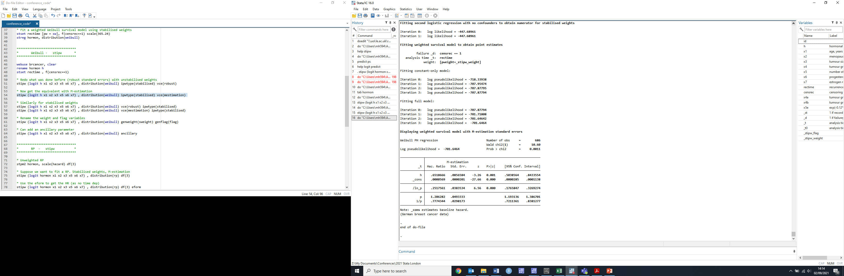
stipw: Weibull
stipw (logit h x1 x2 x3 x5 x6 x7) , distribution(weibull)
stipw (logit h x1 x2 x3 x5 x6 x7) , distribution(weibull) ipwtype(stabilised) vce(mestimation)

Slide 13
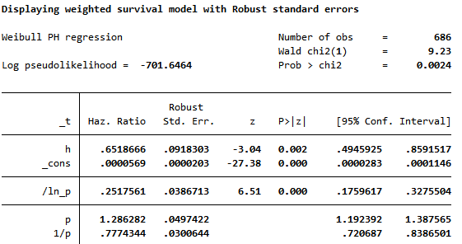

Slide 14
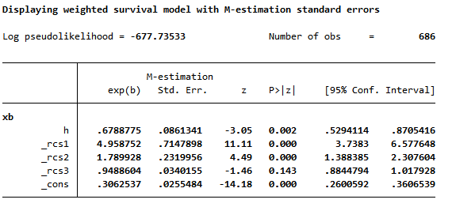
stipw: Royston-Parmar
Royston and Parmar 2002
Lambert and Royston 2009
stpm2 h, scale(hazard) df(3) eform
stipw (logit h x1 x2 x3 x5 x6 x7) , distribution(rp) df(3) eform

Slide 15
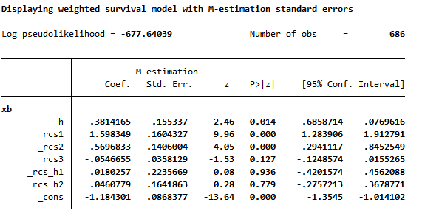
stipw: Royston-Parmar
stpm2 h, scale(hazard) df(3) tvc(h) dftvc(2)
stipw (logit h x1 x2 x3 x5 x6 x7) , distribution(rp) df(3) dftvc(2)

Slide 16
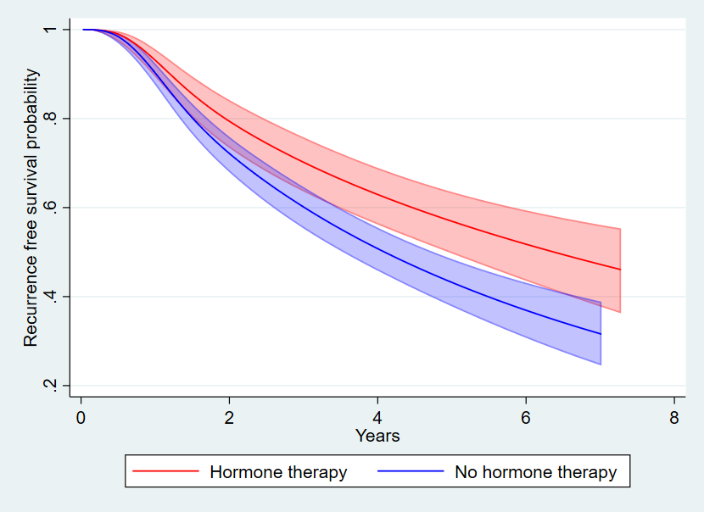
Predictions after stipw
stipw (logit h x1 x2 x3 x5 x6 x7) , distribution(rp) df(3) dftvc(2)
Marginal recurrence free survival probabilities in each group
predict recsurv, survival ci

Slide 17

Predictions after stipw
stipw (logit h x1 x2 x3 x5 x6 x7) , distribution(rp) df(3) dftvc(2)
Marginal restricted mean survival time (RMST) in hormone therapy group at 6 years
predict rmst1 in 1, at(h 1) rmst stdp tmax(6)
Marginal RMST in the non-hormone therapy group at 6 years
predict rmst0 in 1, at(h 0) rmst stdp tmax(6)
Difference in marginal RMST at 6 years
predictnl drmst = predict(rmst at(h 1) tmax(6)) - predict(rmst at(h 0) tmax(6)) in 1, se(drmst_se)
list rmst1* rmst0* drmst* in 1

Slide 18
Conclusion
The stipw package facilitates IPW with survival data and allows the user to calculate robust or M-estimation standard errors. M-estimation appropriately takes into account that weights are estimated.
The variance of a wide range of causal effects can be estimated using the M-estimation variance estimator. This is done using standard post-estimation commands, as the stored variance estimates are updated.
We recommend stipw for large datasets, where treatment prevalence is common and when bootstrapping may be too computationally intensive.
Extensions to stipw could include different treatment models (e.g. probit), adding the Cox model, different types of weights (Mao et al 2018), clustered data, competing risks and more.
@Micki_Hill
mh594@le.ac.uk
Notes:
* Compare paragraph 2 to stteffects

Slide 19
References
Austin PC. Variance estimation when using inverse probability of treatment weighting (IPTW) with survival analysis. Statistics in Medicine. 2016;35(30):5642-55.
Hajage D, Chauvet G, Belin L, Lafourcade A, Tubach F, De Rycke Y. Closed‐form variance estimator for weighted propensity score estimators with survival outcome. Biometrical Journal. 2018;60(6):1151-63.
Lambert PC, Royston P. Further development of flexible parametric models for survival analysis. The Stata Journal. 2009;9(2):265-90.
Mao H, Li L, Yang W, Shen Y. On the propensity score weighting analysis with survival outcome: Estimands, estimation, and inference. Statistics in medicine. 2018;37(26):3745-63.
Royston P, Parmar MKB. Flexible parametric proportional‐hazards and proportional‐odds models for censored survival data, with application to prognostic modelling and estimation of treatment effects. Statistics in Medicine. 2002;21(15):2175-97.
Shu D, Young JG, Toh S, Wang R. Variance estimation in inverse probability weighted Cox models. Biometrics. 2020.
Stefanski LA, Boos DD. The calculus of M-estimation. The American Statistician. 2002;56(1):29-38.
Williamson EJ, Forbes A, White IR. Variance reduction in randomised trials by inverse probability weighting using the propensity score. Statistics in Medicine. 2014;33(5):721-37.

