Slide 1

Time-Variant Propagation Channel Simulation and Rice Factor Estimation
Internship presentation
Mikael Franco – LiU intern / IMT Atlantique student

Slide 2
Contents
Context
Elaboration of a time varying urban channel simulator
Estimation of the Rice factor

Slide 3
Context

Slide 4
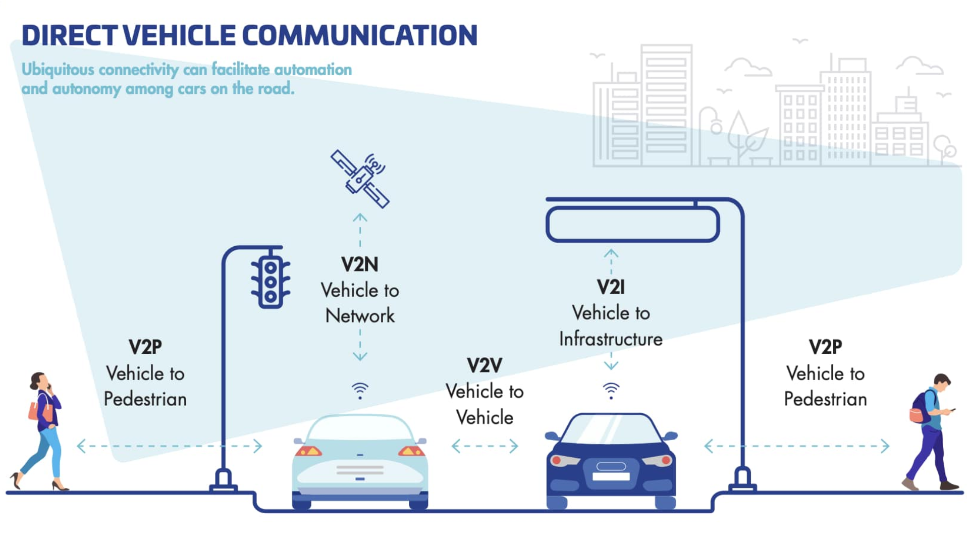
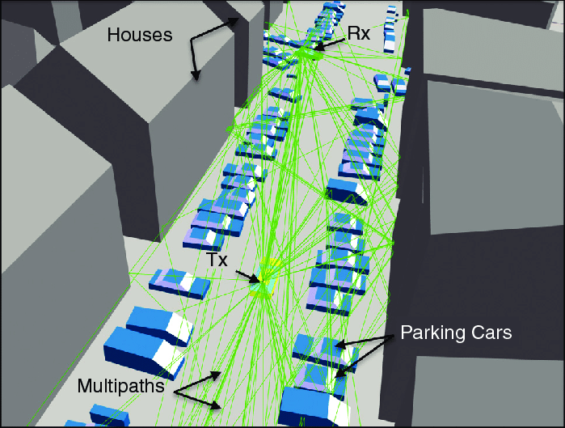
Context
V2I & V2V communication

Slide 5
Elaboration of a time varying urban channel simulator

Slide 6
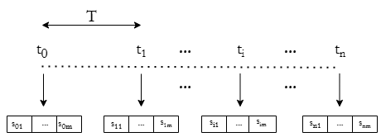
Temporality of the simulation
A sample: A channel expression
For each sample: N-size vector of received signal (filtered by the channel)

Slide 7
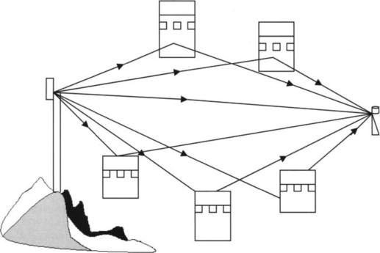
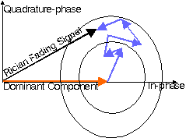
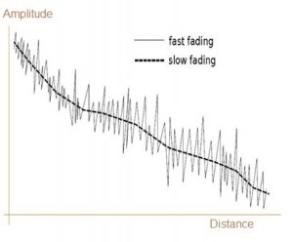
Rice factor definition

Slide 8
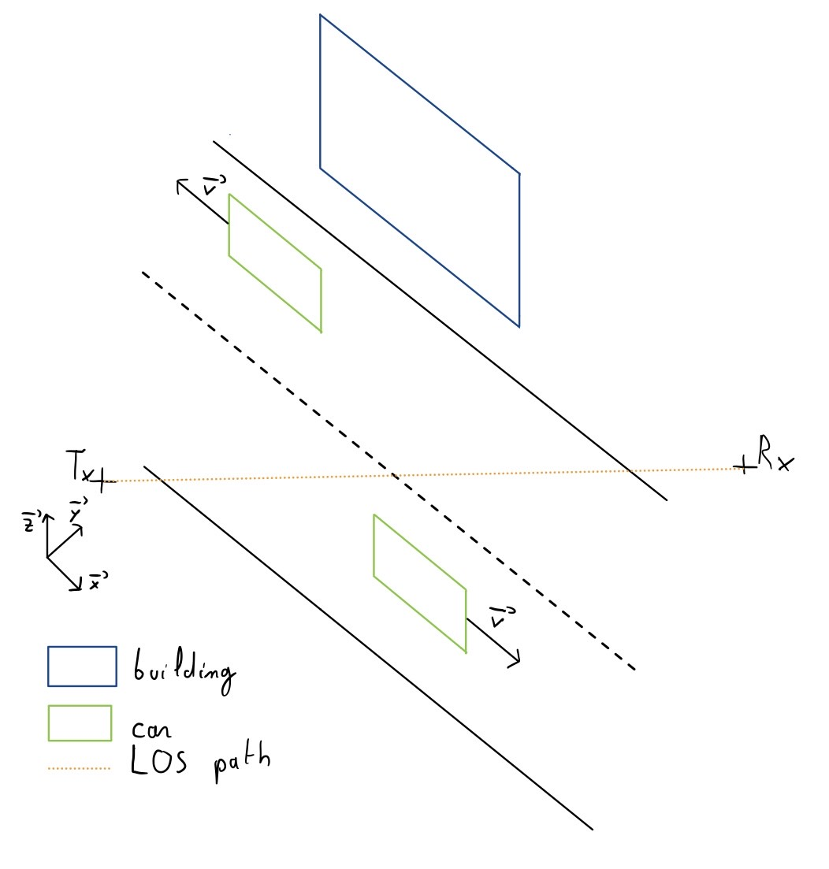
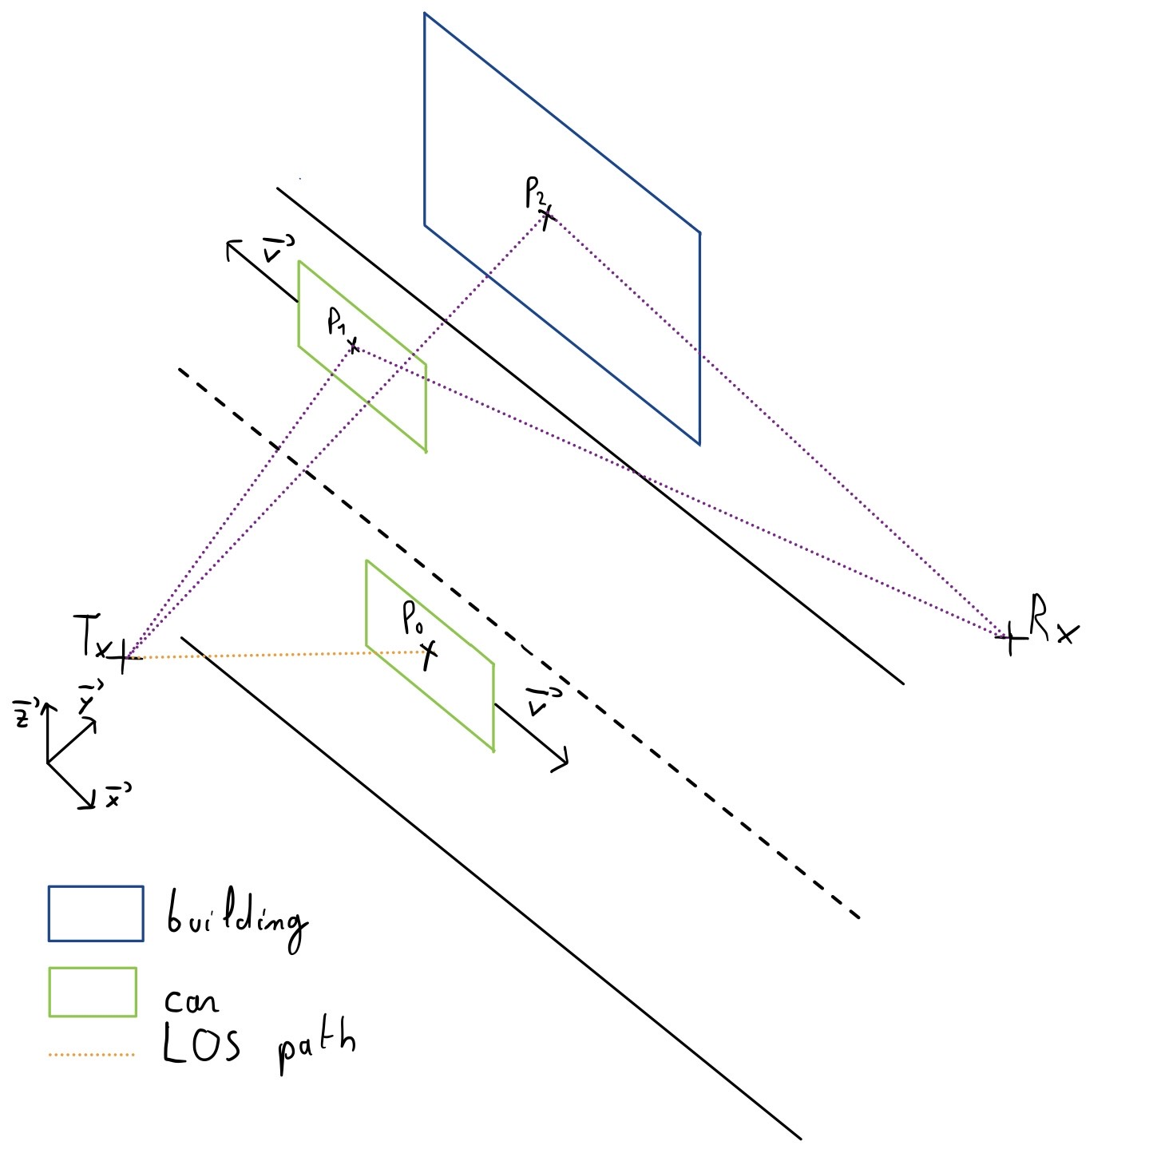
Modelisation of urban conditions

Slide 9
Calculus of multipaths components
FPSL
Delay,
K factor etc
Atténuation des multipaths

Slide 10
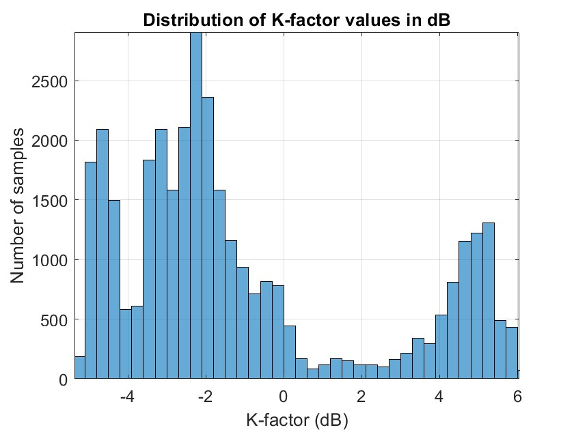
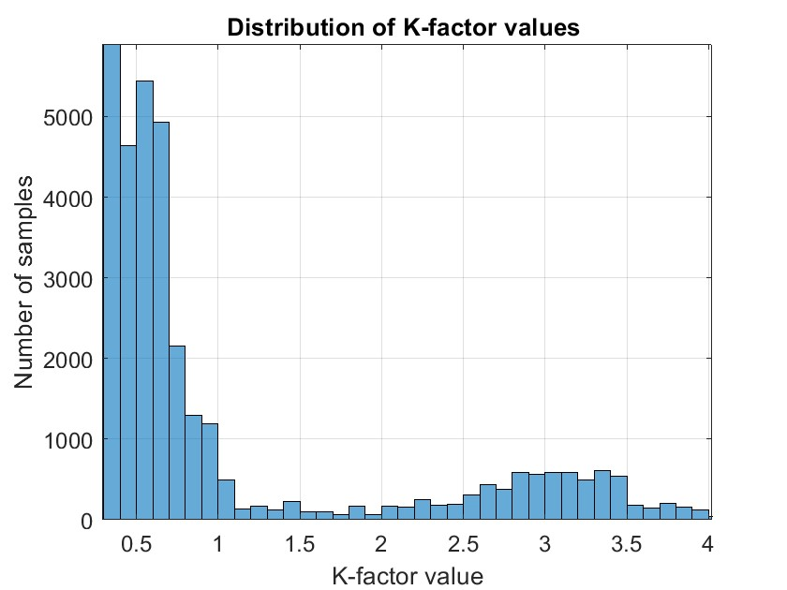

Slide 11
Estimation of the Rice factor

Slide 12
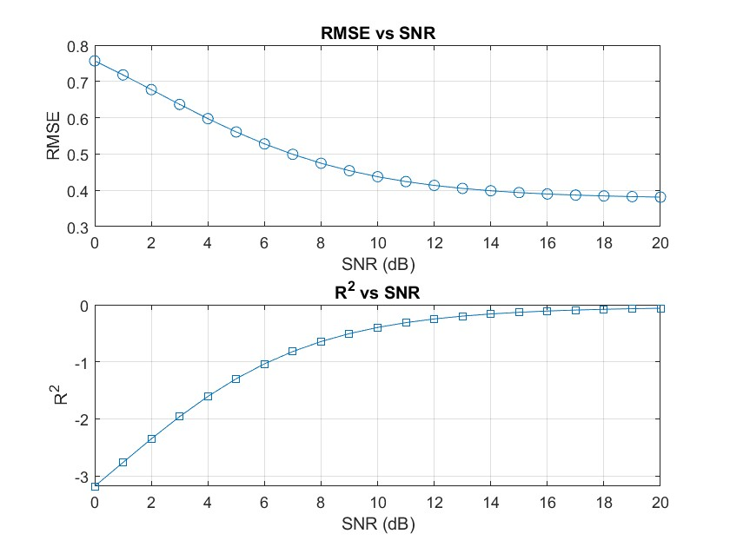
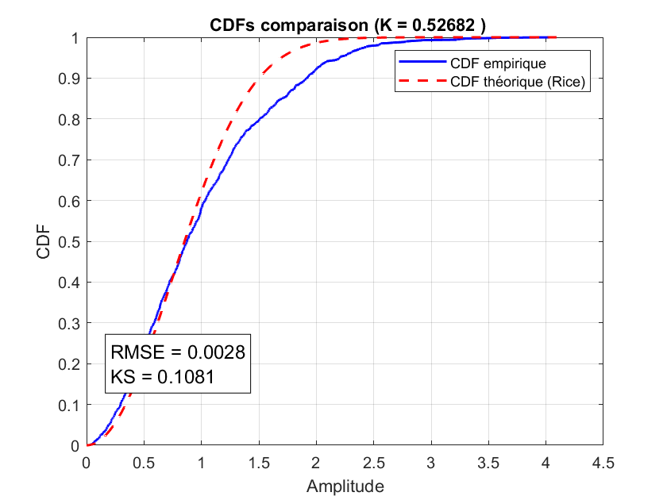
Statistical estimation

Slide 13
NN Network definition
Definition d’un perceptron

Slide 14
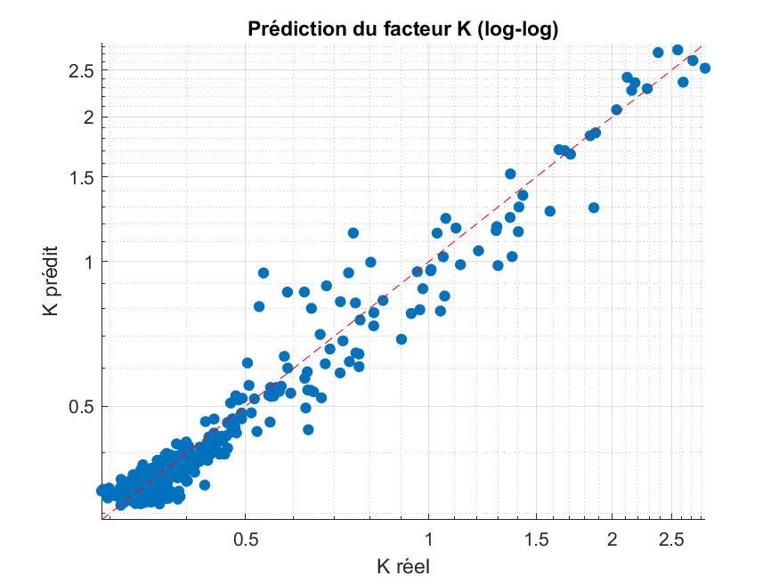
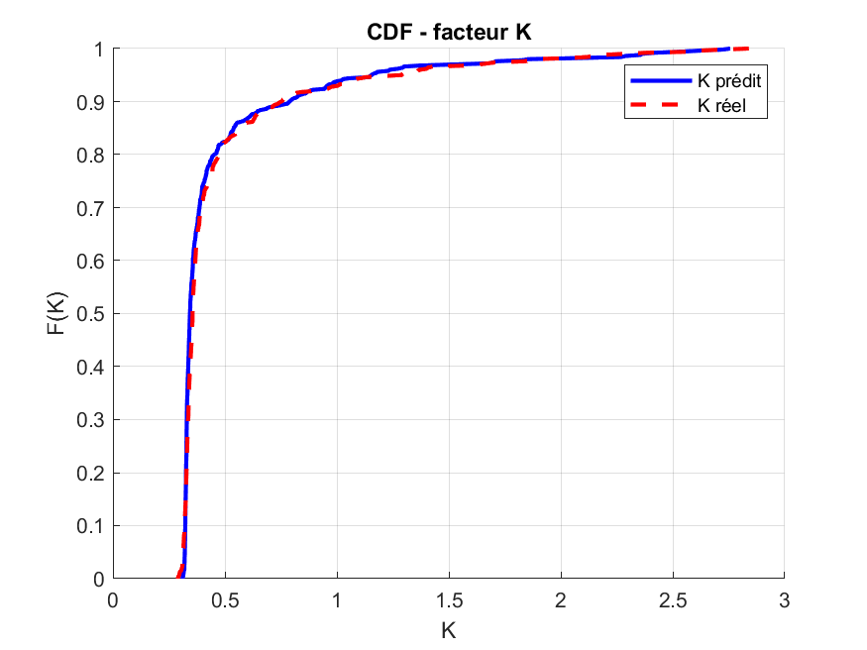
NN Estimation + comparaison avec une linear regression (CDF + Scatter plot)

Slide 15
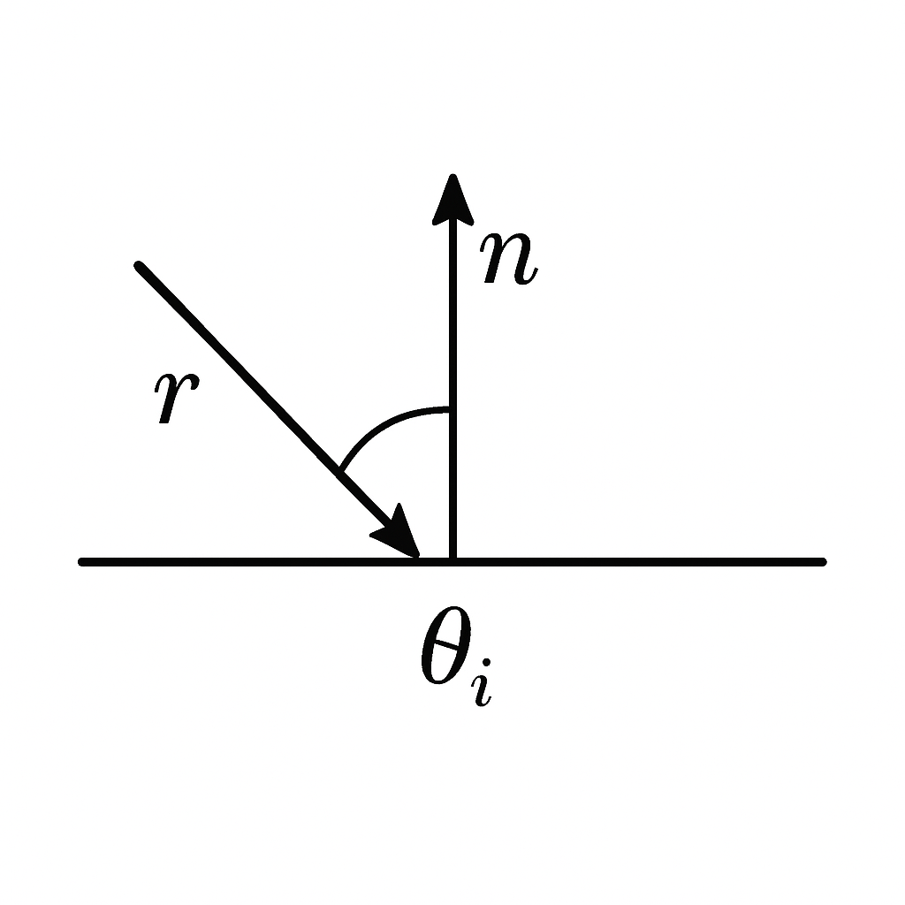
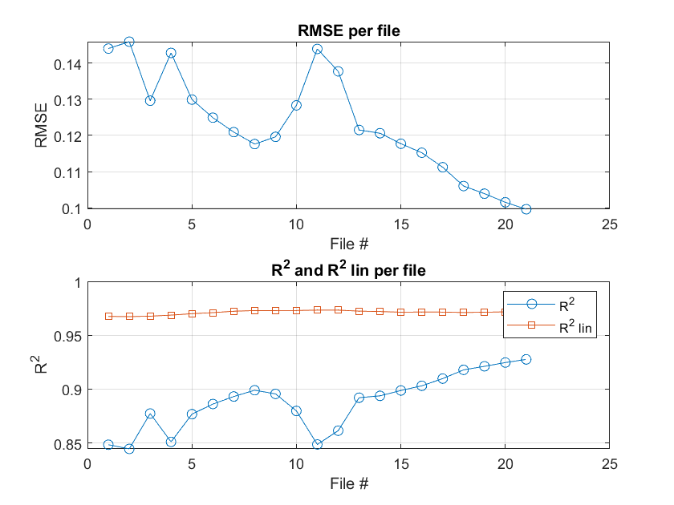

Slide 16
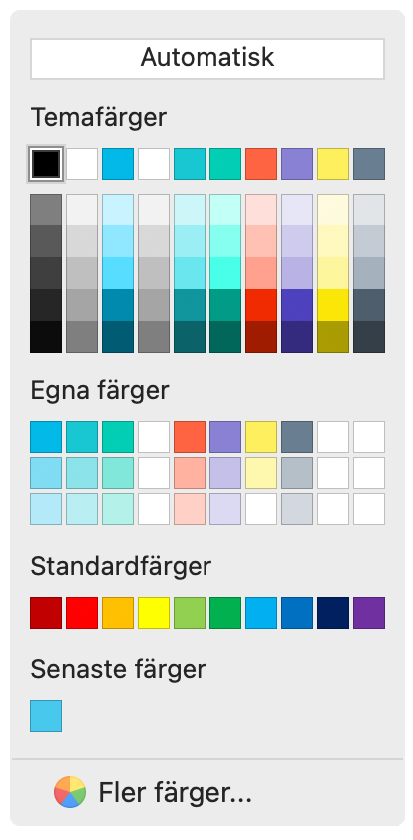
The LiU colours
100%
50%
30%
Base colours
Accent colours

Slide 17
Find out about the LiU graphic profile on Liunet
liuonline.sharepoint.com

