Slide 1
Crypto Tools
By: Momopranto Amin, Viola Rreza, Sean Wang

Slide 2
Cryptographic Protocol
Alice encrypts her message using a GUI
can choose between multiple encryption schemes and hash functions
GUI returns ciphertext
Alice can send ciphertext to Bob through text or email
Alice also mentions some other important information
Bob uses same GUI to decrypt Alice’s message

Slide 3
Options
Hash
MD5
SHA
SHA1, SHA224, SHA256, SHA384, SHA512
Symmetric
AES
CTR, ECB, OFB, CBC
DES

Slide 4
User Input
take the user’s input such as:
designated number of bits (for key generator)
key (copied and pasted from key generator offered by GUI)
choice of mode for encryption scheme (Ex: choose between CTR, ECB, OFB, CBC for AES)
plaintext message (for encrypt)
ciphertext message (for decrypt)

Slide 5
Backend Code
process user’s input
make calls to PyCrypto to obtain high-level functions along with their primitives
rendered output to front end
incorporate back-end code into GUI functionality

Slide 6
Hashing Functions
user inputs message
chooses which version (for SHA)
code makes call to necessary hash function from library
resulting hash is returned to user

Slide 7
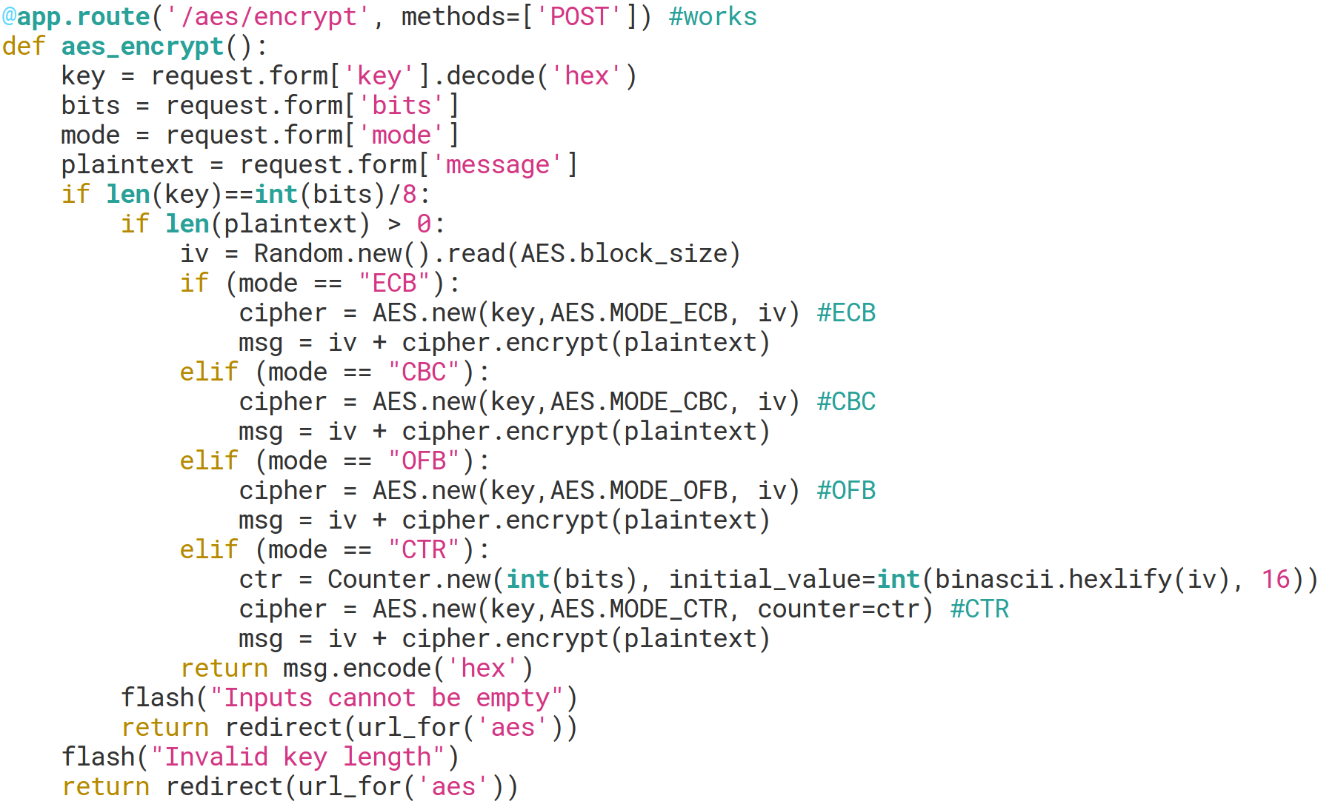
Encryption (ex: AES)
create AES object
create random Initialization Vector (IV)
using IV, message, mode choice, and the generated key
call encrypt on AES object

Slide 8
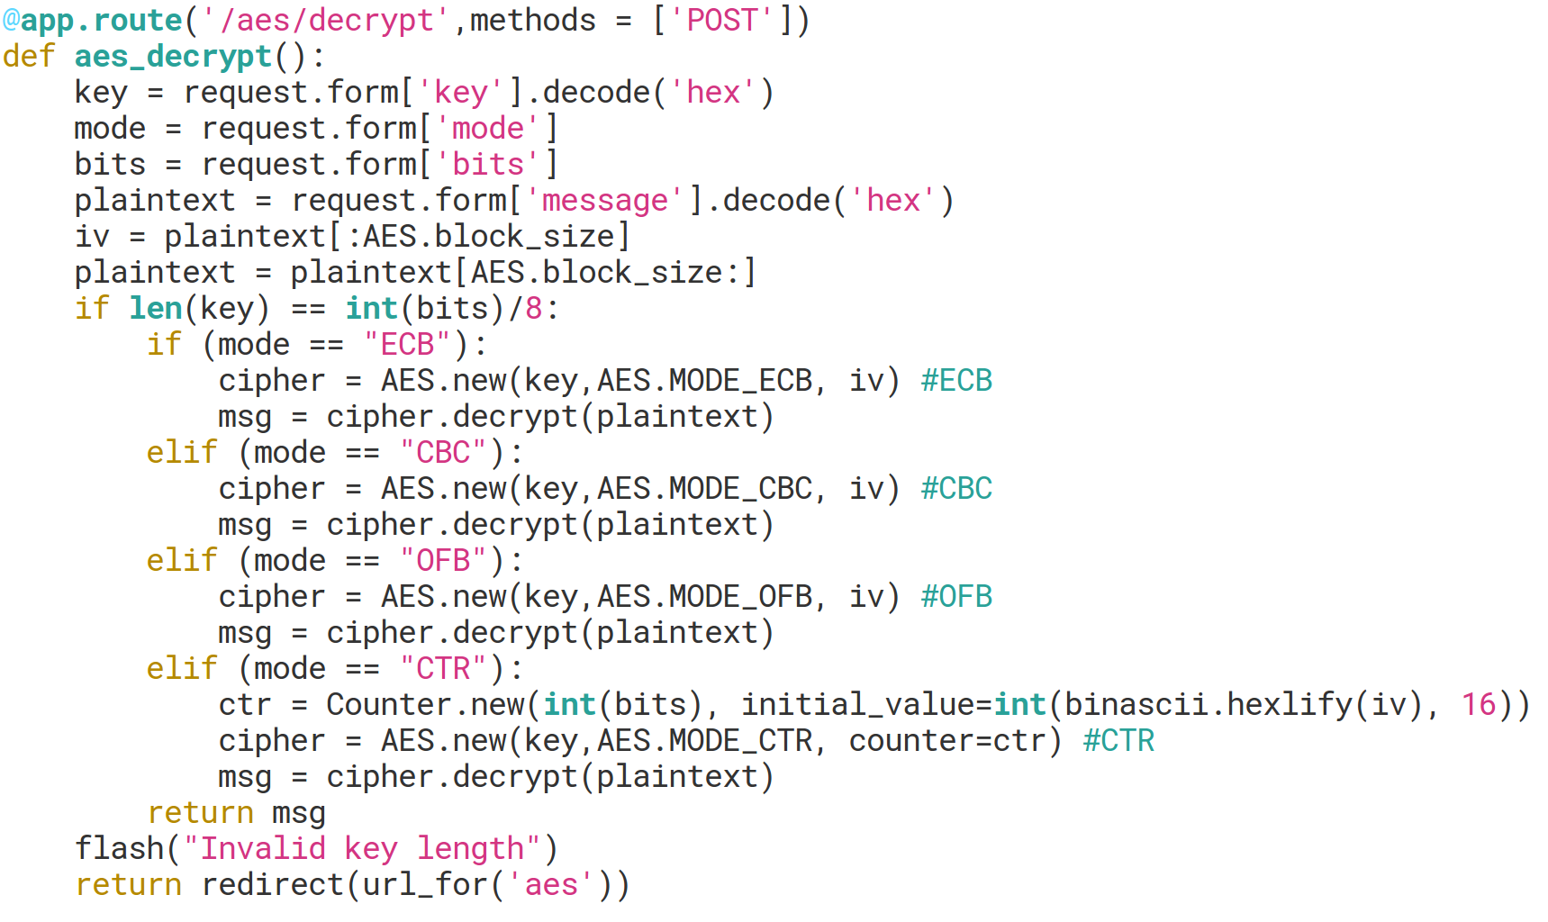
Decryption (ex: AES)
create AES object
create random Initialization Vector (IV)
using IV, message, mode choice, and the generated key
call decrypt on AES object

Slide 9
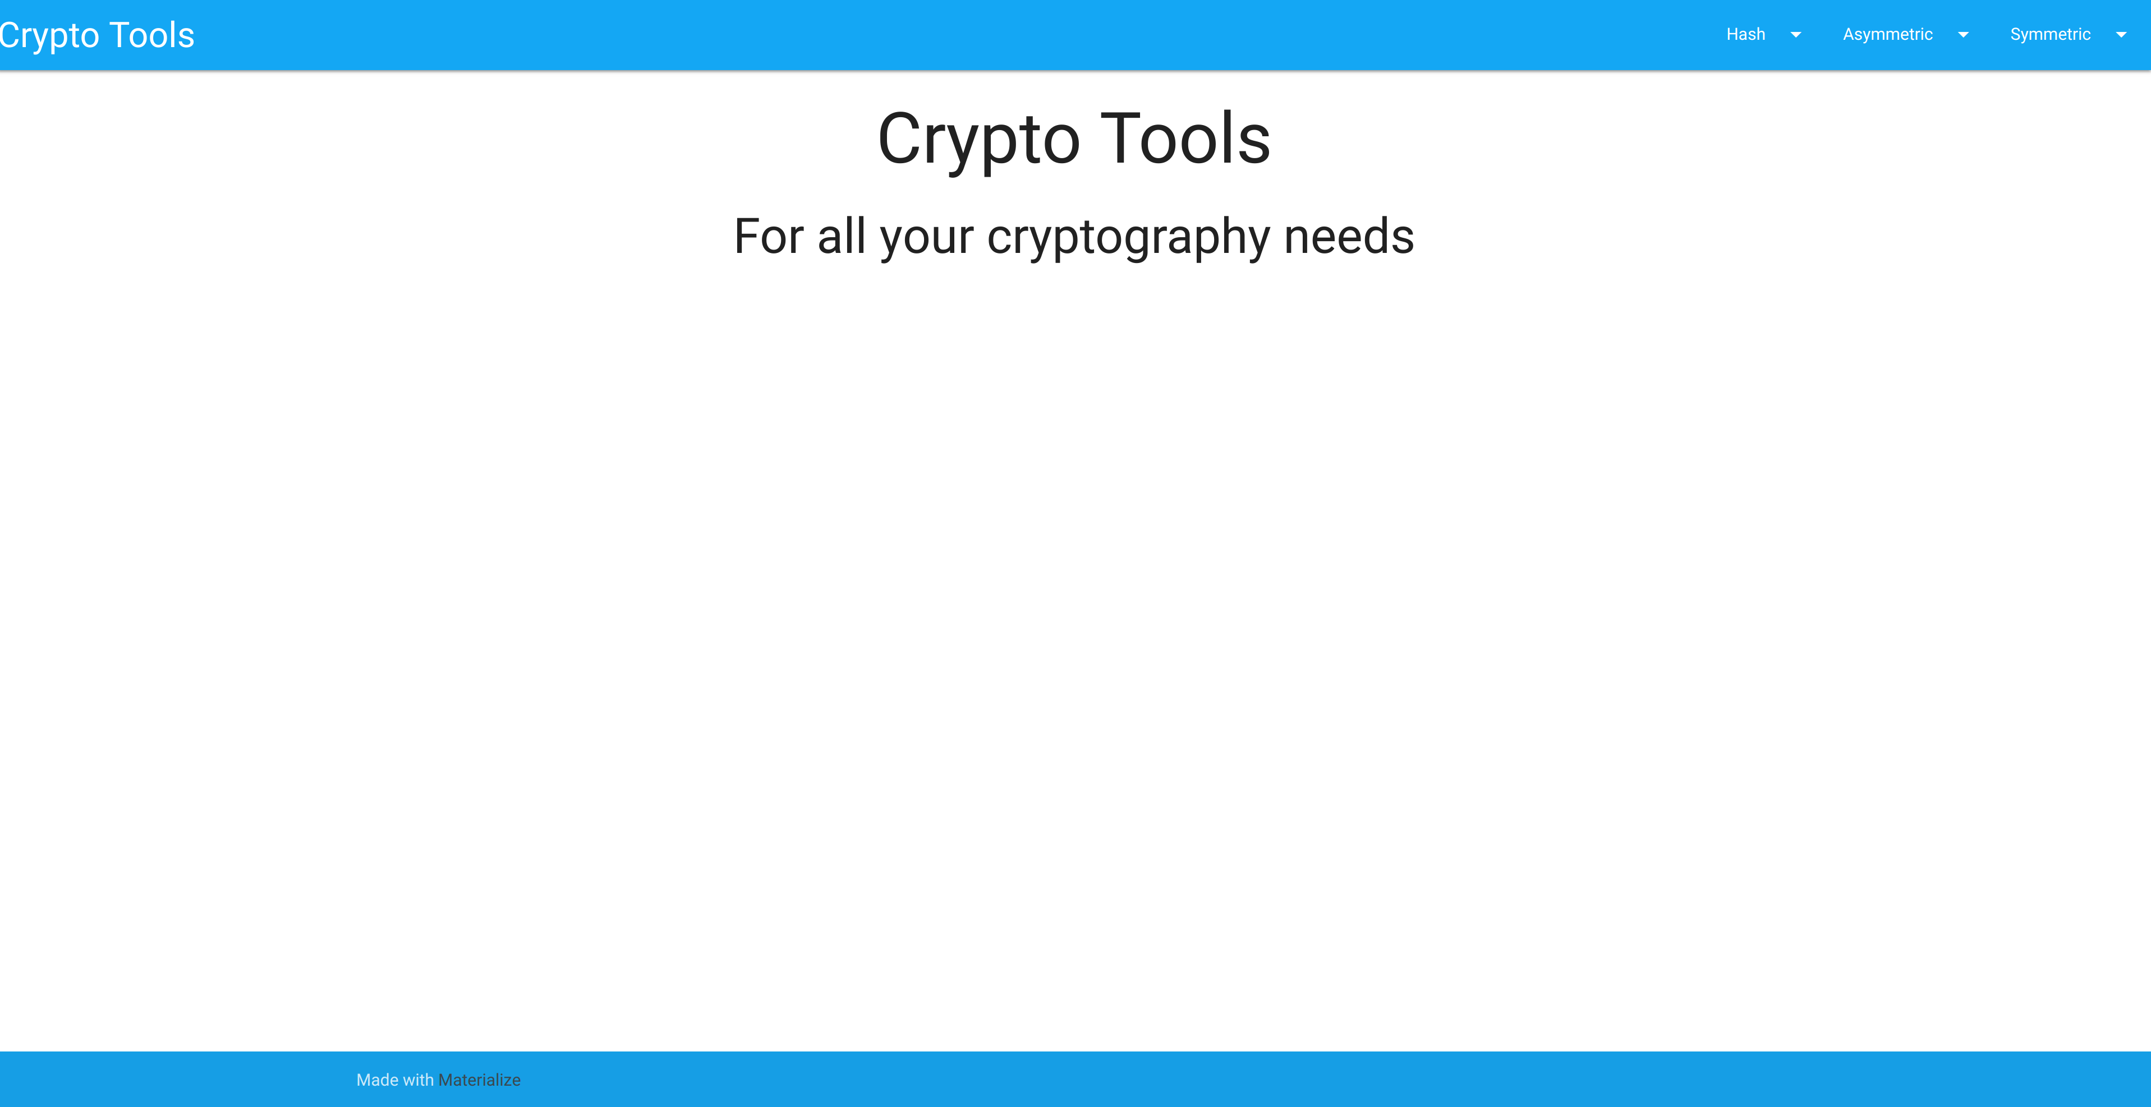
GUI
Alice opens the GUI
options in the top right: Hash, Asymmetric, Symmetric

Slide 10
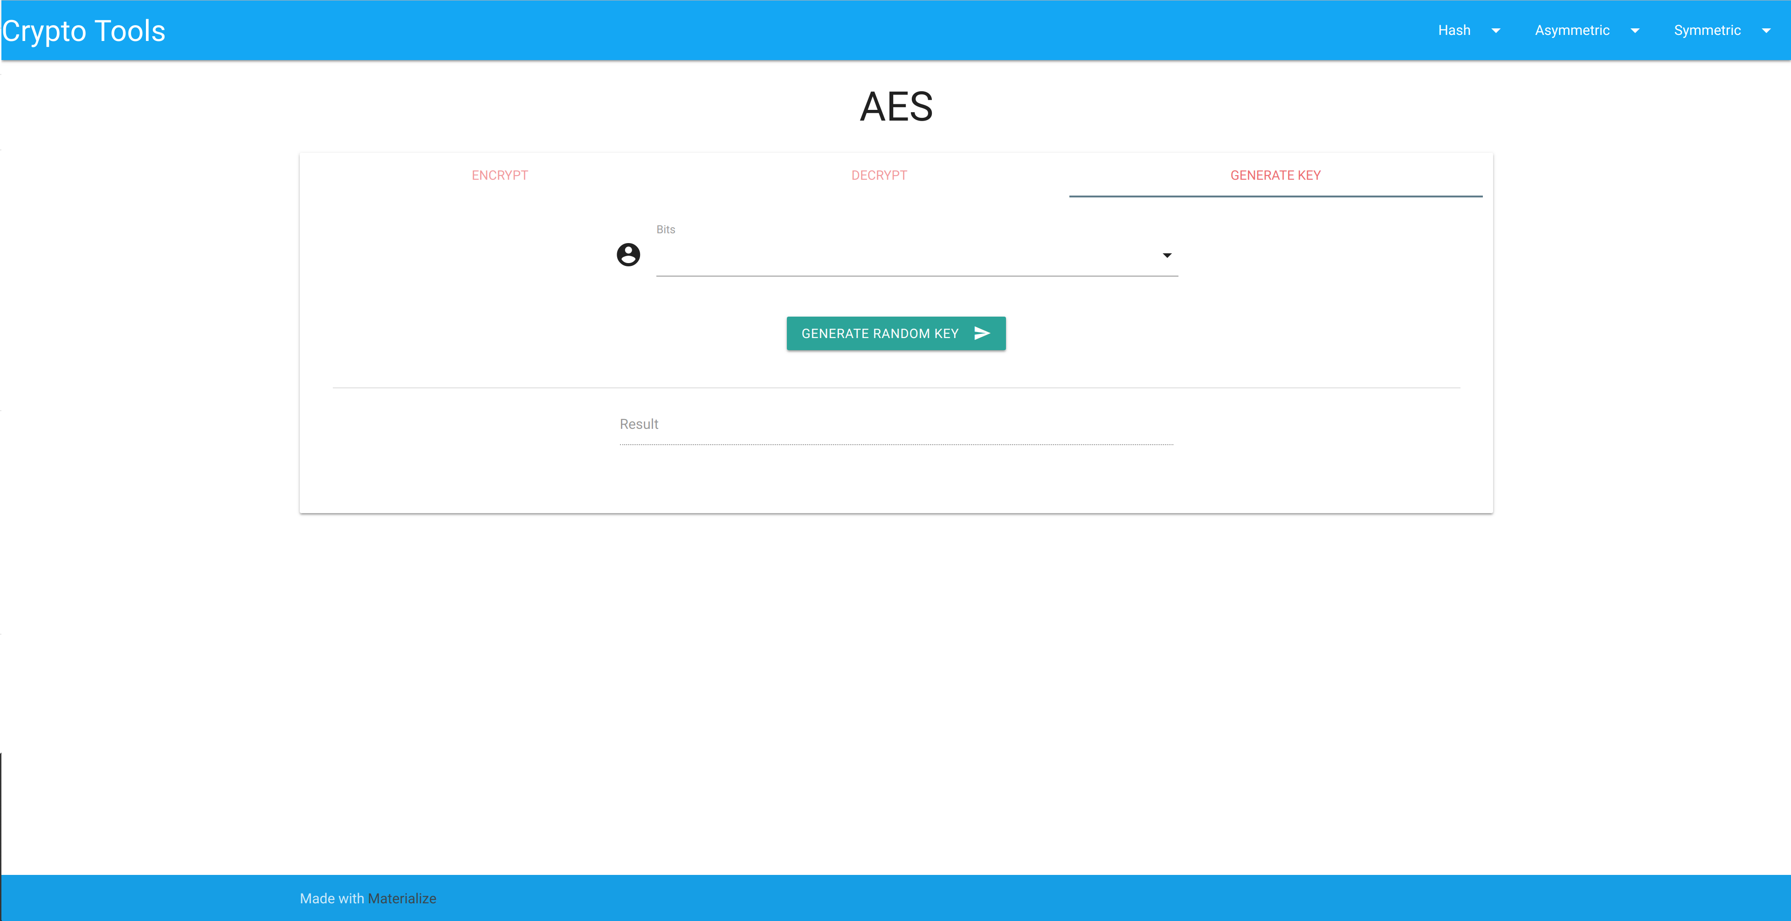
GUI
Alice chooses AES under Symmetric
clicks on “GENERATE KEY” tab
chooses bits number then clicks “GENERATE RANDOM KEY” button
copies the outputted key

Slide 11
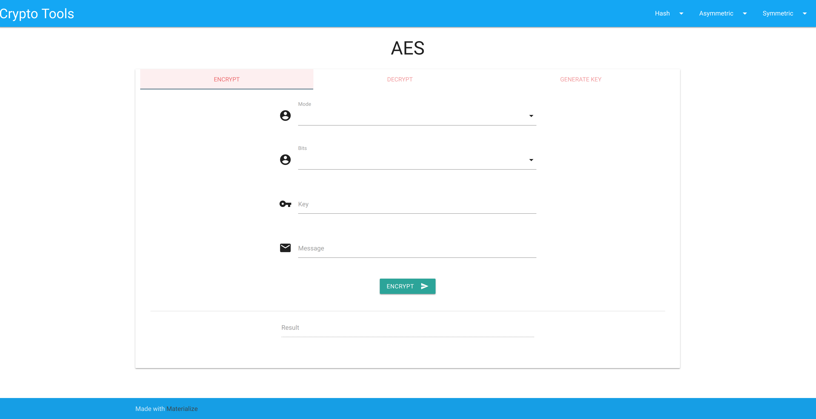
GUI
she then clicks on “ENCRYPT” tab
chooses type of AES from “Mode” dropdown
inputs same bits number she had chosen when generating key
pastes generated key and writes out her message
clicks “ENCRYPT” button

Slide 12
GUI
Bob copies ciphertext and opens GUI
chooses correct scheme and clicks “DECRYPT” tab
inputs necessary information
is outputted the plaintext message
Alice copies outputted ciphertext
Alice gives Bob the:
ciphertext
which encryption scheme she used
number of bits chosen to generate key
randomly generated key

