Slide 1

Exploiting public data
Bas Heijmans
Molecular Epidemiology
Leiden University Medical Center
The Netherlands
bas.heijmans@lumc.nl
FOS course Molecular Data Science – 29 October 2020

Slide 2
Public data
Genomics data is increasingly made publicly available upon publication
Often requirement of journal
‘Open science’
Efficiency of research
Transparency
Reproducibility
More citations

Slide 3
New opportunities for data savvy scientists
Answering a research questions may not require the generation of new data!
(although a combination of new and old is preferred)

Slide 4
Databases
Research data (up to many samples)
Gene Expression Omnibus (GEO) https://www.ncbi.nlm.nih.gov/geo/query/acc.cgi?acc=GSE48472
European Genome-phenome Archive (EGA) https://www.ebi.ac.uk/ega/datasets/EGAD00001000733
ARCHS –RNA-seq gene counts from GEO ready for R https://amp.pharm.mssm.edu/archs4/index.html

Slide 5
Databases
GWAS summary statistics
GWAS catalog of genome-wide significant SNPs https://www.ebi.ac.uk/gwas/
MR-base: summary statistics with focus on Mendelian randomization http://www.mrbase.org/
UK Biobank GeneAtlas http://geneatlas.roslin.ed.ac.uk/

Slide 6
Databases
Reference data (few samples)
Human reference genome https://www.ncbi.nlm.nih.gov/projects/genome/guide/human/
Human reference epigenomes http://epigenomesportal.ca/ihec/
Cancer genomes (reference & research data) https://cancergenome.nih.gov

Slide 7
Databases
Biological pathways
Gene ontology http://www.geneontology.org
Reactome http://www.reactome.org
StringDB https://string-db.org/

Slide 8
Databases
Browsers
Genome browsers like UCSC and ESMBL https://genome-euro.ucsc.edu/cgi-bin/hgGateway?redirect=manual&source=genome.ucsc.edu http://www.ensembl.org/index.html
Omics atlases (effect of SNPs on expression/methylation and much more) http://bbmri.researchlumc.nl/atlas/

Slide 9
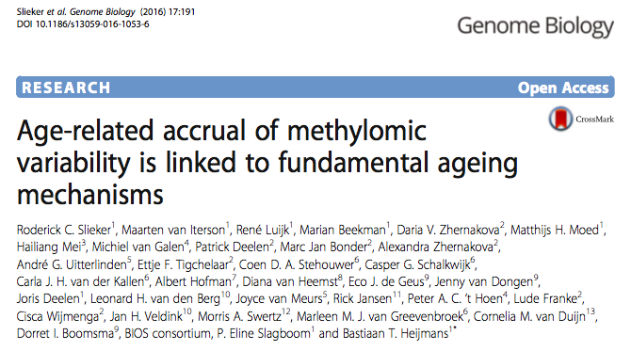

Public data in practice

Slide 10
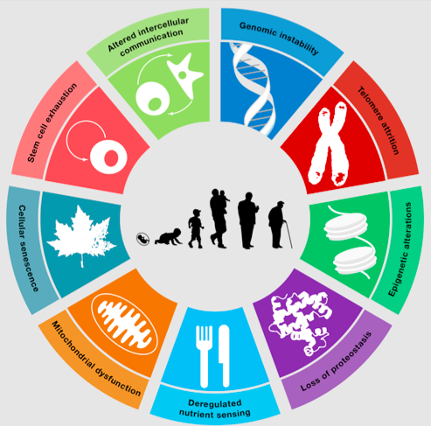
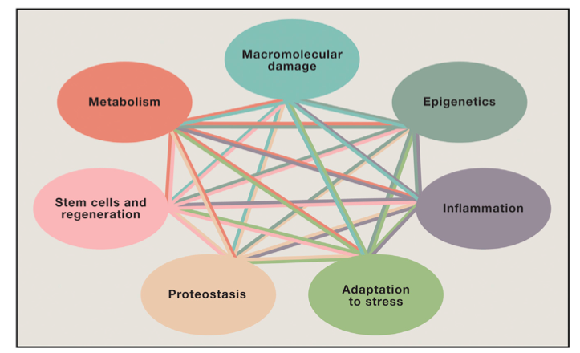
Genomic dysregulation and ageing
Lopes-Otin et al. Cell 2013:
‘9 hallmarks of ageing’
Kennedy et al. Cell 2014:
‘7 pillars of ageing’

Slide 11
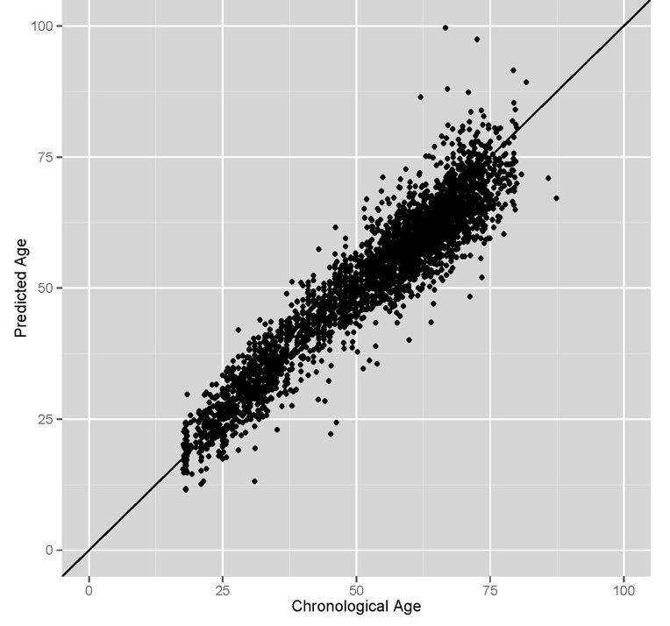
DNA methylation tracks chronological age
DNAmeth clock of Steve Horvath of 353 CpGs (Genome Biol 2013) applied on our own data (N>3000).

Slide 12
Loss of epigenetic control with age
age-related Variably Methylated Positions
aVMPs
Biology remains elusive.
No link with gene expression.
We already know chronological age.

Slide 13
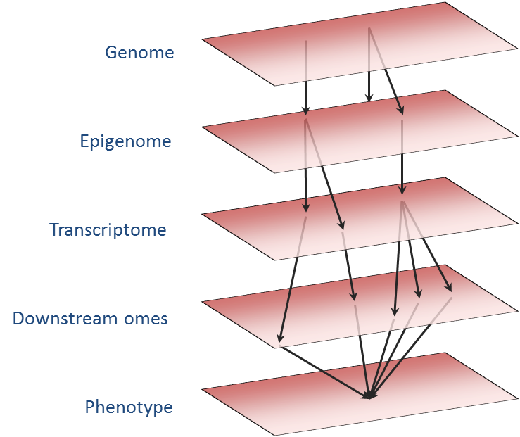

Large scale: Biobank-based Integrative Omics Study (BIOS)
SNP arrays & imputation
Whole blood samples.
3295 methylome profiles: 450k array.
2044 transcriptome profiles: RNA-seq.
Illumina 450k array
RNA-seq

Slide 14
Genomics papers
Discovery
Validation
Interpretation
And often public data helps a lot!

Slide 15
Get a flavour of the possibilities

Slide 16
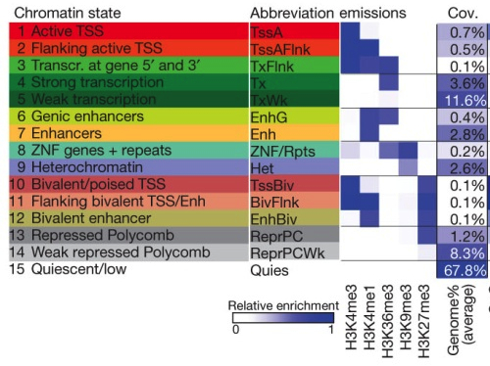
Reference epigenomes inform on biological function
Roadmap Epigenomics Consortium. Nature 2015.

