Slide 1

An introduction to the epigenome
Bas Heijmans and Roderick Slieker
Biomedical Data Sciences
Leiden University Medical Center
The Netherlands
bas.heijmans@lumc.nl
FOS course Molecular Data Science – 26 October 2020

Slide 2

Clinical end-point
Genome
Sub-clinical disease
Epigenome
Classical risk factors
Transcriptome
Metabolome
Proteome

Slide 3
On offer
The molecular basis of epigenetics
The role of epigenetics in fundamental biology
Epigenetics as integrator of environmental signals
Epigenetics in disease mechanisms

Slide 4
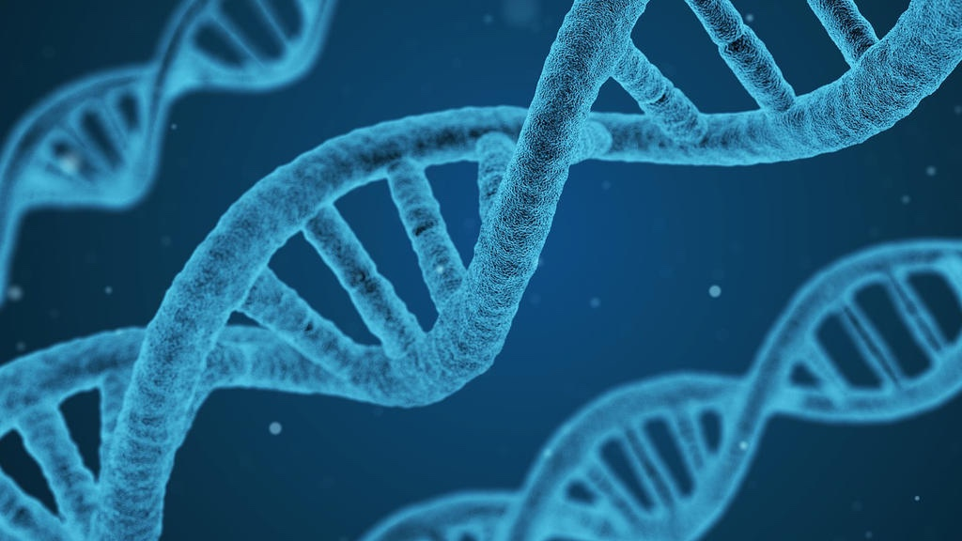

Slide 5
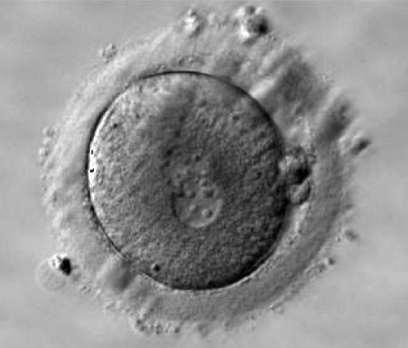
20 hours after fertilization

Slide 6
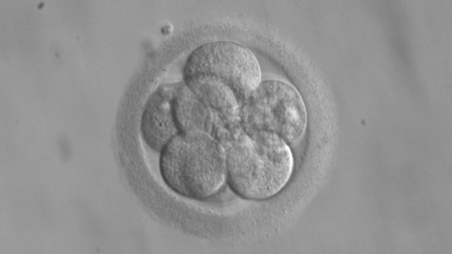
Day 3, 8 cells

Slide 7
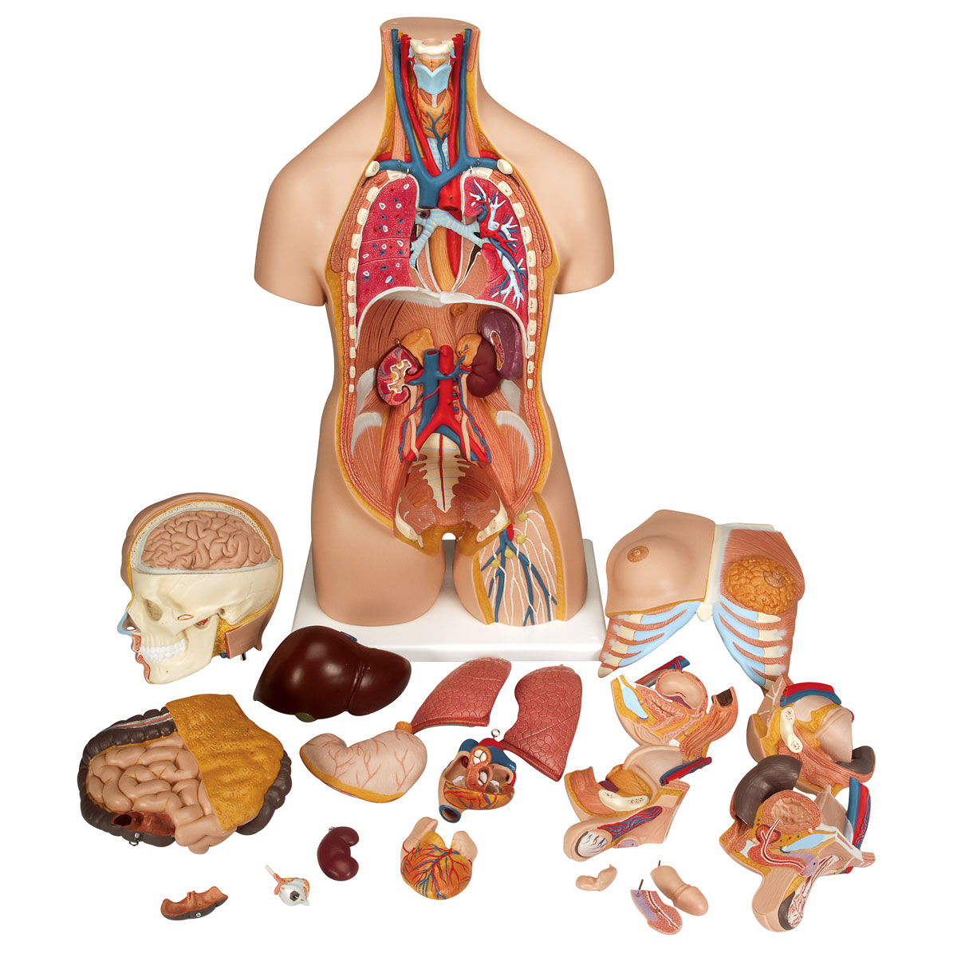

Slide 8
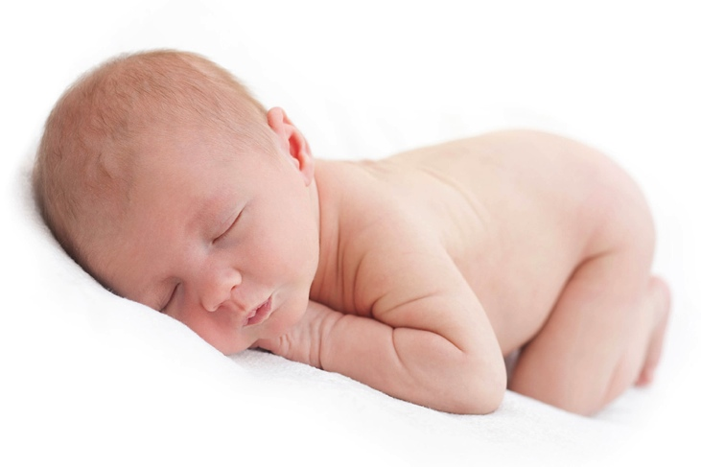
The genetic code is not enough
AGTGCCGGGAAGTGGGGCTTGGC
CCAGGGCCCCCAAGACACACAGA
CGGCACAGCAGGGCTGGTTCAAG
GGCTTTATTCCATCTCTCTCGGT
GCAGGAGGCGGCGGGTGTGGGGC
TGCCTGCGGGCTGCGTCTAGTTG
CAGTAGTTCTCCAGCTGGTAGAG

Slide 9
The genetic code is not enough
AGTGCCGGGAAGTGGGGCTTGGC
CCAGGGCCCCCAAGACACACAGA
CGGCACAGCAGGGCTGGTTCAAG
GGCTTTATTCCATCTCTCTCGGT
GCAGGAGGCGGCGGGTGTGGGGC
TGCCTGCGGGCTGCGTCTAGTTG
CAGTAGTTCTCCAGCTGGTAGAG
A
G
T
C

Slide 10
The genetic code is not enough
AGTGCCGGGAAGTGGGGCTTGGC
CCAGGGCCCCCAAGACACACAGA
CGGCACAGCAGGGCTGGTTCAAG
GGCTTTATTCCATCTCTCTCGGT
GCAGGAGGCGGCGGGTGTGGGGC
TGCCTGCGGGCTGCGTCTAGTTG
CAGTAGTTCTCCAGCTGGTAGAG

Slide 11

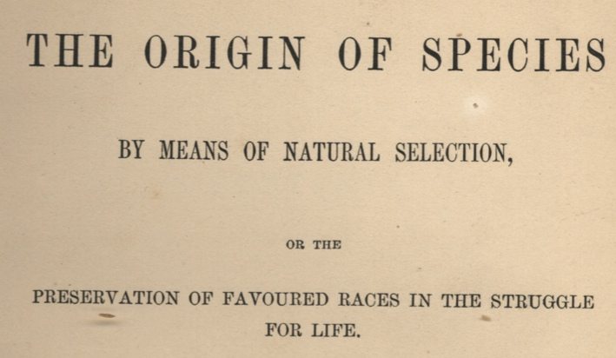
The genetic code is not enough
AGTGCCGGGAAGTGGGGCTTGGC
CCAGGGCCCCCAAGACACACAGA
CGGCACAGCAGGGCTGGTTCAAG
GGCTTTATTCCATCTCTCTCGGT
GCAGGAGGCGGCGGGTGTGGGGC
TGCCTGCGGGCTGCGTCTAGTTG
CAGTAGTTCTCCAGCTGGTAGAG

Slide 12
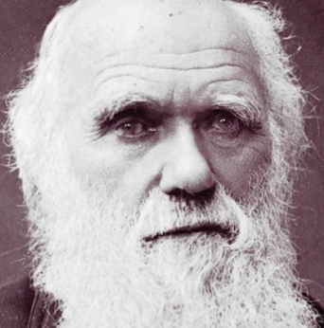
The genetic code is not enough
AGTGCCGGGAAGTGGGGCTTGGC
CCAGGGCCCCCAAGACACACAGA
CGGCACAGCAGGGCTGGTTCAAG
GGCTTTATTCCATCTCTCTCGGT
GCAGGAGGCGGCGGGTGTGGGGC
TGCCTGCGGGCTGCGTCTAGTTG
CAGTAGTTCTCCAGCTGGTAGAG

Slide 13
The genetic code is not enough
AGTGCCGGGAAGTGGGGCTTGGC
CCAGGGCCCCCAAGACACACAGA
CGGCACAGCAGGGCTGGTTCAAG
GGCTTTATTCCATCTCTCTCGGT
GCAGGAGGCGGCGGGTGTGGGGC
TGCCTGCGGGCTGCGTCTAGTTG
CAGTAGTTCTCCAGCTGGTAGAG
Epigenetics
Instructing the DNA where, when and how much to express a gene.
Epigenetics provides variation & memory.

Slide 14
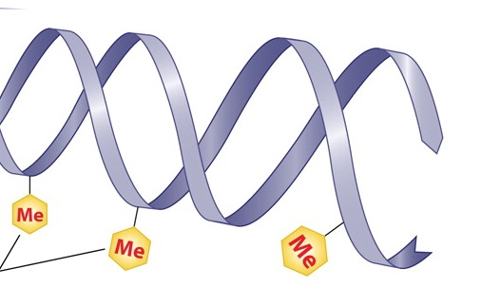

Molecular dimmers on the DNA

Slide 15
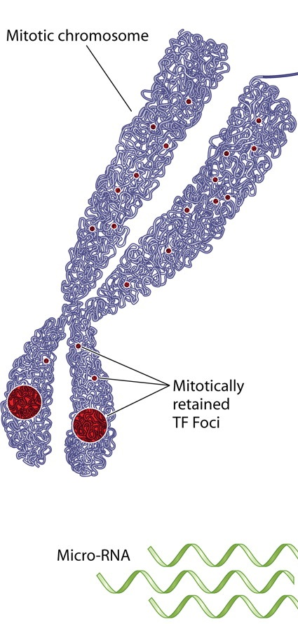
Molecular dimmers on the DNA

Slide 16
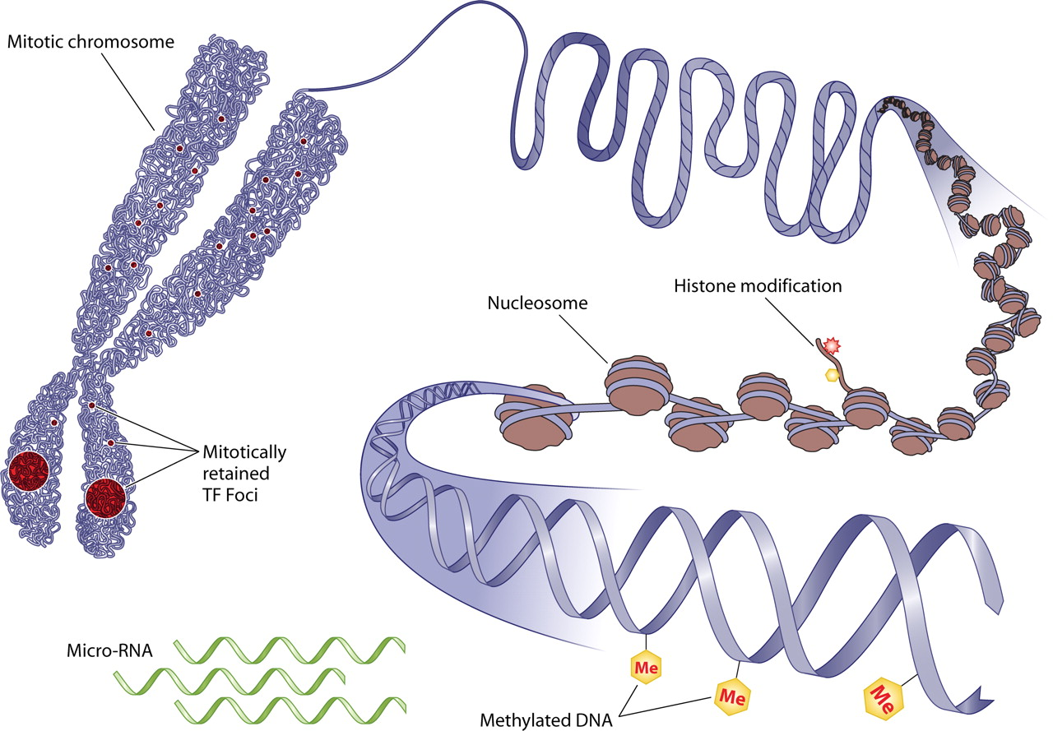



Molecular dimmers on the DNA

Slide 17
Molecular dimmers on the DNA

Slide 18
The simplified (and outdated) text book view
M
--GACGTA--
--CTGCTA--
M
DNMT
MBP
Transcriptionally silent DNA
Gene
HDAC
HDAC
Transcription
Activator complex
Transcriptionally active DNA
Gene
Methylated
Lys4 on H3
Acetylated H3
Disclaimer: The order of events (cause and consequence) is not known

Slide 19
Epigenetic mechanisms
Control gene expression (by changes in the accessibility of DNA and recruiting regulatory factors like transcription factors and chromatin modifiers).
Stable, long-term, but in principle reversible.
Transmitted during cell division, particularly mitosis.
Epigenome: the whole of epigenetics marks in a cell.

Slide 20
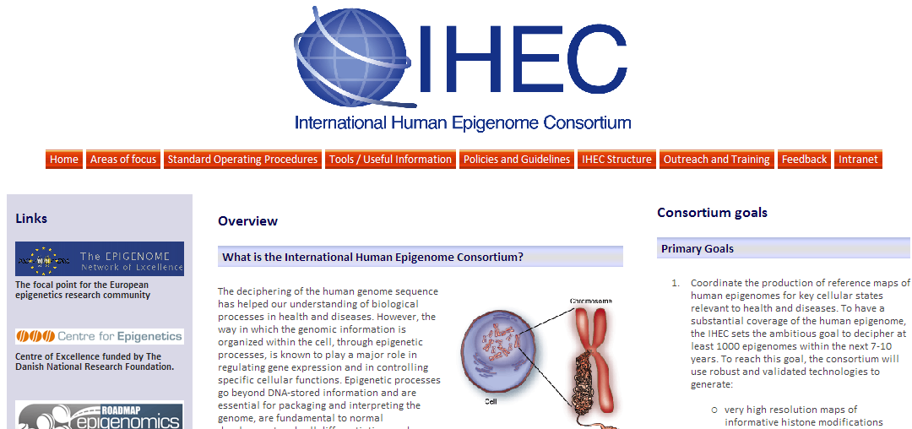
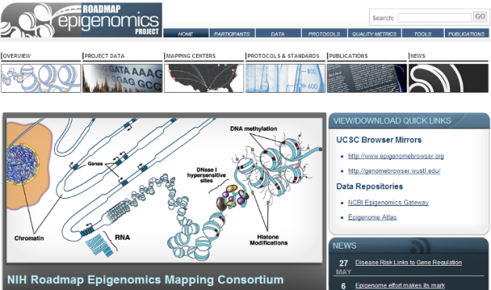
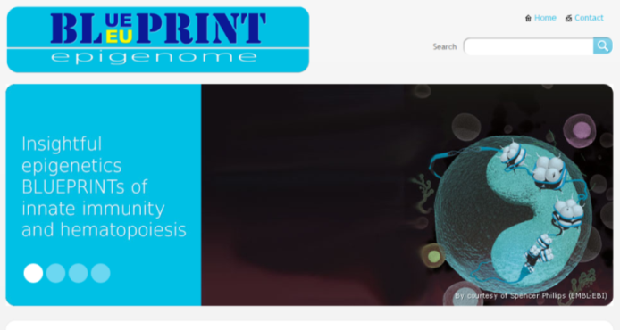
Epigenome Projects
There is one human (reference) genome. How many epigenomes?

Slide 21
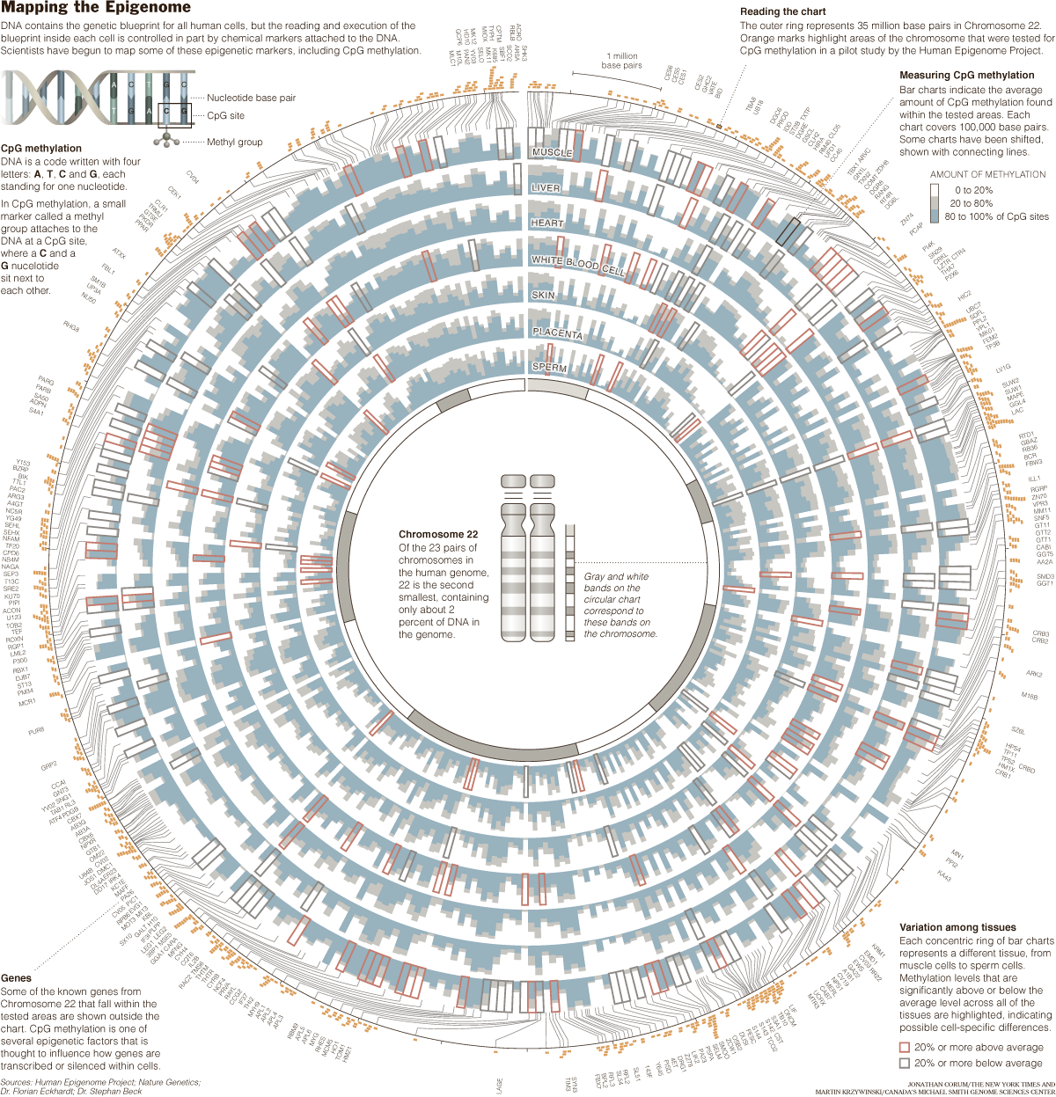

Slide 22
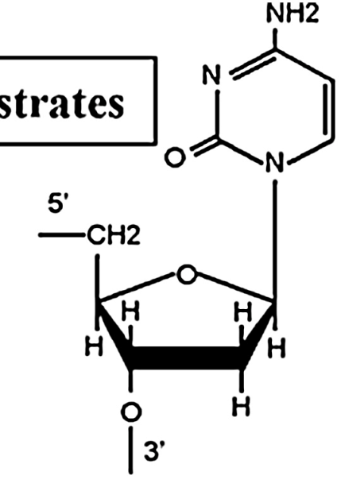
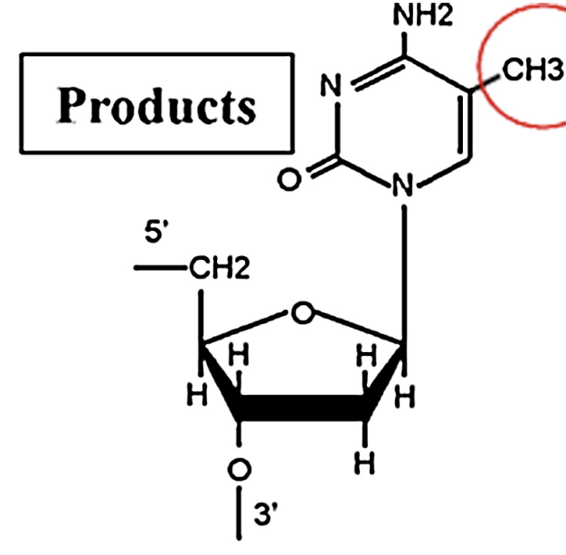
Focus on DNA methylation
Signals altered genomic regulation.*
Standard biomaterial and storage.
High-throughput profiling.
* Controls, stabilizes or reflects gene expression.

Slide 23
Significance methylation depends on genomic context
Enh
AltE1
CGI
E1
Enh
E2
E3
Enh
TSS
TSS
→ Genomic annotation is essential when interpreting DNA methylation data

Slide 24
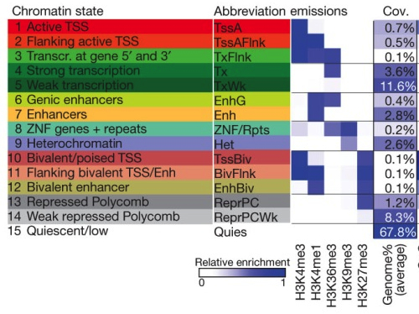
Reference epigenomes inform on biological function
Chromatin states (or segmentation)
Roadmap Epigenomics Consortium. Nature 2015.

Slide 25

Practical
Characterizing DNA methylation differences between tissues.
Genome-wide methylation of close to 500 thousand CpG sites.

Slide 26

Illumina 450k DNA methylation array
Informative: ~483,000 CpGs (<2%) but many annotations
Affordable: ~200 euro per sample
Fast: >1000 samples a week
Data: relatively easy to manage (amount and complexity)
Genic
CpG island
Chromatin

Slide 27
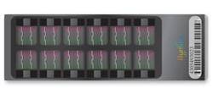
Principle methylation array
M?
M?
M?
M?
x 485,000 (out of 28M)
…CCTGGTACGTCTAGCCGTAATTAGCTCGATTCCGGT…
…CCTGGTACGTCTAG…
Bisulfite conversion
unmethylated
methylated
…UUTGGTUGTUTAG…
…UUTGGTCGTUTAG…
unmeth signal
meth signal
β-value = meth / (meth + unmeth)

Slide 28
Possible DNA methylation levels of one CpG site
M?
…CCTGGTACGTCTAG…
…GGACCATGCAGATC…
M?
A DNA molecule?
A cell?

Slide 29
M?
…CCTGGTACGTCTAG…
…GGACCATGCAGATC…
M?
M?
…CCTGGTACGTCTAG…
…GGACCATGCAGATC…
M?
M?
…CCTGGTACGTCTAG…
…GGACCATGCAGATC…
M?

Slide 30
Possible DNA methylation levels of one CpG site
M?
…CCTGGTACGTCTAG…
…GGACCATGCAGATC…
M?
A DNA molecule?
A cell?
A blood sample?
A muscle biopsy?

Slide 31
M?
…CCTGGTACGTCTAG…
…GGACCATGCAGATC…
M?
M?
…CCTGGTACGTCTAG…
…GGACCATGCAGATC…
M?
M?
…CCTGGTACGTCTAG…
…GGACCATGCAGATC…
M?
4*1 + 3*0 + 1*0.5 + 1*1 + 1*1

Slide 33


