Slide 1

Epigenetics and the Life Course
Bas Heijmans
Molecular Epidemiology
Leiden University Medical Center
The Netherlands
bas.heijmans@lumc.nl
FOS MDS – 27 October 2020

Slide 2
Genes
Environment
Epigenetics
Disease

Slide 3
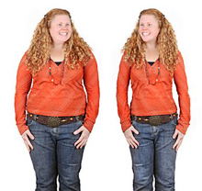
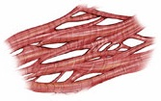
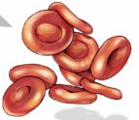
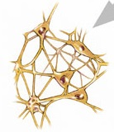
Roles epigenetics: variation and memory
Development and cell differentiation → 1 DNA molecule, many cell types within an individual.
Interface DNA and environment → 1 DNA molecule, multiple possible phenotypes.

Slide 4

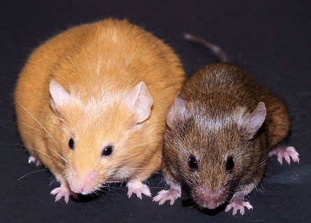
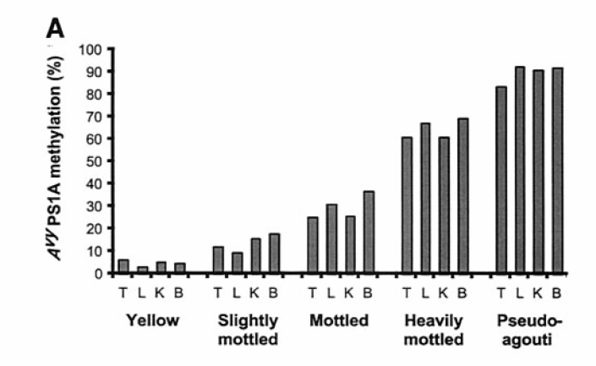
Epigenetics of coat color
Inbred agouti mice: same DNA sequence
Methyl supplementation diet pregnant females
Recorded as higher methylation of agouti gene
Expressed as no synthesis of yellow colour
Propagated across tissues
Retained into adulthood
Pregnant mums
Waterland and Jirtle. Mol Cell Biol 2003

Slide 5
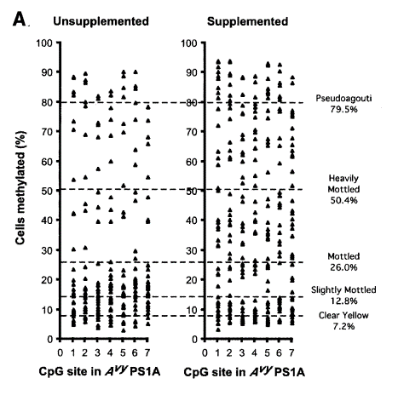
Epigenetics: the memory of the DNA
messy
Pregnant mums
Waterland and Jirtle. Mol Cell Biol 2003

Slide 6
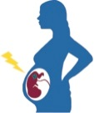

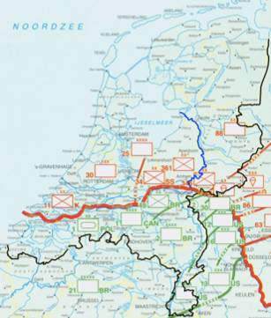
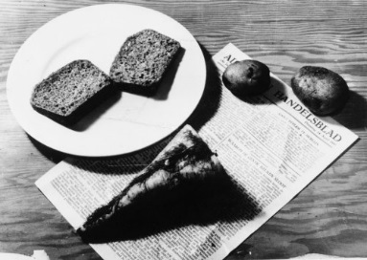
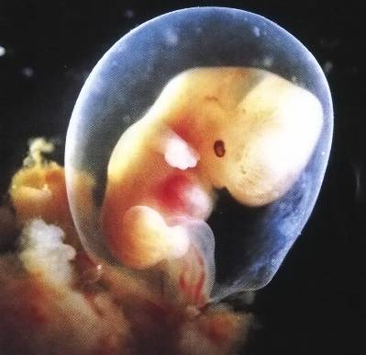
Dutch Hunger Winter
Gametogenesis
Conception
Birth
Growth
Adulthood
Ageing
Health
Severe famine during the winter of 1944-45 in WW2.
Exposure during intra-uterine life associated with cardiometabolic health (overweight, diabetes, unfavourable lipid levels) and schizophrenia.

Slide 7
Study design
Gametogenesis
Conception
Birth
Growth
Adulthood
Ageing
Health
Quasi-experimental: daily rations <700 kcal/day set for whole population.
Prospective: traced back exposed individuals at age 60y from records at institutions in affected cities; timing known.
Best possible controls: unexposed, same-sex siblings.

Slide 8
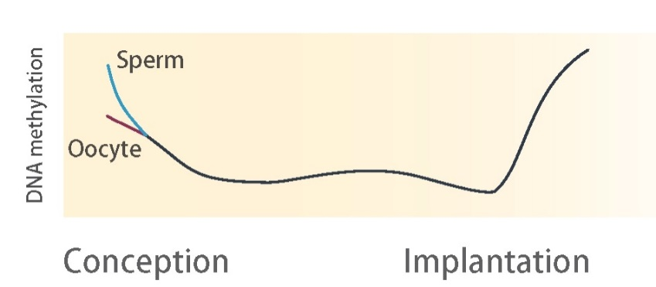
Study design
Gametogenesis
Conception
Birth
Growth
Adulthood
Ageing
Epigenetic
Mechanisms?
Health
Focus on early gestation (ie. conception during Famine)
Sensitive window? Critical stage in establishing and maintaining epigenetic marks.
Soma-wide occurrence? Mitotic inheritance resulting in cross-tissue epigenetic differences (incl. peripheral tissues).

Slide 9
Methylation of a growth gene
DNA from blood of 60 individuals who were periconceptionally exposed to the Famine 6 decades ago.
IGF2: Prenatal growth factor, also implicated in metabolic regulation and memory; epigenetically controlled.
exposed - unexposed sibling
Methylation difference (%)
Daily ration
(kcal/day)
Estimated conception
(Last menstrual period)
Heijmans et al. PNAS 2008

Slide 10
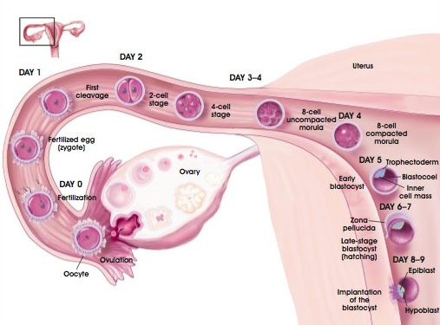
Looking across 16 genes
Gene | Early | Late
IGF2
GNAS
INSIGF
IL10
LEP
ABCA1
Tobi et al. Hum Mol Genet 2009
Picture: Terese Winslow, 2001

Slide 11
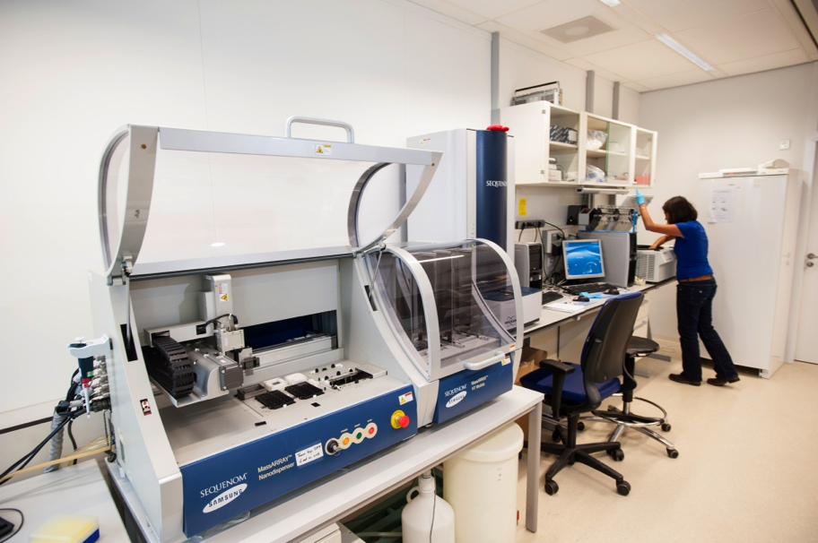
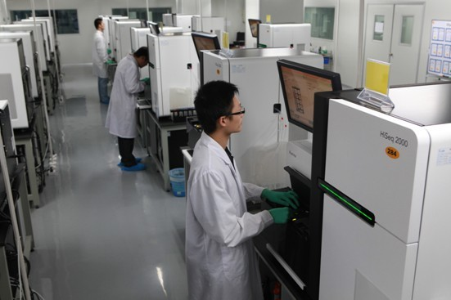
Genome-scale studies
Genes
Genome

Slide 12
Bisulfite sequencing
M?
…CCTGGTACGTCTAG…
Unmethylated
Methylated
Bisulfite conversion
…UUTGGTUGTUTAG…
…UUTGGTCGTUTAG…
HT sequencing
GGTCGTTTAG
TGGTTGTT
TTGGTTGTT
TTTGGTTGTTTAG
TTTGGTTGT
GTCGTTTAG
GTTGTTTAG
GGTCGTTTAG
TTTGGTCGTT
TTGGTTGTTT

Slide 13
Bisulfite sequencing
M?
…CCTGGTACGTCTAG…
Unmethylated
Methylated
Bisulfite conversion
…UUTGGTUGTUTAG…
…UUTGGTCGTUTAG…
HT sequencing &
Alignment
TTGGTTGTT
TTTGGTTGT
GTTGTTTAG
TGGTTGTT
TTTGGTTGTTTAG
TTGGTTGTTT
GTCGTTTAG
TGGTCGTTTA
TTTGGTCGTT
GGTCGTTTAG
This fake example
10x coverage, 4/10=40% (95% CI, 17-70%) methylated

Slide 14
Genome-scale study of prenatal famine
Focus on periconceptional exposure: 24 exposed + 24 sibling controls
Reduced-Representation Bisulfite Sequencing (RRBS)
Methylation of 1.2M CpG sites after QC and exclusion uninformative sites (mean coverage 28x; call rate 0.998)
Mapping to genomic features to decrease multiple testing, accumulate evidence over adjacent CpGs and increase interpretability.
Promoter, enhancer etc.
11/28
3/16
3/8
6/14
2/6
0/11
0/5
Tobi et al. Nat Commun 2014

Slide 15
Validated top-hits
Gene | Location | Function
SMAD7 SMAD family member 7 | 25kb downstream | TGFβ signaling, colorectal cancer, β-cell function & development
CDH23 cadherin-related 23 | Intragenic | Inner ear development, hearing loss
INSR insulin receptor | Intragenic | Insulin signaling, growth, height
CPT1A carnitine palmitoyltransferase-1 | Intragenic | Fatty acid β-oxidation, fatty acid-induced IR and inflammation in adipocytes
KLF13 Krüppel-like factor 13 | Intragenic | LDLR regulation, schizophrenia
RFTN1 raftlin | Intragenic | Eye development, obesity
Tobi et al. Nat Commun 2014

Slide 16
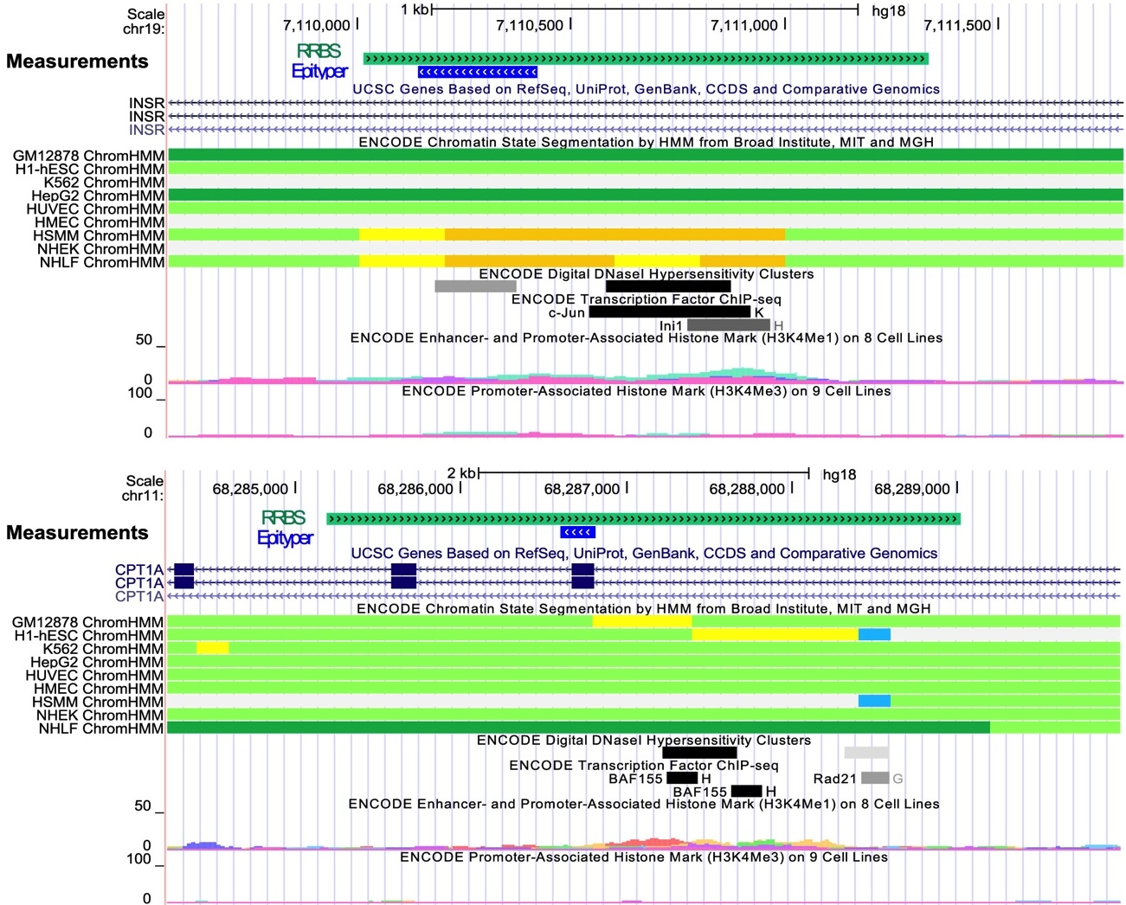
Towards causality
In silico annotation-based predictions of DMR functionality

Slide 17
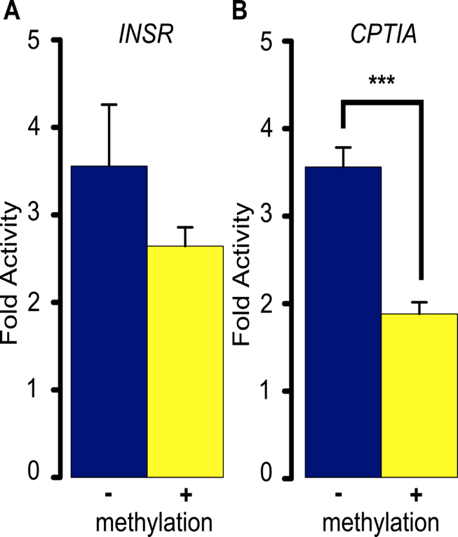
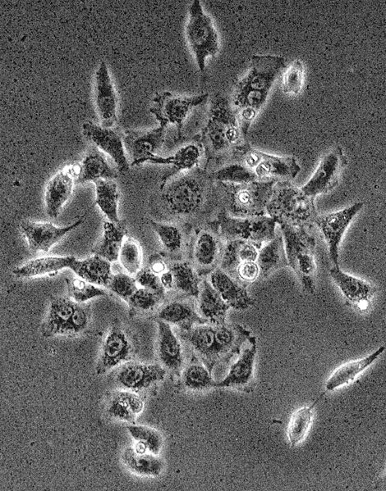
Towards causality
In silico annotation-based predictions of DMR functionality
In vitro testing DMR functionality
DMR/Suspected enhancer
Promoter
Embryonic kidney
cell line HEK-293
Luciferase

Slide 18
Towards causality
In silico annotation-based predictions of DMR functionality
In vitro testing DMR functionality
In vivo experiments in animals (moving from principles to testing specific human outcomes), short-term interventions in humans, human cells.
Integrative genomics from genome and epigenome to transcriptome and further
Causal inference testing statistical approach to evaluate whether DNA methylation mediates associations between prenatal adversity and later-life outcomes
Tobi et al. Science Adv 2018

Slide 19
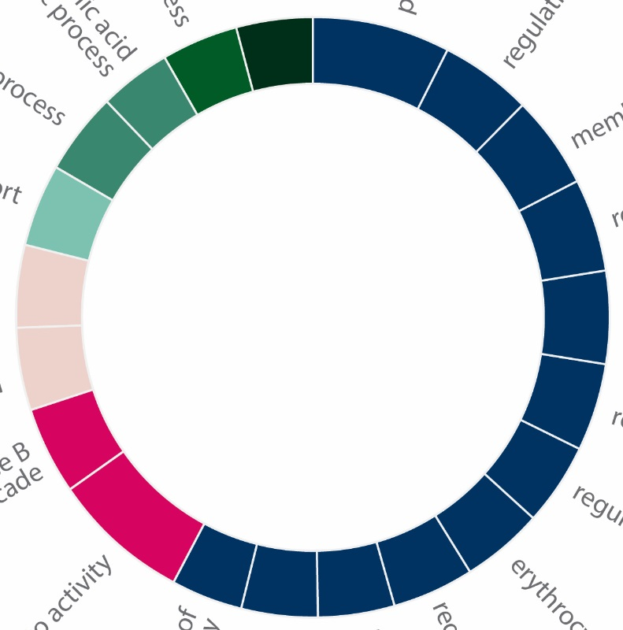
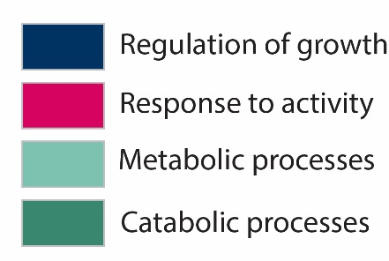
Genome-scale view
Growth
Tobi et al. Nat Commun 2014

Slide 20
Epigenetic changes after prenatal famine
Gametogenesis
Conception
Birth
Growth
Adulthood
Ageing
Health
Exposure to famine during early development is associated with persistent epigenetic differences in humans.
DNA methylation differences are modest but extend into biological pathways.
DNA methylation signatures identified link prenatal famine exposure to growth and metabolism.

Slide 21
The nature epigenetic signatures
DNA methylation signature of an adverse prenatal environment

Slide 22
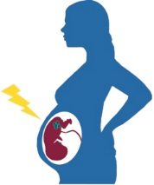






The nature epigenetic signatures
Plasticity
Immediate adaptive developmental plasticity
Predictive adaptive developmental plasticity
Damage or constraint
Epigenetic selection
Inability to sustain normal epigenetic remodeling
Activation of adaptive pathways promoting survival in utero
Activation of adaptive pathways promoting fitness in adulthood
Random variation and selection of fit embryo
DNA methylation signature of an adverse prenatal environment

Slide 23
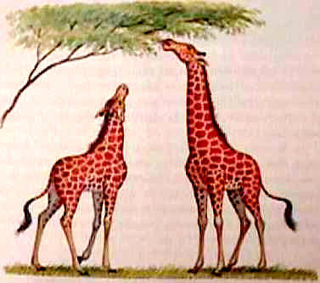
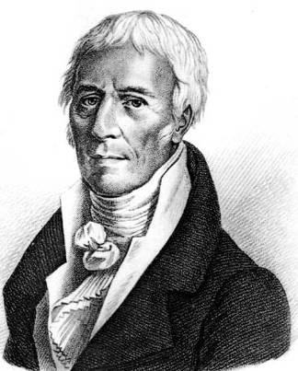
Transgenerational epigenetics?
Lamarckism revisited – the inheritance of acquired traits
Jean-Baptiste Lamarck
(1744-1829)

Slide 24
Transgenerational epigenetics?
F0
F1
F2
F3
Intra-generational (or inter-; ‘effects’ )
Inter-generational (or multi-; ‘transmission’)
Trans-generational (‘inheritance’)

Slide 25
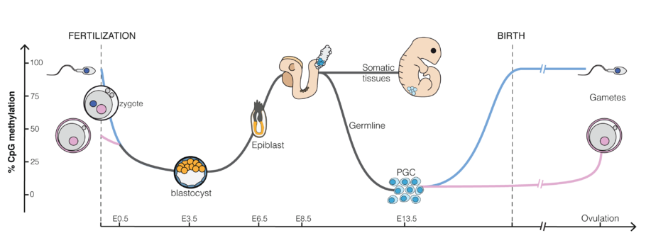
Unlikely, certainly in humans
Evolutionary arguments
No evidence for advantage
Mechanistic arguments
Extensive reprogramming

Slide 26
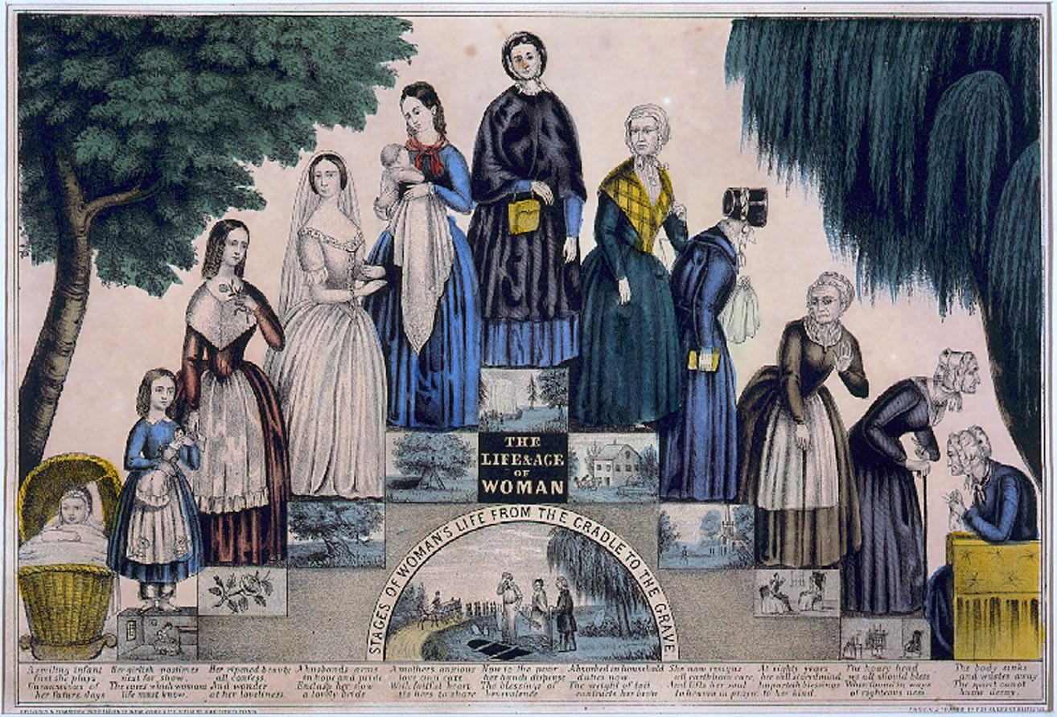

Slide 27
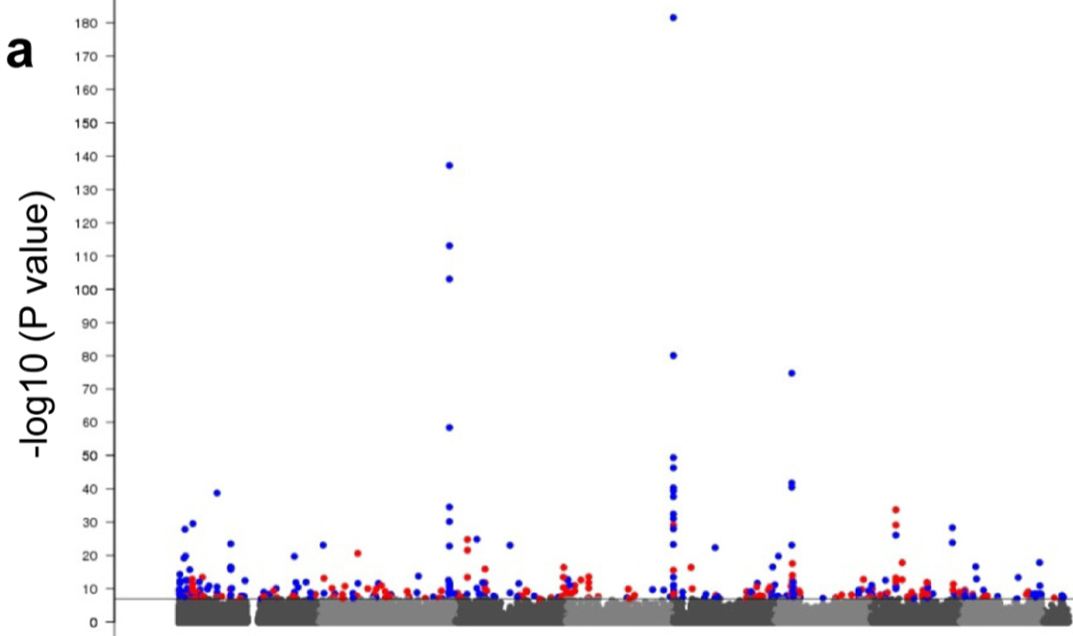
Smoking
AHRR gene: P not 0.05
but 0.0000000000000000000000000000000000000000000 0000000000000000000000000000000000000000000000000000000000000000000000000000000000000000000000000000000000000000000000000000000000000001
262 smokers
749 non-smokers
Chromosome
Zeilinger et al. PLoS ONE 2013

Slide 28
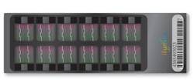
Principle methylation array
M?
M?
M?
M?
x 485,000 (out of 28M)
…CCTGGTACGTCTAGCCGTAATTAGCTCGATTCCGGT…
…CCTGGTACGTCTAG…
Bisulfite conversion
unmethylated
methylated
…UUTGGTUGTUTAG…
…UUTGGTCGTUTAG…
unmeth signal
meth signal
β-value = meth / (meth + unmeth)

Slide 29
To think through
In the study of smoking-induced DNA methylation changes in blood, counts of the various white cells occurring in blood were measured for every individual and included as confounder in the statistical model. Why?

Slide 30
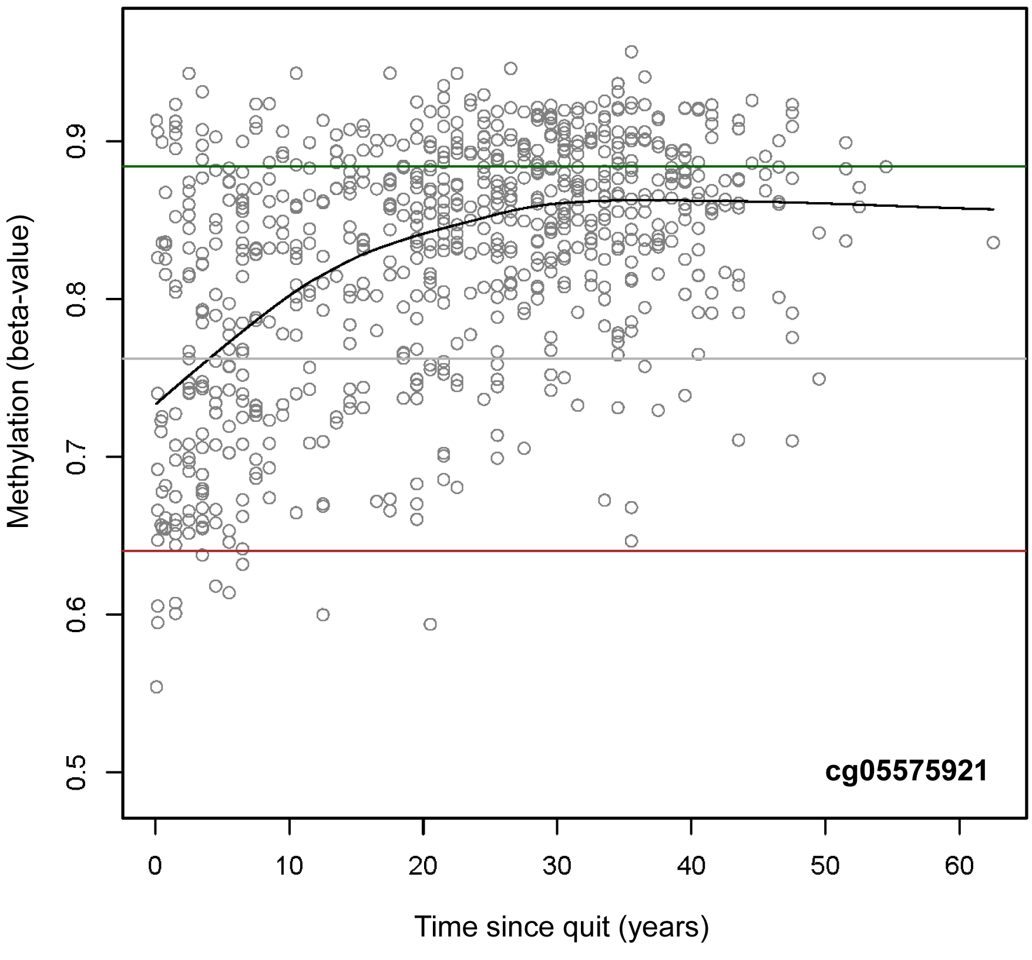
Smoking sticks epigenetically
Chromosome

Slide 31
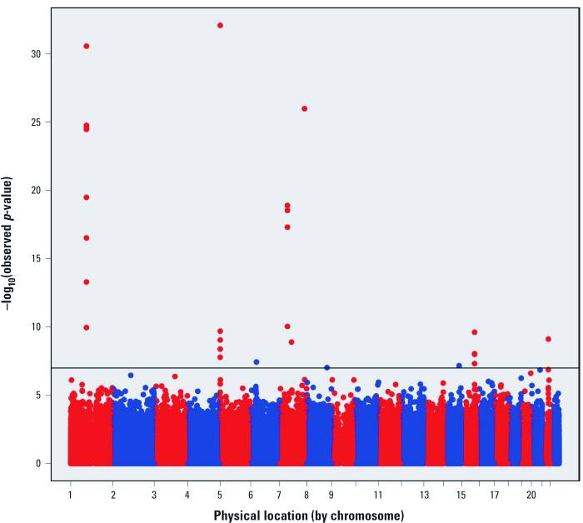
Maternal smoking affects fetus
Methylation (450k array) in 1062 newborns vs. maternal plasma cotinine, a biomarker of smoking.
Joubert et al. Environ Health Perspect 2012

Slide 32
DNA methylation and age
An exceptional case: methylation at CpGs near ELOVL2 change with age in any tissue.
Slieker et al. Epigenetics Chromatin 2018

Slide 33
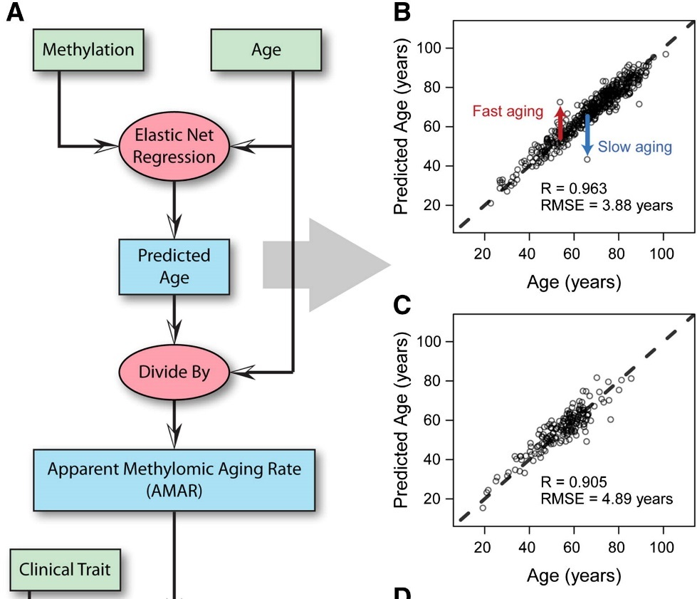
DNA methylation and age
DNAm at 450 thousand CpGs →
Hannum et al. Mol Cell 2013

Slide 34
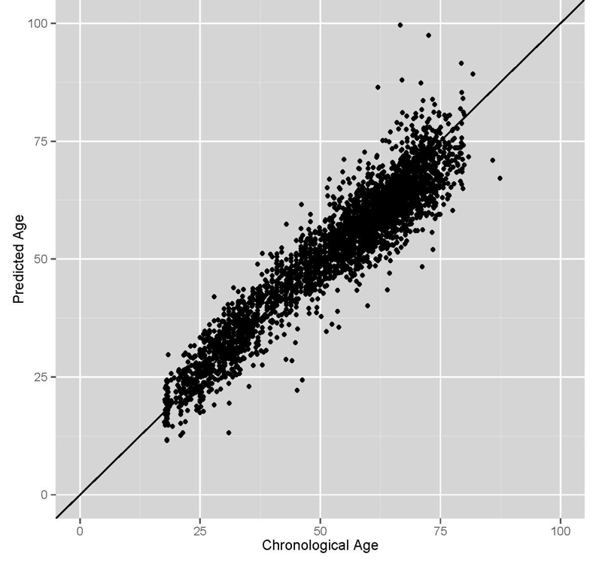

Our age is in our DNA methylation
Epigenetic clock by Horvath of 353 CpGs (Genome Biol 2013) applied to own data (N>3000).

Slide 35
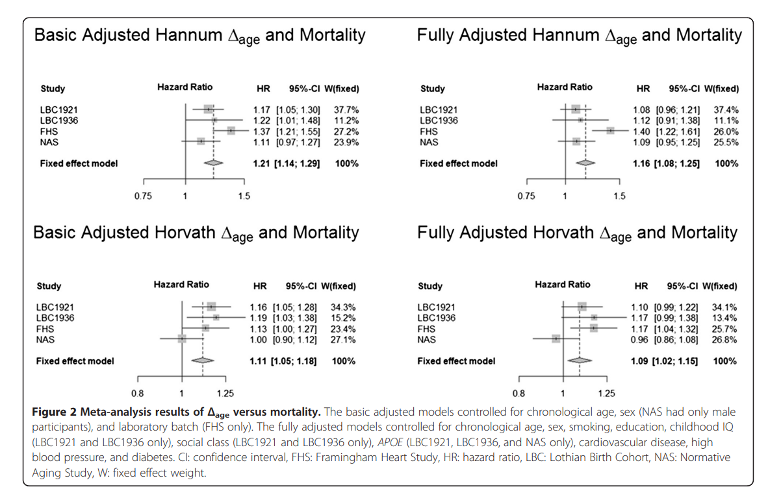
DNAm changes and mortality
…. 40% of inter-individual differences in Δage can be attributed to genetic factors.
Marioni et al. Genome Biol 2015

Slide 36
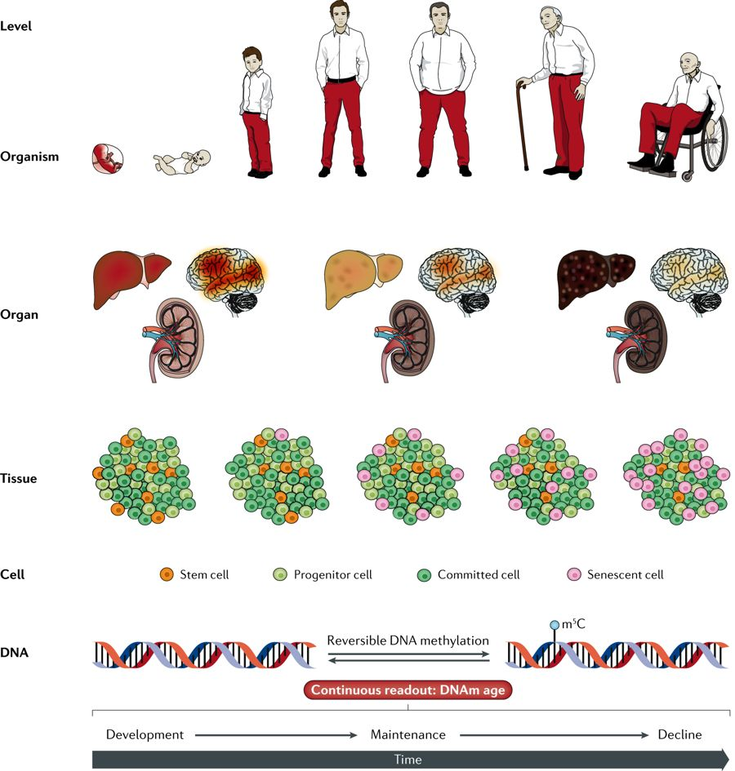
Biological implications?
Horvath and Raj.
Nat Rev Genet 2018

Slide 37

Conclusions
Across the whole life course, from intrauterine life to adulthood, the environment continuously influences the epigenome.
DNA methylation changes precisely track chronological age and may also mark biological age.

