Slide 1
Introduction to genome-wide association analysis: rvtests
Department of Biomedical Data Sciences
Section of Molecular Epidemiology
LUMC, Leiden

Slide 2
Outline
Genome-wide association study
Introduction to rvtests software
Requirements: input files
Association analysis
Output file
Post-association analysis steps
Quality control
Visualization

Slide 3
Outline
Genome-wide association study
Introduction to rvtests software
Requirements: input files
Association analysis
Output file
Post-association analysis steps
Quality control
Visualization

Slide 4
Genome-wide association study (GWAS)
Millions of genetic variants across the genomes of many individuals tested to identify genotype–phenotype associations
Various statistical methods and tools available
Today’s practical: Rvtests (Rare Variant tests)
Available on Linux, MacOS and Windows, developed by Zhan et al.
Developed to support genetic association analysis for sequence datasets
Can analyze:
unrelated individuals and related (family-based) individuals
quantitative and binary outcomes
http://zhanxw.github.io/rvtests/#introduction
Notes:
(http://zhanxw.github.io/rvtests/#introduction)
Genome-wide association studies (GWAS), in which hundreds of thousands to millions of genetic variants across the genomes of many individuals are tested to identify genotype–phenotype associations
Can analyze
unrelated individual and related (family-based) individuals for both quantitative and binary outcomes.

Slide 5
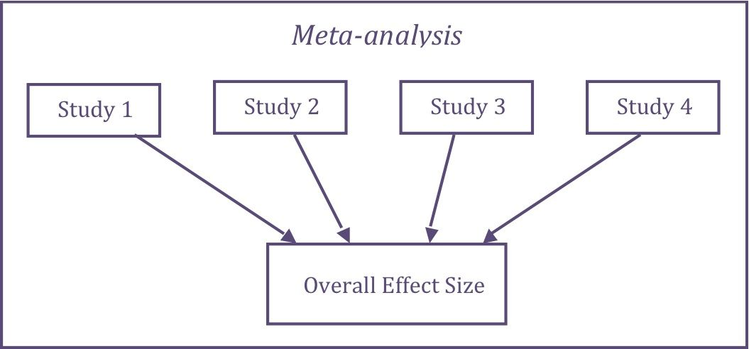
Rvtests and meta-analysis
Meta-analysis - combining the results of individual studies with statistical methods
Notes:
Larger samples have become available, and researchers have recognized the value of collaborating to combine resources

Slide 6
Outline
Genome-wide association study
Introduction to rvtests software
Requirements: input files
Association analysis
Output file
Post-association analysis steps
Quality control
Visualization

Slide 7
Input files (1)
Phenotype file
fid | iid | fatid | matid | sex | phenotype1 | phenotype2 | phenotype3
1 | 1 | 0 | 0 | 1 | 5.879 | 25.888 | 0
2 | 2 | 0 | 0 | 2 | 8.954 | 19.324 | 2
3 | 3 | 0 | 0 | 2 | 1.909 | 20.125 | 1
4 | 4 | 0 | 0 | 1 | NA | 28.587 | 1
5 | 5 | 0 | 0 | 1 | 7.888 | 35.996 | 1
Covariate file
fid | iid | fatid | matid | sex | covariate1 | covariate2
1 | 1 | 0 | 0 | 1 | 78.534 | 1
2 | 2 | 0 | 0 | 2 | 67.987 | 0
3 | 3 | 0 | 0 | 2 | 85.123 | 0
4 | 4 | 0 | 0 | 1 | 49.023 | 1
5 | 5 | 0 | 0 | 1 | 55.943 | 1
Notes:
In phenotype file, missing values can be denoted by NA or any non-numeric values. Individuals with missing phenotypes will be automatically dropped from subsequent association analysis. For each missing phenotype value, a warning will be generated and recorded in the log file.
When the phenotype values are only 0, 1 and 2, rvtests will automatically treat it as binary traits. However, if you want to treat it as continuous trait, please use “--qtl” option.

Slide 8
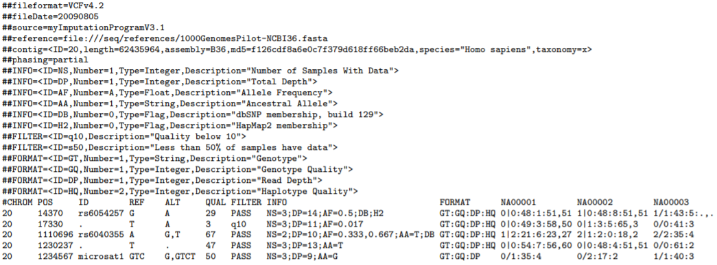
Input files (2)
Genotype files – VCF (Variant Call Format) /BGEN/PLINK format

Slide 9
Input files (2)
Genotype files – VCF (Variant Call Format) /BGEN/PLINK format
Header
Header
Records
Records

Slide 10
Input files (2)
Genotype files – VCF (Variant Call Format) /BGEN/PLINK format
Header
INFO meta-information
FILTER meta-information
FORMAT meta-information

Slide 11

Input files (2)
Genotype files – VCF (Variant Call Format) /BGEN/PLINK format
Optional: FORMAT field specifying data type and per-sample genotype data
Fixed fields
Records
Records

Slide 12
Input files (2)
Genotype files – VCF (Variant Call Format) /BGEN/PLINK format

Slide 13
VCF file --genotype fields
Sample 1
Sample 2
Sample 3
Haplotype qualities
Read depth at this position for this sample
Genotype
0 - the reference allele (REF field)
1 - the first allele listed in ALT
2 - the second allele list in ALT
Conditional genotype quality

Slide 14
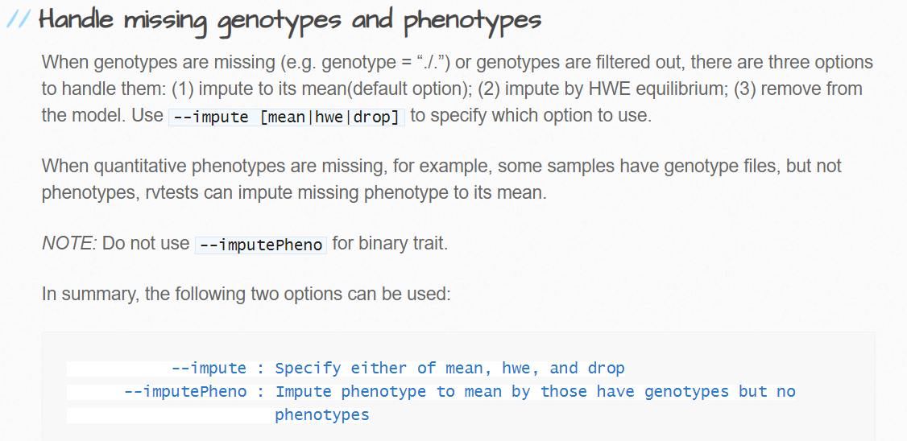
Missing values

Slide 15
Outline
Genome-wide association study
Introduction to rvtests software
Requirements: input files
Association analysis
Output file
Post-association analysis steps
Quality control
Visualization

Slide 16
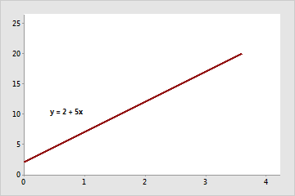
Association analysis
Model: Trait ~ constant + β₁x SNP + β₂ x covariate 1 + β₃ x covariate 2
The dependent variable ”trait” is:
Quantitative trait → Linear regression
Case control status → Logistic regression
test H0: β1 = 0, No association
H1: β1 ≠ 0, Association
Estimate of regression intercept
Estimate of regression slope
Notes:
Standard approach to idenify gentic varinats associated with phenotype in GWAS is
A linear regression line has an equation of the form Y = a + bX, where X is the explanatory variable and Y is the dependent variable. The slope of the line is b, and a is the intercept (the value of y when x = 0).

Slide 17
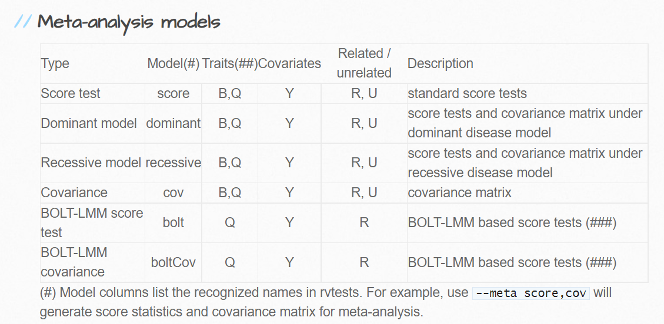
Association tests (1)

Slide 18
Run GWAS --command
rvtest --inVcf input.vcf → specify genotype file
--pheno phenotype.ped → specify phenotype file
--pheno-name phenotype1 → specify phenotype
--covar example.covar → specify covariate file
--covar-name age,sex → specify covariates
--dosage DS → specify dosage tag
--meta score → specify association model
--out output → specify output file

Slide 19
Demonstration using HPC (SHARK)

Slide 20
Outline
Genome-wide association study
Introduction to rvtests software
Requirements: input files
Association analysis
Output file
Post-association analysis steps
Quality control
Visualization

Slide 21
Output file
CHROM | POS | REF | ALT | N INFORMATIVE | AF | INFORMATIVE ALT AC | CALL RATE | HWE PVALUE | N_REF | N_HET | N_ALT | U_STAT | SQRT_V_STAT | ALT_EFFSIZE | PVALUE
1 | 13380 | C | G | 2158 | 7,22E-01 | 0.029 | 1 | 1 | 2158 | 0 | 0 | -0.0098 | 0.007996 | -154.14 | 0.217756
1 | 16071 | G | A | 2158 | 0.0002 | 0.796 | 1 | 1 | 2157 | 1 | 0 | 0.03002 | 0.738133 | 0.0551133 | 0.96755
1 | 16141 | C | T | 2158 | 0.0002 | 0.6 | 1 | 1 | 2158 | 0 | 0 | 0.48214 | 0.465026 | 22.296 | 0.29982
1 | 16280 | T | C | 2158 | 0.0004 | 1.647 | 1 | 1 | 2158 | 0 | 0 | 0.00312 | 0.063440 | 0.777443 | 0.960663
1 | 49298 | T | C | 2158 | 0.6361 | 2745.95 | 1 | 9.33E-284 | 6 | 1777 | 375 | 0.72486 | 526.607 | 0.02613 | 0.890518
1 | 54353 | C | A | 2158 | 0.0007 | 3.171 | 1 | 1 | 2158 | 0 | 0 | 0.09704 | 0.113511 | 753.182 | 0.39258
1 | 54564 | G | T | 2158 | 0.0001 | 0.518 | 1 | 1 | 2158 | 0 | 0 | -0.00917 | 0.033233 | -830.354 | 0.782583
1 | 54591 | A | G | 2158 | 0.0002 | 0.956 | 1 | 1 | 2158 | 0 | 0 | 0.03387 | 0.5388 | 0.1167 | 0.949864
1 | 54676 | C | T | 2158 | 0.3790 | 1636.34 | 1 | 0 | 278 | 1874 | 6 | 0.55609 | 541.083 | 0.0189943 | 0.918141
Number of samples analyzed for association
Number of samples carrying
homozygous reference/ heterozygous/ homozygous alternative alleles
Allele frequency
P-value Hardy-Weinberg equilibrium
The number of alternative alleles in the analyzed samples
The fraction of non-missing alleles

Slide 22
Outline
Genome-wide association study
Introduction to rvtests software
Requirements: input files
Association analysis
Output file
Post-association analysis steps
Quality control
Visualization

Slide 23

Quality control
Cleaning of the data by deleting poor quality data
SNPs with low minor allele frequency (MAF)
SNP deviating from Hardy-Weinberg equilibrium (HWE)
SNPs with low imputation quality (R² < 0.3)
Detect bias – QQ plot

Slide 24
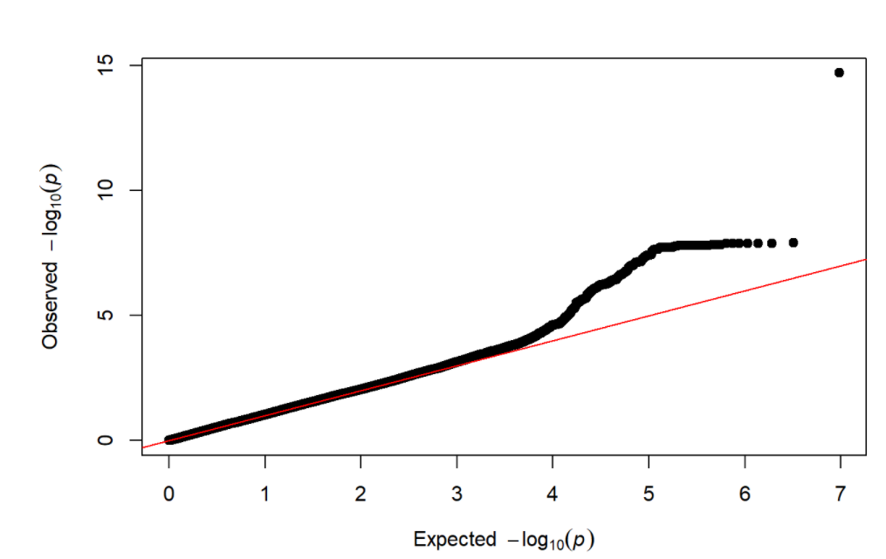
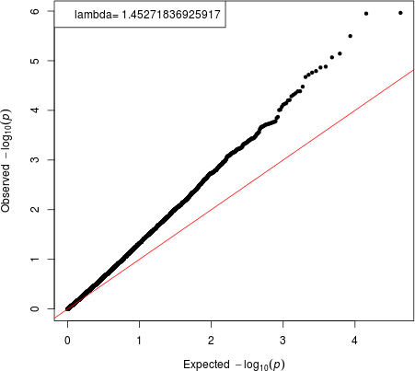
QQ plot – bias detection
Notes:
No quality of this QQ plot is not acceptable. Observed values deviate from the expected p-values too soon. Population stratification and cryptic relatedness, can cause spurious associations in genome-wide association studies (GWAS). Also undetected sample duplications, a poorly calibrated test statistic or systematic technical bias.

Slide 25
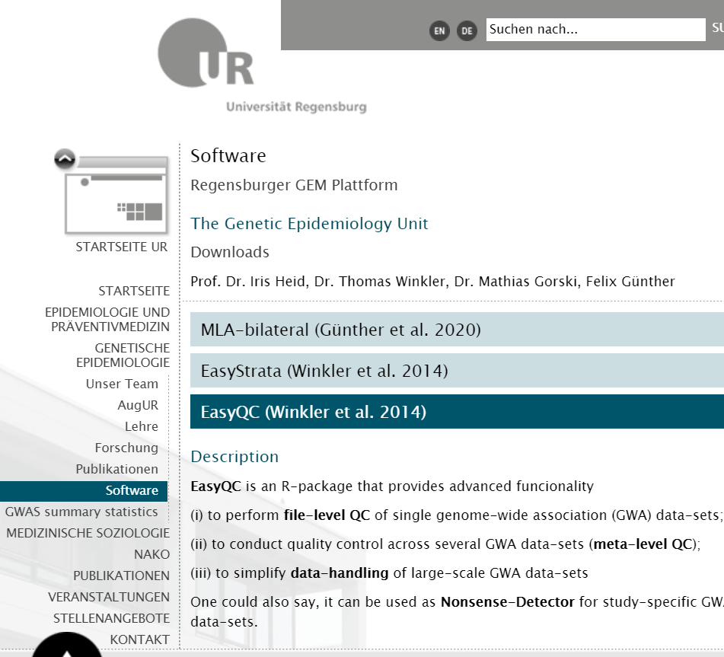
Easy QC software

Slide 26
Outline
Genome-wide association study
Introduction to rvtests software
Requirements: input files
Association analysis
Output file
Post-association analysis steps
Quality control
Visualization

Slide 27
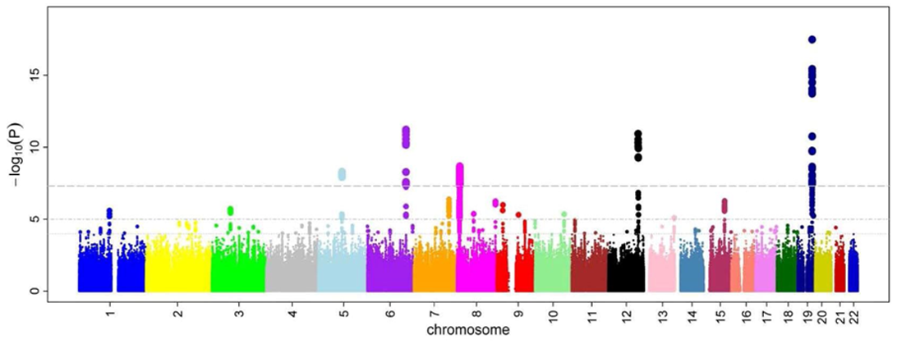
Manhattan plot

Slide 28
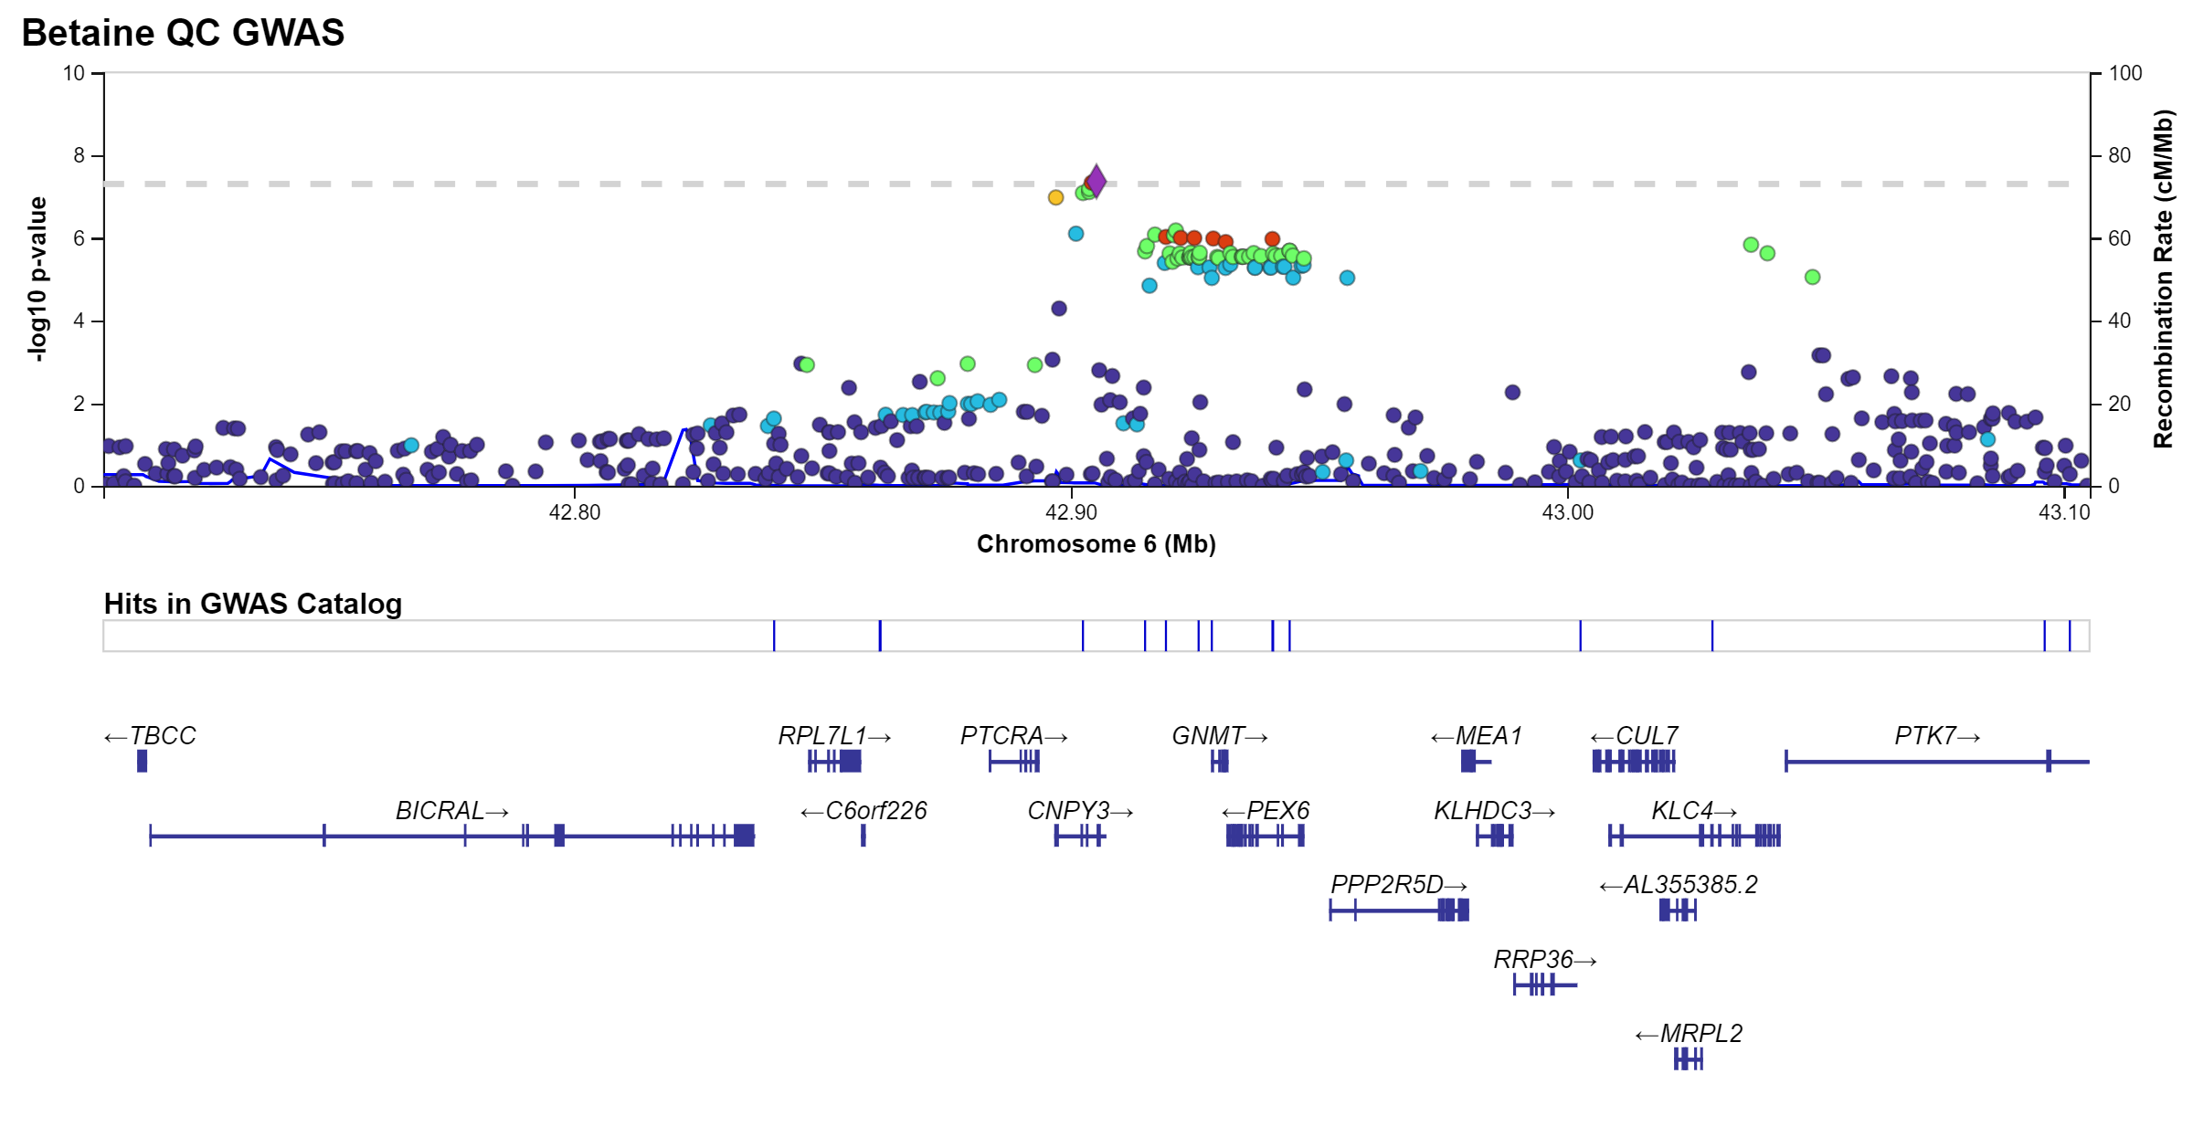
Locus Zoom

Slide 29
THANK YOU FOR YOUR ATTENTION!

Slide 30
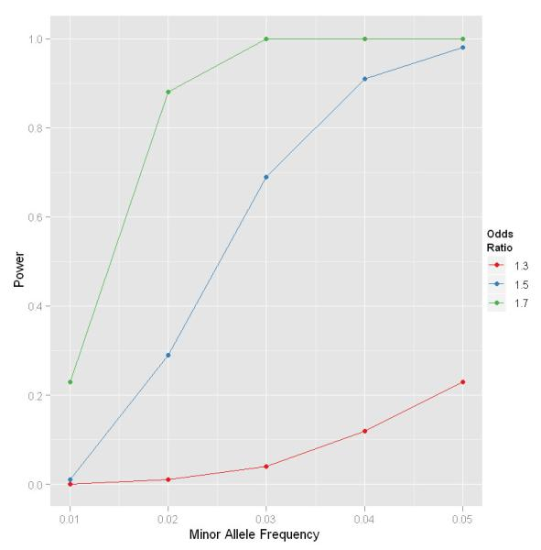
Quality control - MAF
Statistical power is extremely low for rare SNPs
Remove any extremely rare SNPs (including any monomorphic SNPs)
Small number of carriers - unreliable statistics
https://www.ncbi.nlm.nih.gov/pmc/articles/PMC3066182/
Notes:
https://www.ncbi.nlm.nih.gov/pmc/articles/PMC3066182/
a relatively large effects (OR between 1.3 and 1.7)

Slide 31
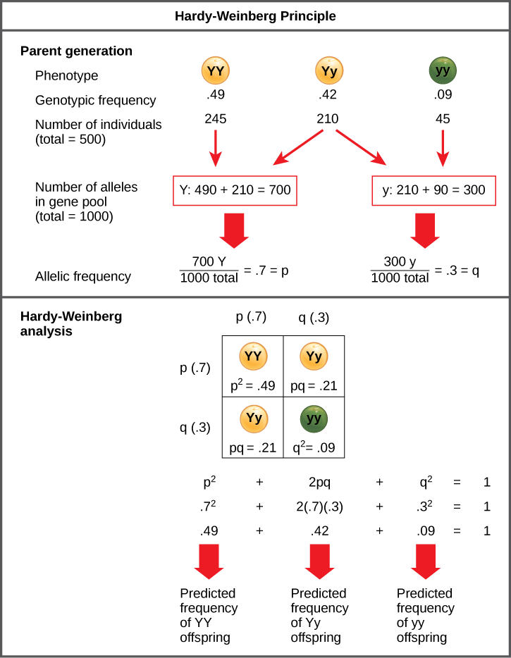
Quality control - HWE
Genotype frequencies and allele frequencies are the same in each generation at birth
Allelic frequency measured in the field differs from the predicted value
Notes:
Below, we will demonstrate that a population is in H-W eq if the following conditions hold (with respect to a particular gene):
There is no migration (“gene flow”) in or out of the population.
Natural selection is not occurring.
Mutation is not occurring.
Each member of the population is equally likely to breed.
The population is infinitely large.
Fully random mating: each pair from the population is equally likely to breed. (This is not the case when females of a species often prefer males with certain traits. Examples originally identified by Darwin include peacock feather displays, antlers in deer, and the manes of lions.)⁴

Slide 32
Quality control – imputation quality
Genotype imputation - standard practice to increase genome coverage and improve power in GWAS and meta-analysis
Imputation software generates the SNP-level quality metric Rsq - SNP-specific estimated r2 (squared Pearson correlation) between allele dosages and the unknown true genotypes
An efficient post-imputation quality control metric
Notes:
https://slideplayer.com/slide/1719314/

Slide 33
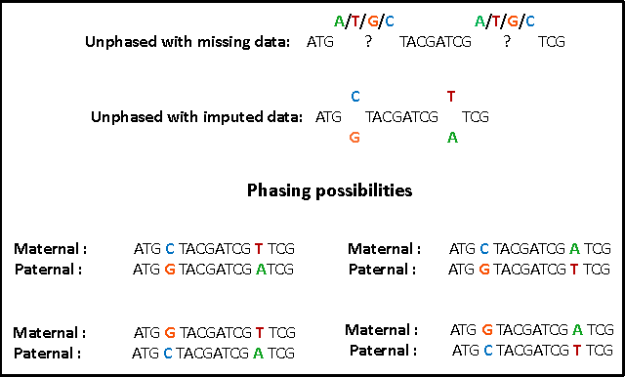
Unphased and phased

Slide 34
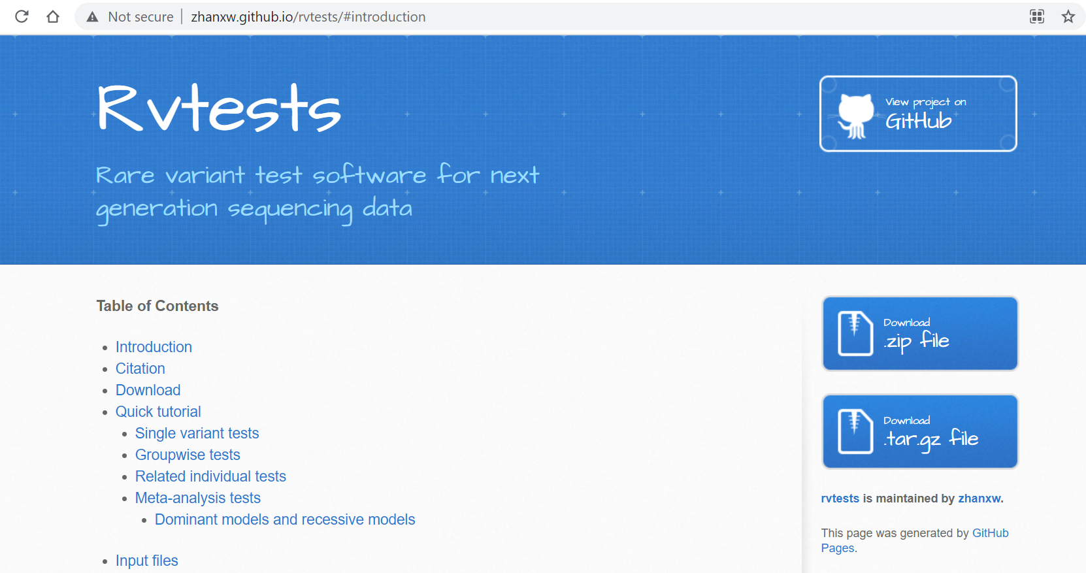
Rvtests webpage
http://zhanxw.github.io/rvtests/#introduction
Notes:
http://zhanxw.github.io/rvtests/#introduction

Slide 35
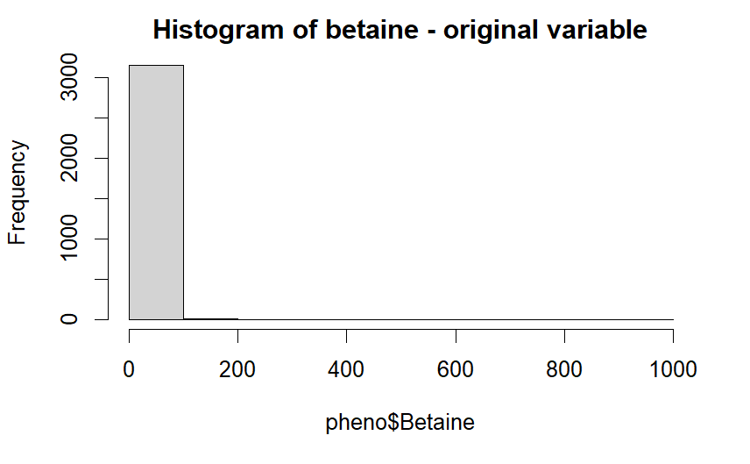
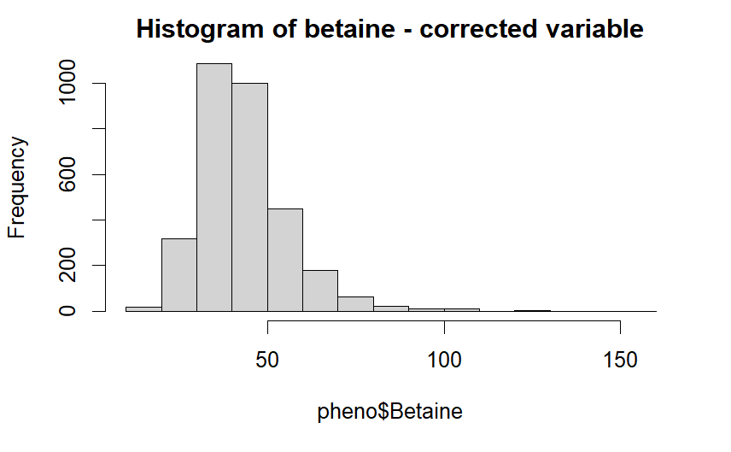
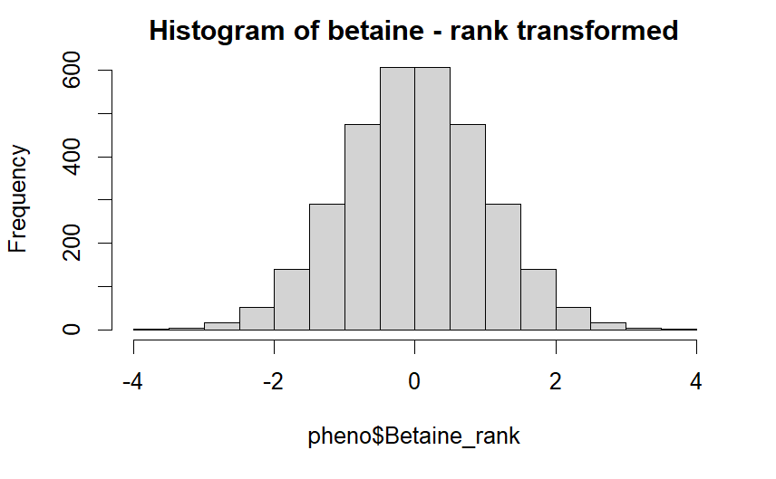
Input files (1) - phenotype
Missing values
Distribution of trait
Transformation

Slide 36
Manhattan Plot and QQ before and after QC
Lambda
AF check reference panel
https://www.nature.com/articles/s41431-018-0159-6
Notes:
https://www.nature.com/articles/s41431-018-0159-6

Slide 37
Outline of the practicals
Explore phenotype: trait distribution, transformation, coding of missings
Demo: show input file, coding of genetic data, run GWAS, how does the output look like, overall QC like QQ plot
Practicals with output file (probably 1 or 2 chromosomes): figuring out what columns indicate (effects size, p-value, significance threshold, allele frequency, imputation quality, hardy weinberg, call rate). -perform filtering of output on allele frequency, HWE, call rate, imputation quality -visualisations (not yet discussed)
Data set: One of the gut-related metabolites.
Dina: prepare demo in which input files are shown, GWAS is run, QQ plots are being made
Dina: pick one phenotype (out of 5 gut-related metabolites), where there are known hits and at least one novel hit.

Slide 38
Lambda value
# Calculate lambda based on median chi2 testchi2<-(single$beta/single$se)^2lam <-median (sort(chi2))/qchisq(0.5,1)print(lam)

Slide 39
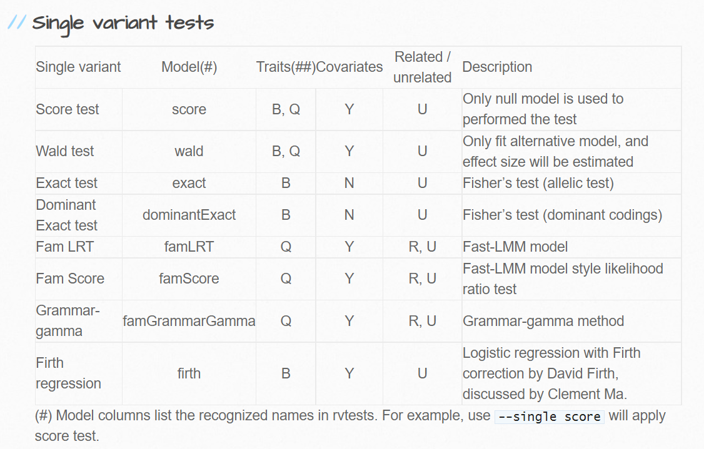
Association tests (1)

Slide 40
In phenotype file, missing values can be denoted by NA or any non-numeric values. Individuals with missing phenotypes will be automatically dropped from subsequent association analysis. For each missing phenotype value, a warning will be generated and recorded in the log file.
When the phenotype values are only 0, 1 and 2, rvtests will automatically treat it as binary traits. However, if you want to treat it as continuous trait, please use “--qtl” option.

Slide 41
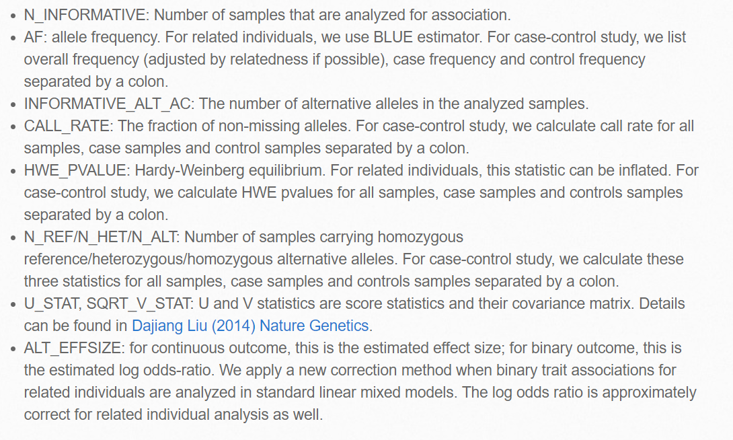
Output

Slide 42
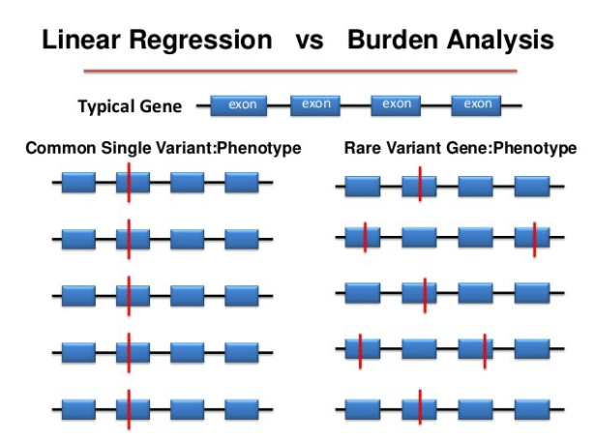
Supports both single variant and gene-level tests
It includes a variety of association tests (e.g. single variant score test, burden test, variable threshold test, SKAT test, fast linear mixed model score test).
It takes VCF/BGEN/PLINK format as genotype input file and takes PLINK format phenotype file and covariate file.

Slide 43
Quality control
A critical step in genetic association analyses and meta-analyses is to examine the quality of the datasets. RVTESTS implements comprehensive features for checking strand flips and reference/alternative allele swaps, among others. It will automatically generate a variety of per-variant QC metrics, including Hardy Weinberg equilibrium P-values, variant call rates and global QC metrics, including the transition/transversion ratio. RVTESTS supports selecting a subset of samples for association analyses as well as filtering variants based on generated QC metrics and genotype qualities.
R2, AF, HWE

