Slide 1

FOS course Molecular Data Science

Slide 2

In person teaching
Key to education but now a fragile luxury
Test if you have symptoms – do not take risks
Hybrid teaching: Teams (have buddy on Discord?)
Be flexible & mild for yourself and each other

Slide 3
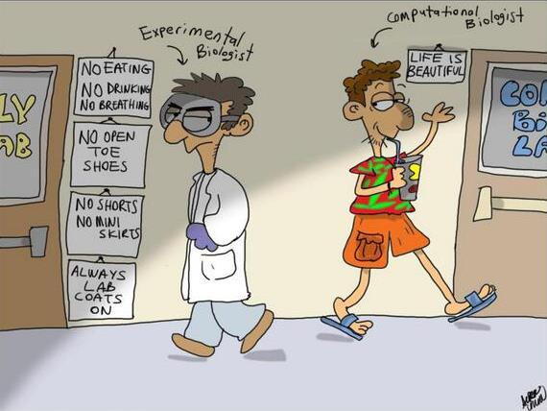

Slide 5
Molecular Data Science
Solving a biological puzzles without touching a pipette

Slide 6

Data drive the modern life sciences
“Tomorrow’s discoveries will be made by today’s early-career researchers. ... We also hope to be guided by them, so that we can meet their needs when it comes to publishing their work, as research becomes more data-rich and computationally heavy.”
Magdalena Skipper,
Editor-in-Chief Nature

Slide 7
Many discoveries remain
The human genome
~ 3.2 billion bases (billion = miljard)
~ 22 thousand protein coding genes
~ 98% of human genome is non-coding
… and we hardly have a clue.

Slide 8
Many discoveries remain
Our human DNA is uncharted territory
Dedicated paper on 5400 genes.
90% of papers just on 2,000 genes.
2015: 50% of research devoted on 3,000 genes known by 1991
Stoeger et al. PLoS Biology 2018

Slide 9

Features of current biology
Data intensive
Acknowledge lack of knowledge: genome-wide
Gene
PCR
Chosen by researcher
Genome-wide
Array
All current knowledge
Whole genome
Sequencing
Everything there is

Slide 10
Features of current biology
Data intensive
Acknowledge lack of knowledge: genome-wide
From reductionist (1 gene) to the system (all genes)
Acknowledges
Complexity of biology
Advantage of whole picture

Slide 11
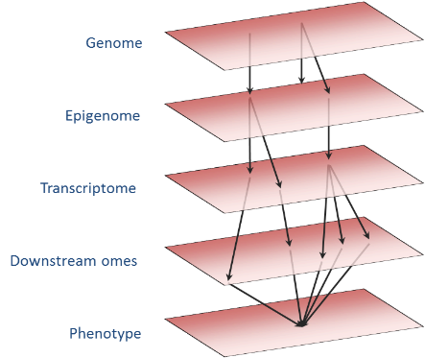
Features of current biology
Data intensive
Acknowledge lack of knowledge: genome-wide
From reductionist (1 gene) to the system (all genes)
Integrative: combine levels to trace processes

Slide 12



Features of current biology
Data intensive
Acknowledge lack of knowledge: genome-wide
From reductionist (1 gene) to the system (all genes)
Integrative: combine levels to trace processes
Using natural variation (instead of experimental) in large-scale population studies

Slide 13
Who
Tutors
Ingrid Meulenbelt & Bas Heijmans (coordinators)
14 others
You
16 Master students Biomedical Sciences
2 PhD students (first 2.5 weeks)

Slide 14
The course
Learning by doing: analyzing all kind of omics data → 12 days
Applying knowledge: develop molecular data science project → 8 days

Slide 15
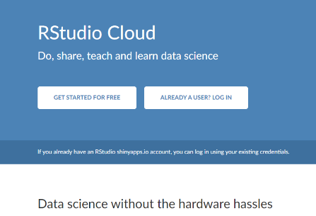

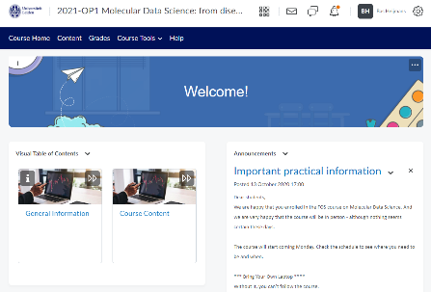

Tools
RStudio Cloud
Discord, Teams…
Brightspace

Slide 16
Learning objectives

Slide 17
Knowledge and understanding
Knows how large-scale molecular data can inform on mechanisms and risk of common diseases.
Has insight in modern data analysis methods used to discover molecular signatures of disease phenotypes in genetic, epigenetic, gene expression, and metabolomics data sets.

Slide 18
Applying knowledge and understanding
Get hands-on experience in the analysis and interpretation of genetic, epigenetic, gene expression, and metabolomics data sets.
Shows the ability to develop new researcher project in the field of ageing using molecular data science including background, hypothesis, pilot data, objectives, study design, work plan, and expected outcomes (e.g. causality).
Can perform analyses to generate pilot data in order to critically appraise and, if necessary, reformulate a hypothesis.

Slide 19
Communication
Shows communication skills to clearly and convincingly present and defend a research proposal.
Is able to respond constructively to questions/feedback and connecting this feedback to his/her own position regarding his/her own research and in doing so showing an open, self-critical yet firm and self-confident attitude.

Slide 20
Learning skills
Shows professional conduct: being critical yet constructive and eager to improve oneself and in doing so contributes to the learning process of the other students.
Critically and constructively discusses research proposals of peers.

Slide 21
Pay close attention
Assessment

Slide 22
Assessment
Handing in assignments. Individually assessed (0%, P/F).
Contribute to interim evaluation of student participation and development during workgroups (0%).
Fill out project proposal form (for reflective assignment) (0%, P/F).
Presentation project proposal (background, hypothesis, pilot data, objectives, study design, workplan, expected outcomes) (45%).
Active and critical participation during discussion after project presentations of peers (15%).
Reflective assignment that shows mastering key aspects of development of research proposal in molecular data science and addressing points raised during peer review (40%).

Slide 23
Evaluation
Who will it be?
(2 are needed)

Slide 24


Every morning @10.30
Every afternoon @15.00
In the classroom

Slide 25
FOS course Molecular Data Science
Part of the Master Track Data-driven Research

