Slide 1

Analyzing large-scale genomics data
Bas Heijmans
Molecular Epidemiology
Leiden University Medical Center
The Netherlands
bas.heijmans@lumc.nl
FOS course Molecular Data Science – 21 November 2022.

Slide 2
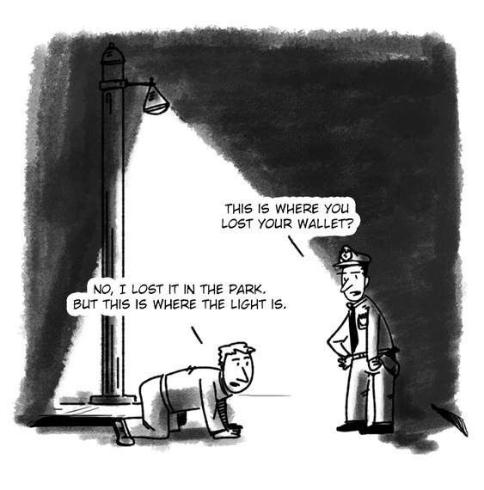
The drunkard’s search effect

Slide 3
From 1 to all
All genetic variants, genes, metabolites → comprehensive & representative (instead of generalizing a single bit of knowledge)
Disease ≠ 1 gene → hypotheses (!) and discoveries on the full complexity of biology.
Exploiting natural variation → The human as model organism

Slide 4
Learning objectives
SPSS 2nd
‘R’ 1st

Slide 5
Why?
From traditional data to large-scale (high-dimensional) data:
Many different formats of data files
Data require preprocessing (quality control, normalization)
Many tests (thousands, millions, billions)
Novel methods
Computationally intensive methods
Smart figures to make sense of data
Visualizations to make sense of results
Linking to external knowledge for interpretation

Slide 6
How to in SPSS
GeneExpression.cel
(Affymetrix)
GeneExpression.idat
(Illumina)
Many different formats of data files.
Data require preprocessing (quality control, normalization) prior to analysis.

Slide 7
How to in SPSS
Person-id | Expression gene 1 | Outcome
1 | 10 | 2.3
2 | 6 | 0.9
… | … | ….
1000 | 15 | 1.5

Slide 8
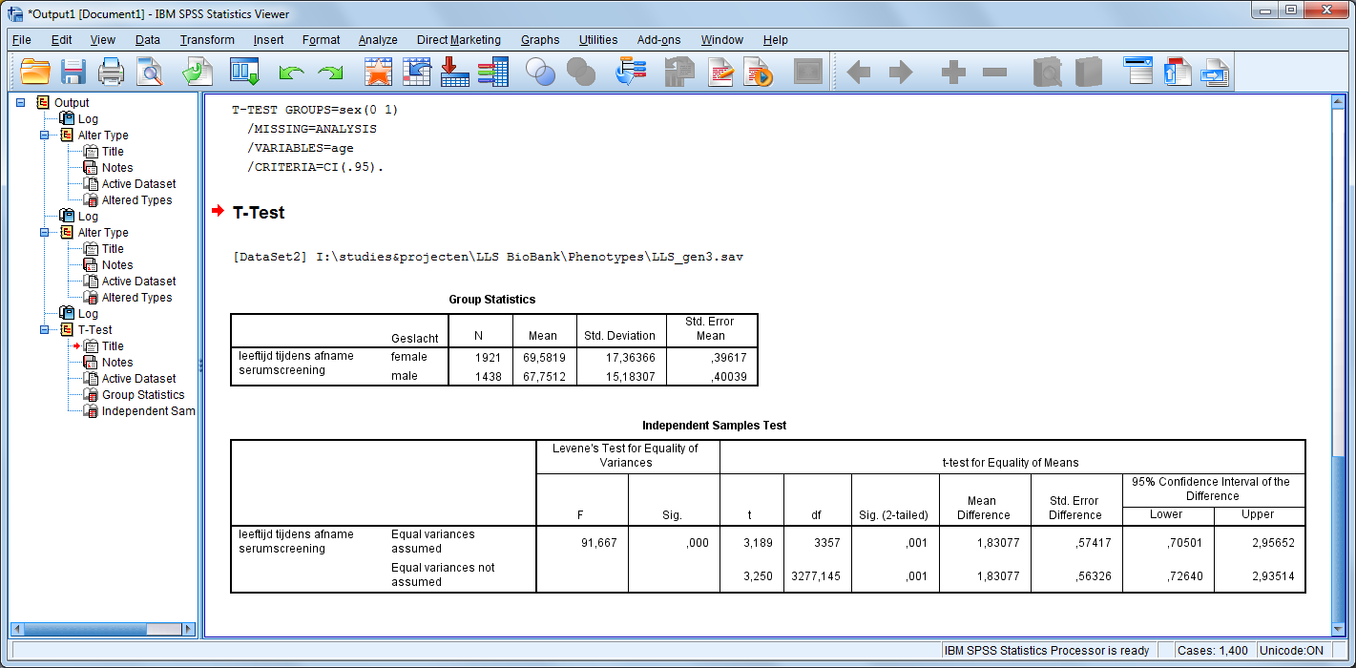
How to in SPSS

Slide 9
How to in SPSS
Person-id | Gene 1 | Gene 2 | … | Gene 22,703 | Outcome
1 | 10 | 1 |  | 90 | 2.3
2 | 6 | 0 |  | 54 | 0.9
… | … | … |  | … | ….
1000 | 15 | 3 |  | 39 | 1.5
22,703 tests
Repeat same analysis many times and store results in one data object.

Slide 10
How to in SPSS
Person-id | Variant 1 | Variant 2 | … | Variant 7x10⁶ | Gene 1 | Gene 2 | … | Gene 22,703 | Outcome
1 | AG | TT |  | AT | 10 | 1 |  | 90 | 2.3
2 | GG | TC |  | AA | 6 | 0 |  | 54 | 0.9
… | … | … | … | … | … | … | … | … | …
1000 | GG | TC |  | AT | 15 | 3 |  | 39 | 1.5
7M x 22,703 tests
Distribute computations across processors (parallelization)
Novel methods

Slide 11
How to in SPSS
Person-id | Variant 1 | Variant 2 | … | Variant 7x10⁶ | Gene 1 | Gene 2 | … | Gene 22,703 | Outcome
1 | AG | TT |  | AT | 10 | 1 |  | 90 | 2.3
2 | GG | TC |  | AA | 6 | 0 |  | 54 | 0.9
… | … | … | … | … | … | … | … | … | …
1000 | GG | TC |  | AT | 15 | 3 |  | 39 | 1.5
7M x 22,703 tests
Smart figures to make sense of data
Visualizations to make sense of results → 0.1 trillion (= 10¹¹) p-values

Slide 12
How to in SPSS
Person-id | Variant 1 | Variant 2 | … | Variant 7x10⁶ | Gene 1 | Gene 2 | … | Gene 22,703 | Outcome
1 | AG | TT |  | AT | 10 | 1 |  | 90 | 2.3
2 | GG | TC |  | AA | 6 | 0 |  | 54 | 0.9
… | … | … | … | … | … | … | … | … | …
1000 | GG | TC |  | AT | 15 | 3 |  | 39 | 1.5
7M x 22,703 tests
Linking to external knowledge for interpretation (e.g. location variant, function of gene)

Slide 13
How to in SPSS
Person-id | Expression gene 1 | Outcome
1 | 10 | 2.3
2 | 6 | 0.9
… | … | ….
1000 | 15 | 1.5
Click-fest
Complex output
Ugly graphs
Black-box: need to trust developers

Slide 14
Why?
From traditional data to large-scale (high-dimensional) data
Many different formats of data files
Data require preprocessing (quality control, normalization)
Many tests (thousands, millions, billions)
Novel methods
Computationally intensive methods
Smart figures to make sense of data
Visualizations to make sense of results
Linking to external knowledge for interpretation

Slide 15
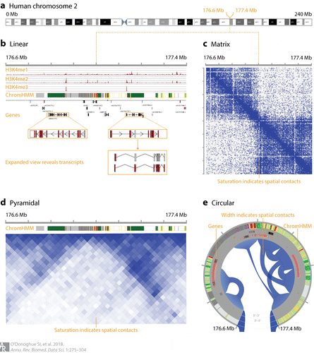
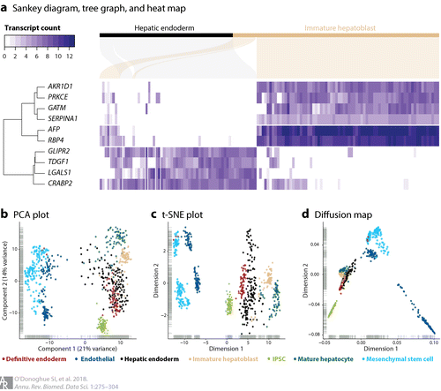
Visualizations
O'Donoghue et al. Annu Rev Biomed Data Sci 2018

Slide 16
R first
Do not fear the blinking cursor!
You will find that R is not more complicated than SPSS if scripts are available.
But: some analyses you will do are!
Curriculum in transition: this is not an R course (a flavour of R & not all is in R).
Also: R is not the answer to all issues in bioinformatics.

