Slide 1

FOS course Molecular Data Science

Slide 2

In person teaching
Key to education but now a fragile luxury.

Slide 3
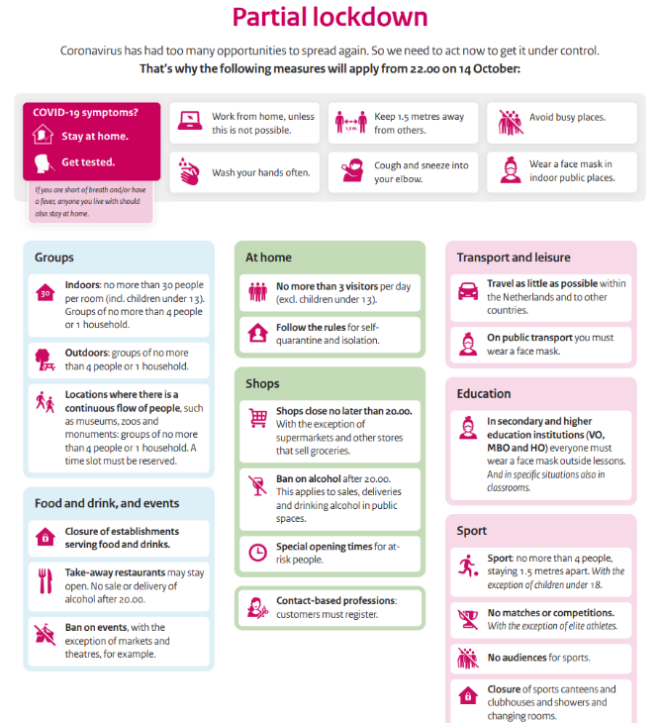
Measures
Keep distance
Stay home and test when symptoms
Use face mask in building outside class
Disinfect your hands on ground floor
Use wipes to keep everything clean
Coffee and tea in class
Hybrid teaching in case of symptoms
Adhere to rules outside the course

Slide 4
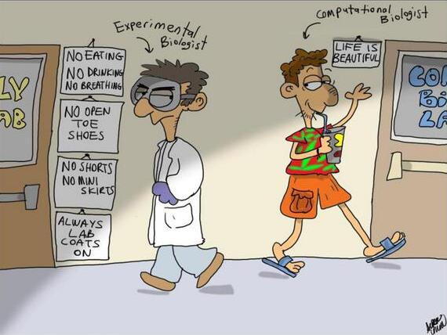

Slide 6
Molecular Data Science
Solving a biological puzzles without touching a pipette

Slide 7
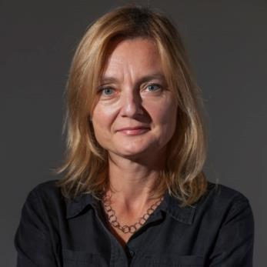
Data drive the modern life sciences
“Tomorrow’s discoveries will be made by today’s early-career researchers. ... We also hope to be guided by them, so that we can meet their needs when it comes to publishing their work, as research becomes more data-rich and computationally heavy.”
Magdalena Skipper,
Editor-in-Chief Nature

Slide 8
Many discoveries remain
The human genome
~ 3.2 billion bases (billion = miljard)
~ 22 thousand protein coding genes
~ 98% of human genome is non-coding
… and we hardly have a clue.

Slide 9
Many discoveries remain
Our human DNA is uncharted territory
Dedicated paper on 5400 genes.
90% of papers just on 2,000 genes.
2015: 50% of research devoted on 3,000 genes known by 1991
Stoeger et al. PLoS Biology 2018

Slide 10

Features of current biology
Data intensive
Acknowledge lack of knowledge: genome-wide
Gene
PCR
Chosen by researcher
Genome-wide
Array
All current knowledge
Whole genome
Sequencing
Everything there is

Slide 11
Features of current biology
Data intensive
Acknowledge lack of knowledge: genome-wide
From reductionist (1 gene) to the system (all genes)
Acknowledges
Complexity of biology
Advantage of whole picture

Slide 12
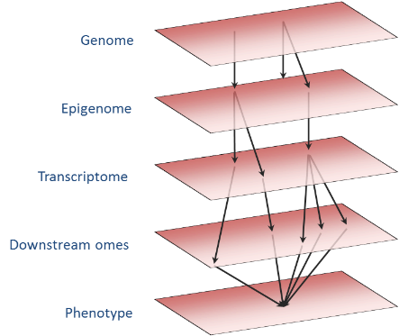
Features of current biology
Data intensive
Acknowledge lack of knowledge: genome-wide
From reductionist (1 gene) to the system (all genes)
Integrative: combine levels to trace processes

Slide 13



Features of current biology
Data intensive
Acknowledge lack of knowledge: genome-wide
From reductionist (1 gene) to the system (all genes)
Integrative: combine levels to trace processes
Using natural variation (instead of experimental) in large-scale population studies

Slide 14
Who
Tutors
Ingrid Meulenbelt & Bas Heijmans (coordinators)
13 others
You

Slide 15
The course
Learning by doing: analyzing all kind of omics data → 12 days
Applying knowledge: develop molecular data science project → 8 days

Slide 16
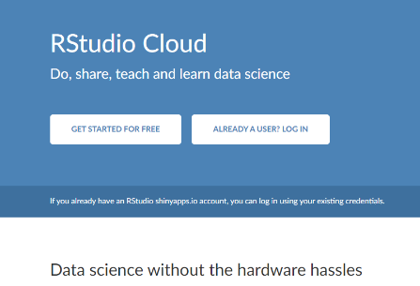
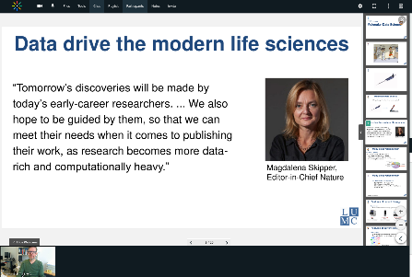
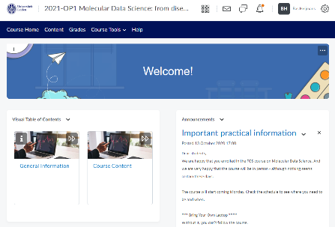
Tools
RStudio Cloud
Kaltura
Brightspace

Slide 17
Learning objectives

Slide 18
Knowledge and understanding
Knows how large-scale molecular data can inform on mechanisms and risk of common diseases.
Has insight in modern data analysis methods used to discover molecular signatures of disease phenotypes in genetic, epigenetic, gene expression, and metabolomics data sets.

Slide 19
Applying knowledge and understanding
Get hands-on experience in the analysis and interpretation of genetic, epigenetic, gene expression, and metabolomics data sets.
Shows the ability to develop new researcher project in the field of ageing using molecular data science including background, hypothesis, pilot data, objectives, study design, work plan, and expected outcomes (e.g. causality).
Can perform analyses to generate pilot data in order to critically appraise and, if necessary, reformulate a hypothesis.

Slide 20
Communication
Shows communication skills to clearly and convincingly present and defend a research proposal.
Is able to respond constructively to questions/feedback and connecting this feedback to his/her own position regarding his/her own research and in doing so showing an open, self-critical yet firm and self-confident attitude.

Slide 21
Learning skills
Shows professional conduct: being critical yet constructive and eager to improve oneself and in doing so contributes to the learning process of the other students.
Critically and constructively discusses research proposals of peers.

Slide 22
Pay close attention
Assessment

Slide 23
Assessment
Handing in assignments. Individually assessed (0%, P/F).
Contribute to interim evaluation of student participation and development during workgroups (0%).
Fill out project proposal form (for reflective assignment) (0%, P/F).
Presentation project proposal (background, hypothesis, pilot data, objectives, study design, workplan, expected outcomes) (45%).
Active and critical participation during discussion after project presentations of peers (15%).
Reflective assignment that shows mastering key aspects of development of research proposal in molecular data science and addressing points raised during peer review (40%).

Slide 24
Evaluation
Who will it be?
(2 are needed)

Slide 25
FOS course Molecular Data Science
Part of the Master Track Data-driven Research

