Slide 1


Analyzing multiple omics levels - Mendelian randomization
Bas Heijmans
Molecular Epidemiology
Dept. of Biomedical Data Sciences
Leiden University Medical Center
The Netherlands
bas.heijmans@lumc.nl
Koen Dekkers
FOS course Molecular Data Science – 3 November 2020.

Slide 2
The single most important distinction in study designs

Slide 3
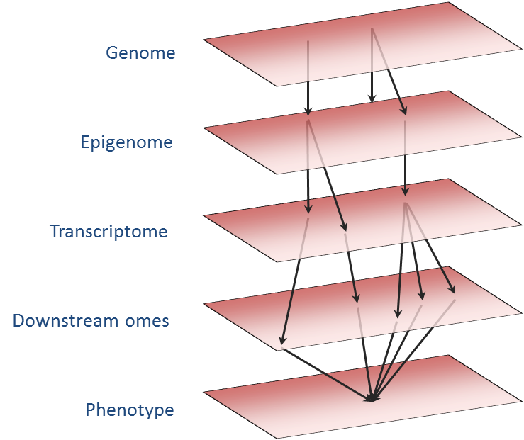

Slide 4
Epigenome-wide Association Study
1. Data: methylation at 450 thousand CpGs + lipids levels in 2000 individuals
2. Test per CpG: DNAm ~ cholesterol + sex + age + cell counts + batches
Cholesterol
LDLR methylation

Slide 5
What’s next?
Cholesterol
LDLR methylation
Can we make conclusions stronger?
What are the main limitations in observational epidemiology?

Slide 6
What’s next?
Cholesterol
LDLR methylation

Slide 7
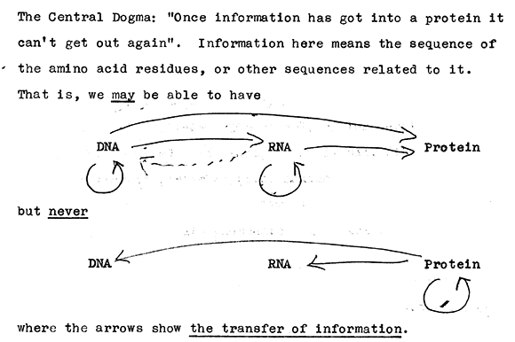
Alternative for experiment
Cholesterol
LDLR methylation
Cholesterol
Crick, 1956

Slide 8
Alternative for experiment
Cholesterol
LDLR methylation
An experiment of nature using genetic variation as causal anchor
‘Mendelian randomization’: a natural trial with exposures to genetic variations randomized according to Mendel’s law and with the exposed blinded towards exposure.
Uses genetic variant(s) as ‘instrumental variable’ instead of measured variable itself.

Slide 9
Alternative for experiment
Confounding
Cholesterol
LDLR methylation
SNPs
*
*Which we know from GWASs

Slide 10
Mendelian randomization
Identify (sufficiently strong) genetic instrument. Here: SNP associated with cholesterol from GWAS (see last week’s practical)
Predict cholesterol level for every individual on basis of one’s genotype. Will explain only small proportion of variation
Test whether predicted (genetic) level is associated with methylation. No confounding (unbiased effect estimate) & only one possible direction of causality

Slide 11
Two-stage least squares model
Pred(Chol) = γ₀ + γ₁ x genotype + γ₂ x age + γ₃ x batch + …
DNAm = β₀ + β₁ x pred(Chol) + β₂ x age + β₃ x batch + …
Cholesterol
LDLR methylation
Genetic Instrument

Slide 12
Beware of assumptions
Pleiotropy
Cholesterol
LDLR methylation
Genetic Instrument
Triglycerides

Slide 13
Example: good and bad cholesterol
HDL
LDL
What is the evidence for being good and bad?
Do you know medication targeting good or bad cholesterol?

Slide 14
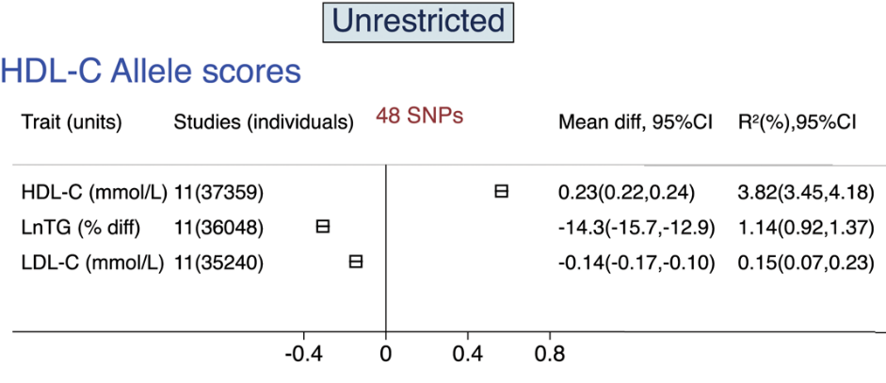
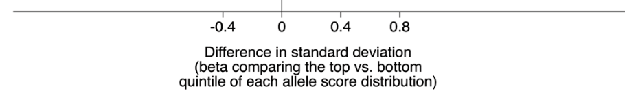
MR – validation PolyGenic Scores
Holmes et al. Eur Heart J 2015

Slide 15
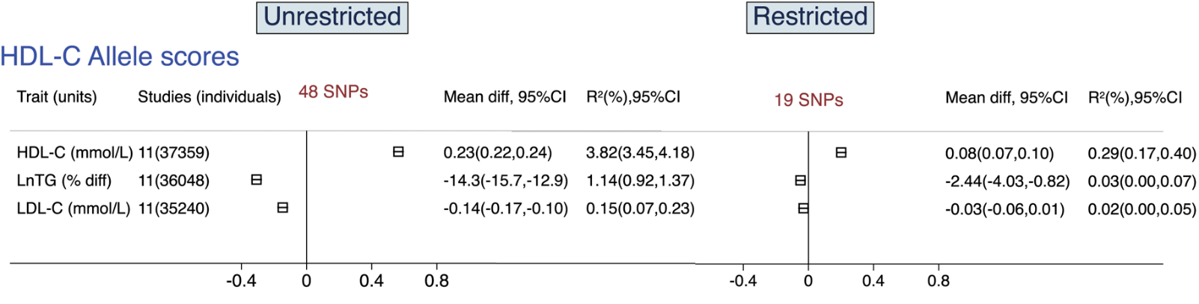
MR – validation PolyGenic Scores
Holmes et al. Eur Heart J 2015

Slide 16
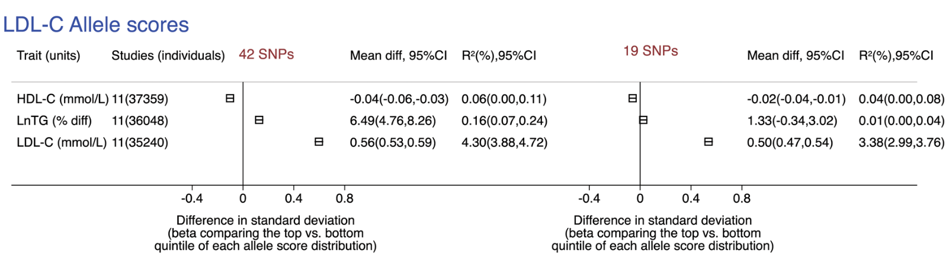
MR – validation PolyGenic Scores
1. Pred(Lipid) = γ₀ + γ₁ x PGS + ...
Holmes et al. Eur Heart J 2015

Slide 17
PolyGenic Scores (PGSs)
Find a GWAS publication with SNPs and effect sizes.
Have genotypes for your own study.
Count the number of minor alleles an individual has.
Multiply this number by the effect size of the allele.
The result is the genetically predicted level for an individual.

Slide 18

Constructing PGS
Minor allele effect size
Let genotypes for individual ‘Harry’ be:
GG (LCAT), TC (CMIP), GG (STARD3)
What is his PGS (or genetically predicted HDL level)?
Deloukas et al. Nat Genet 2013

Slide 19
MR – validation PolyGenic Scores
1. Pred(Lipid) = γ₀ + γ₁ x PGS + ...
Holmes et al. Eur Heart J 2015

Slide 20
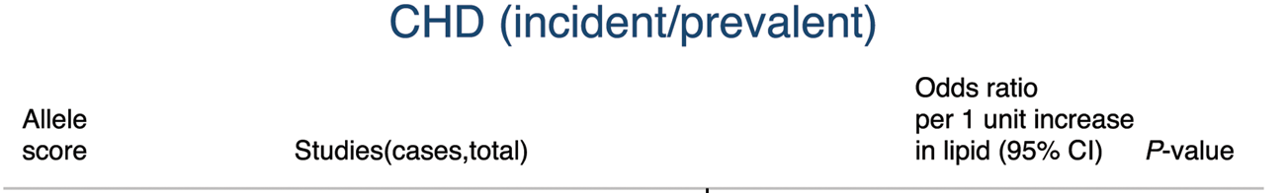
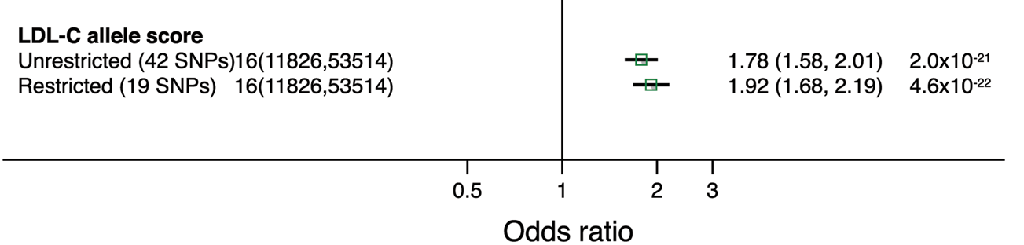
MR – causal inference
2. CHD = β₀ + β₁ x pred(Lipid) + ….
Holmes et al. Eur Heart J 2015

Slide 21
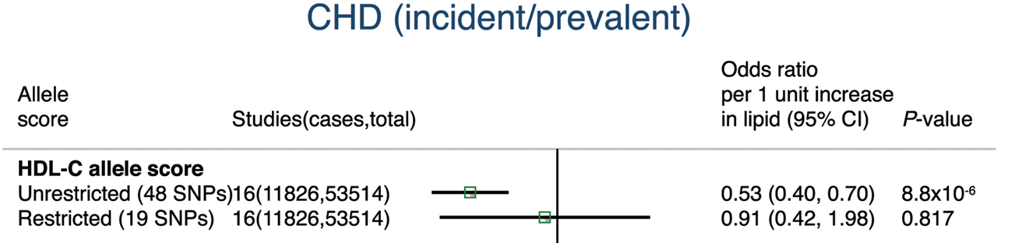
MR – causal inference
2. CHD = β₀ + β₁ x pred(Lipid) + ….
Holmes et al. Eur Heart J 2015

Slide 22
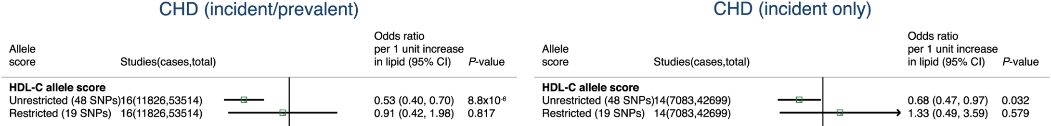
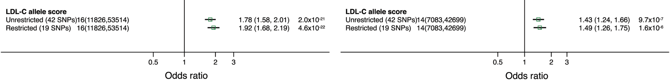
Mendelian randomization
Holmes et al. Eur Heart J 2015

Slide 23
HDL and LDL in human studies
Observational: cross-sectional & prospective case/control studies
Experimental: drugs in clinical trial
‘Natural experiment’: Mendelian randomization

Slide 24
Integrative Genomics
Genome
Reference data
Environment
Methylome
Phenotype
Transcriptome

Slide 25



Molecular Data Science in populations
The human as ‘model organism’: Exploiting natural variation in large-scale population studies
Genome biology
Disease mechanisms
Biomarkers
❶
❷
❸

